Slide 1
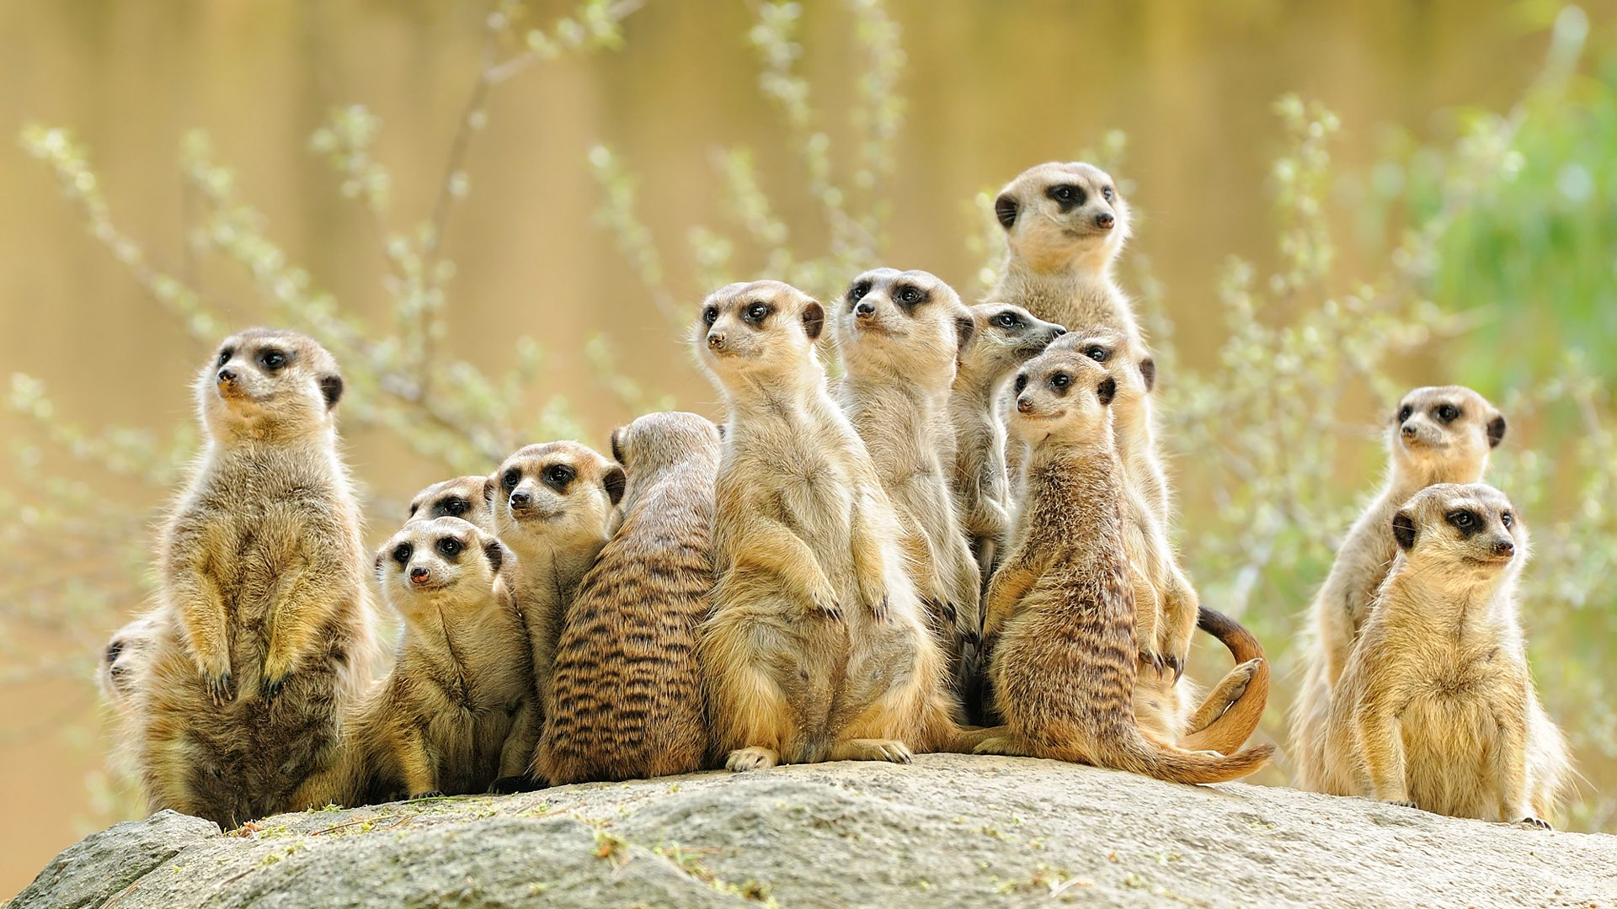
Desert Meerkats
non – chronological report

Slide 2
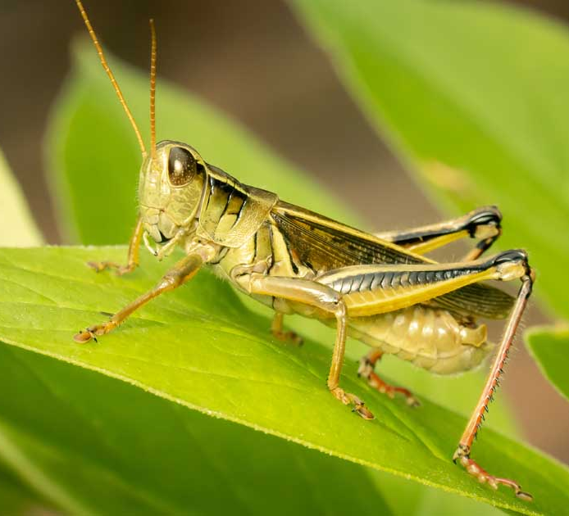
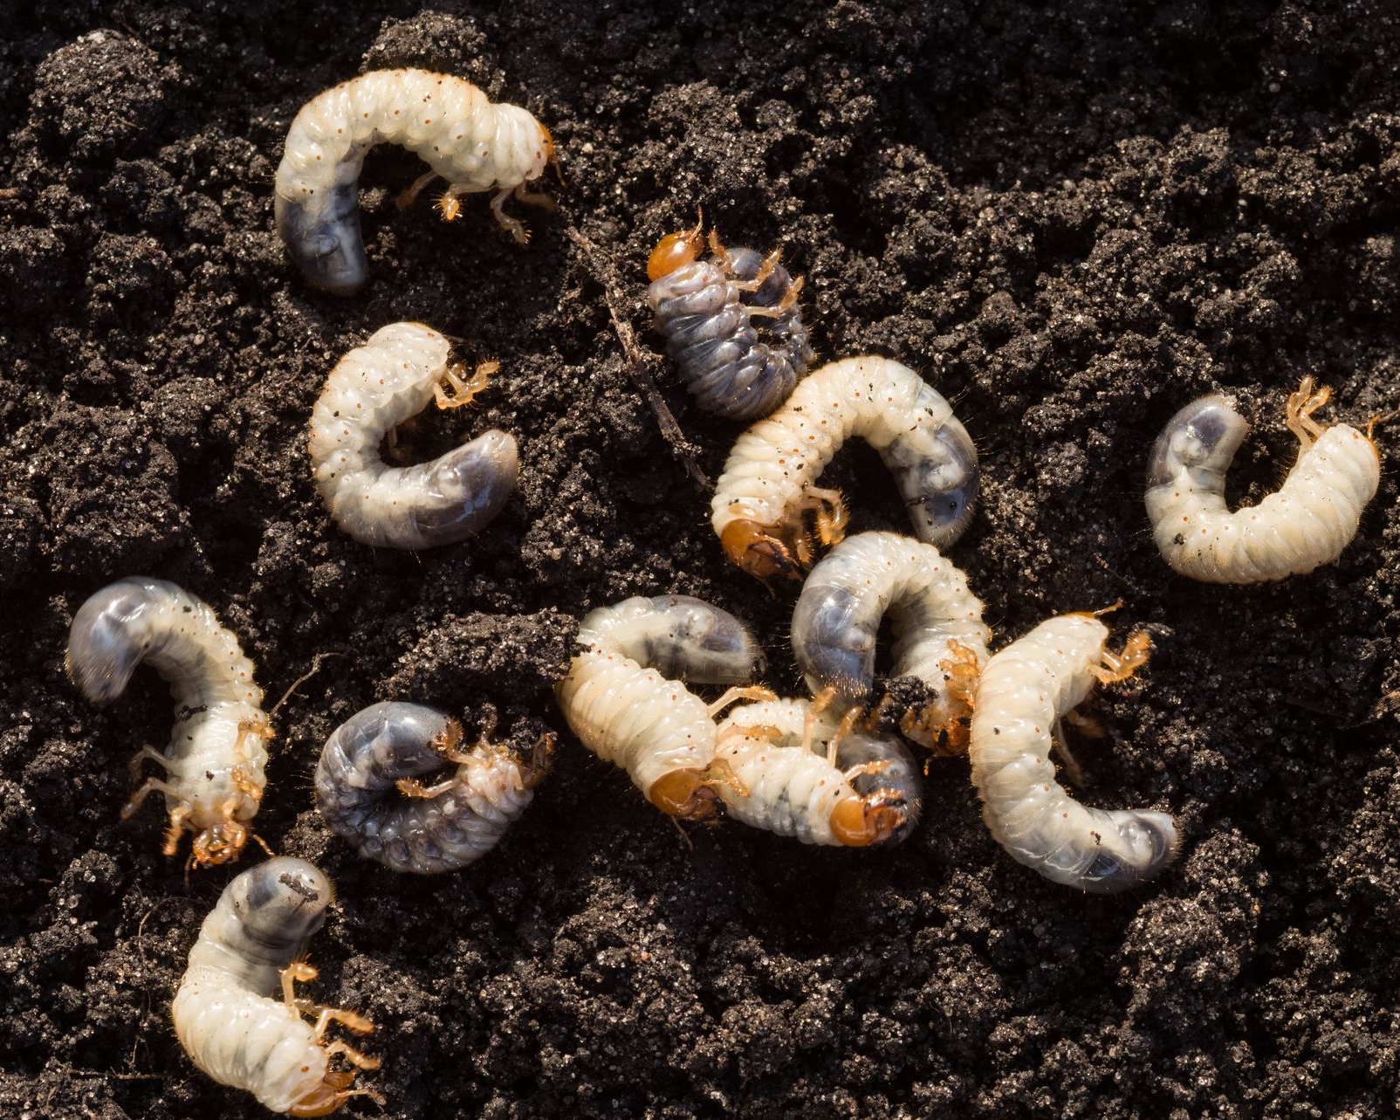
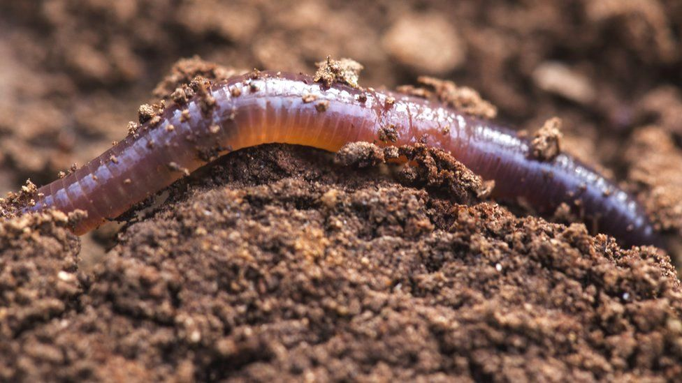
Their Food
They eat grasshoppers.
They eat grubs.
They eat worms.

Slide 3
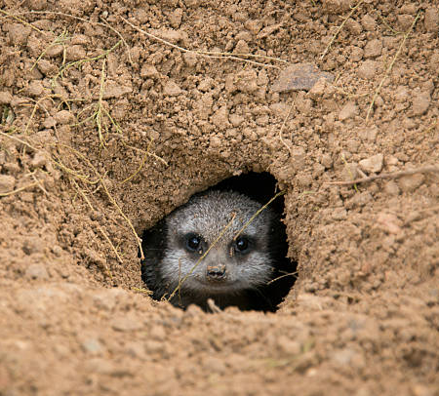
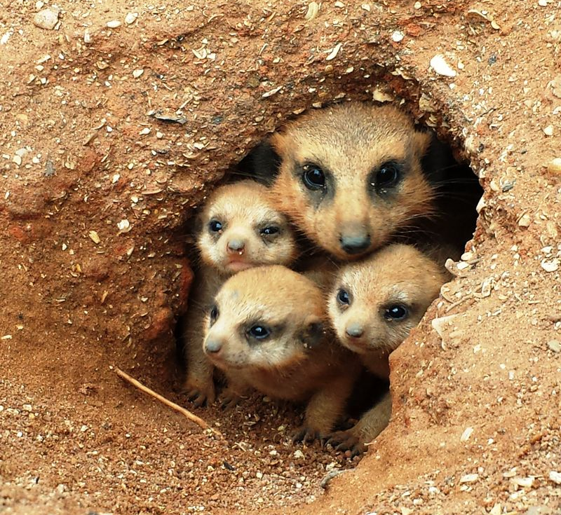
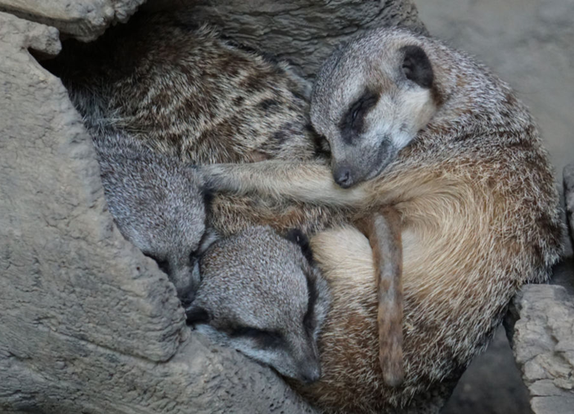
Their habitat
Burrows are safe places to give birth to their young.
They sleep in their burrows at night.
When they are in danger they run to their burrows.

Slide 4
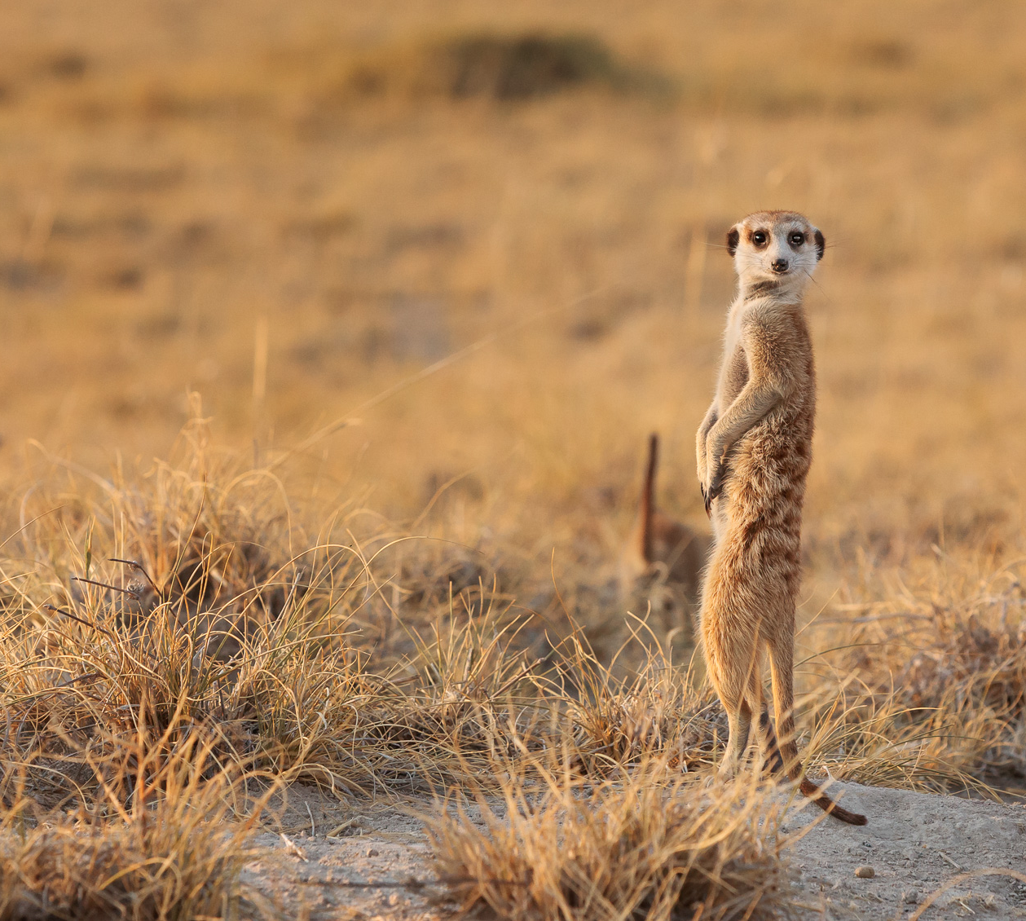
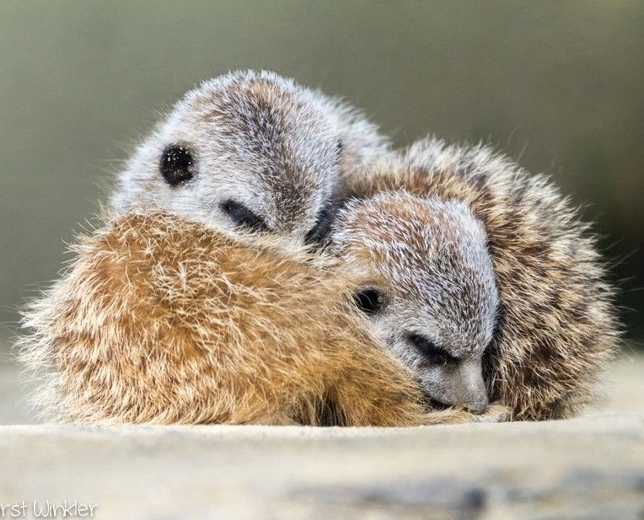
Safety
One meerkat stays awake and looks out for danger,
They have a nap.

