Slide 1
Grammar Oxford Book
Indefinite Pronouns-Unit 9

Slide 2
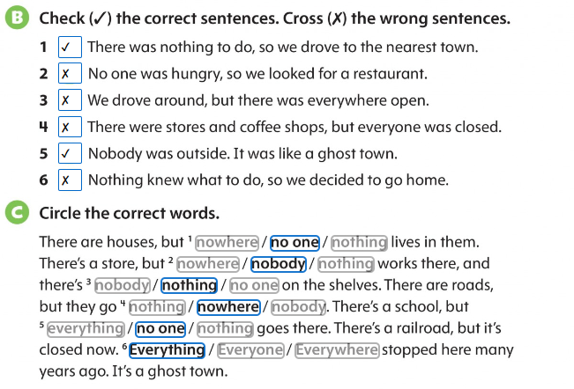
Page 50

Slide 3
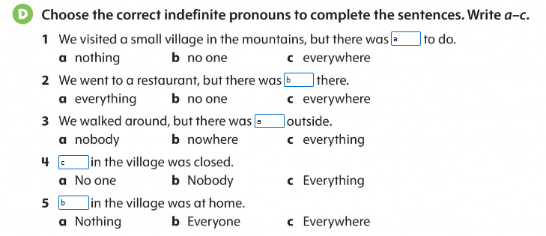
Page 51

Slide 4
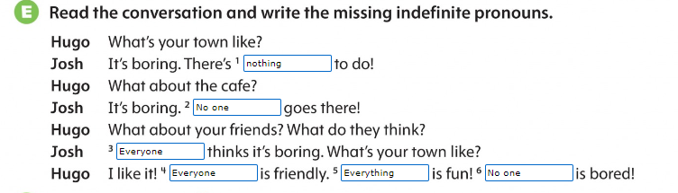
Page 51

Slide 5
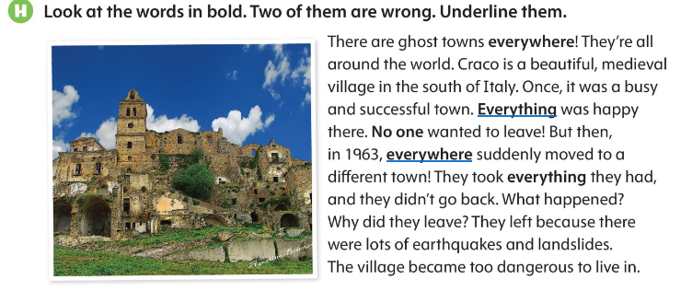
Page 51

Slide 6
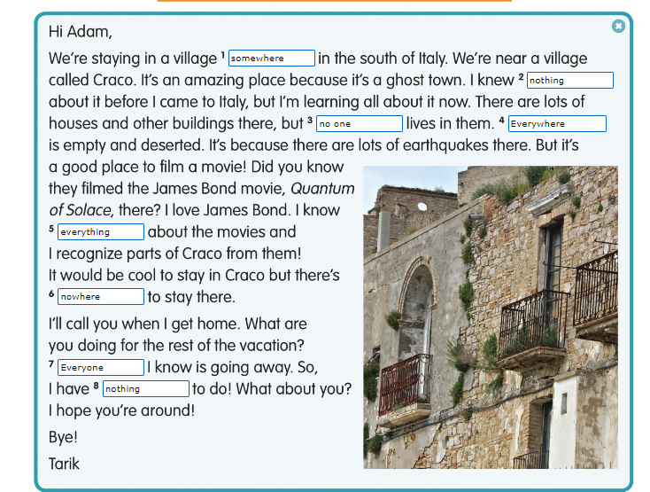
Page 52

