Slide 1
Indefinite Pronouns
Grammar Book Unit 7 p. 41+42+43

Slide 2
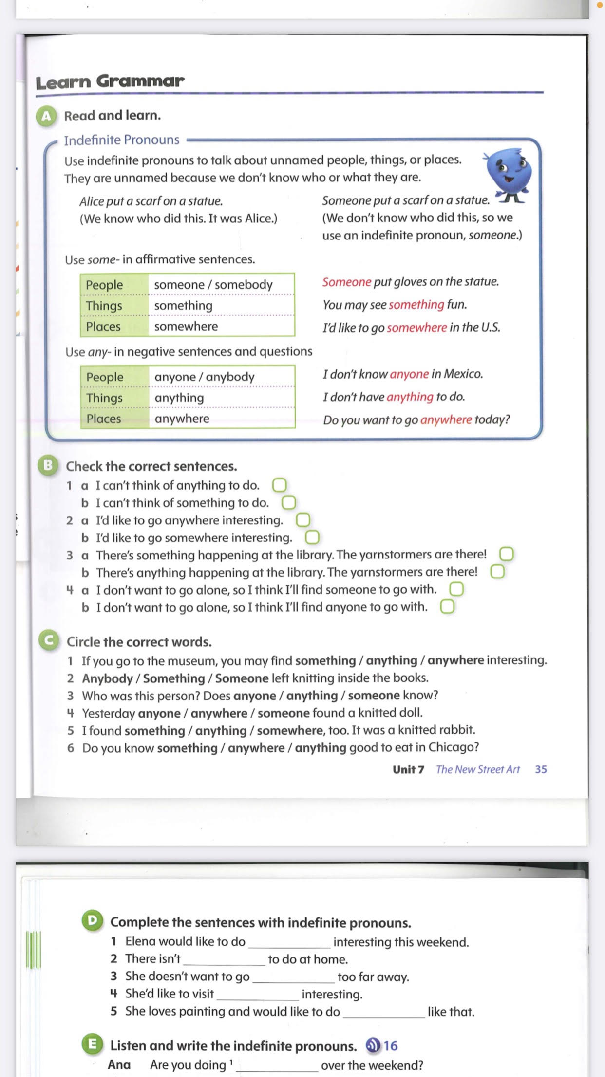
Page 41

Slide 3
Page 41

Slide 4
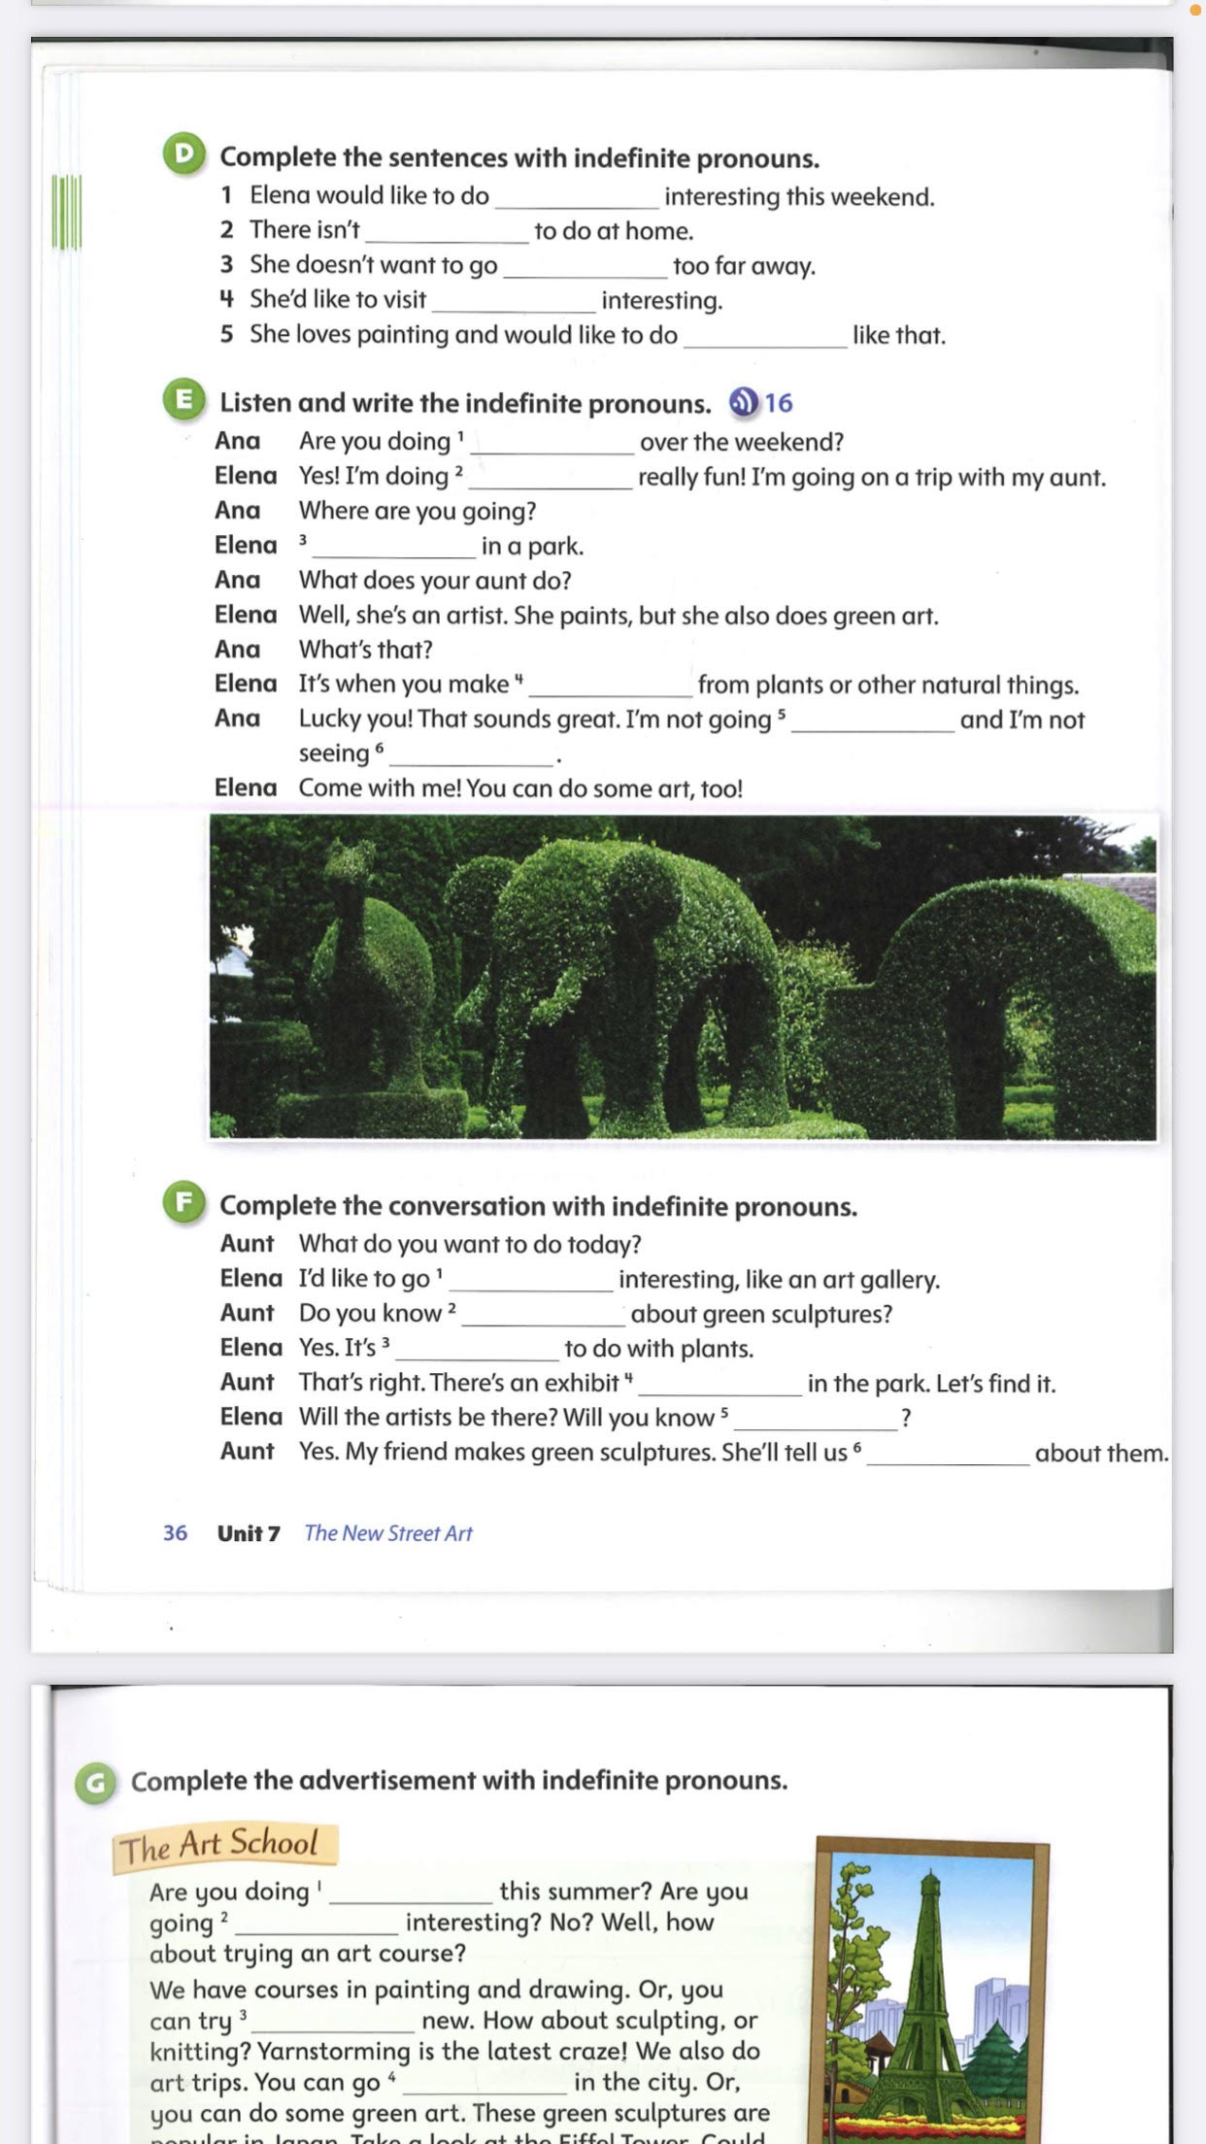
Page 42
something
anything
anywhere
somewhere
something

Slide 5
Page 41
anything
something
Somewhere
something
anywhere
anyone

Slide 6
Page 42
somewhere
anything
something
somewhere
anyone
everything

Slide 7
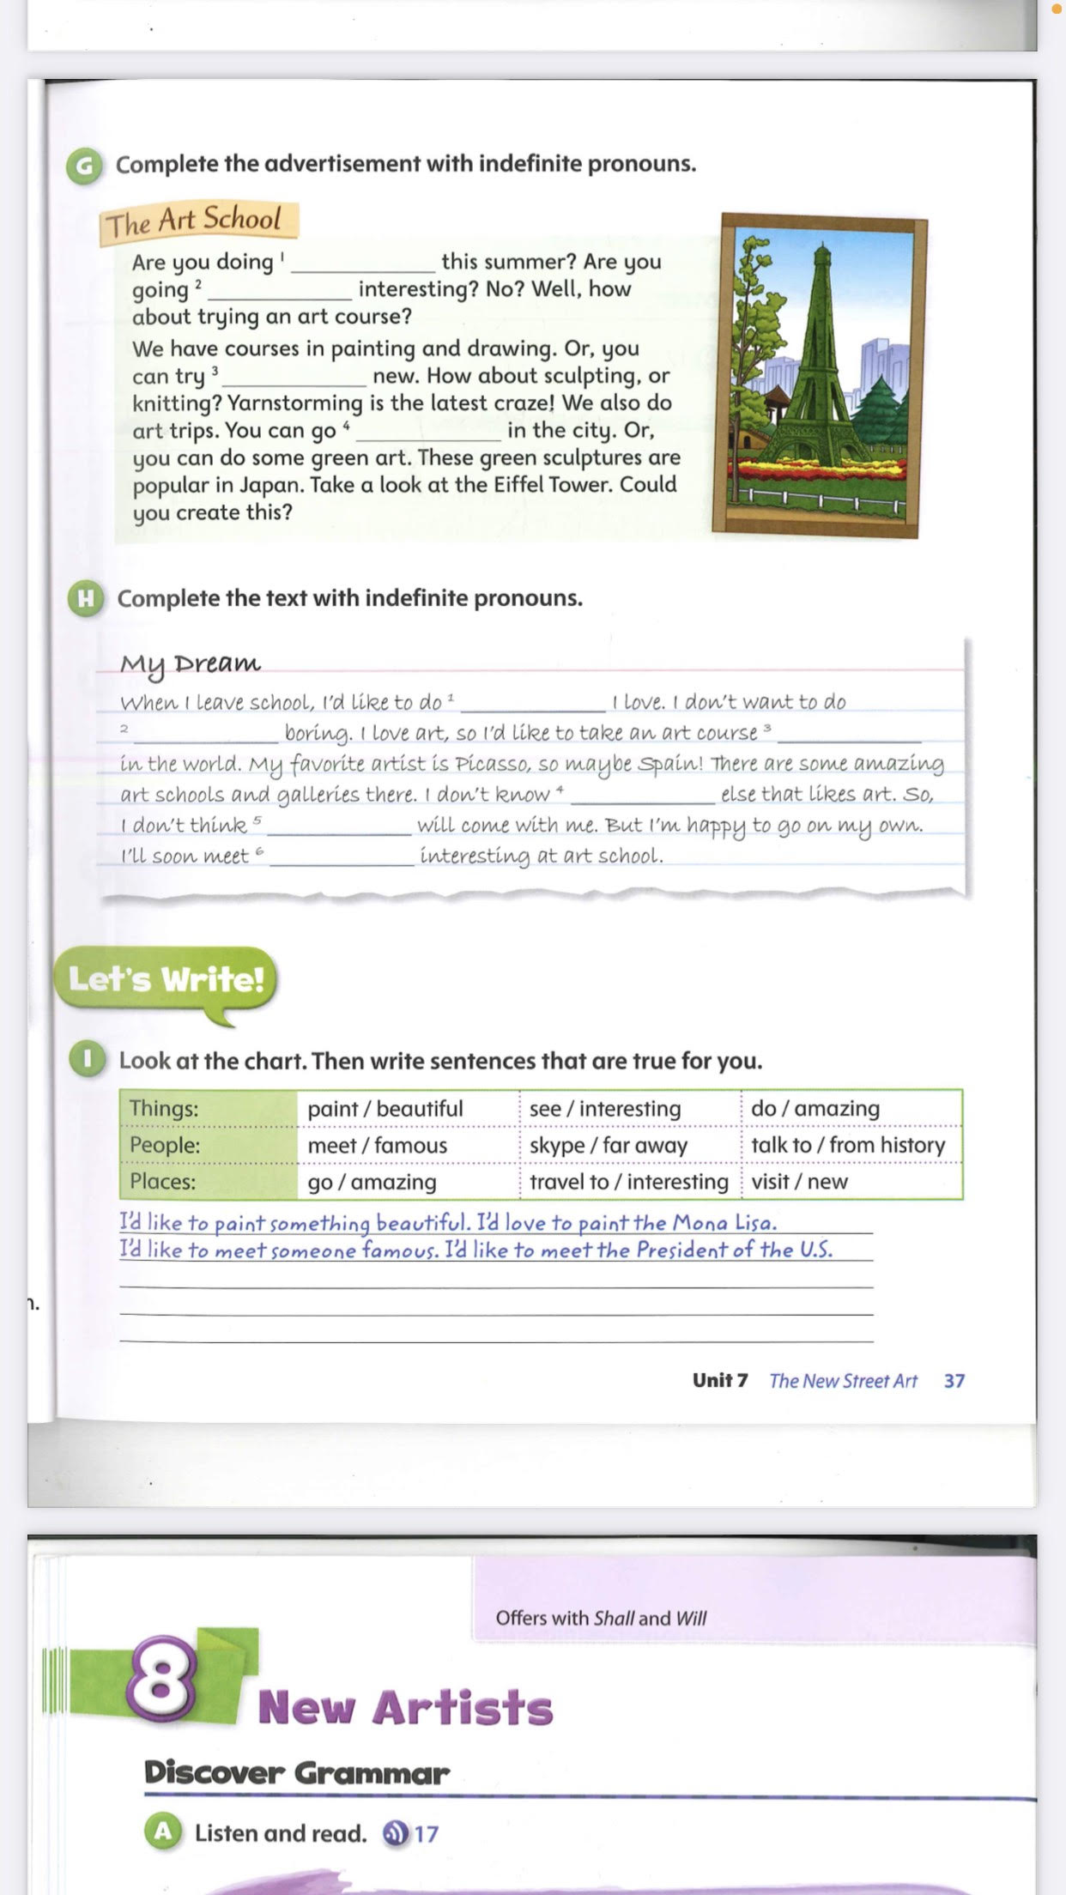
Page 43
anything
anywhere
something
somewhere

Slide 8
Page 43
something
anything
somewhere
anyone
anyone
someone

