Slide 1
Student Book and Workbook
Answer Keys
Unit 8

Slide 2
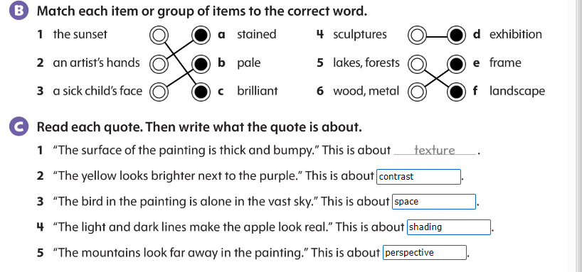
Student Book
Page 76

Slide 3
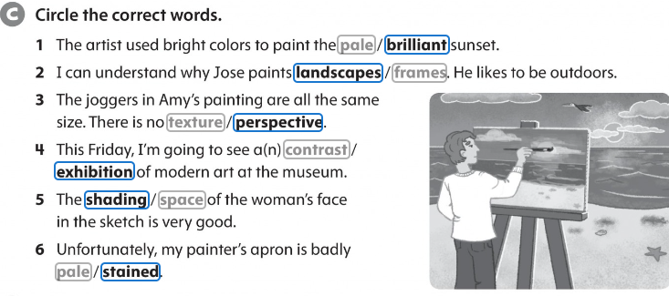
Workbook p.68

Slide 4
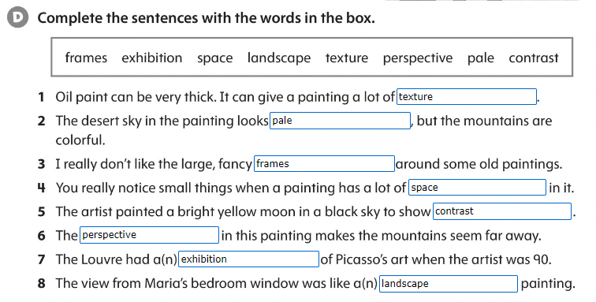
Workbook p.68

Slide 5
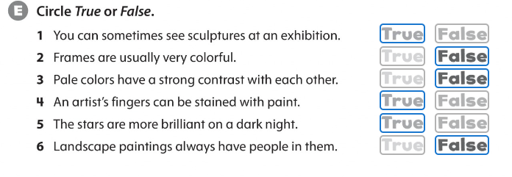
Workbook p.68

Slide 6
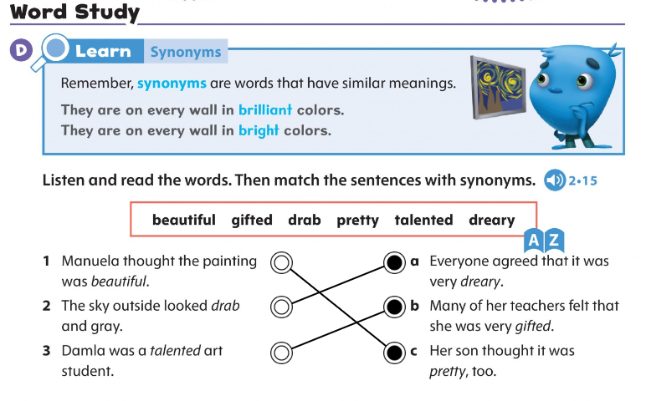
Synonyms
Student Book p.83

Slide 7
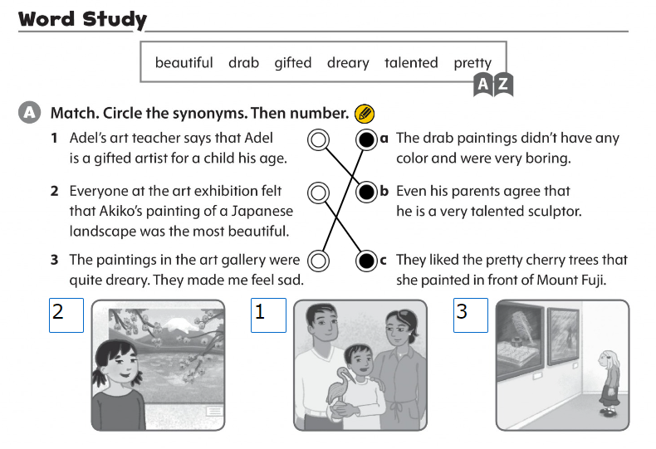
Workbook p.73

Slide 8
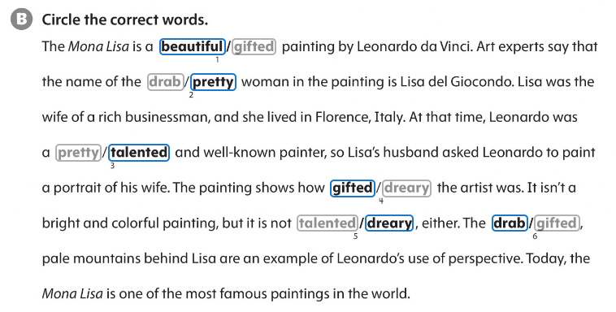
Workbook p.73

