Slide 1
The Past Tense
https://youtu.be/xLA58CSIf3M

Slide 2
Objective:
To form the past tense of regular and irregular verbs.
To form questions and negative sentences in the past tense.

Slide 3
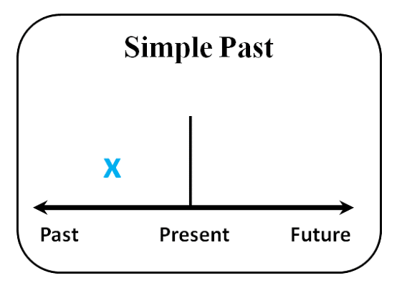
When do we use the past tense?

Slide 4
We use the past tense to describe an action that started and finished at a specific time in the past, for example:
I saw a movie yesterday.
She watched TV last night.
Last summer, my parents visited Australia.
We had lunch together two hours ago.

Slide 5
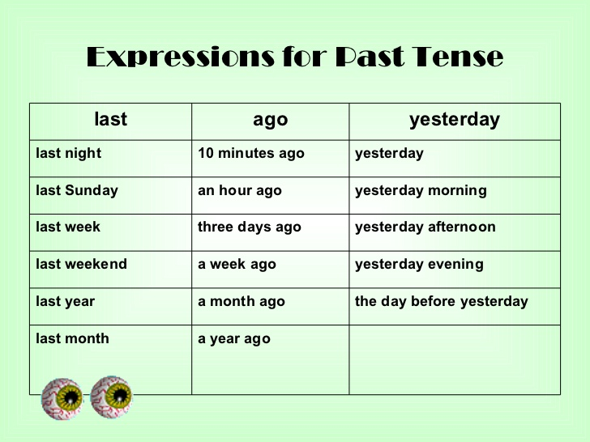

Slide 6
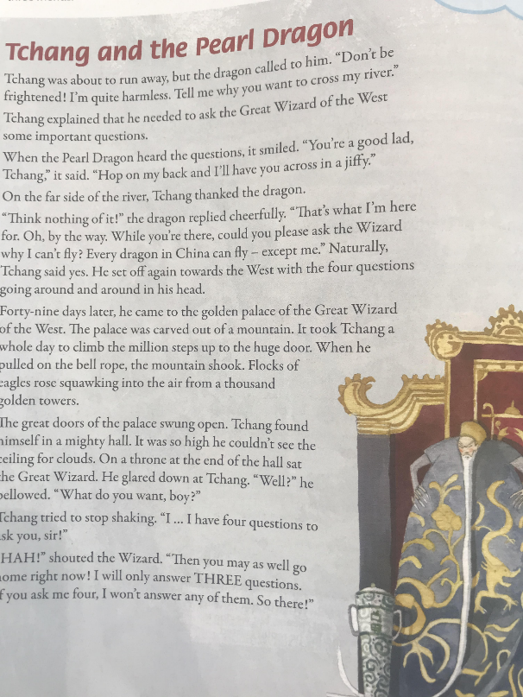
We also use the past tense for actions that happened one after the other in the past ( like in a story).
- He came in, took off his coat and sat down.
- I went to the party, and I saw my friends, then we danced together.

Slide 7
Verb to be in the past
https://youtu.be/RB6d-1tdx54
https://www.liveworksheets.com/rt1658952dr

Slide 8
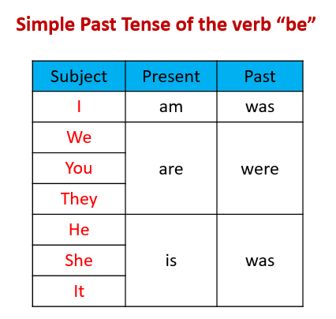

Slide 9
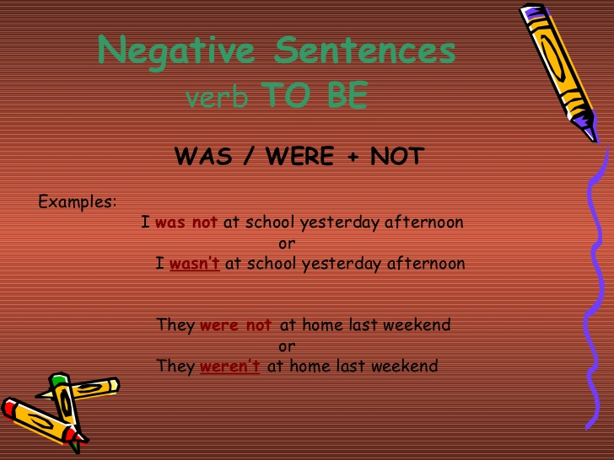

Slide 10
Write the past tense of the following verbs.
Laugh
Smile
Pray
Spy
clap
Buy
cut

Slide 11
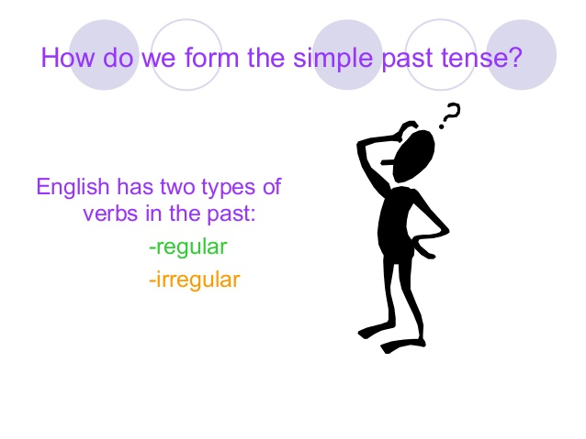

Slide 12
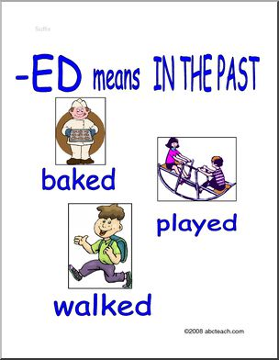

Slide 13
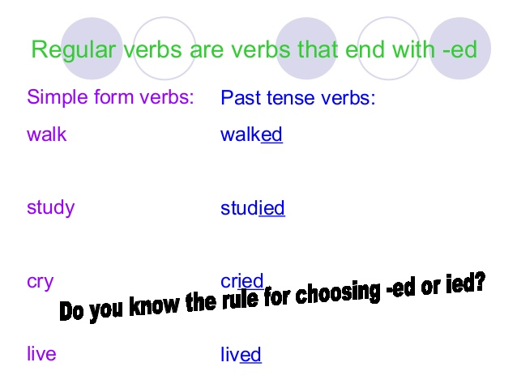

Slide 14
Change the following verbs into the past.
looked
look
talk
cook
talked
cooked
Adding ed to a verb will change it to the past tense.

Slide 15
loved
love
smile
bake
smiled
baked
Rule: Verbs ending in –e take only -d.

Slide 16
fried
fry
cry
carry
cried
carried
Rule: Verb ending in a consonant + y, drop the y and take -ied

Slide 17
played
play
stay
pray
stayed
prayed
Rule: Verbs ending in a vowel +y, take -ed

Slide 18
stopped
stop
plan
sob
planned
sobbed
Rule: Verb ending in one stressed vowel between two consonants double the last consonant and take - ed.

Slide 19
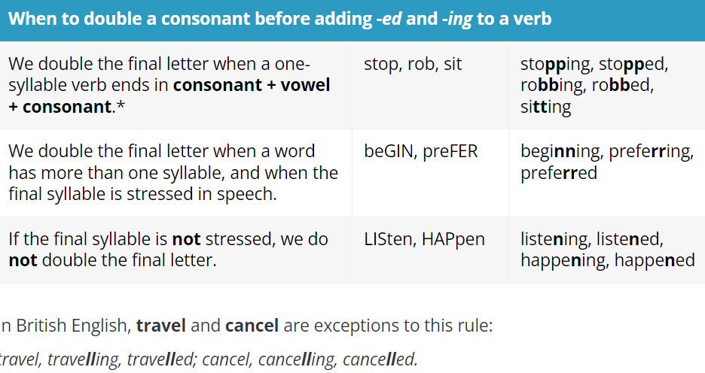

Slide 20
Choose the correct past tense of the following verbs.
1- marry
marryed b. married
2- destroy
destroied b. destroyed
3- plan
planed b. planned
4- decide
decideed b. decided

Slide 21
5- die
a. dyed b. died
6- repeat
a. repeated b. repeatted
7- travel
a. travelled b.traveled
8- mix
mixxed b. mixed

Slide 22
went
go
buy
leave
bought
left
Rule: Some verbs are Irregular there is no rule for these verbs. You should learn them by heart.

Slide 23


Slide 24
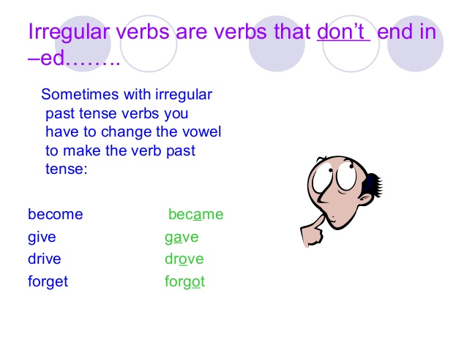

Slide 25
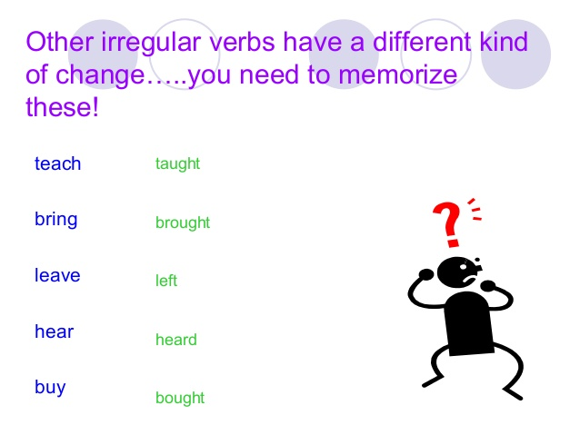

Slide 26
Common Verbs That Don’t Change in the Past Tense:
put, hit, shut, cut, let, quit, beat, hurt
Last week, I put the notebook on the table.
She cut her finger yesterday.
Yesterday, Jack hit me first.
I beat my father in football last week.

Slide 27
Change the verbs between brackets into the past tense.
I _______________ (come) to England in 1993.
She _____________(stand) under a tree to shelter from the rain.
3. They _____________(do) their homework yesterday.
4. We _____________(sing) too much last night - I have a sore throat!
5. He already ______________(eat) all the cake.
6. The child_____________(fall) off his bicycle.
It _____________(take) three hours to drive to Paris.
8. I _______________(find) your keys under the table.
came
stood
did
sang
ate
fell
took
found

Slide 28
9. She ____________(get) a new bike for her birthday.
She _____________(sell) her house last year.
11. We _______________(go) to New York in January.
12. Finally my mother ______________(let) me go to a party.
It ________________(be) cold last night.
14. I ________________(meet) John at the weekend.
Lucy ____________(pay) the bill before leaving the restaurant.
16. We _______________(see) the new film yesterday.
got
sold
went
let
was
met
paid
saw

Slide 29
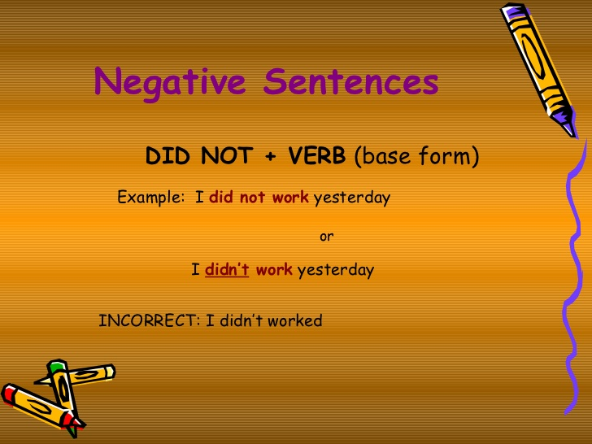

Slide 30
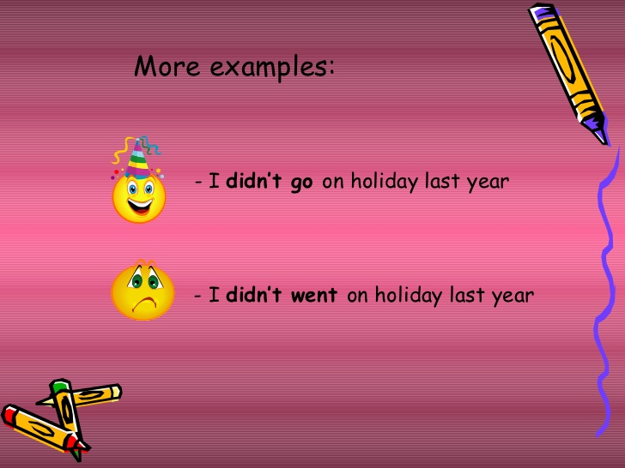

Slide 31
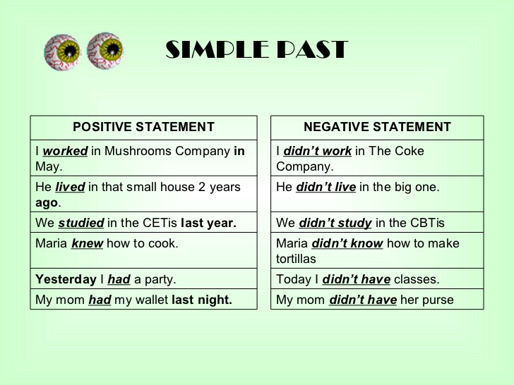

Slide 32
Complete the sentences with the Past Simple of the verbs in brackets.
didn’t order
1- We .......................... (not order) steak and chips at the restaurant yesterday.
2- Billy .......................... (not stop) at the stop sign.
3- I .......................... (not go) to school yesterday.
4- we ......................... (not walk) to the bank and ..................... (not pay) our bills.
didn’t stop
didn’t go
didn’t walk
didn’t pay

Slide 33
Change the sentences to the negative form.
1- She studied French at university.
2- They visited Paris on their last vacation.
3- They won the game last week.
4- He swam in the sea.
5- He wrote his name on the paper.
6- He caught a fish with his fishing line.
7- He bought some toys for his kids.
8- They put all the toys in the box.
She didn’t study French at university.
They didn’t visit Paris on their last vacation
They didn’t win the game last week.
He didn’t swim in the sea.
He didn’t write his name on the paper.
He didn’t catch a fish with his fishing line.
He didn’t buy some toys for his kids.
They didn’t put all the toys in the box.

Slide 34
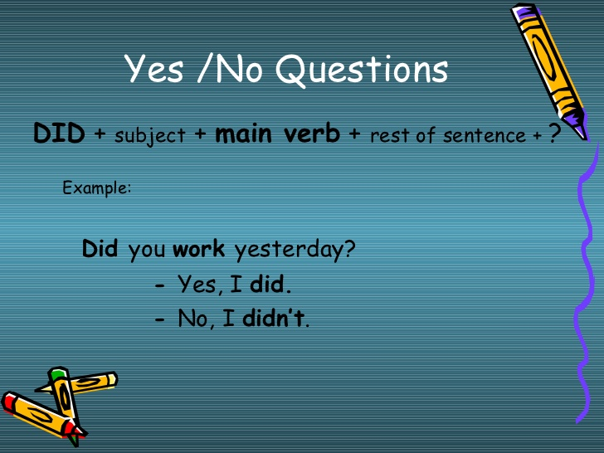

Slide 35
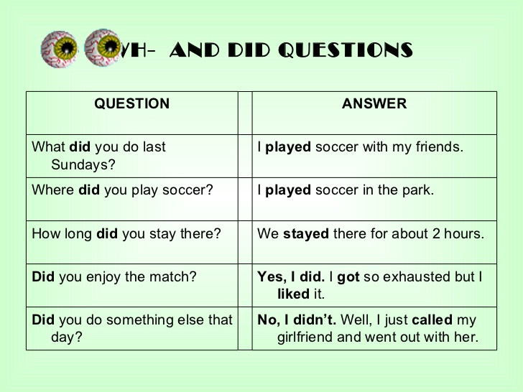

Slide 36
Write the question.
you / watched TV / last night
_________________________________________________________
2. your friends / played football / yesterday
_________________________________________________________3. your mum / baked / a cake / last weekend
_________________________________________________________
Did you watch TV last night?
Did your friends play football yesterday?
Did your mum bake a cake last weekend?

Slide 37
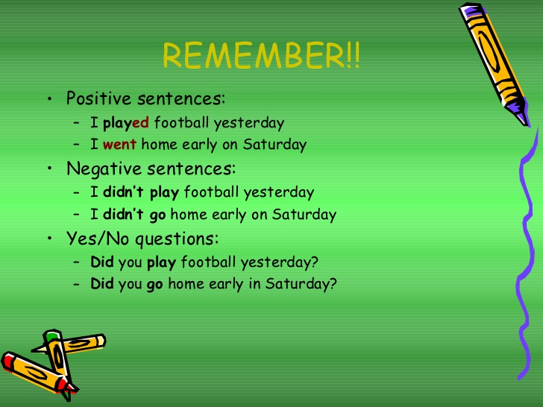

Slide 38
https://agendaweb.org/verbs/past_simple-exercises.html
https://wordwall.net/resource/6065449/double-or-drop-or-change-spelling-rules-adding-ing
https://wordwall.net/resource/1868008/adding-ed-verbs

Slide 39


