Slide 1
An opinion Essay

Slide 2
An opinion Essay
An opinion essay is a formal piece of writing. It requires your opinion on a topic, which must be stated clearly, giving various viewpoints on the topic supported by reasons and/or examples.

Slide 3
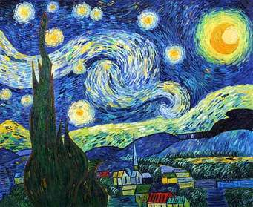
Starry Night by Vincent Van Gogh
Title
Vincent Van Gogh painted many beautiful works of art.
However , I think this painting Starry Night is my favourite.
There are three reasons why I think so.
First, in Starry Night, Van Gogh painted
swirling lines through the sky, around
the moon, and around the stars. This
movement helps me to see the beauty
and energy of the night sky. The moon
and the stars are full of light, and they
make me feel warm inside . Next, the little
town below the stars looks very peaceful . I imagine that
children can see the stars through their bedroom windows.
Finally, there is a strong contrast between the dark tree in front
of the scene and the bright sky. This contrast makes the sky
look even more beautiful.
I am thankful to Vincent Van Gogh for his beautiful work of art.
The swirling sky, the beautiful stars .and the peaceful town
are so special to me. It will always be my favourit work of art.
Topic and
opinion
Reasons
and
details
Summary
and final
thought

Slide 4
My favourite work of art: Starry Night by Van Gogh
First reason | Second reason | Third reason
Van Gogh painted swirling lines through the sky, around the moon, and around the stars. | The little town below the stars looks very peaceful . | There is a strong contrast between the dark tree in front of the scene and the bright sky.

Slide 5
A successful opinion essay should have:
A title.
An introductory paragraph in which you state the topic and your opinion.
A main body which consists of several paragraphs, each presenting a separate viewpoint supported by reasons and details.
A Conclusion in which you summarize the reasons and write a final thought.

Slide 6
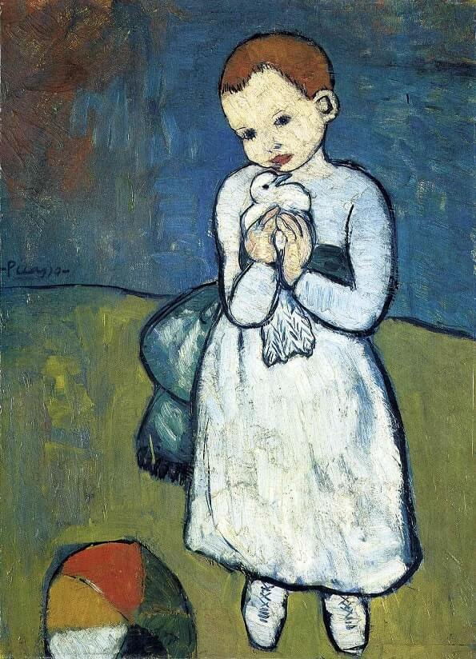
Child with a Dove
Child with a Dove is one of Picasso's earliest works:
he was twenty-one, or even less. He probably
painted it in Paris.
In Child with a Dove, we see a new thoughtfulness.
In this early work, we find a feature of Picasso's painting
that was to characterize his following work: the painter is deeply
involved, wholeheartedly caught up in the object represented.
Picasso's father, who was an artist, had made pigeons a favored
subject of his paintings, and as a boy Picasso must often have seen
pigeons, as well as his father's pictures of them. Childhood
memories must surely have been involved.

Slide 7
Child with a Dove by Picasso
Title
Picasso painted many beautiful works of art.
However , I think this painting Child with a Dove is my favourite.
There are three reasons why I think so.
First, in Child with a Dove , Picasso painted
a little girl, with short ginger hair, wearing
a white gown tied at the waist with a blue sash,
holding a white dove in both hands. This
white dove helps me to see the purity
of childhood. The innocent look of the girl
is full of peace, hope and love , and it
makes me feel calm inside . Next, the small ball with brightly
coloured segments in front of the child looks very peaceful .
I imagine the child having fun playing with it with his friends.
Finally, the blue wall behind the girl resembles and the blue sky
and the green floor resembles the green grass. This resemblance makes
the painting look even more beautiful.
I am thankful to Picasso for his beautiful work of art.
The white dove, the colorful ball and the sky and grass resemblance
are so special to me. It will always be my favourite work of art.
Topic and
opinion
Reasons
and
details
Summary
and final
thought

Slide 8
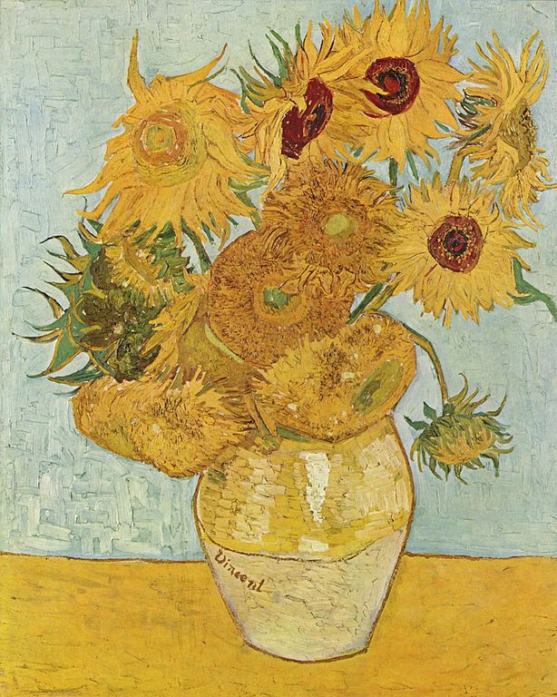
Sunflowers
Van Gogh’s paintings of Sunflowers
are among his most famous. He did them
in Arles, in the south of France, in 1888 and 1889. Vincent
painted a total of five large canvases with sunflowers in a
vase, with three shades of yellow ‘and nothing else’. In this
way, he showed that it was possible to create an image with
numerous variations of a single colour. One of these
paintings went to decorate his friend Paul Gauguin's
bedroom. The paintings show sunflowers in all stages of life,
from full bloom to withering.

Slide 9
Sunflowers by Vincent Van Gogh
Vincent Van Gogh painted many beautiful works of art. However , I think this painting Sunflowers is my favourite. There are three reasons why I think so.
First, in Sunflowers, Vincent painted a large canvas with sunflowers in a vase with three shades of yellow. The colour yellow represents the sun, I can feel its warmth and brightness. Next, the sunflowers are a symbol of life, the flowers are in various stages showing the cycle of life. I can smell their fragrance. Finally, the grey wall behind the vase makes a beautiful contrast with the yellow flowers. It makes me full of happiness.
I am thankful to Vincent for his beautiful work of art. The yellow sunflowers, the various stages of the sunflowers and the contrast of the grey wall are so special to me. It will always be my favourite work of art.

Slide 10
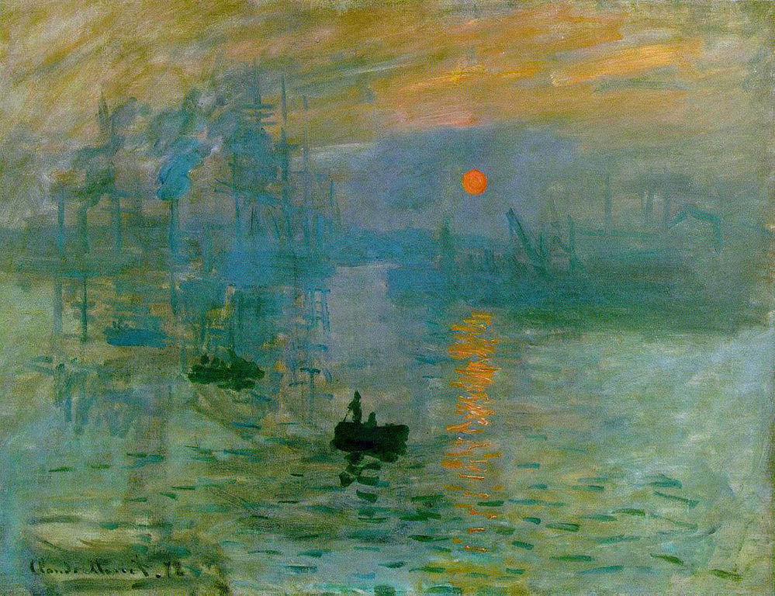
Sunrise
Claude Monet Impression: Sunrise
was a great example of the new
style. The lighting gives the viewer
the feeling or "impression" that the sun is just rising.
Monet's use of light was unique. An interesting fact
about this picture is the brightness of the sun. It is the
same as the sky. If you turn this picture into a black and
white picture, the sun virtually disappears.

