Slide 1
Writing an exciting story
Student Book page 124-125

Slide 2
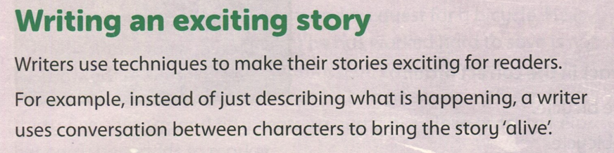

Slide 3
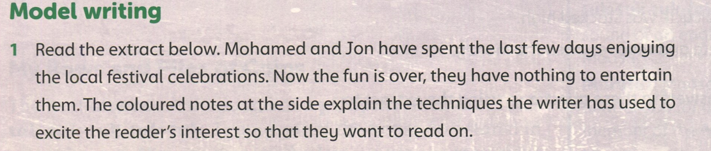

Slide 4
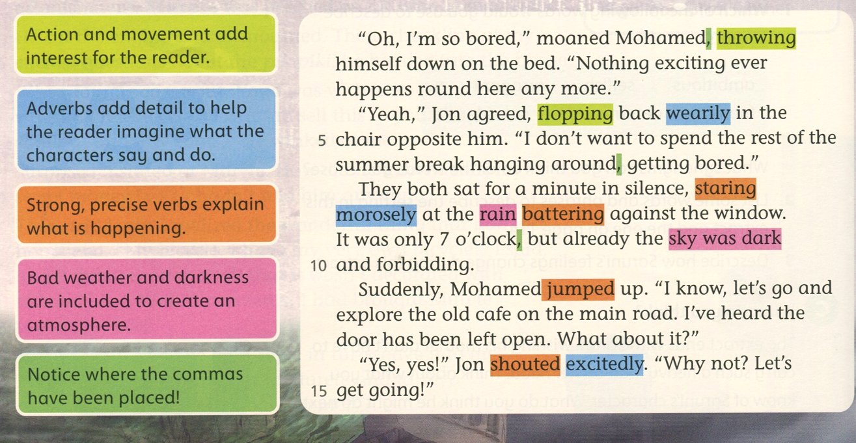
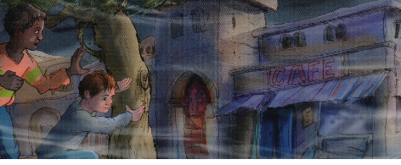

Slide 5
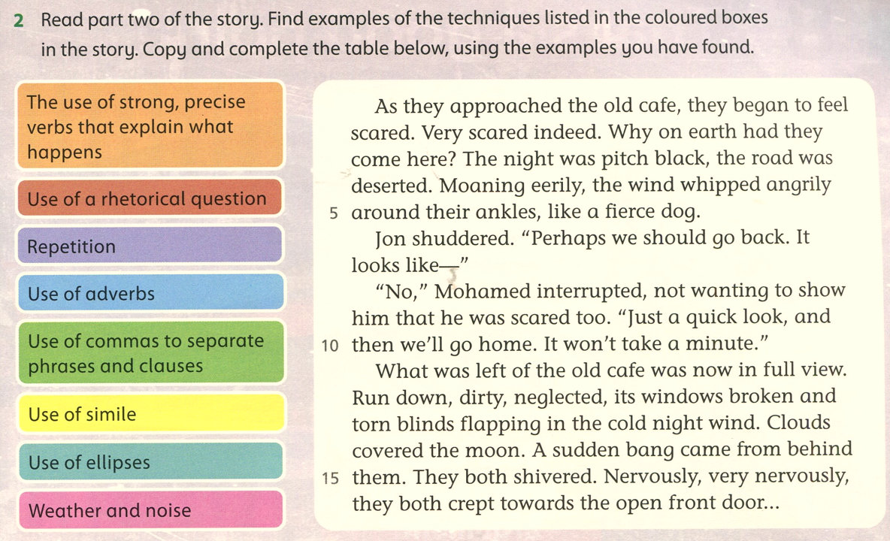

Slide 6
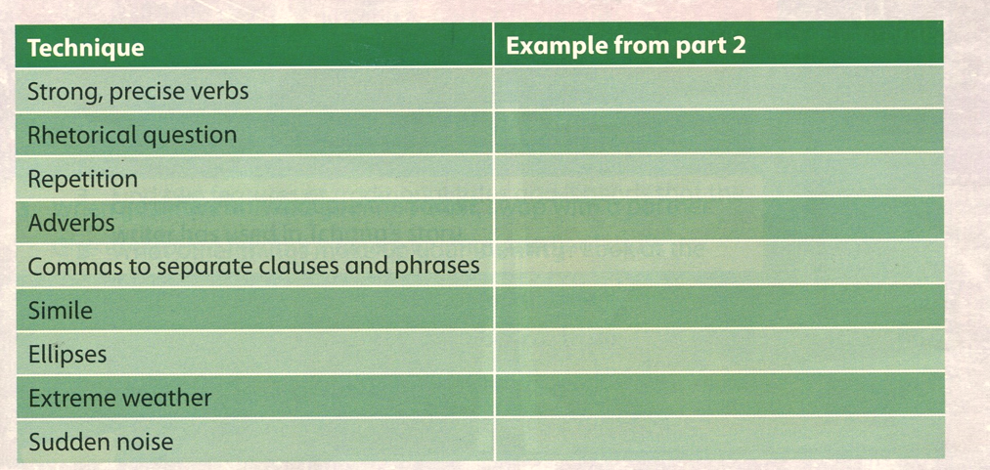
whipped, shuddered, shivered, crept
Why on earth had they come here?
Scared. Very scared indeed.
eerily, angrily, nervously
As they approached the old cafe, they…( L.1)
…like a fierce dog
the open front door…
The wind whipped angrily
A sudden bang

