Slide 1
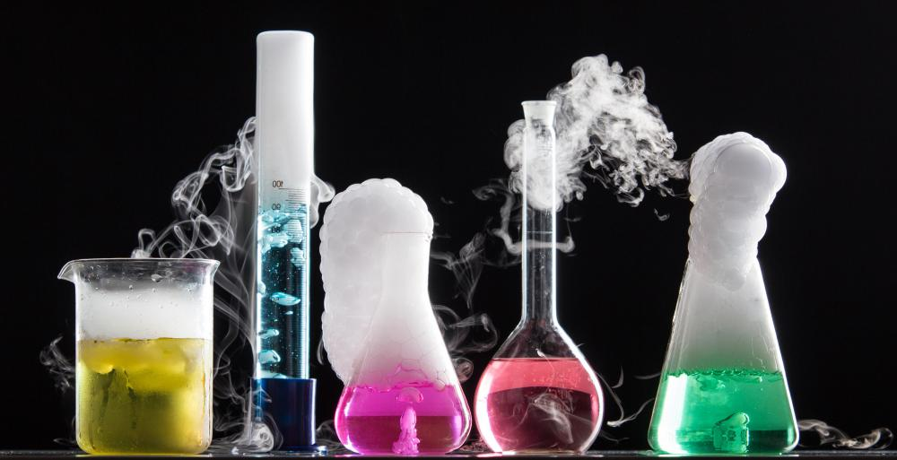
Chemical reactions

Slide 2
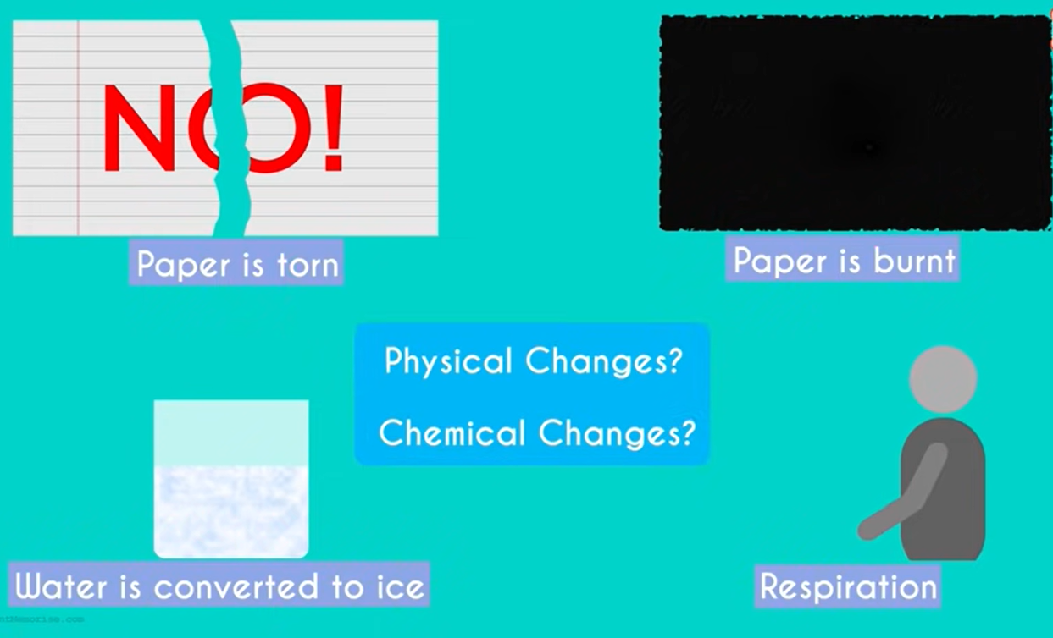
https://www.youtube.com/watch?v=NRCn8z8gb1w

Slide 3
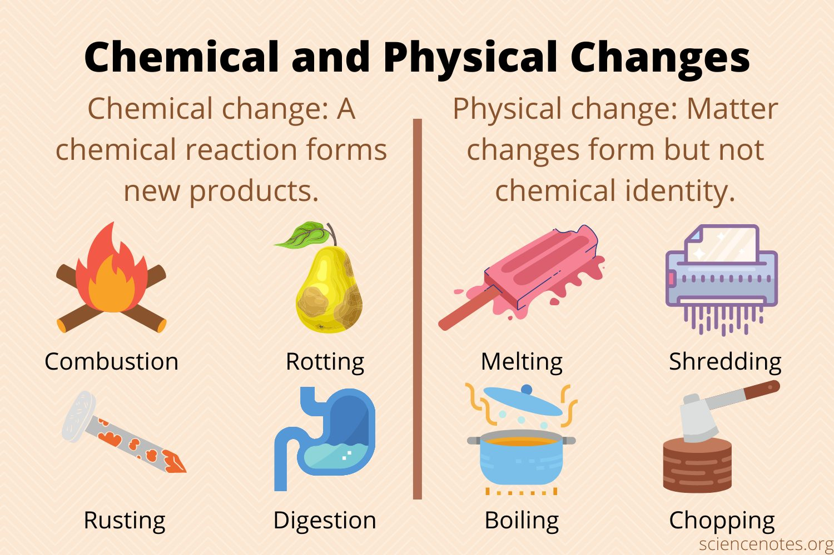
Physical changes do not produce a new substance.
Chemical changes result in the production of a new substance

Slide 4
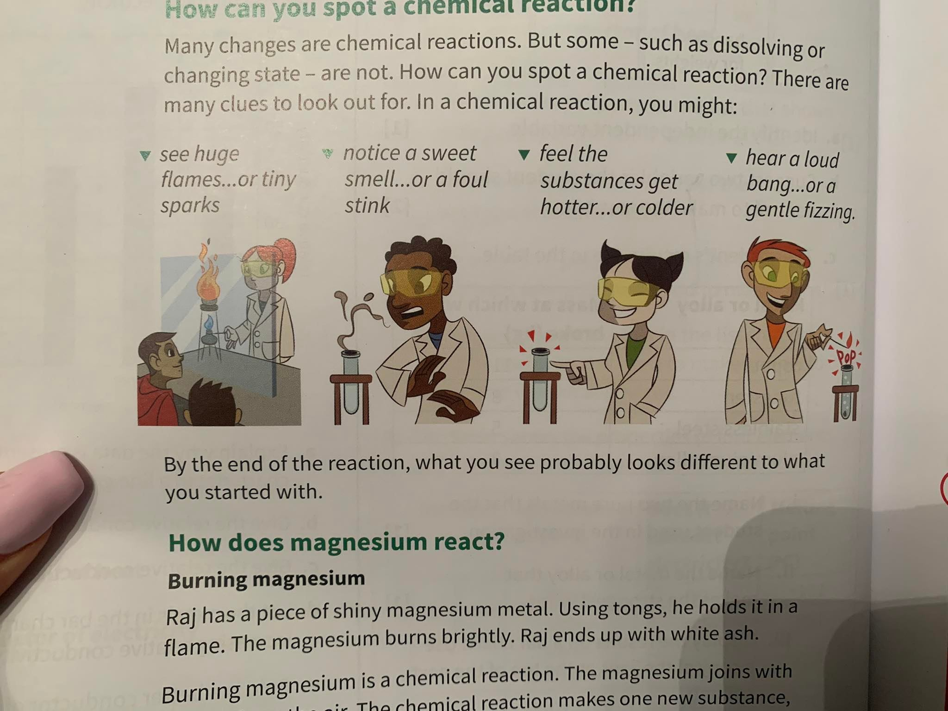
Signs of chemical reaction
There are five signs of a chemical change:
Color Change.
Production of an odor.
Change of Temperature.
Evolution of a gas (formation of bubbles).
Precipitate (formation of a solid)

Slide 5
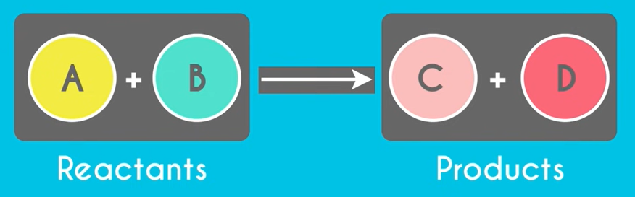
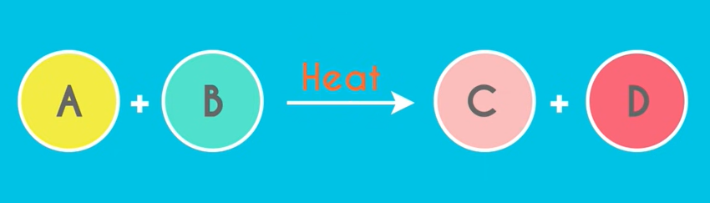
Chemical reactions
In a chemical reaction:
The starting substances are reactants.
The substances that are made are products.
If there is any condition (ex. Heat) it’s written above the arrow.

Slide 6
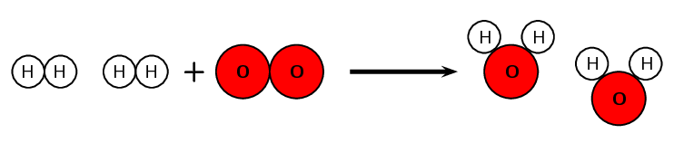
Modelling a chemical reaction
A chemical reaction can be modelled in two dimensions by using colored circles to represent the atoms.
A hydrogen atom can be represented by a white circle and an oxygen atom can be represented by a red circle.
Models of atoms can be used to show what happens to them when a chemical reaction takes place.

Slide 7
Modelling a chemical reaction
Hydrogen atoms occur naturally in pairs. They form a molecule of two atoms.
Oxygen atoms occur naturally in pairs. They form a molecule of two atoms.
The model shows that the pairs of hydrogen atoms separate, and the pair of oxygen atoms separate, then two atoms of hydrogen join with one atom of oxygen to form water.

Slide 8
Types of chemical reactions
There are different types of chemical reactions, but in this chapter we will be focusing on only four types of them.
Synthesis reactions.
Oxidation reactions.
Corrosion reactions.
Acid reactions. (neutralisation)

Slide 9
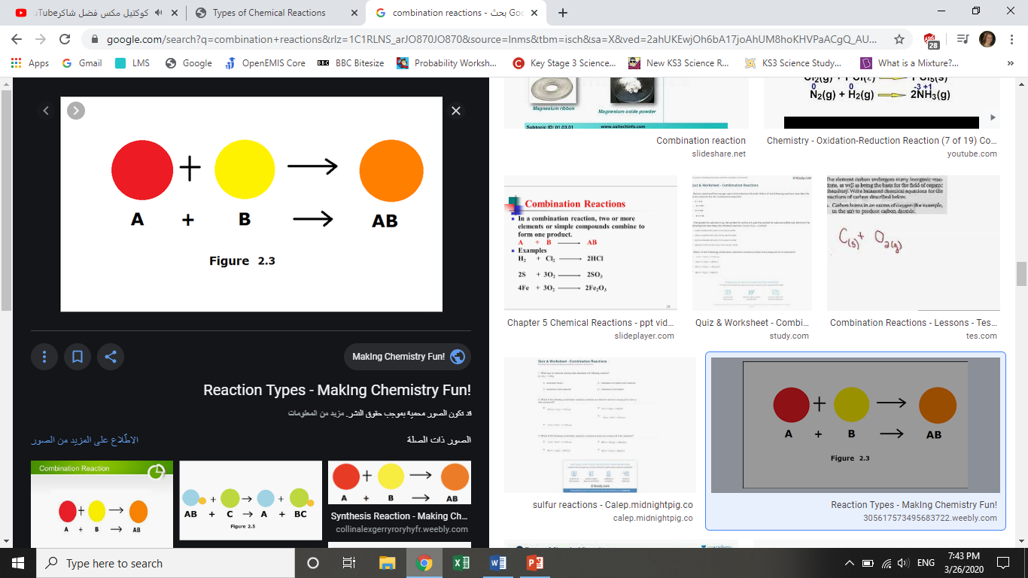
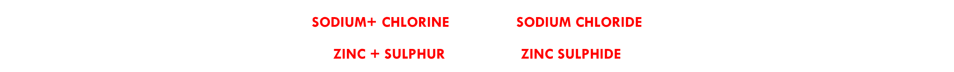
Synthesis reactions
Synthesis reactions occur when two different atoms or molecules interact to form a different molecule or compound.
We can always identify a synthesis reaction because there is only one product.

Slide 10
Oxidation reactions
(When elements react with oxygen to form oxides )
Elements may react with oxygen in different ways:
Slow oxidation (ex. rusting)
when the element is exposed to oxygen for a long period of time.
Fast oxidation (Combustion) (ex. burning coal)
when you burn an element in an open air, heat and light are given out.

Slide 11
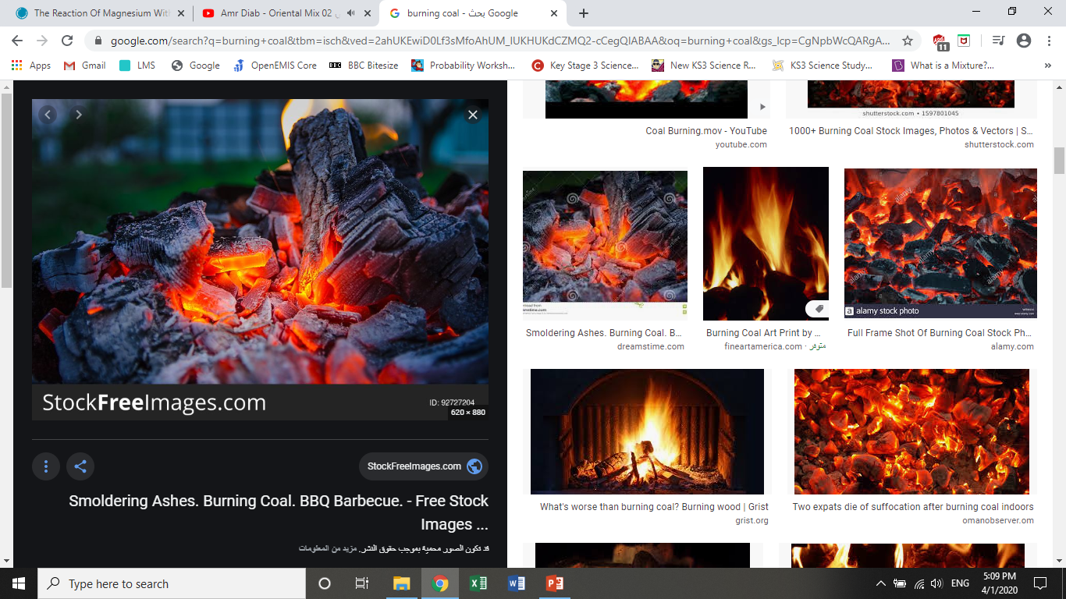
Combustion
Combustion reactions always involve oxygen. Oxygen combines with a substance and releases energy in the form of heat and light.
Anytime anything burns , it is a combustion reaction.

Slide 12
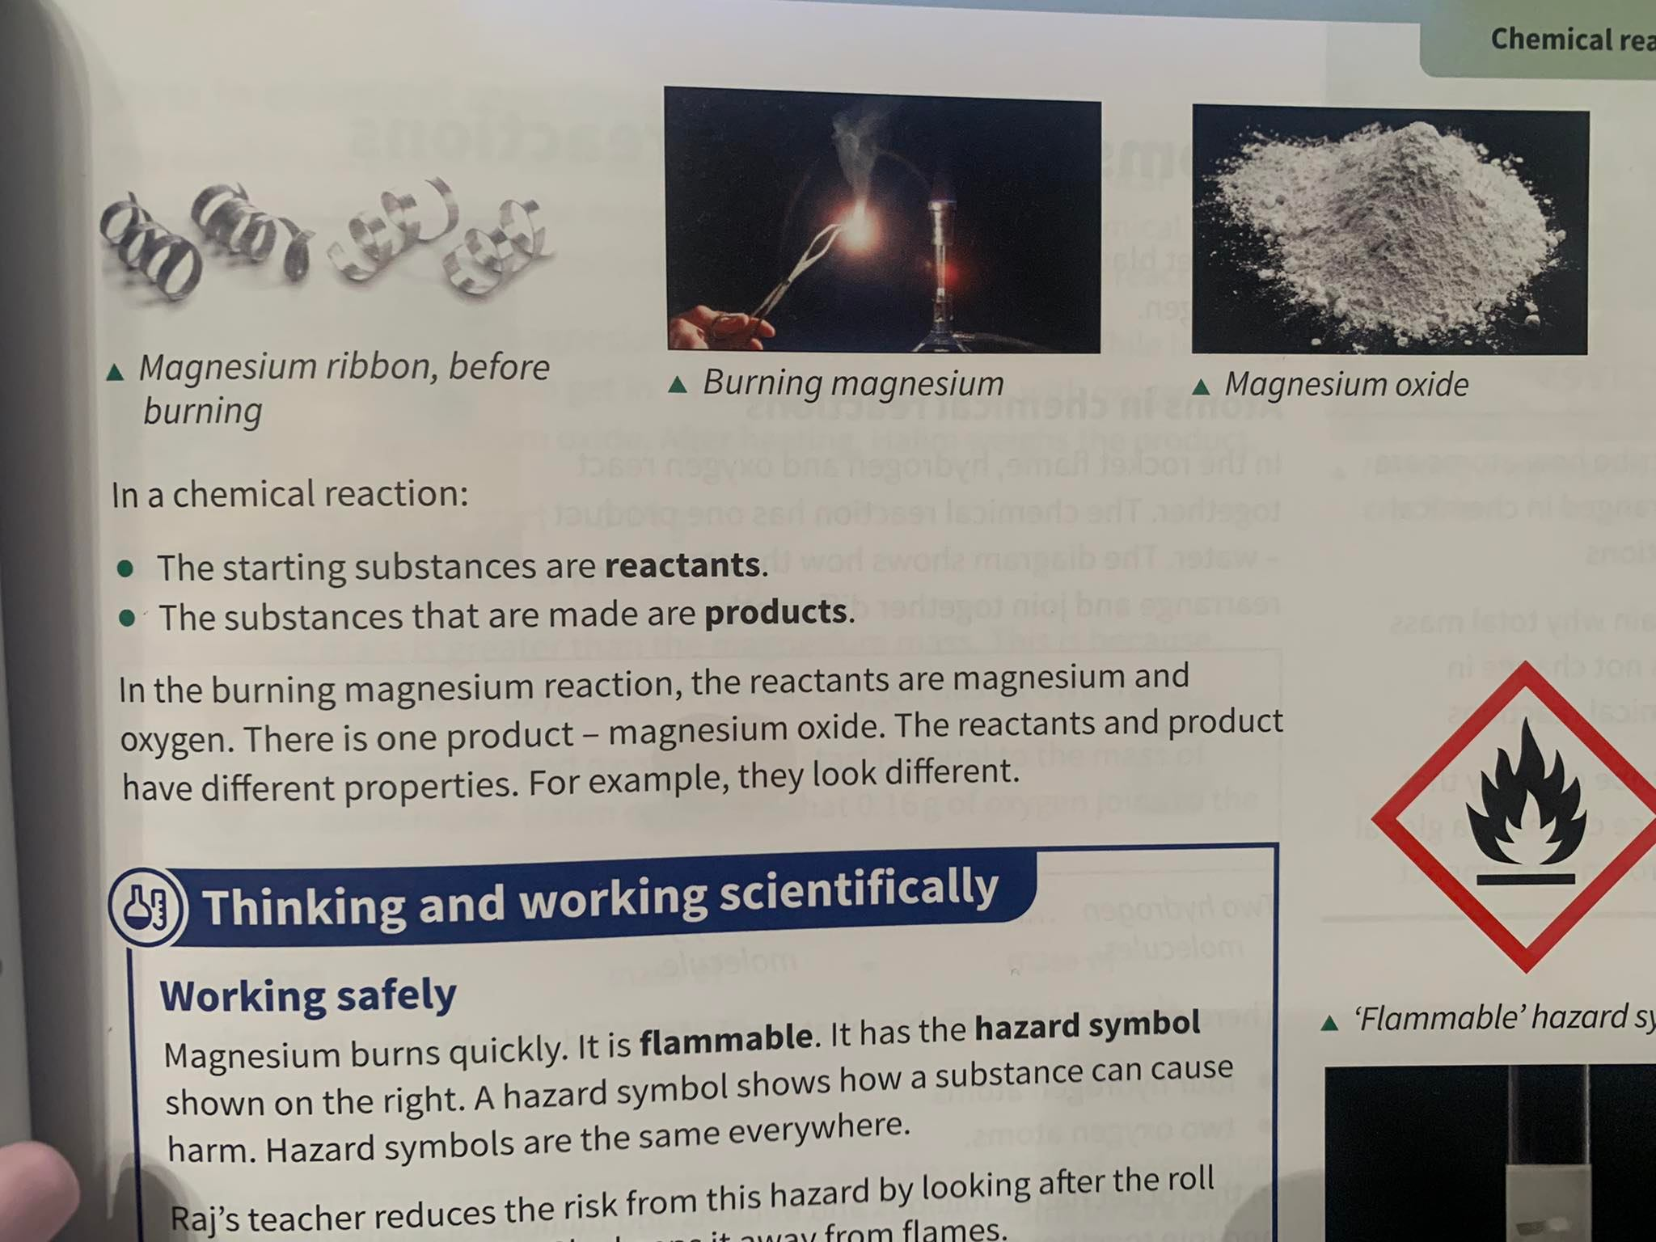
Examples of combustion reactions
Burning magnesium
https://www.youtube.com/watch?v=64LMt9iUflU

Slide 13
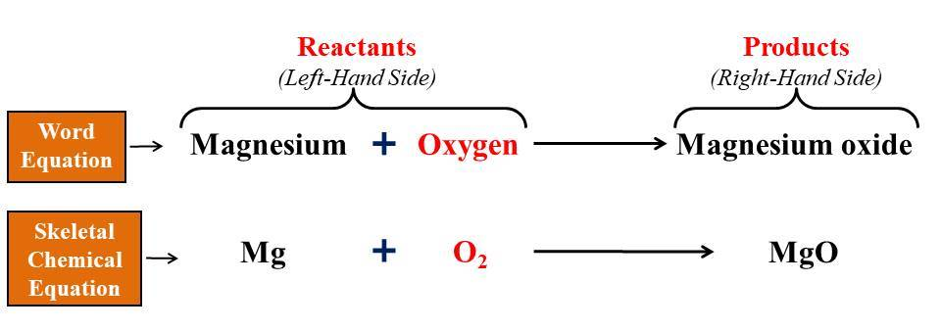
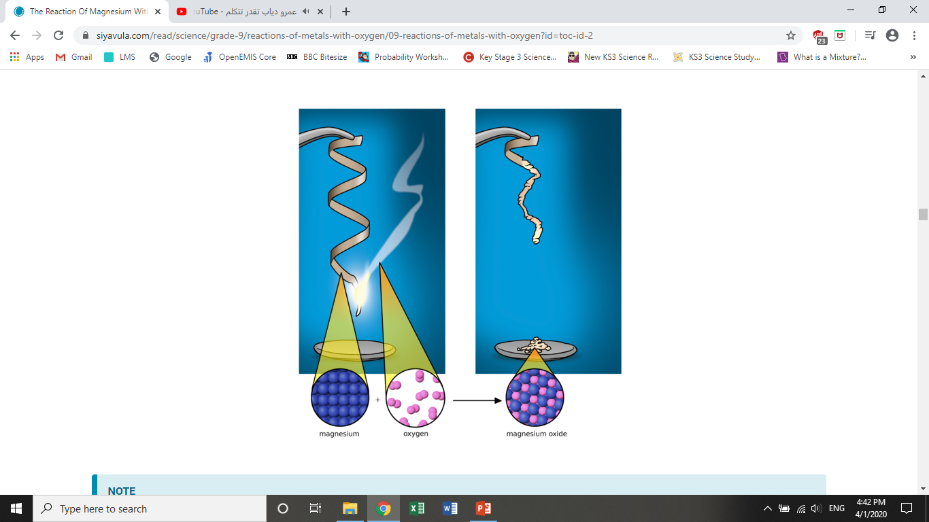
Burning magnesium

Slide 14
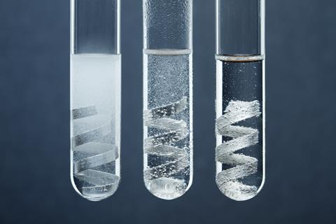
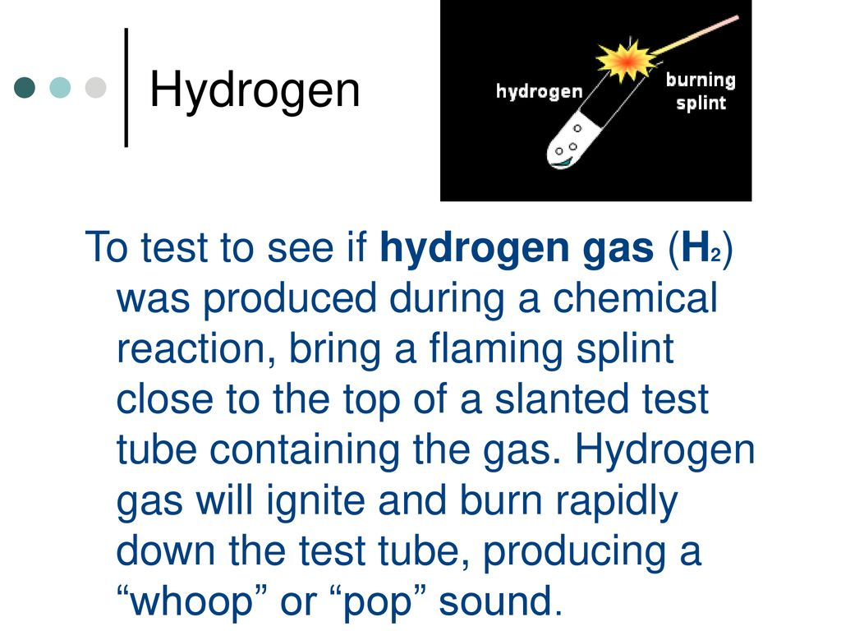
Examples of chemical reactions
https://www.youtube.com/watch?v=cpy_Zh-8sKA
Magnesium and acid
Magnesium reacts with hydrochloric acid. The bubbles are one of the products of the reaction - hydrogen gas.
The chemical reaction of magnesium and hydrochloric acid

Slide 15
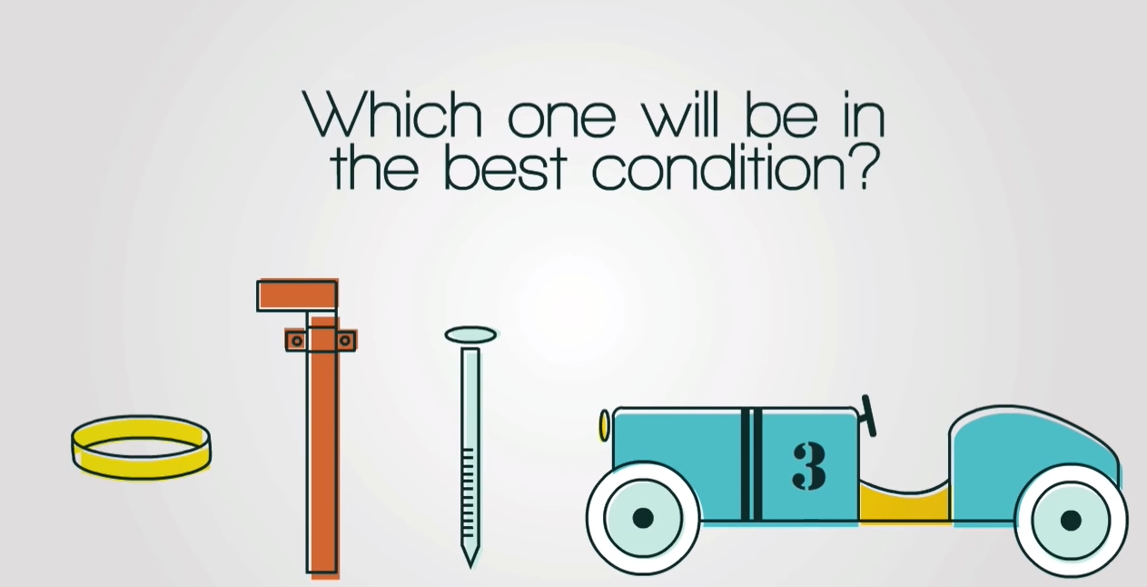
https://www.youtube.com/watch?v=TKMgUCq3npg

Slide 16
Corrosion reactions
Corrosion is a chemical reaction that takes place on the surface of metals .
Most corrosion reactions are very slow.
Some metals don’t corrode, like gold.
Examples:
  Iron corrosion
  Copper corrosion
  Silver corrosion

Slide 17
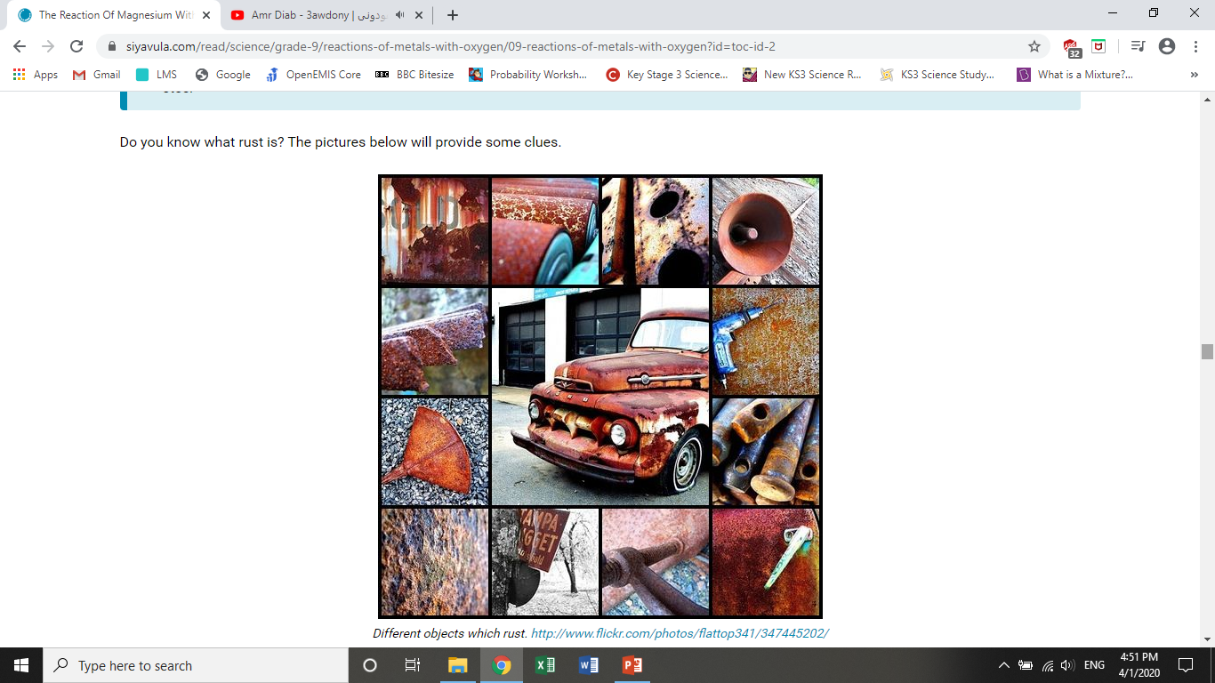
Iron corrosion rusting
Iron corrosion happens when iron reacts with oxygen and/or water.
The product of rusting reaction is hydrated iron oxide.
Iron + oxygen + water hydrated iron oxide
Rust forms on the surface of iron. Easily comes off so the iron is exposed ready to rust.

Slide 18
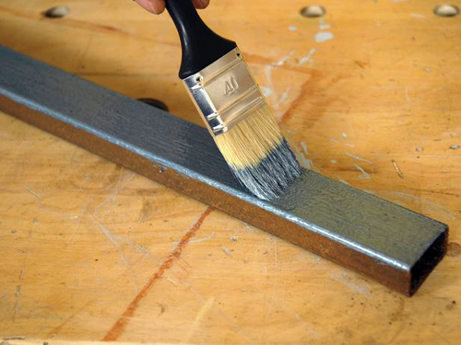
Preventing Iron corrosion rusting
We can prevent rusting by keeping oxygen and water away from iron. Chemists do this by coating iron with:
Paint (on cars)
Oil or grease (in engines)
Another metal

Slide 19
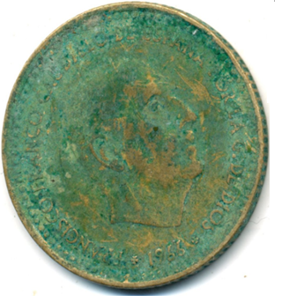
Copper corrosion
Copper corrosion happens when copper reacts with carbon dioxide in the air.
Copper will tarnish (lose luster), forming a green layer on its surface, for example copper carbonate.
The green compounds cover the surface of the copper. They do not easily come off, so the copper underneath is not damaged.

Slide 20
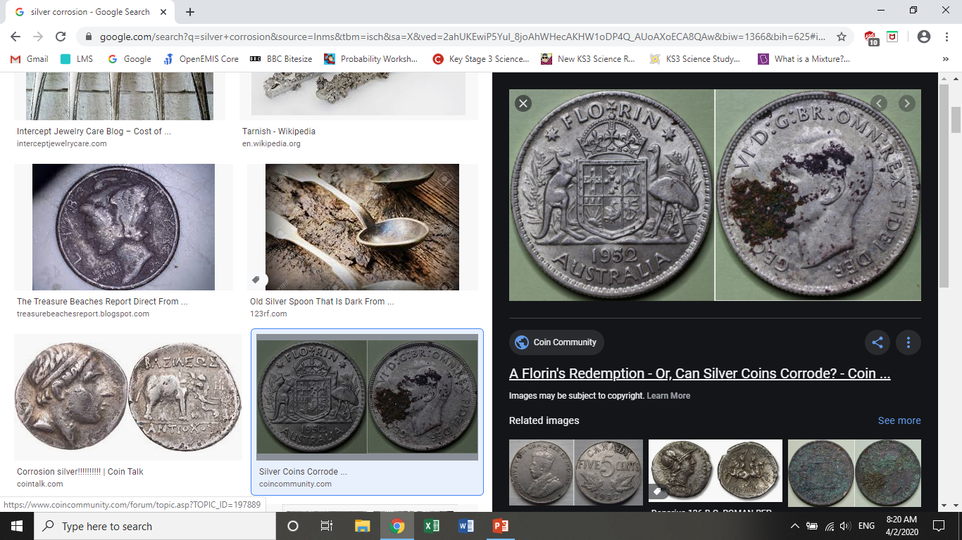
Silver corrosion
Silver (a gray metal) does not react with water or oxygen at 20°C. In clean air, it does not corrode.
It reacts with polluted air (containing hydrogen sulfide) forming a black layer on its surface.
The product of the reaction is silver sulfide.

Slide 21
Acid reactions
Acids and alkali
The products of the reaction of an acid and an alkali are salt and water. (neutralization reaction)
Acid + Base Salt + water
Acids with metal oxides:
Acids can also be neutralized with metal oxides.
Example:
Sulfuric acid + copper oxide Copper sulfate +water
(salt)

