Slide 1
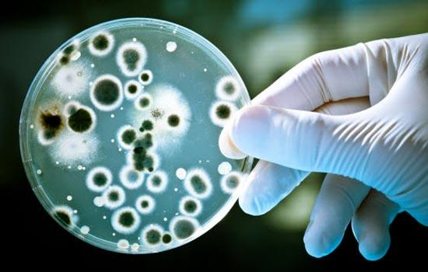
Microorganisms
https://www.youtube.com/watch?v=YSitT0oOoyc

Slide 2
Microorganisms ( microbes )
Micro organisms
They are organisms which can’t be observed with naked eyes and require a microscope to be seen.
Very small , microscopic structures
Living things

Slide 3
Fungi
  The largest of all microbes. they can be found in the air, on plants and in water
  Large plant like structures which lack chlorophyll
  Need to absorb nutrients from whatever they are growing on
  Fungi can be very helpful and humans have used them in
      The food industry - brewing beer, making bread rise
      Medicine – making antibiotics
  They can also be harmful if they steal nutrients from another living organism. Examples include, mould on bread and athletes foot.

Slide 4
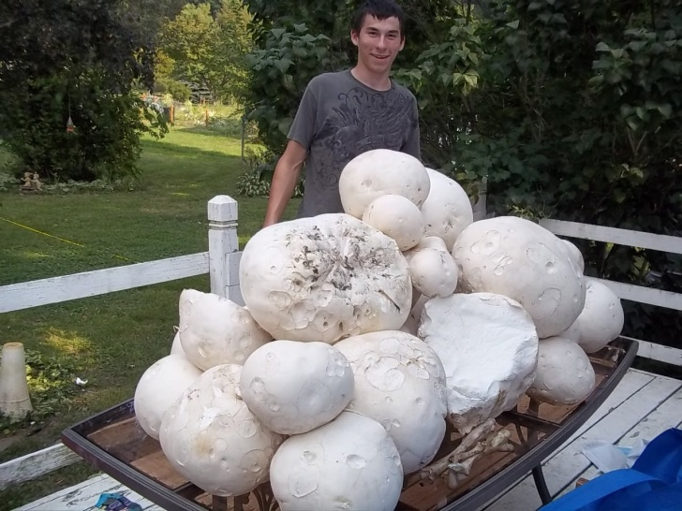
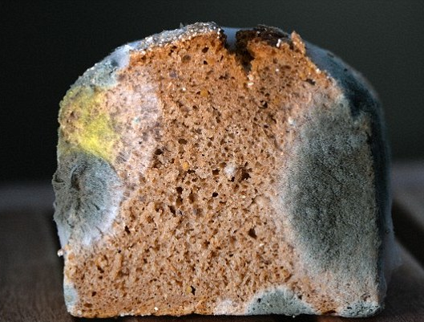
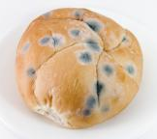
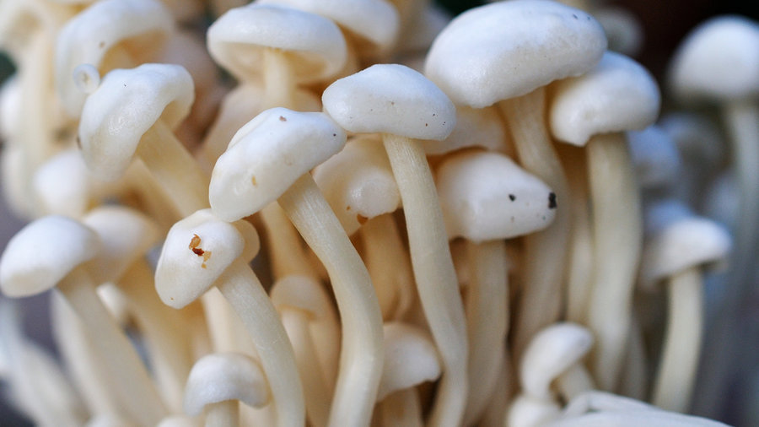
The Fungi kingdom
Microscopic organisms Macroscopic organisms

Slide 5
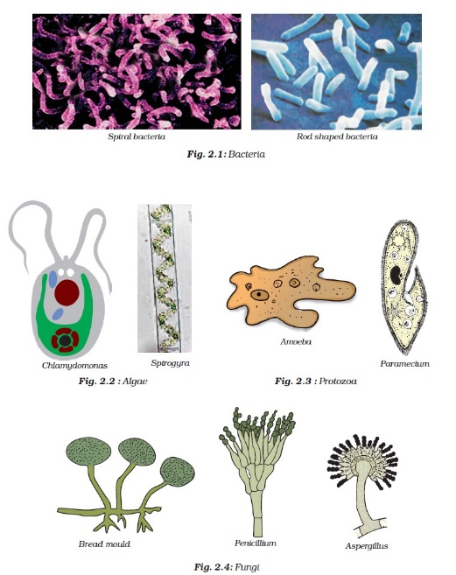
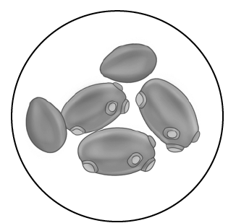
The fungi kingdom
The fungi kingdom is divided into:
Mushrooms
Molds
Yeast
Parasites

Slide 6
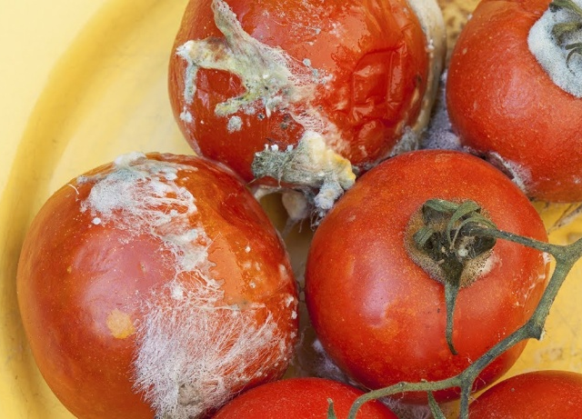
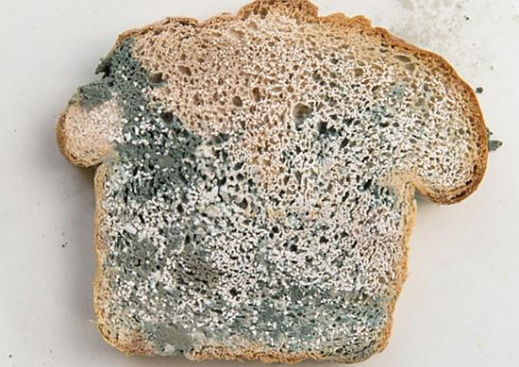
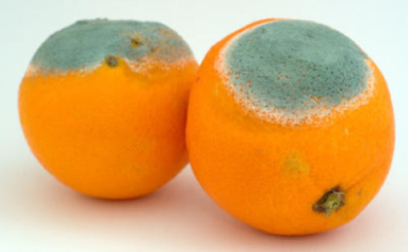
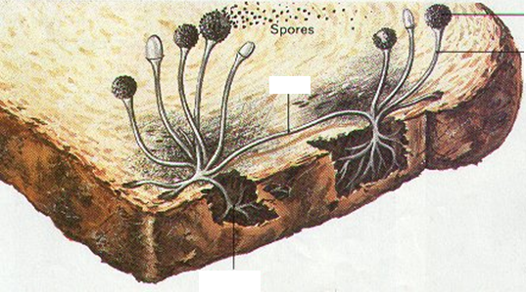
Fungi on food (Mold)

Slide 7
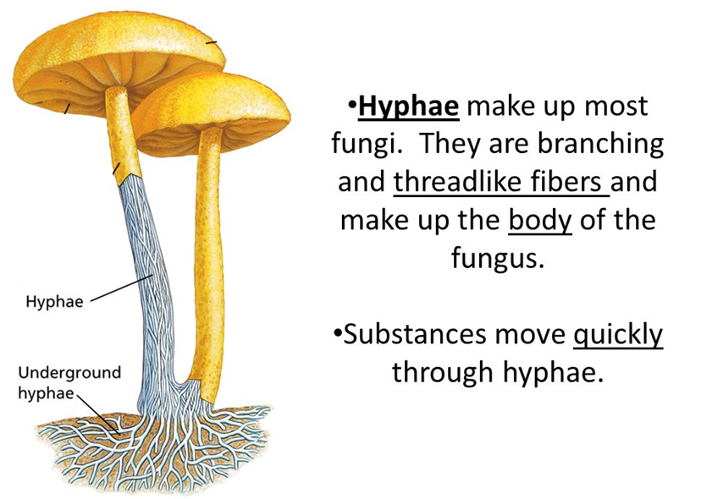

Slide 8
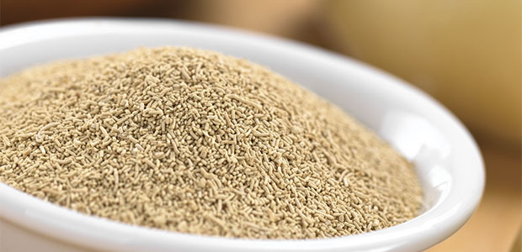
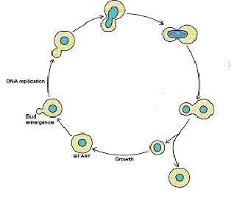
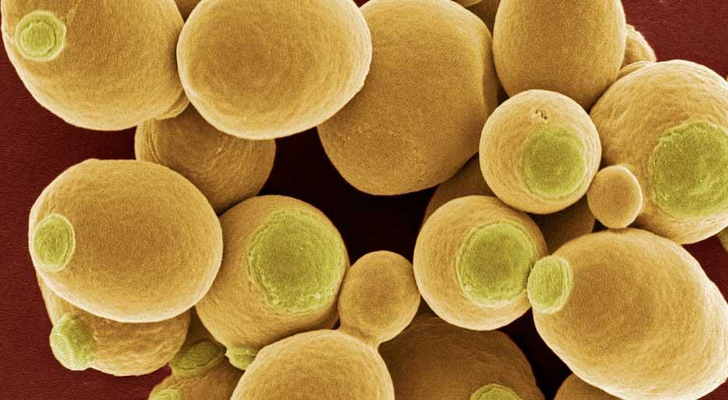
Yeast life cycle
When they are fully grown they produce copies of themselves that stick to their bodies & are described as buds
A fungus reproduces by budding.

Slide 9
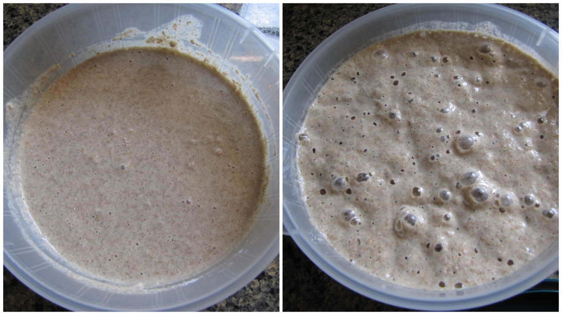
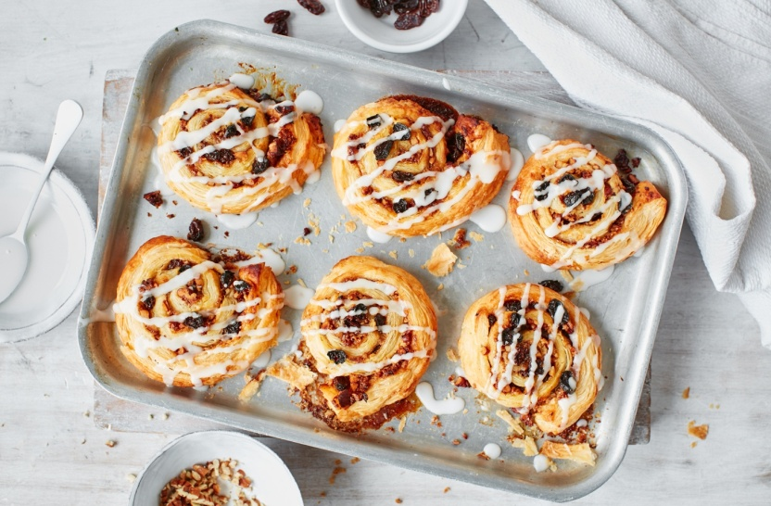
Yeast
As yeast is used, it respires and produces bubbles of carbon dioxide that makes the dough rise.

Slide 10
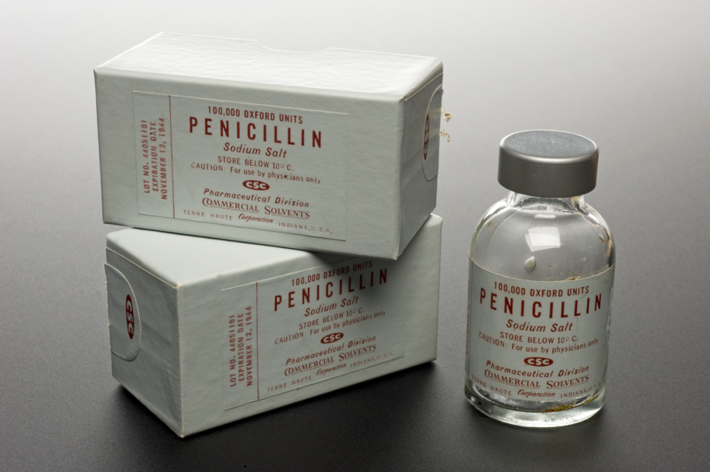
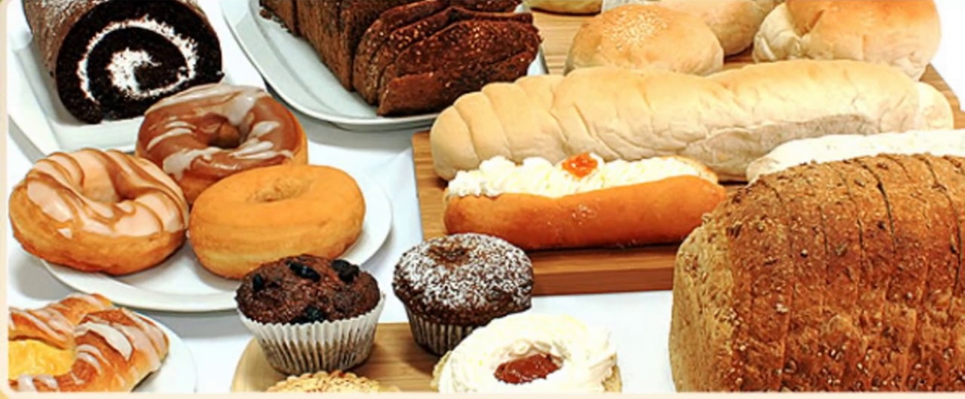
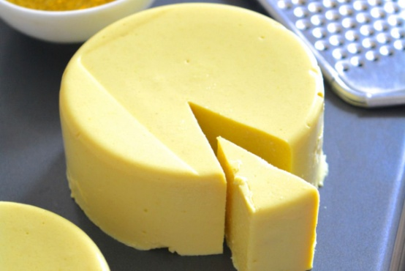
Useful fungi
In medicinal products In bakery items and cheese

Slide 11
Bacteria
  Obtain nutrients from their environments in order to live. In some cases that environment is a human body
  Most are helpful or harmless. But some cause disease
  Bacteria can reproduce outside of the body or within the body as they cause infections
  Some bacteria are good for our bodies:
    Good bacteria live in our intestines and help us use the nutrients in the food we eat and make waste from what's left over.
  They are found everywhere on earth, in the ocean, in rocks, in our bodies and in the soil

Slide 12
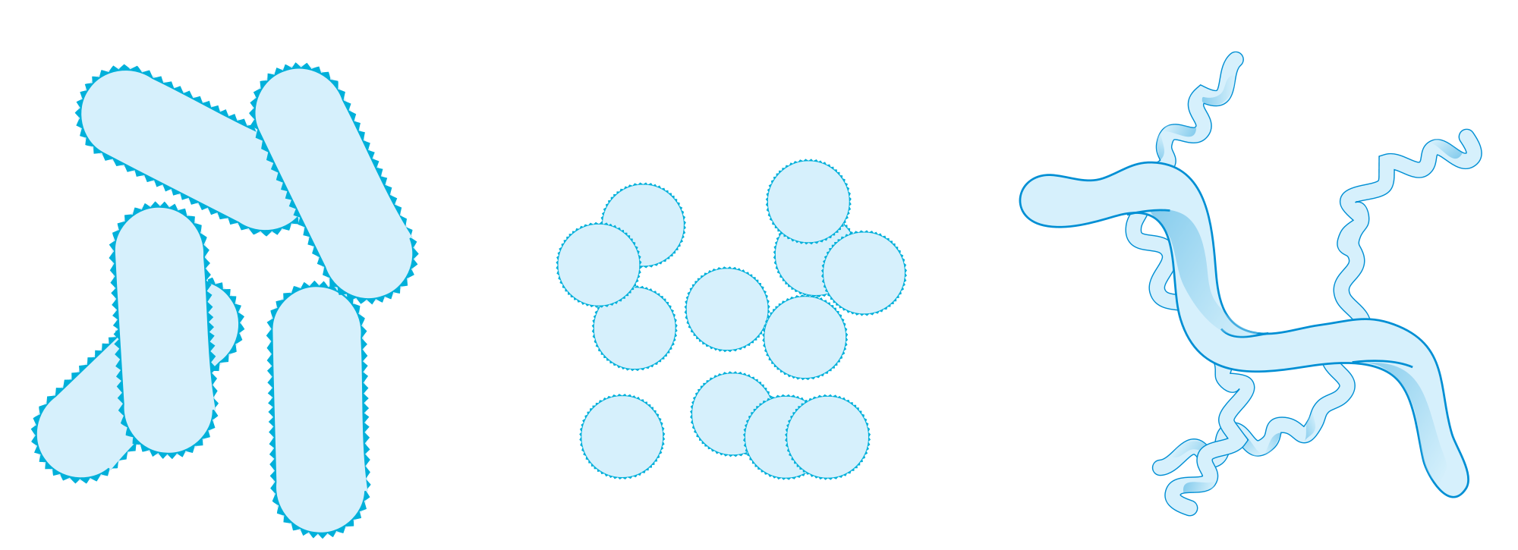
Bacterial shapes
There are 3 different shapes of bacteria
rod, spherical and spiral.

Slide 13
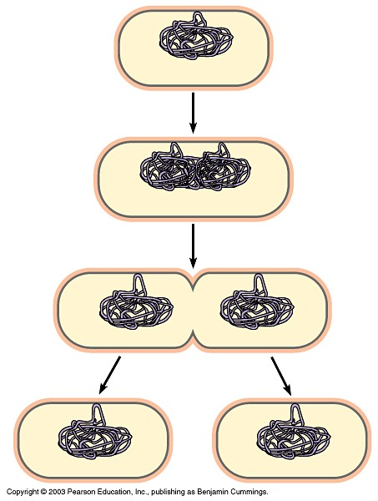
Bacterial reproduction
Bacteria reproduce by a process called fission.
Fission produces two cells with the same genetic material as the parent cell.

Slide 14
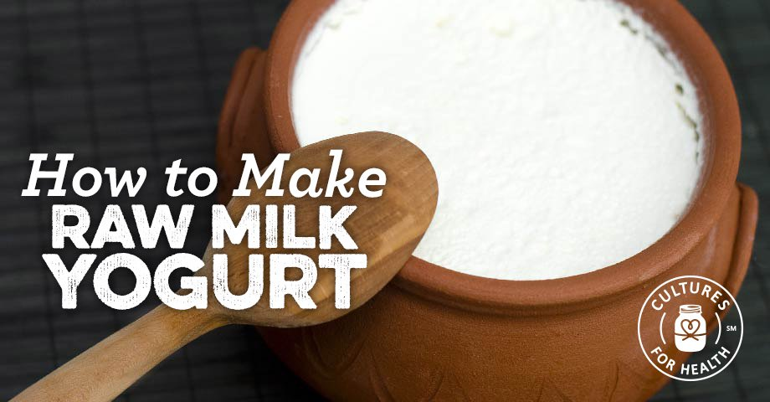
Useful bacteria
Yoghurt is made by introducing certain bacteria to milk.
These species eat the sugars in milk. As the bacteria eat milk sugars, the bacteria produce something called lactic acid. Lactic acid makes milk proteins curdle.

Slide 15
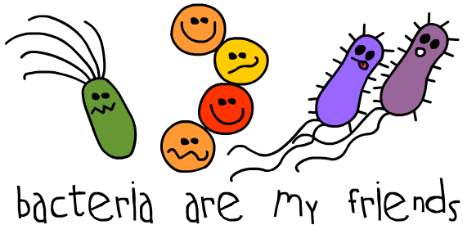
Thanks to bacteria
Life wouldn’t exist as we know it without bacteria.
Bacteria filled the atmosphere with the oxygen.

Slide 16
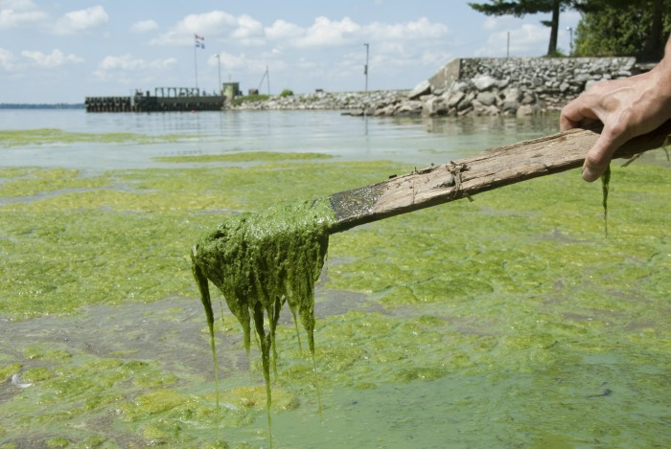
Blue-green algae (cyanobacteria)
Photosynthetic creatures that can produce oxygen.
They can be small and round or form long green strands.

Slide 17
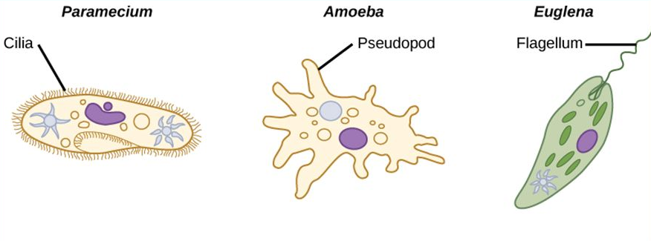
Protozoa
Protists have adaptive structures for movement including Cilia, Pseudopodia, Flagella.
They mainly feed on bacteria, sometimes fungi.

Slide 18
Viruses
  Viruses are even smaller than bacteria and can sometimes live INSIDE bacteria
  Most viruses make us ill
  Diseases like CHICKENPOX and the FLU are caused by viruses.
  Viruses cannot reproduce by themselves. They infect other cells in order to reproduce.
  They multiply inside the ‘host’ cell and destroy it.

Slide 19
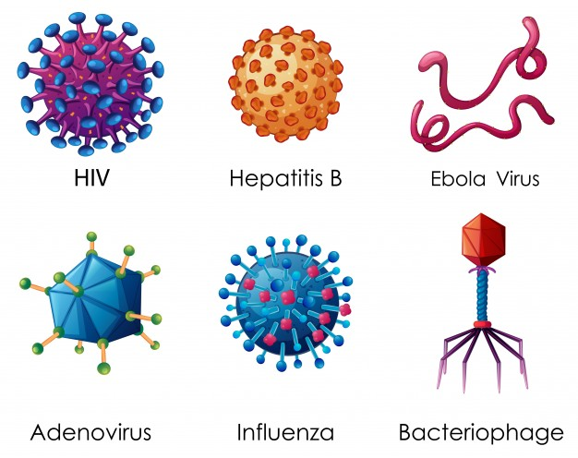
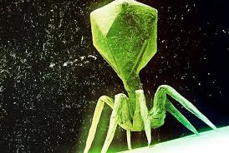
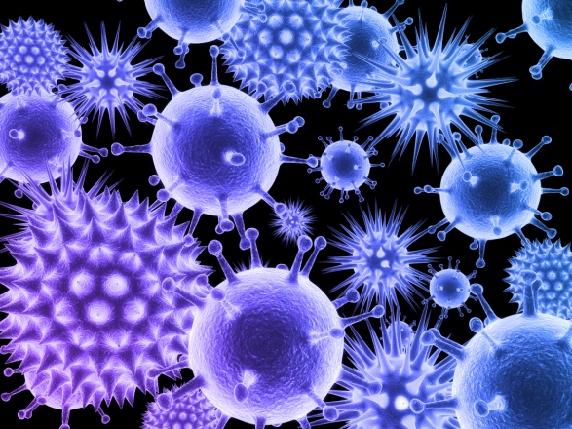
Viruses
A virus is a small infectious agent that replicates only inside the living cells of other organisms.
Viruses can infect all types of life forms, from animals and plants to microorganisms.

Slide 20
What are some viruses?
AIDS
Bird Flu.
Chickenpox.
Common Cold.
Vaccines can reduce the risk of acquiring some viral illnesses.

