Slide 1
Chemical and physical changes

Slide 2
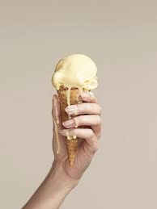
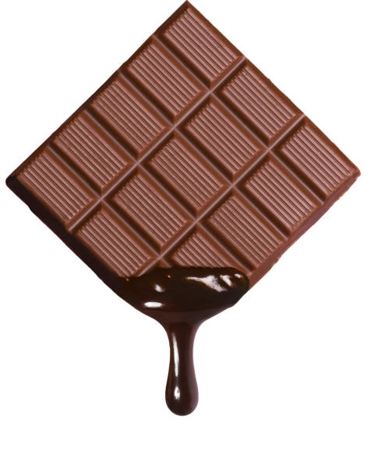
Physical Change
When a Physical change occurs, no new substances are produced.
The physical properties may change but no new substance is formed. For this reason, physical changes are often reversible.

Slide 3
Physical Changes Video
https://www.youtube.com/watch?v=w4UjfZqo1M0&list=RDCMUCUbEq1jv8SeWy4zUwZPJWiw&start_radio=1&rv=w4UjfZqo1M0&t=121

Slide 4
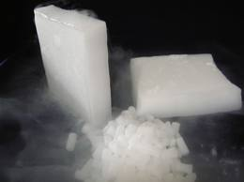
Physical Change
Evidence that a physical change occurred:
A change of shape or form
Change in size
A change of state (solid, liquid or gas)
Physical changes are usually reversible

Slide 5
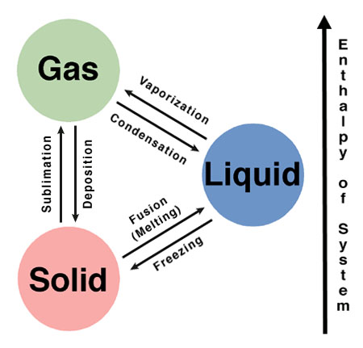
Physical Change - examples
Examples of physical change include:
Melting
Freezing
Evaporation
Condensation

Slide 6
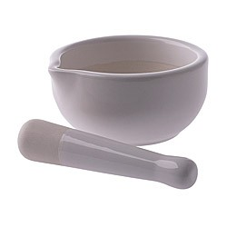
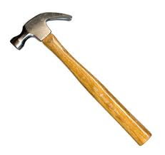
Physical Change
Physical changes might be caused by:
Grinding
Cutting
Crushing
Bending
Breaking
Heating/cooling
(change in state)

Slide 7
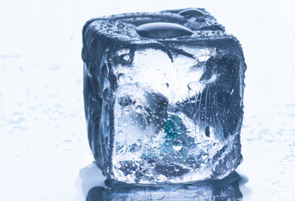
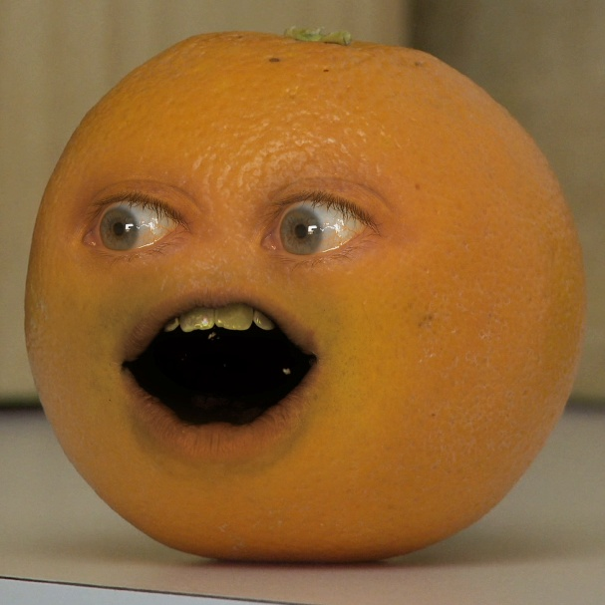
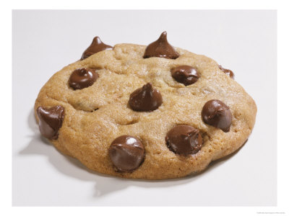
Physical change
What could you do to these items to cause a physical change to occur?

Slide 8
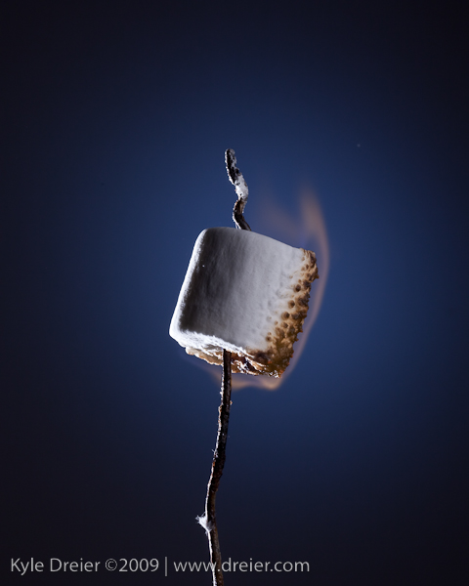
Chemical change
A chemical change has occurred, a new substance has formed.
Cannot be reversed

Slide 9
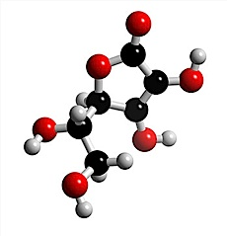
Chemical change
Chemical changes occur when a chemical reaction causes bonds between atoms to break or to form.

Slide 10
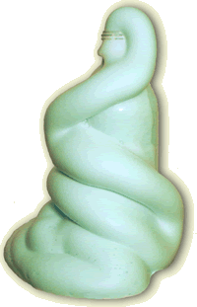
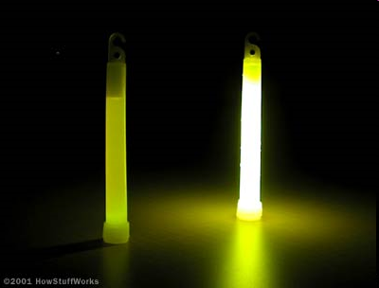
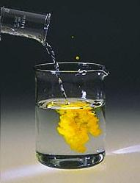
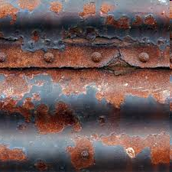
Chemical Change: Evidence
Evidence that a chemical change occurred include:
Seeing a change in colour
Smelling a gas or seeing bubbles
Releasing heat
Releasing light

Slide 11
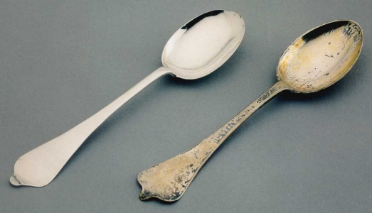
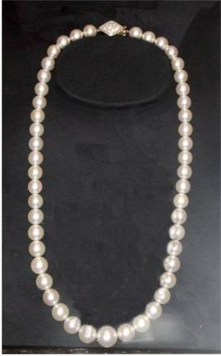
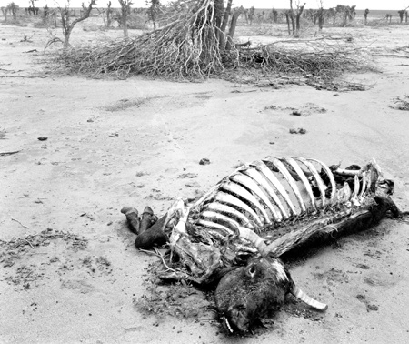
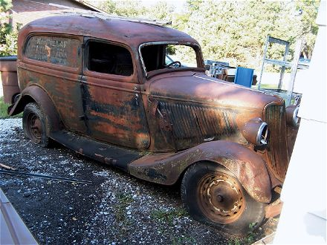
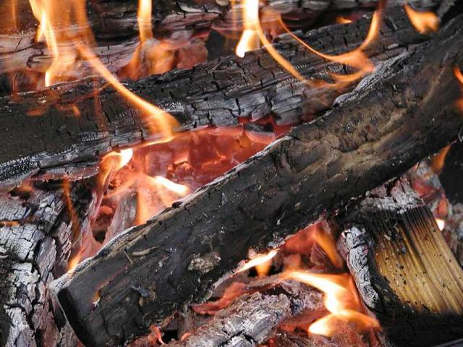
Chemical change
Examples of chemical changes include:
Burning
Rusting
Decomposing
Digestion

Slide 12
Chemical changes Video
https://www.youtube.com/watch?v=37pir0ej_SE

Slide 13
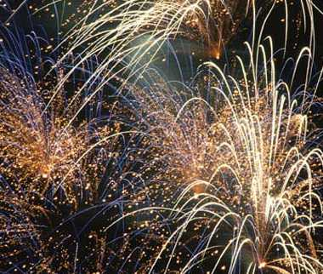
What type of reaction is most likely occurring here?
How do you know?

Slide 14
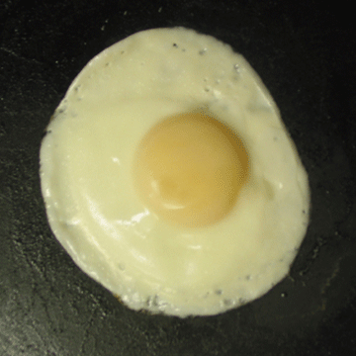
What type of reaction is most likely occurring here?
How do you know?

Slide 15
Chemical reaction equations

Slide 16
Chemical Equations
Chemical reactions are represented by chemical equations.
A chemical equation describes exactly what happens in a chemical reaction.
A chemical equation shows
Compounds before a chemical reaction takes place on the left (reactants) المتفاعلات
Compounds formed after the chemical reaction on the right (products).النواتج
Reactants → Products

Slide 17
Parts of a Chemical Reaction
Reactants  Products
Reactants: Substances that are broken down by the chemical change.
Products: Substances created by the chemical change.
 Means “Yields”
Notes:
17

Slide 18
Reactants and Products
In a chemical reaction we start with one set of chemicals called the reactants, a reaction happens and we end up with another set, called the products.
Example: when hydrogen and oxygen are reacted together, they form water
Hydrogen + oxygen → water
Example: when hydrogen and oxygen are reacted together they form water.
Reactants | Products
Hydrogen Oxygen | Water

