Slide 1
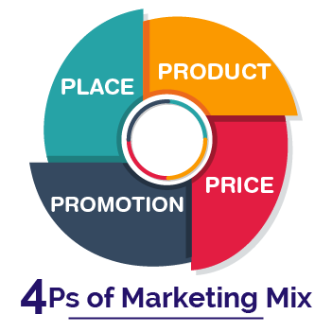
The marketing mix (4Ps)
The four elements of the marketing mix
Product
Price
Promotion
Place

Slide 2
The marketing mix
The marketing mix is a term which is used to describe all the activities which go into marketing a product or service.
These activities are often summarized as the four Ps
product, price, place and promotion

Slide 3
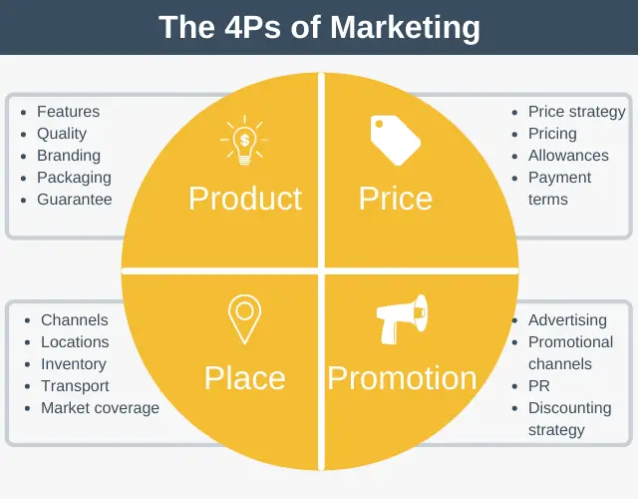

Slide 4
Product
This applies to the good or service itself - its design, features and quality. How does the product compare with competitors' products?
Does the packaging of the good help customers identify it? If it is a service being offered, do customers receive a clearly better service than rivals offer.
The product itself is the most important element in the marketing mix- without a product that meets customer needs, the rest of the marketing mix is unable to achieve marketing success.

Slide 5
Types of products
There are several types of product. Some products are sold to consumers and some can be sold to other businesses (that is, to other producers)
Products are usually grouped into the following types:
Consumer goods :These are goods which are bought by consumers for their own use.
They can be goods that do not last long, such as food and cleaning or Some goods last a relatively long time and give enjoyment over a long time, such as furniture and computers.
Consumer services: These are services that are bought by consumers for their own use. Examples include hairdressing and education.

Slide 6
Producer goods: These are goods that are produced for other businesses to use.
They are bought to help with the production process. Examples include trucks, machinery and components.
Producer services: These are services that are produced to help other businesses.
Examples include accounting, insurance and advertising agencies.

Slide 7
What makes a product successful
Satisfies existing needs and wants of consumers.
Capable of stimulating new wants from the consumer.
Not too expensive to produce (relative to the price that could be charged).
Has something very distinctive that makes it appear different.

Slide 8
Branding
Selling a product directly to the customer makes it easy to inform the customers of the product's qualities and good points.. Today, the manufacturers of most products do not sell directly to the customers products are sold to other businesses or retailers, who sell them on to the customer. This means that the product's unique features and the reasons for buying it must be conveyed in a different way.
This is done by creating a brand for the product. It will have a unique name, a brand name.
Brand name :
Is the unique name of a product that distinguishes it from other brands.
Brand loyalty :
Is when consumers keep buying the same brand again and again instead of choosing a competitor's brand.
Brand image :
Is an image or identity given to a product which gives it a personality of its own and distinguishes it from its competitors brands.

Slide 9
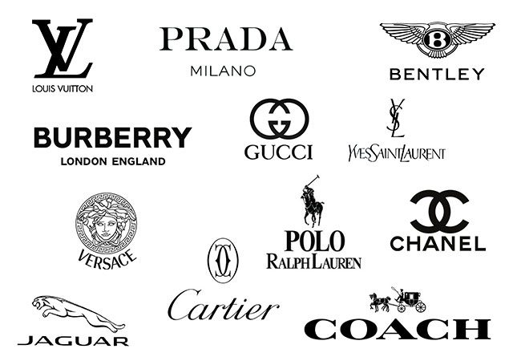
The importance of branding
Higher quality of than unbranded products.
Higher price than unbranded products .
Creates a brand image.
Encourages customers to keep buying it (brand loyalty)
Always of the same standard (assured quality).

Slide 10
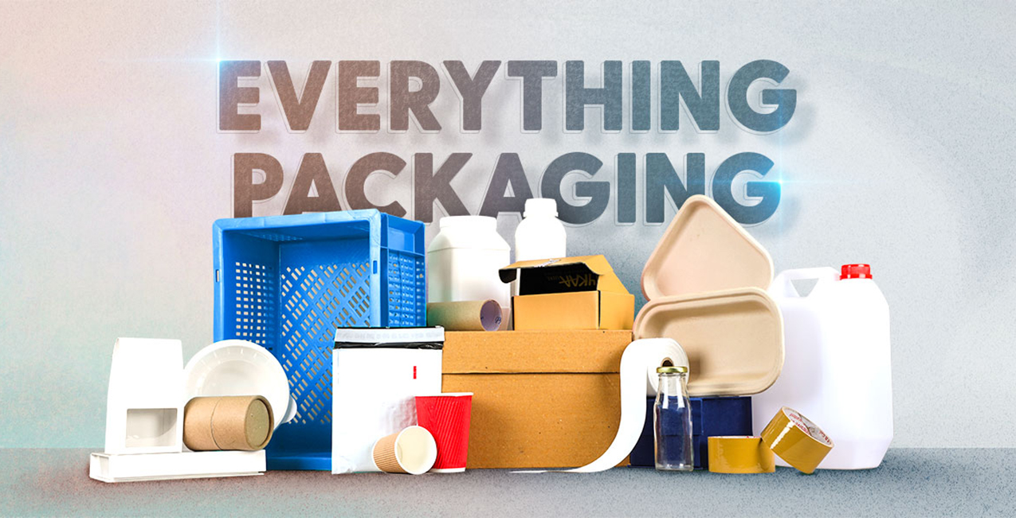
The role of packaging
Packaging : Is the physical container or wrapping for a product.it is also used for promotion and selling appeal.
The role of packaging :
Protects the product.
Easy to transport the product.
Suitable for the product to fit in .
Carries information about the product.
Promotes the brand image.

Slide 11
Price
The price at which the product is sold to the customer is a key part of the marketing mix. A comparison must be made with the prices of competitors products.
Price should in the long run ,cover costs.
The main methods of pricing :
Cost - plus pricing
Competitive pricing
Price skimming

Slide 12
Cost-plus pricing
Cost – plus pricing :
Is the cost the manufacturing the product plus a profit mark –up .
Mark - up refers to the amount added to the cost price of a product expressed as a percentage. it represents the profit that the company desires to earn on each unit sold .
For example, if a product costs $100 to produce and the desired profit margin is 20%, the markup would be $20 (20% x $100 = $20).
The selling price would then be set at $120 ($100 + $20 = $120).
Benefits
﻿﻿The method is easy to apply.
Limitations
﻿﻿Businesses could lose sales if the selling price is higher than competitors' prices.

Slide 13
Competitive pricing
Competitive pricing: is when the product is priced in line with or just below competitors' prices to try to capture more of the market.
Benefits
﻿﻿Sales are likely to be high as the price is at a realistic level and the product is not under- or over-priced.
Limitations
If the costs of production for a business are higher than those of competitors - perhaps because the product is of a higher quality - then a competitive price could lead to losses being made.

Slide 14
Price skimming
Price skimming: is where a high price is set for a new product on the market.
Benefits
﻿﻿Skimming can help to establish the product as being of good quality.
Limitations
The high price may discourage some potential customers from buying it.

Slide 15
Place
This refers to the channels of distribution that are selected .
A distribution channel is the means by which a product is passed from the place of production to the customer.
Distribution channels
1 DC --------------------------------------------------------------------------------------------
2DC --------------------------- -----------------------------------
3DC ------------ -------------------------------------------------------
4DC ----------------------------------------------------------------------------------------------------------
Producer
customer
Producer
Retailer
customer
Producer
wholesaler
Retailer
Customer
Producer
Agent
Wholesaler
Retailer
customer

Slide 16
Definitions to learn
Producer :is someone or business who creates and supplies goods or services.
Retailer : a person or business that you purchase goods from.
Retailers typically don't manufacture their own items. They purchase goods from a manufacturer or a wholesaler and sell these goods to consumers in small quantities.
Wholesaler: a person or company that sells goods in large quantities at low prices, typically to retailers.
Agent : a person or business that has been legally empowered to act on behalf of another person or an entity.

Slide 17
Distribution Channels
Advantages - Disadvantages
Channel 1 (Direct to consumers )
Advantages :
Products can be sold by mail order (catalogue ) or via internet.
Disadvantages:
It can be very expensive to send products by post.
Channel 2 (using a retailer as the only intermediary )
Advantages :
Producers sells large quantities to retailers.
Disadvantages :
No direct contact with customers.

Slide 18
Channel 3 (using a wholesaler and retailer as intermediaries )
Advantages:
Wholesaler can give advice to small retailers , also the manufacturer about what is selling well.
Disadvantages:
May be more expensive for a small shop to buy from a wholesaler than if its bought straight from the manufacturer .
Channel 4 (using an additional intermediary such as an agent)
Advantages:
Manufacturer may not know the best way to sell the product in another market.
Disadvantages:
The producer has less control over the way the product is sold to customers.

Slide 19
Promotion
Refers to the efforts used to raise awareness and interest in a product ,service or brand to increase sales and brand loyalty.
Promotion
Advertising
Sales promotion
Public relations-Sponsorship

Slide 20
Types of advertising media
Advertising media | Advantages | Disadvantages | Examples of suitable products /services to advertise using this method
Television | The advert will go out to million of people | Very expensive form of advertising | Food products and drinks that are bought by most people
billboards | They are potentially seen by everyone who passes them | No detailed information can be included in the advert | Local events
Digital advertising(internet) | A large amount of information can be placed on a website. | There is a lot of competition from other websites | Products that customers are familiar with(books electrical goods /fashion clothes)

Slide 21
Sales promotion
Sales promotions are incentives such as special offers or deals aimed at consumers to achieve short term increases in sale.
Different types of sales promotion :
After –sales service : with expensive products like cars or computers , providing an after sales service can be a way of encouraging customers to buy it .
Example :warranty
Gifts: sometimes small gifts are placed in the packing of a product to encourage the customers to buy it.
Free samples :This is most commonly used with products like food, shampoo and cleaning products. A free sample can be handed out in the shop to encourage the customer to try the product and hopefully buy it.

Slide 22
Public relations /sponsorship
This is concerned with promoting a good image for the business and/or its products.
Public relations can take many forms, from sponsoring events such as football matches, Another example is where companies donate some of their products to charity - for relief when there has been a natural disaster.
All these types of activity raise the public's awareness of the company and its products, and increase the likelihood of their choosing its products over its competitors.

Slide 23


