Slide 1
Sizzling Science

Slide 2
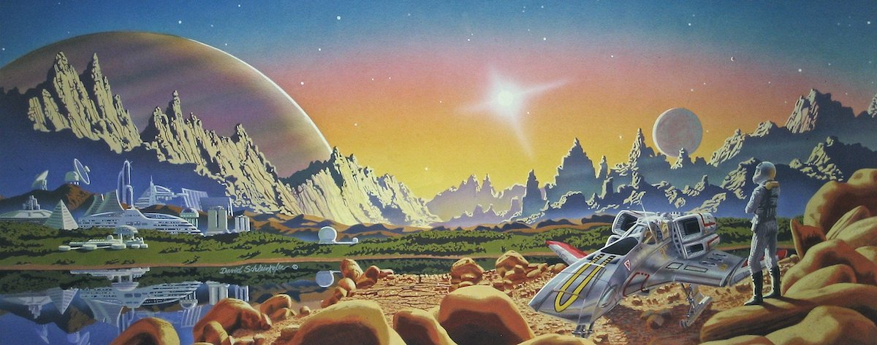
What is science fiction?

Slide 3
fiction based on imagined future scientific or technological advances and major social or environmental changes, frequently portraying space or time travel and life on other planets.

Slide 4
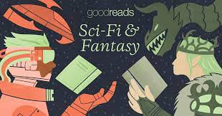
What is the difference between “Science Fiction” and “Fantasy”?

Slide 5
The main difference between fantasy and science fiction is that fantasy deals with the impossible, whereas science fiction deals with the possible. Fantasy features magic and monsters, the realm of the imagination, and science fiction is grounded in scientific principles.

Slide 6

Thinking time p.103

Slide 7
Why is a good imagination important when writing a science fiction story?

Slide 8
Science fiction writers need to place themselves in one of two locations or dimensions - the future or somewhere else in the universe. And these dimensions have to be imagined.

Slide 9
Think of Five inventions used today that would have been considered science fiction 100 year ago.

Slide 10
Smartphones, interactive game playing modules, microwaves and ovens.

Slide 11
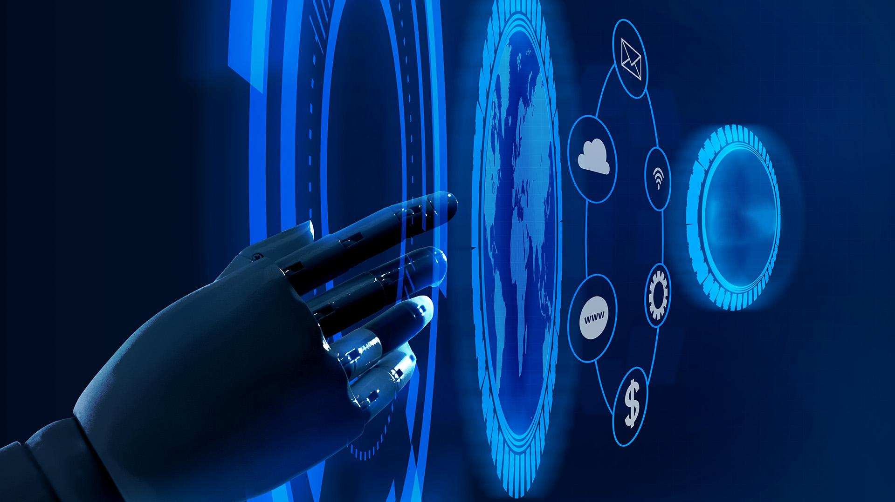
What is a genre?

Slide 12
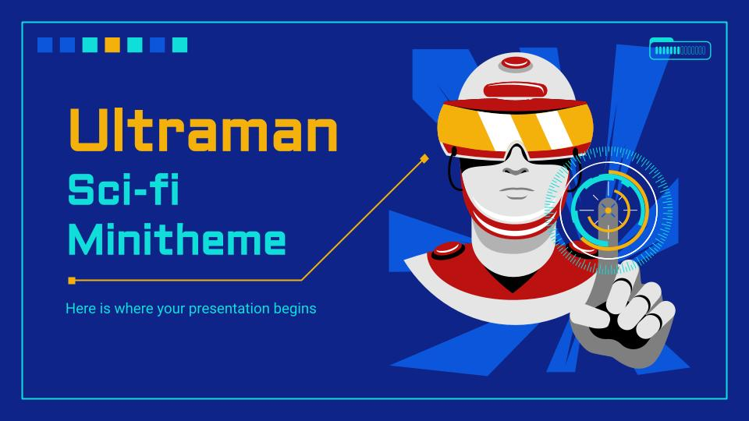
A particular kind or style of art or literature.

Slide 13
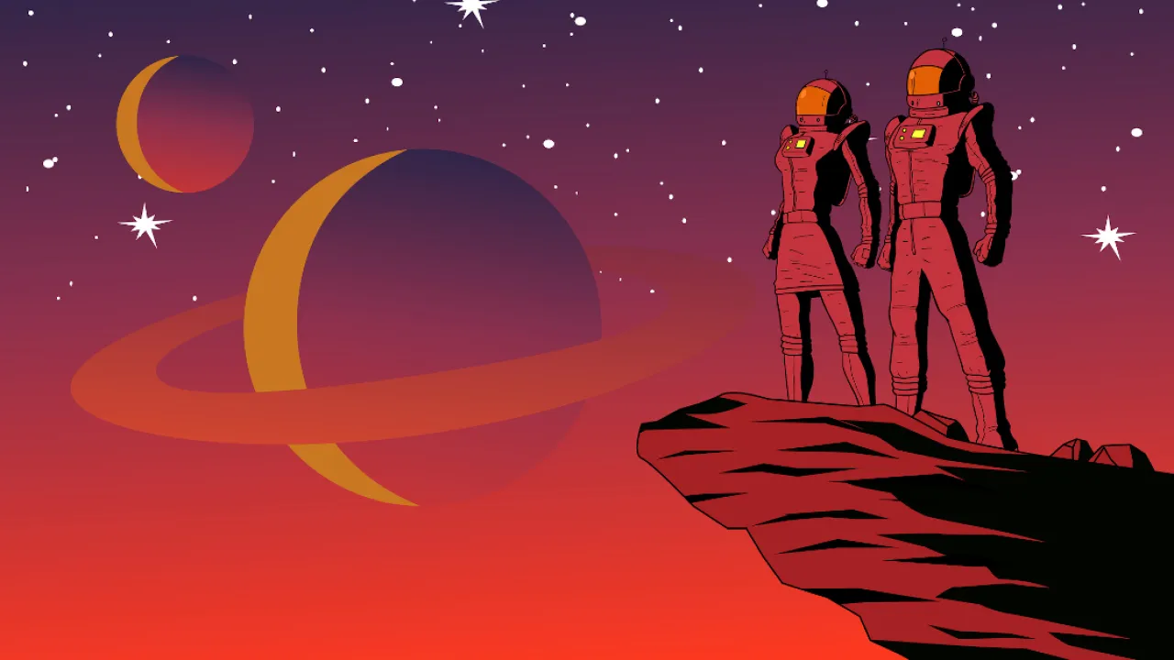
Features of Science Fiction Genre

Slide 14
Advanced technology not available today

Slide 15
Set in an alternative past
fiction that is based on history and that explores what might have happened if certain historical events, figures, etc., had been different.

Slide 16
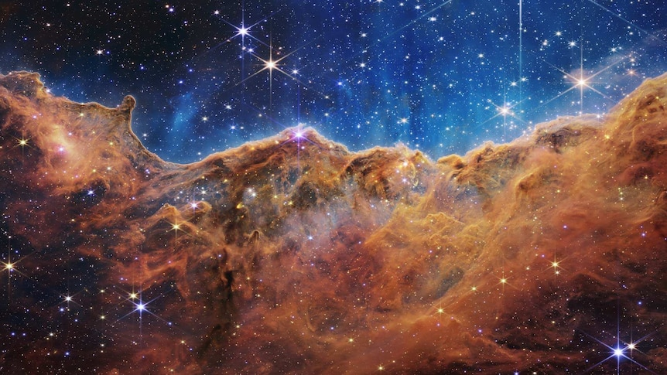
Voyages through space

Slide 17
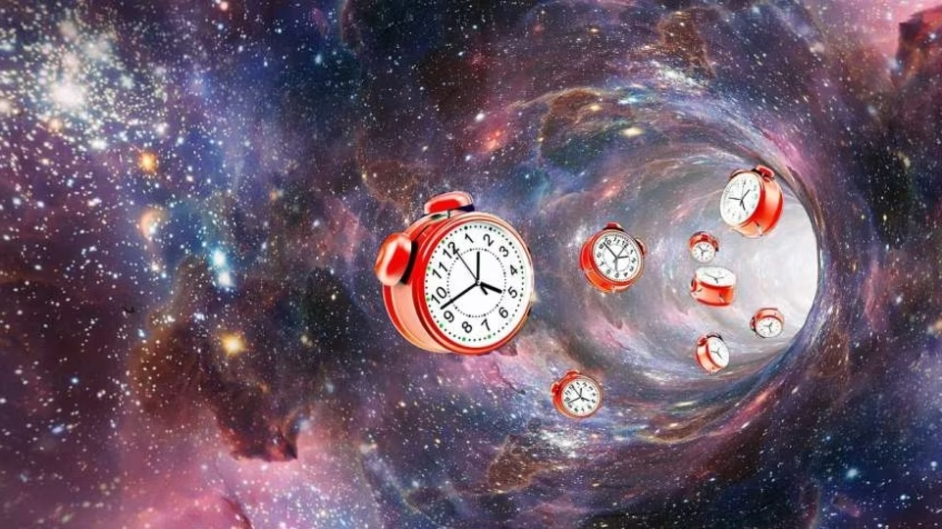
Time travel

Slide 18
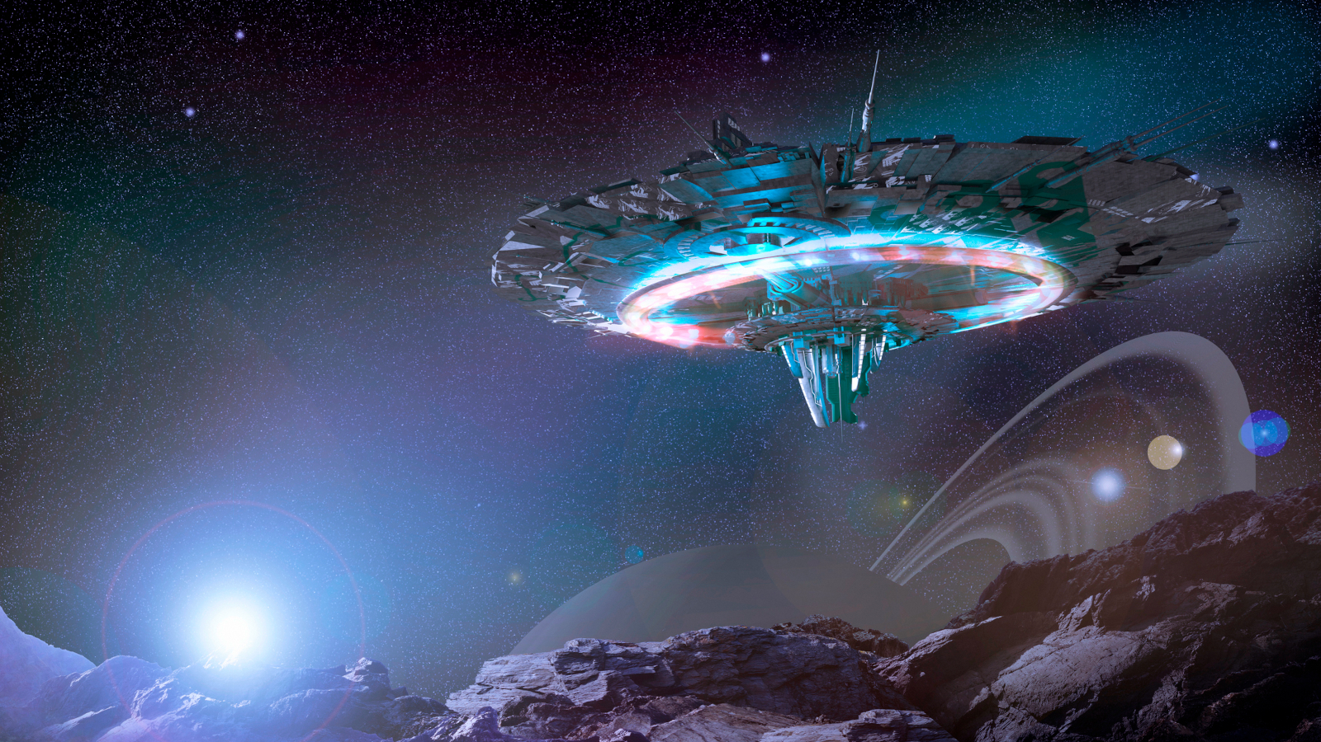
spaceships

Slide 19
Set in the future

Slide 20
Other galaxies

Slide 21
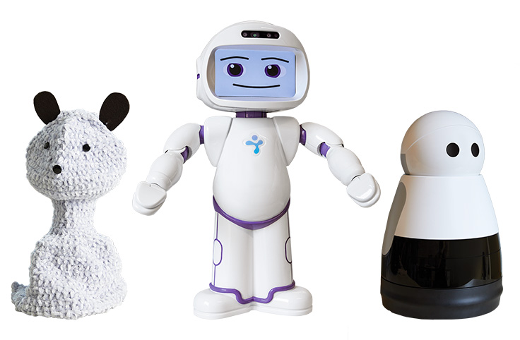
Robots

Slide 22
Set on an alien planet

Slide 23
Travel through dimensions

Slide 24
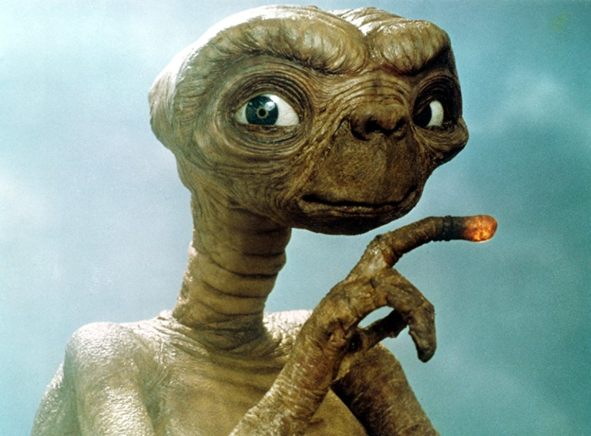
Aliens

Slide 25
Futuristic cities

Slide 26
Set in a post - apocalyptic world
destruction of the world.

