Slide 1
Disclaimer/s
We hope you find the information on our website and resources useful.
Animations
This resource has been designed with animations to make it as fun and engaging as possible. To view the content in the correct formatting, please view the PowerPoint in ‘slide show mode’. This takes you from desktop to presentation mode. If you view the slides out of ‘slide show mode’, you may find that some of the text and images overlap each other and/or are difficult to read.
To enter slide show mode, go to the slide show menu tab and select either from beginning or from current slide.
You may wish to delete this slide before beginning the presentation.

Slide 3
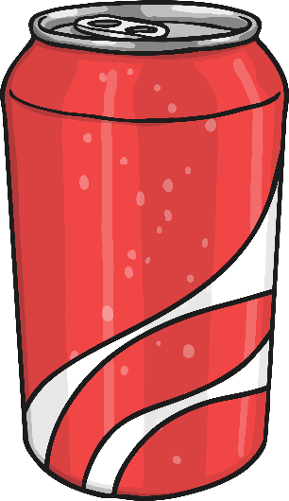
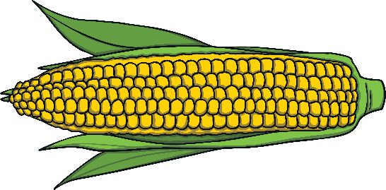
What is a compound word?
A compound word is two or more words used together to make a different word with its own meaning. This is sometimes called a compound noun.
Let’s see an example:
pop
+
corn
=
popcorn

Slide 4
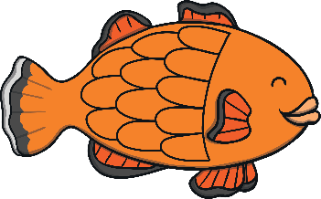
rainbow
Which two words make this compound word?
+
rain + bow = rainbow

Slide 5
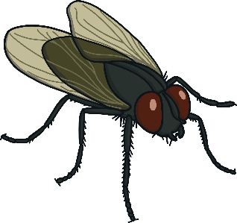
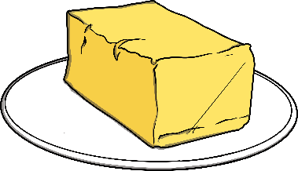
butterfly
Which two words make this compound word?
+
butter + fly = butterfly

Slide 6
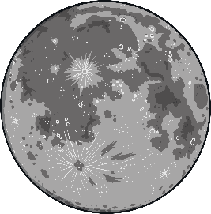
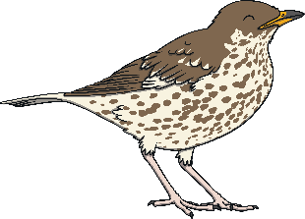
starfish
Which two words make this compound word?
+
star + fish = starfish

Slide 7
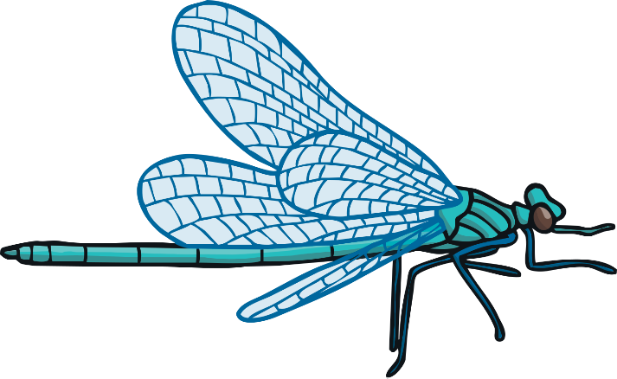
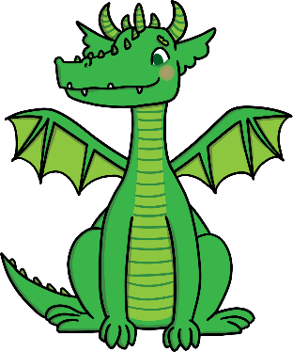
dragonfly
Which two words make this compound word?
+
dragon + fly = dragonfly

Slide 8
pancake
Which two words make this compound word?
+
pan + cake = pancake

Slide 9
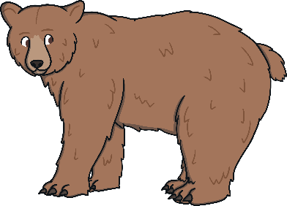
handbag
Which two words make this compound word?
+
hand + bag = handbag

Slide 10
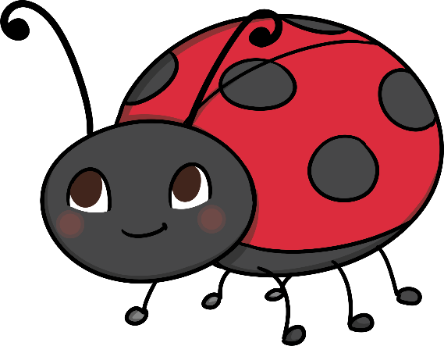
ladybird
Which two words make this compound word?
+
lady + bird = ladybird

Slide 11
snowman
Which two words make this compound word?
+
snow + man = snowman

Slide 12
Which compound word is made up of these words?
+
=
tooth + brush = toothbrush

Slide 13
Which compound word is made up of these words?
+
=
sun + flower = sunflower

Slide 14
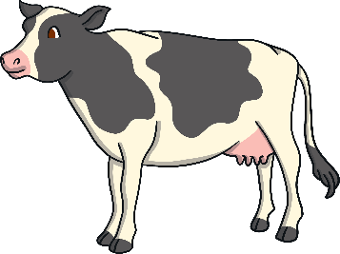
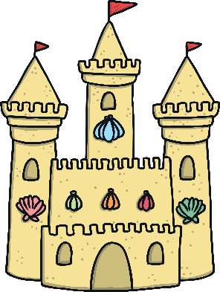
Which compound word is made up of these words?
+
=
cow + boy = cowboy

Slide 15
Can you remember which two words make up these compound words?
pan + cake = pancake
cow + boy = cowboy
snow + man = snowman
tooth + brush = toothbrush
rain + bow = rainbow
star + fish = starfish
lady + bird = ladybird

