Slide 1
Daily message
Today we are going to learn a new sound.

Slide 2
oo oo
. .

Slide 3
oo
.

Slide 4
Short /oo/

Slide 5
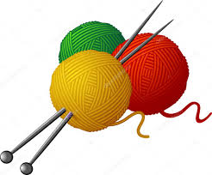
wool
. . .

Slide 6
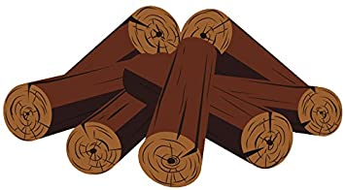
wood
. . .

Slide 7
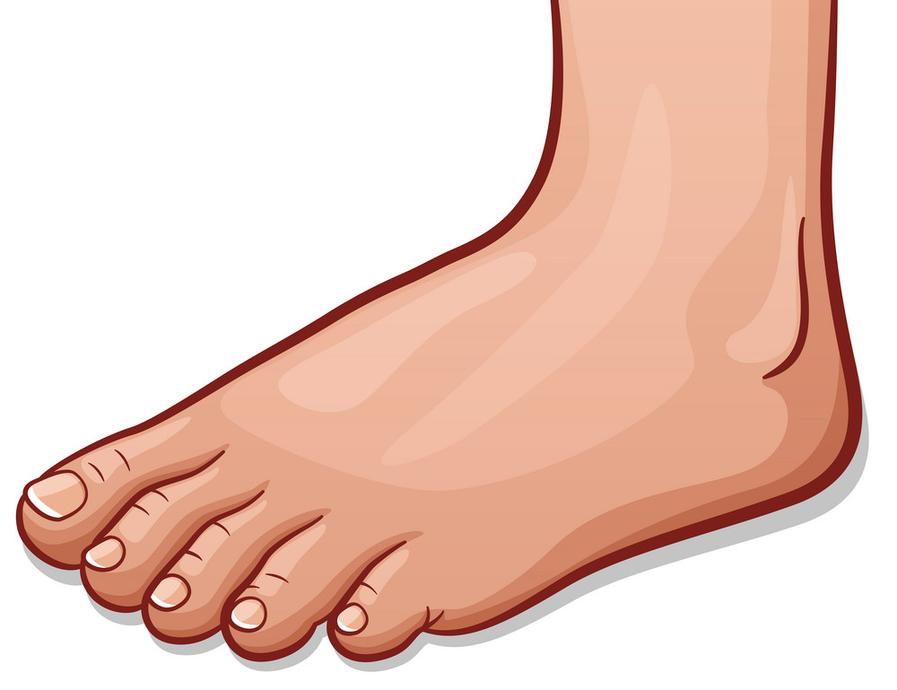
foot
. . .

Slide 8
book
. . .

Slide 9
hook
. . .

Slide 10
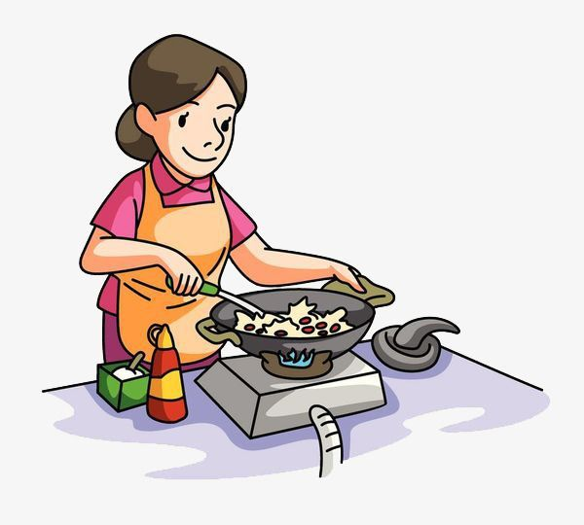
cook
. . .

Slide 11
oo
.

Slide 12
Long oo

Slide 13
moon
. . .

Slide 14
zoo
. .

Slide 15
boot
. . .

Slide 16
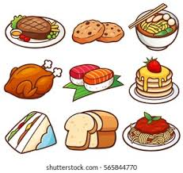
food
. . .

Slide 17
pool . . .

Slide 18
roots
. . .

Slide 19
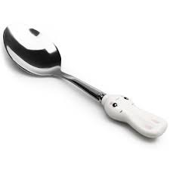
spoon
. . . .

Slide 20
room
. . .

Slide 21
scoop
. . . .

Slide 22
look
. . .

Slide 23
zoom
. . .

Slide 24
bloom
. . . .

Slide 25
book
. . .

Slide 26
good
. . .

Slide 27
noon
. . .

Slide 28
stood
. . . .

Slide 29
soon
. . .

Slide 30
took
. . .

Slide 31
broom
. . . .

Slide 32
wool
. . .

Slide 33
tool
. . .

Slide 34
hoop
. . . .

Slide 35
hook
. . .

Slide 36
cool
. . .

Slide 38
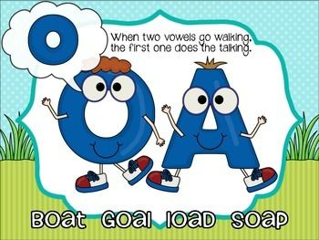

Slide 39
i
i
i
i
i
i
i
i
i

Slide 40
ee or
. .

Slide 41
aid
. .

Slide 42
aim
. .

Slide 43
nail
. . .

Slide 44
rain
. . .

Slide 46
soap
. . .

Slide 47
loaf
. . .

Slide 48
toad
. . .

Slide 49
goal
. . .

Slide 50
tie
. .

Slide 51
pie
. .

Slide 52
dried
. . . .

Slide 53
lied . . .

Slide 54
speed
. . . .

Slide 55
greed
. . . .

Slide 56
sport
. . . .

Slide 57
storm
.. . .

