Slide 1
Unit 5: Area and volume

Slide 2
Units of area.
You have to know that:
$1 {cm}^{2}=100 {mm}^{2}$
$1 m^{2}=10 000 {cm}^{2}$
$1 m^{2}=1 000 000{ mm}^{2}$
$1 km^{2}=1 000 000{ m}^{2}$
$1 ha=10 000{ m}^{2}$

Slide 3
To review watch the videos below:
https://www.youtube.com/watch?v=YdaWjrtHwWM
P.73, Ex 5A
Q1, 2, 3, 4, 5, 6

Slide 4
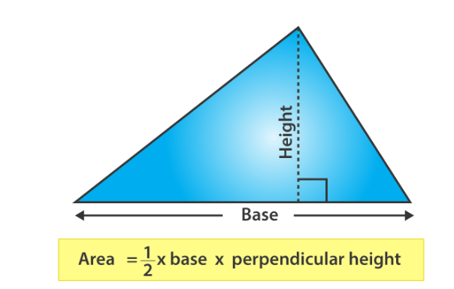
Areas of triangles.
A triangle is a closed shape that has three sides and three vertices.
The area of a triangle is defined as the total region that is enclosed by the three sides of any particular triangle.

Slide 5
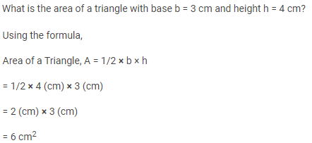
Example.

Slide 6
To review watch the video below:
https://www.youtube.com/watch?v=xCdxURXMdFY
https://www.youtube.com/watch?v=AImr5tpMKaE
P.75, Ex. 5B
Q1, 2, 3, 4, 5
P.77, Ex. 5C
Q1, 2, 3, 4, 5, 6, 7

Slide 7
The volume of the cuboid.
A cuboid is a 3-dimensional shape.

Slide 9
Note: the result is in m³ (cubic meters) because we have multiplied meters together three times.

Slide 10
To review watch the video below:
https://www.youtube.com/watch?v=J3MyJmgypUc
P.80, Ex 5E
Q1, 2, 3, 4 , 5 , 6 , 9

Slide 11
Surface area.
The area of the total surface of a solid is called its surface area.
For example, the surface area of a box is the sum of the area of its six rectangle faces.

Slide 12
The surface area of the cuboid.

Slide 13
The surface area of the cubes.

Slide 14
To review watch the video below:
https://www.youtube.com/watch?app=desktop&v=PhLc6B5WXtc
P.83, Ex 5E
Q1, 2, 3, 4

