Slide 1
Student Book 5N
Units 11+12
Answer Key

Slide 2
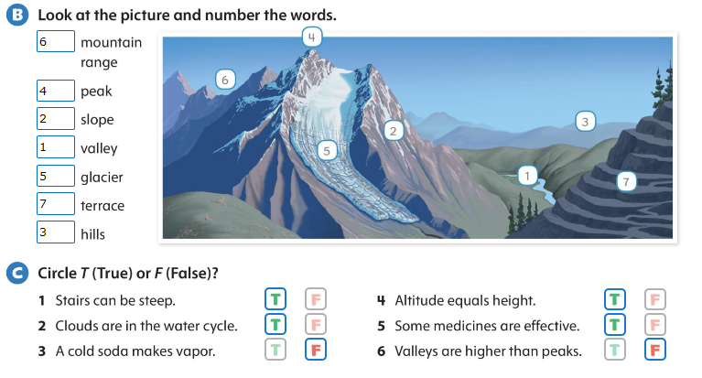

Slide 3
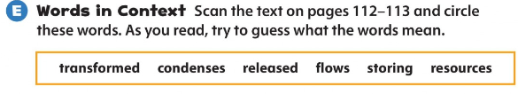
Page 111

Slide 4
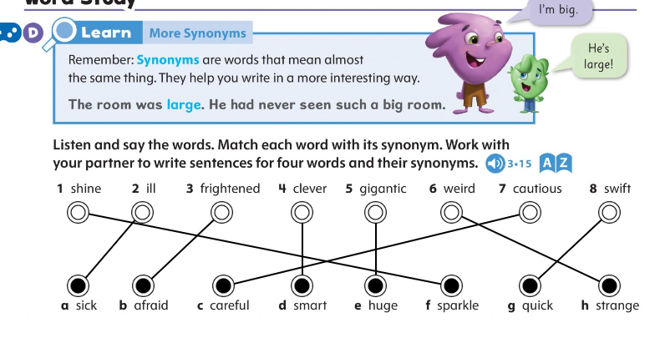
Page 125

Slide 5
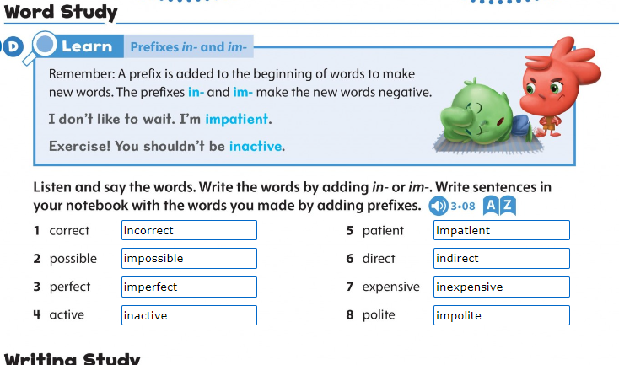
Page 117

