Slide 1
Oxford Discover 5
Grammar Book –Answer key
Units 11+12

Slide 2
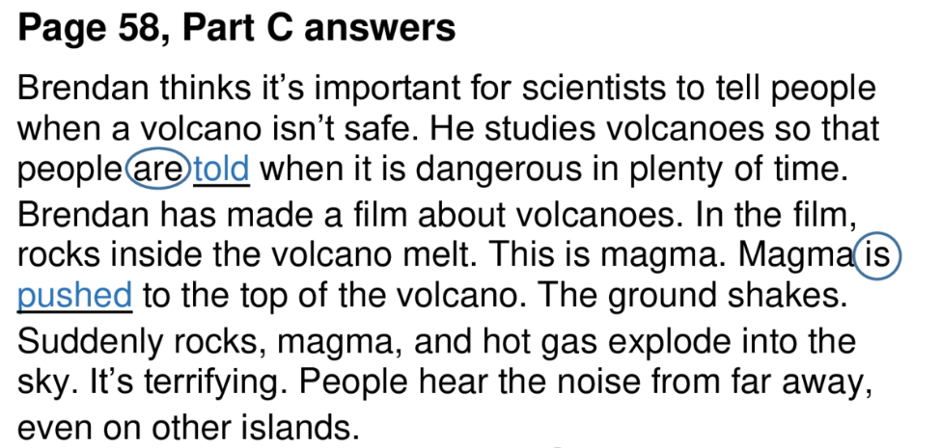
Page 58

Slide 3
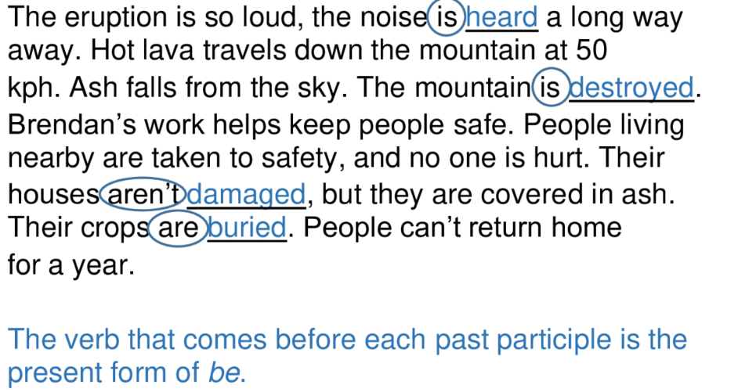
Page 58

Slide 4
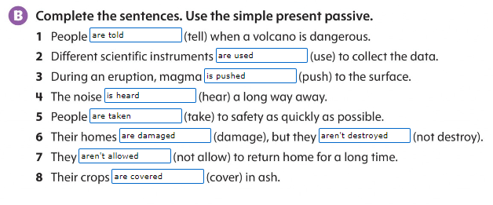
Page 59

Slide 5
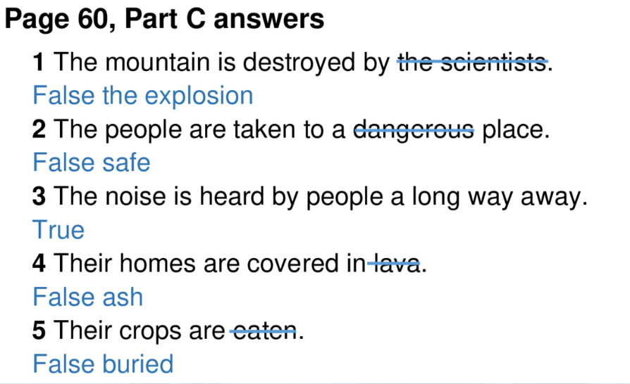
Page 60

Slide 6

Page 60

Slide 7
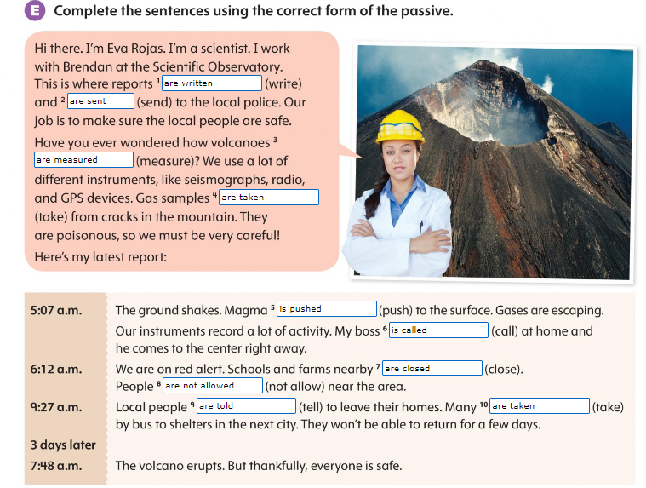
Page 60

Slide 8
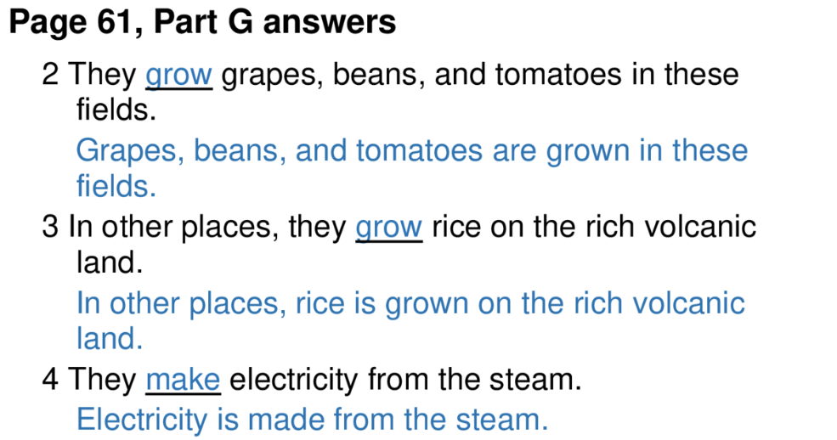
Page 61

Slide 9

Page 61

Slide 10
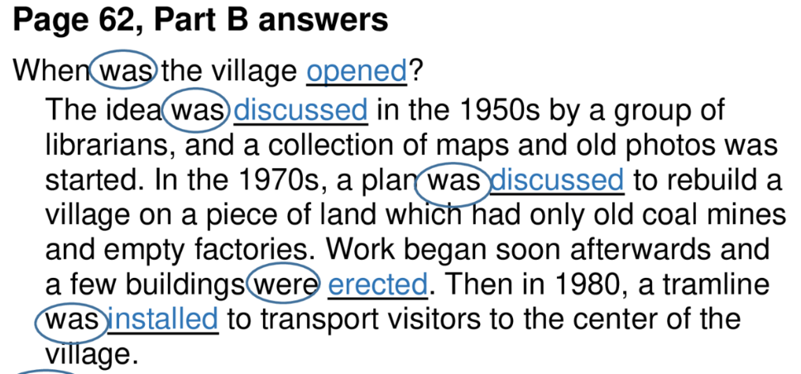
Page 62

Slide 11
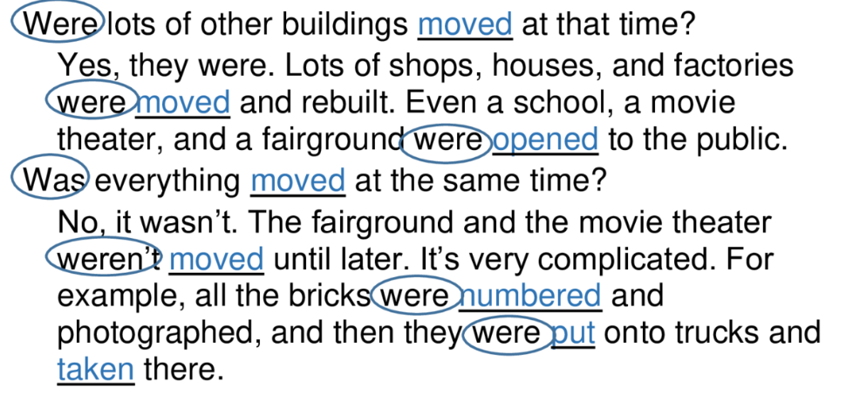

Slide 12
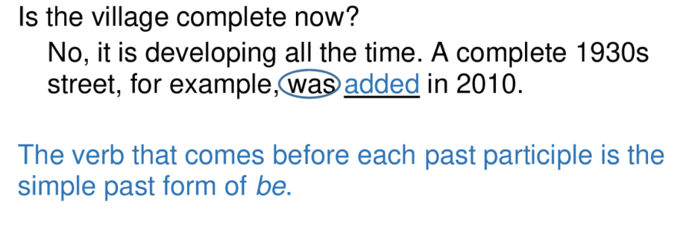

Slide 13
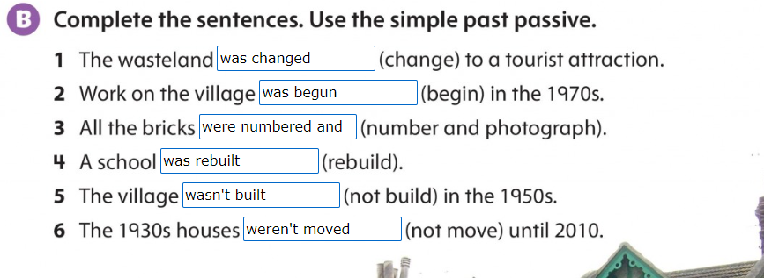
Page 63

Slide 14
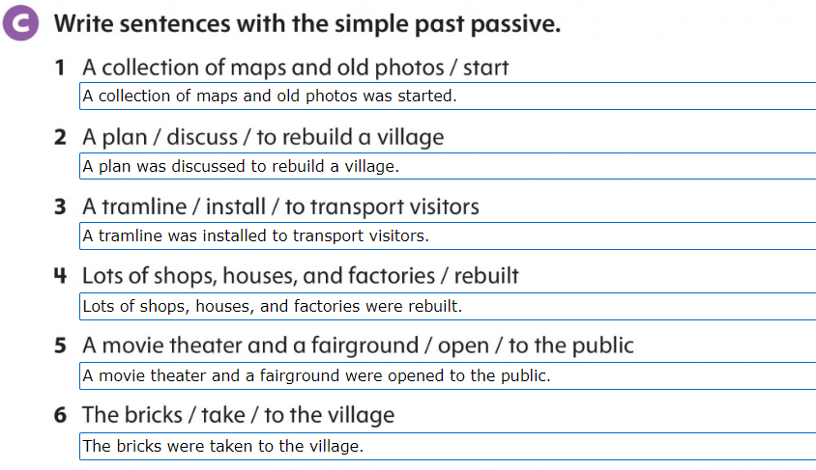
Page 64

Slide 15
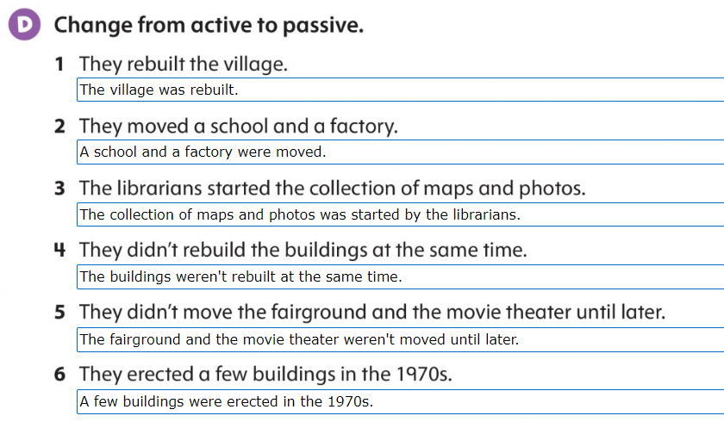
Page 64

Slide 16
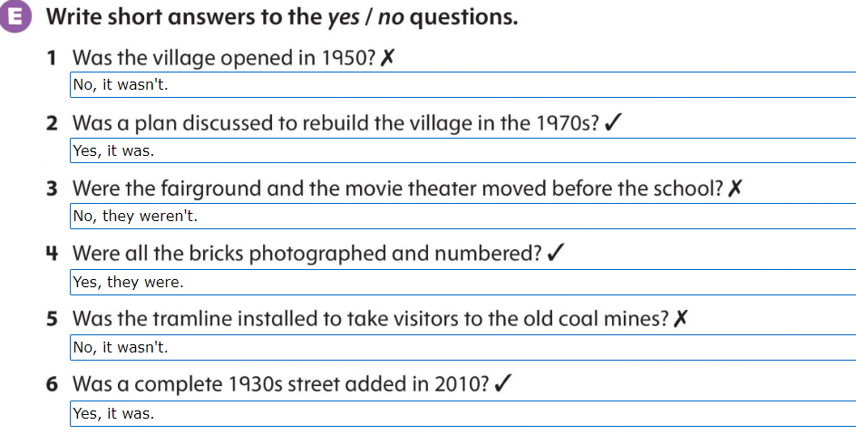
Page 64

Slide 17

Page 65

