Slide 1
Oxford Discover Workbook units 11+12
Final Material -Answer Key

Slide 2
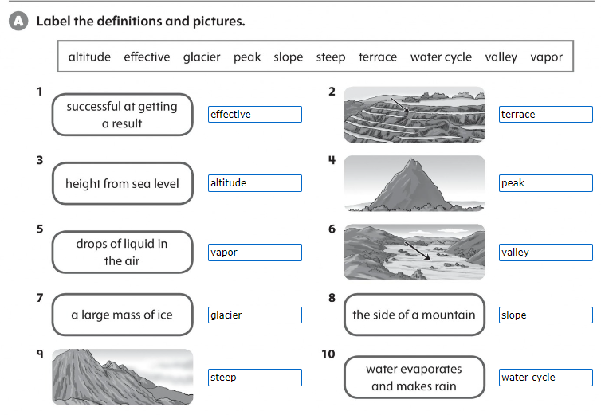
Page 102

Slide 3
Page 103

Slide 4
Page 103

Slide 5
Page 106

Slide 6
Page 107

Slide 7
Page 114

Slide 8
Page 114

Slide 9
Page 115

Slide 10
Page 117

Slide 11
Page 116

Slide 12
Page 108

