Slide 1
Cardinal and ordinal numbers
3rd
7th 0 2nd 4 4th 7
5 9th
I 9 6th 8th 2
6 1st 8 10th
5th
3

Slide 2
1
st

Slide 3
nd
2

Slide 4
rd
3

Slide 5
th
4

Slide 6

5

Slide 7
6

Slide 8
7

Slide 9
8

Slide 10
9

Slide 11
10

Slide 12

1st
2nd
3rd
4th
5th
6th
7th

Slide 13


Slide 14

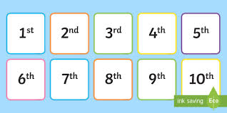
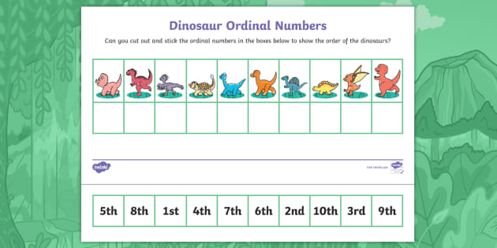
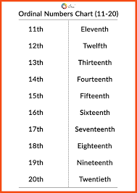

Slide 15
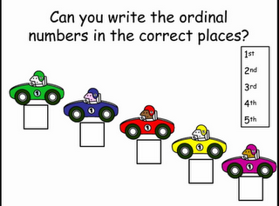
1st
2nd
3rd
4th
5th

Slide 16
