Slide 1


Slide 2
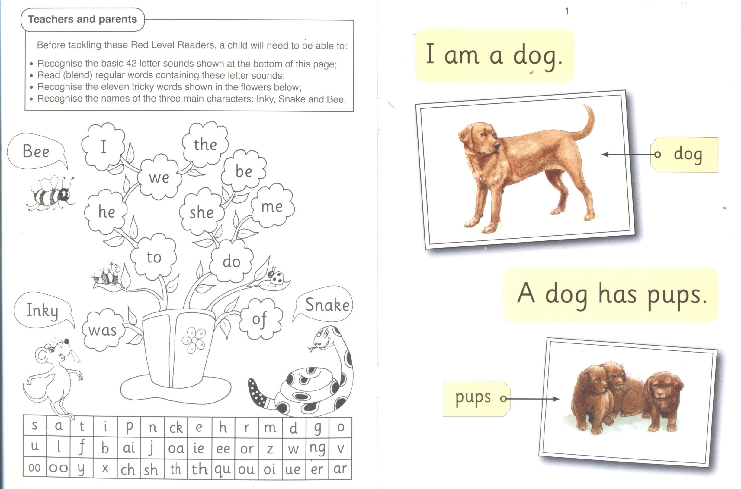

Slide 3
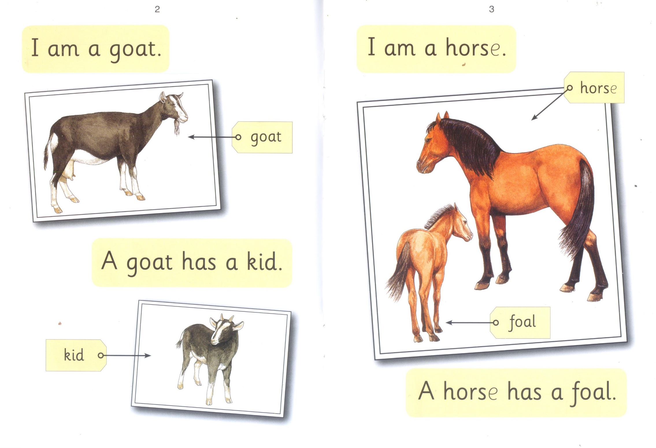

Slide 4


Slide 5
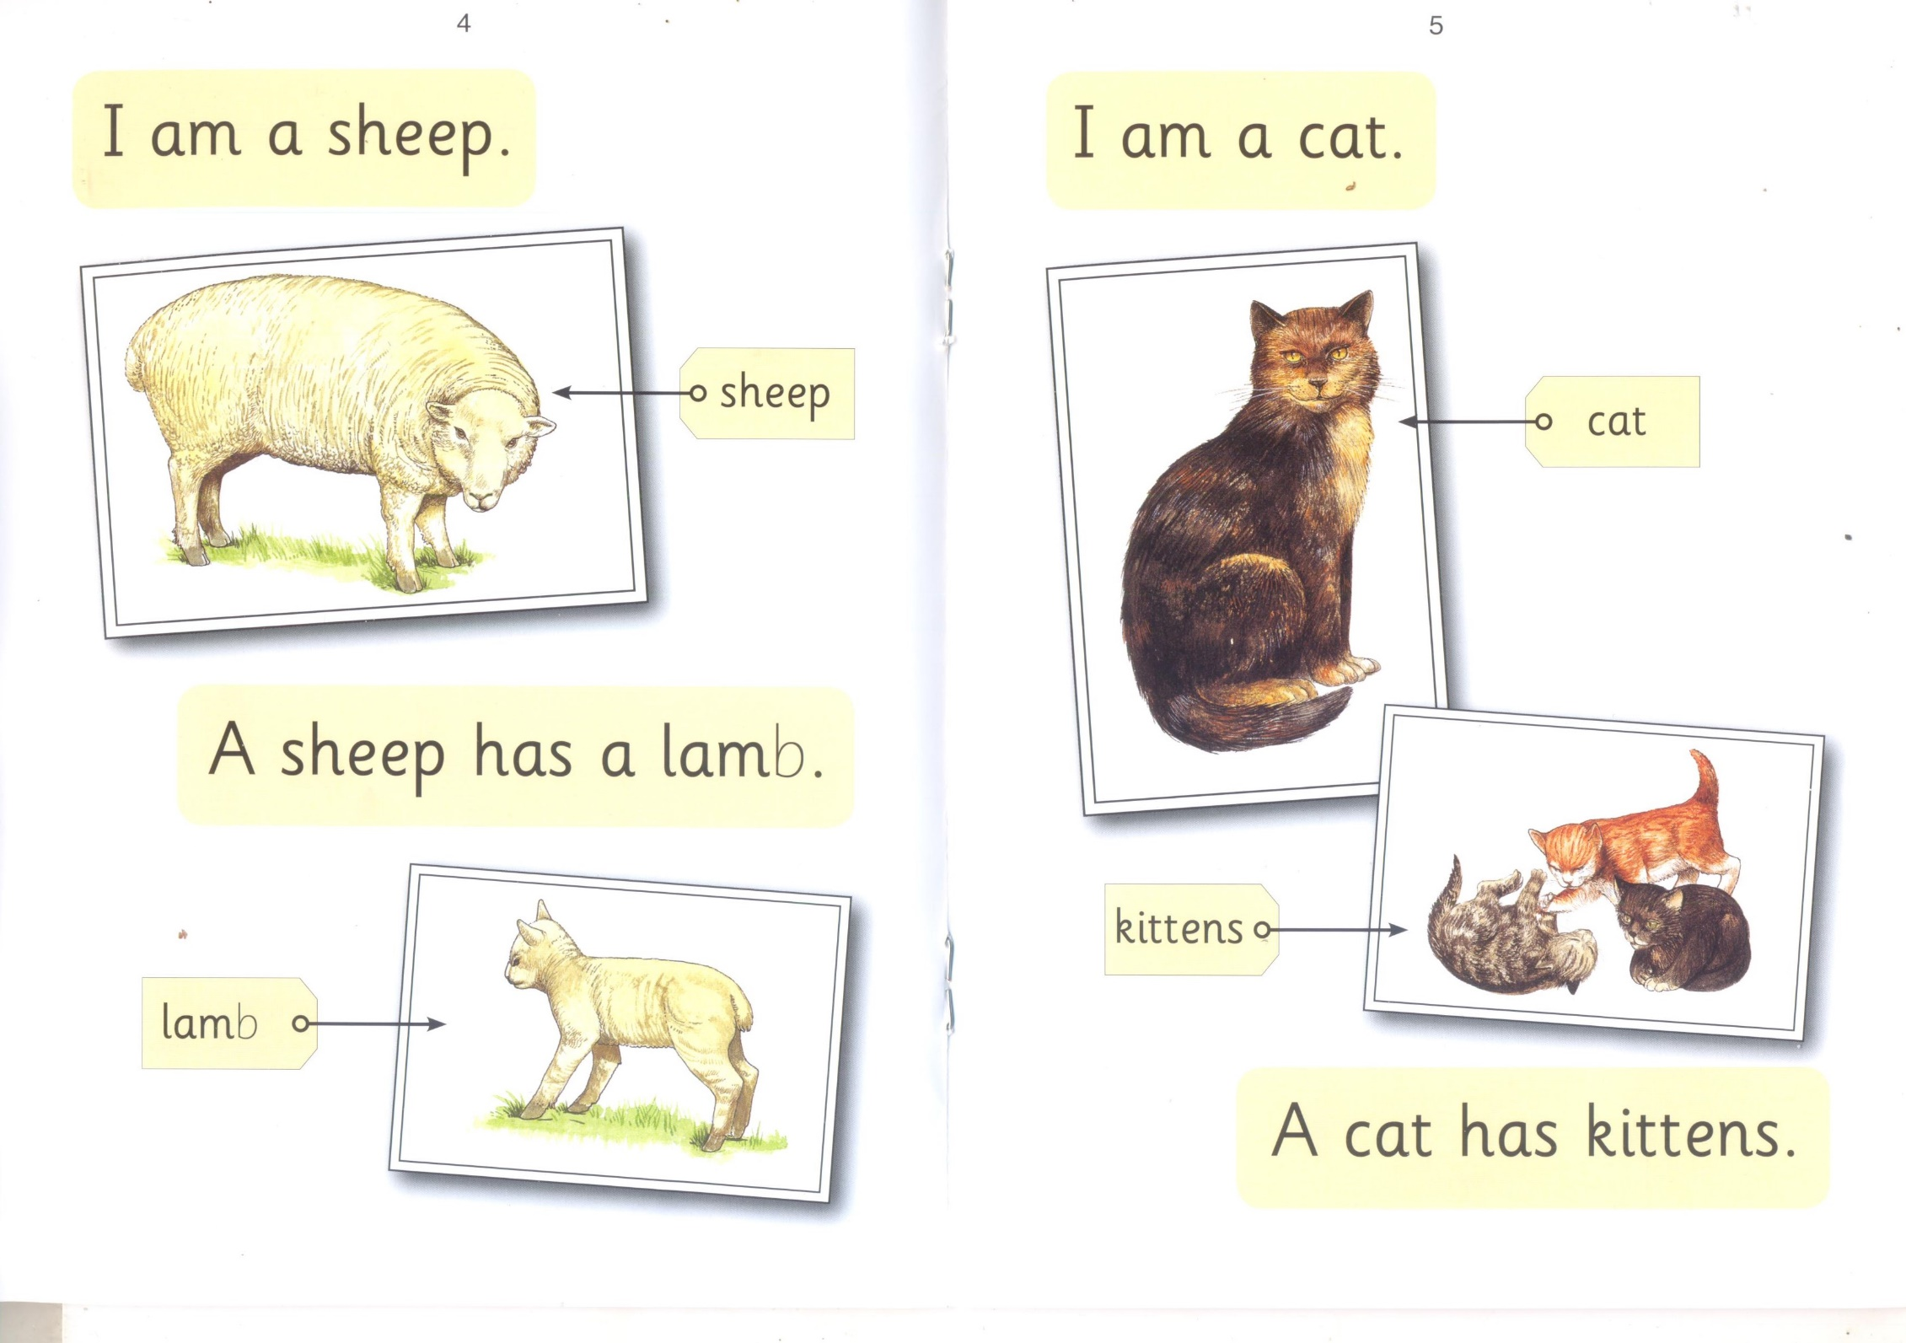

Slide 6


Slide 7
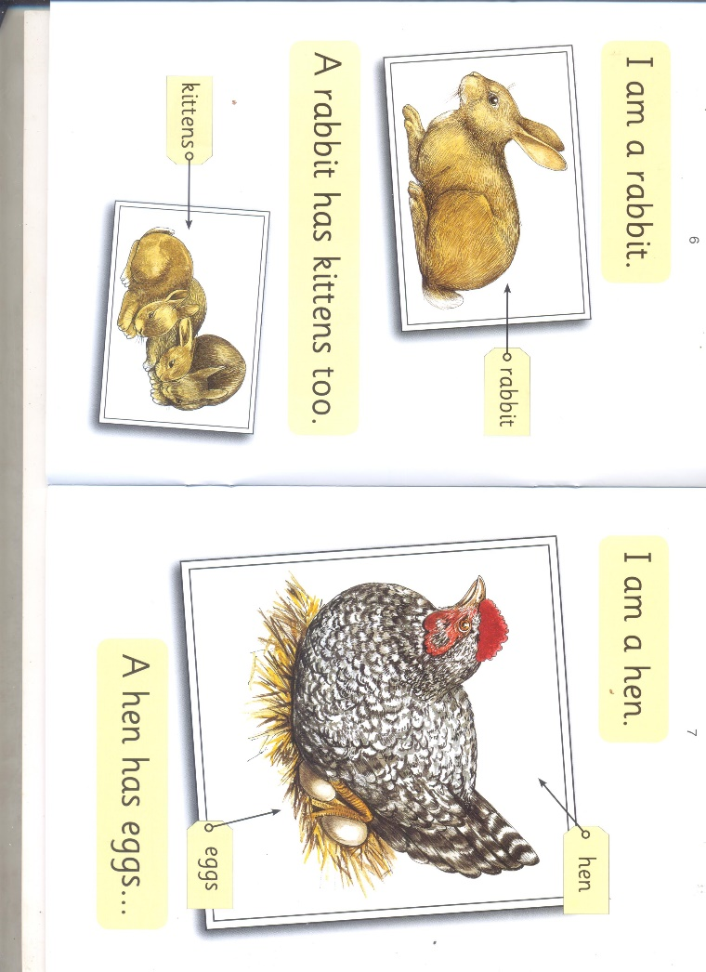

Slide 8
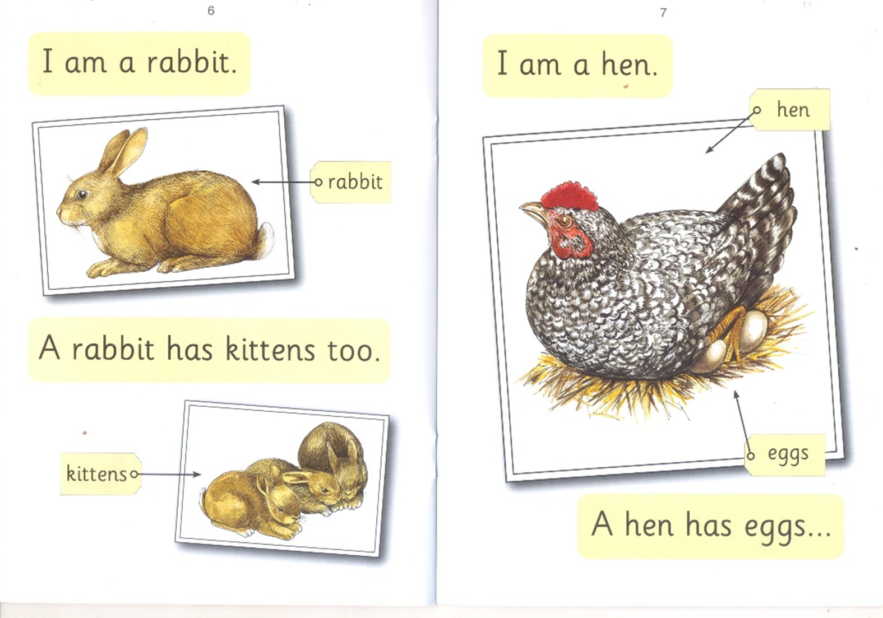

Slide 9
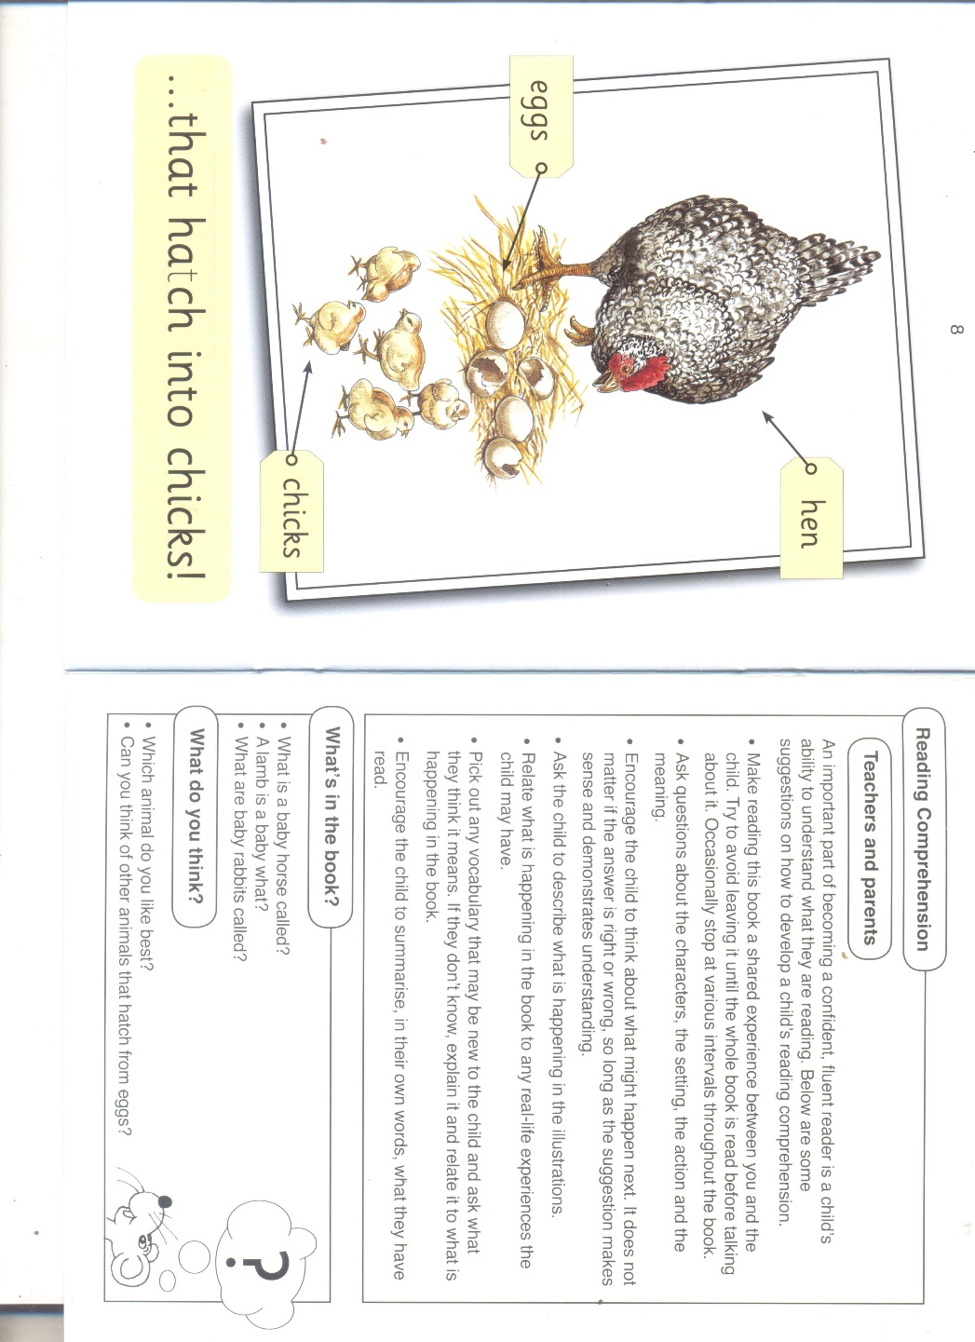

Slide 10
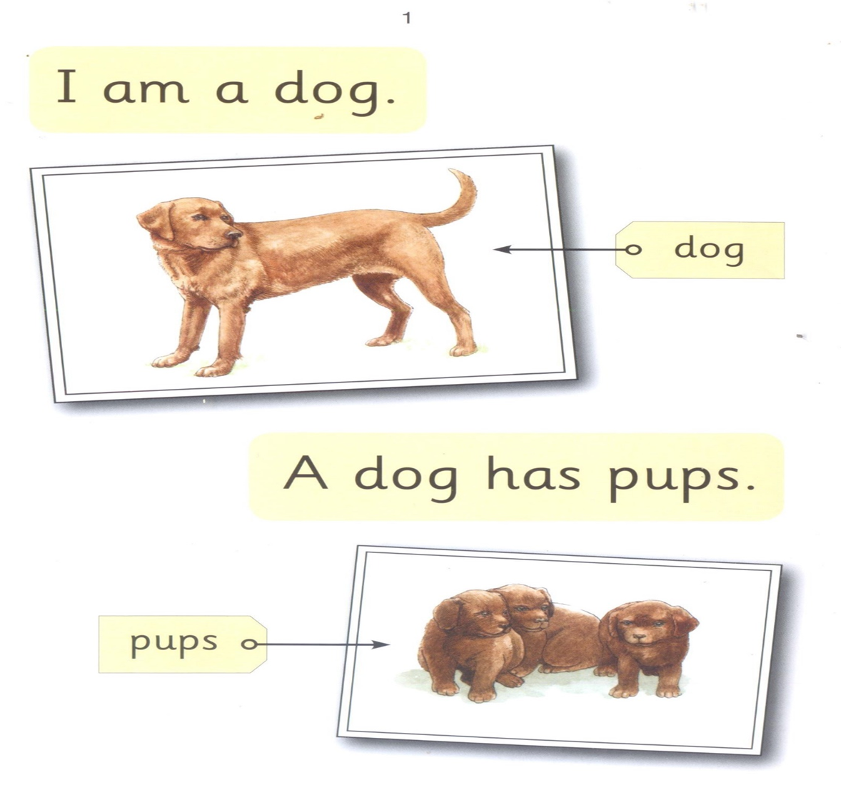

dog puppy
l 2

Slide 11



Slide 12
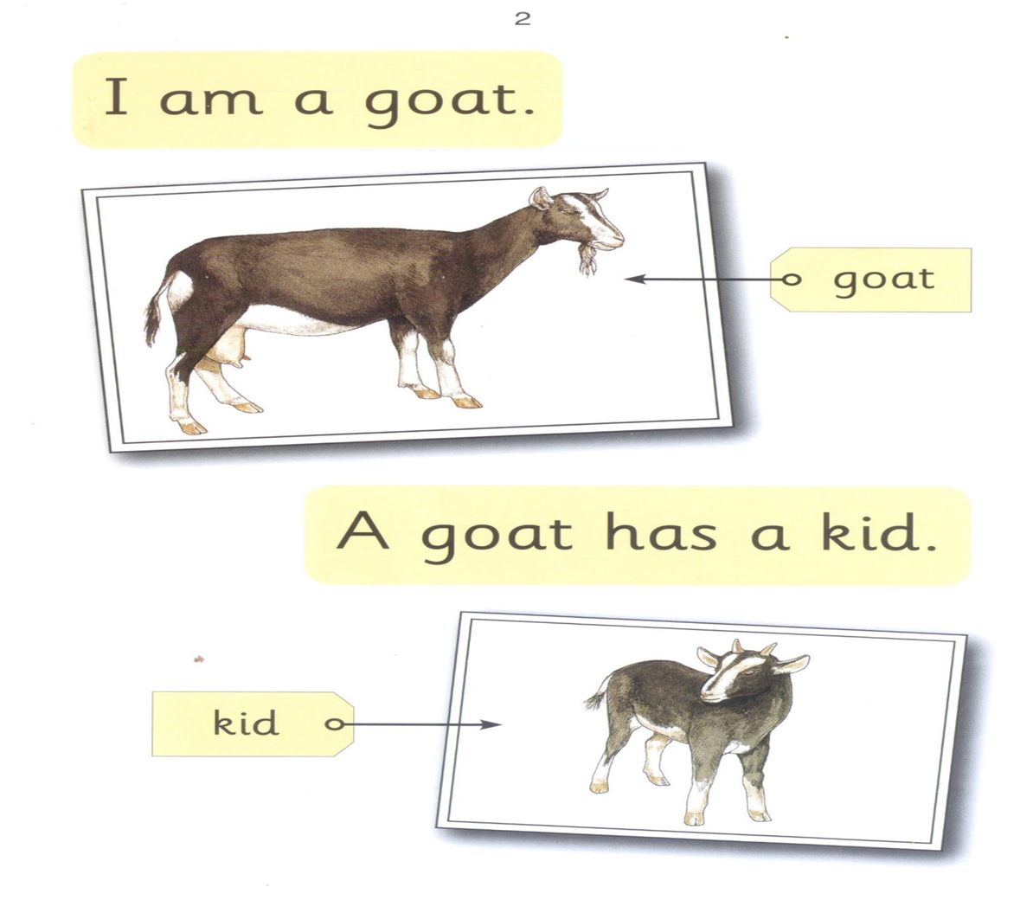

dog goat
l 2

Slide 13

kid goat
l 2

Slide 14
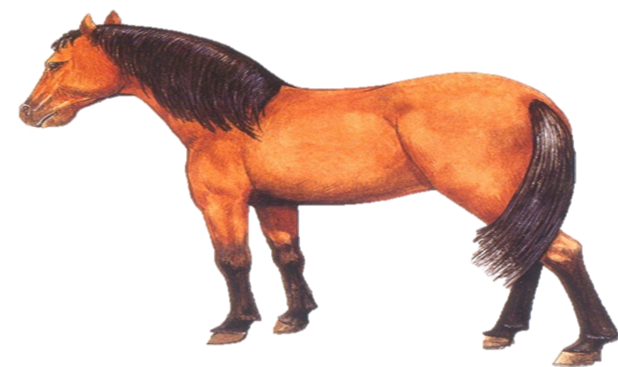

horse goat
l 2

Slide 15
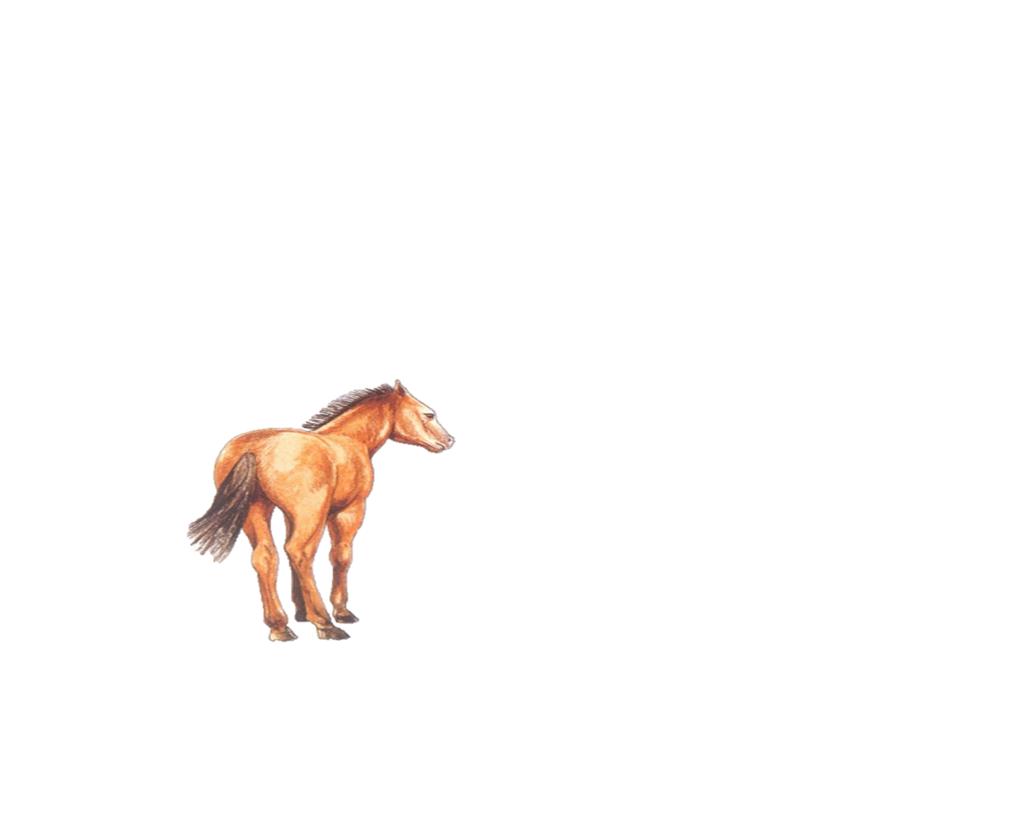

horse foal
l 2

Slide 16
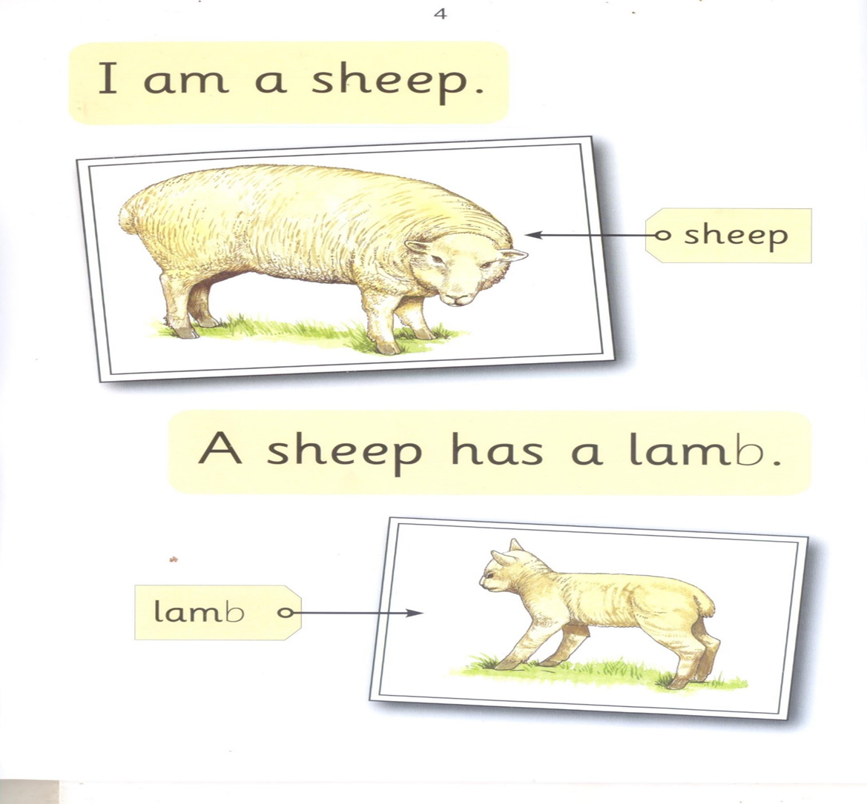

sheep foal
l 2

Slide 17

sheep lamb
l 2

Slide 18
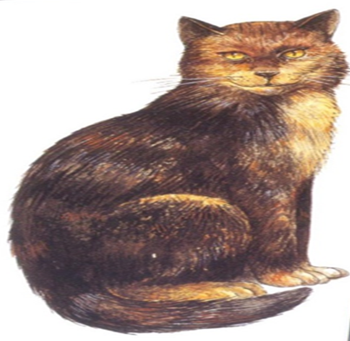

lamb cat
l 2

Slide 19
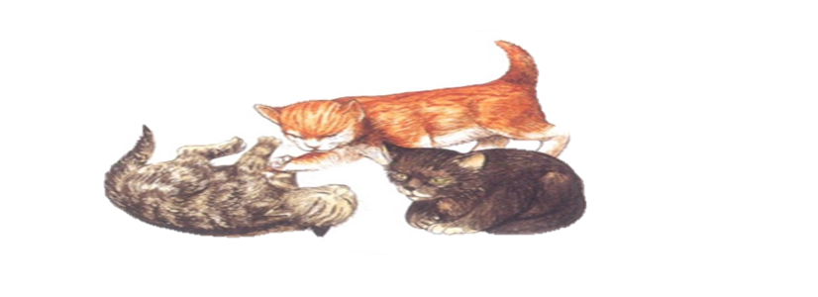

kittens cat
l 2

Slide 20
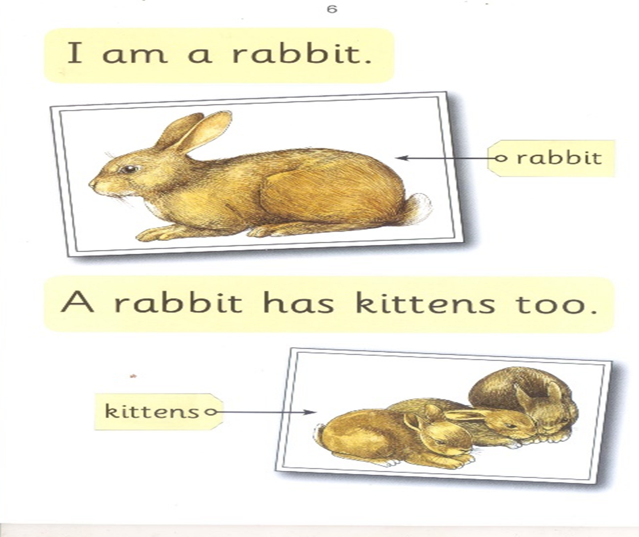

rabbit cat
l 2

Slide 21
kittens rabbit
l 2

Slide 22
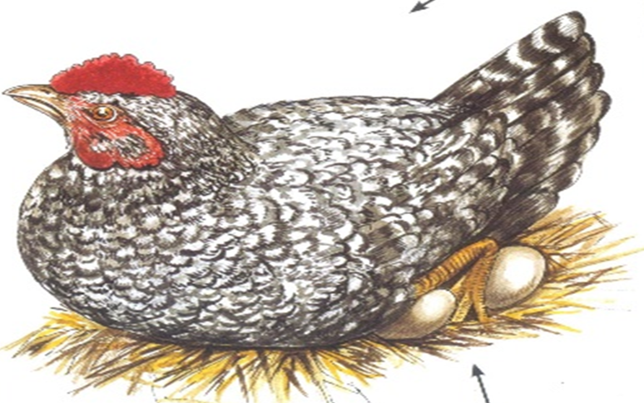

kittens hen
l 2

Slide 23
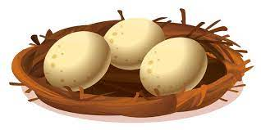

eggs hen
l 2

Slide 24
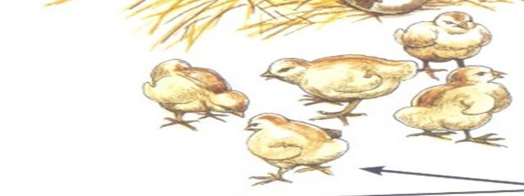
chicks hen
l 2

Slide 25

dog puppy
l 2

Slide 26

goat kid
l 2

Slide 27

sheep lamb
l 2

Slide 28

cat kittens
l 2

Slide 29

rabbit kittens
l 2

Slide 30

hen eggs
l 2

Slide 31

eggs chicks
l 2

