Slide 1
Number Games

Slide 2
Count from 1 to 30 1 2 3 4 5 6 7 8 9 10 11 12 13 14 15 16 17 18 19 20 21 22 23 24 25 26 27 28 29 30

Slide 3
Count backwards from 10 to 0 10 9 8 7 6 5 4 3 2 1 0

Slide 4
zero 0 one 1 two 2 three 3

Slide 5
Four 4 five 5 six 6 seven 7

Slide 6
eight
nine
ten
8
9
10

Slide 7
..
…
.
….
3
1
2
4
0

Slide 8
…..
…….
……
6
5
7

Slide 9
………
……….
……..
8
9
10

Slide 10
one
two

Slide 11
three zero

Slide 12
four
one

Slide 13
three
five

Slide 14
three
four

Slide 15
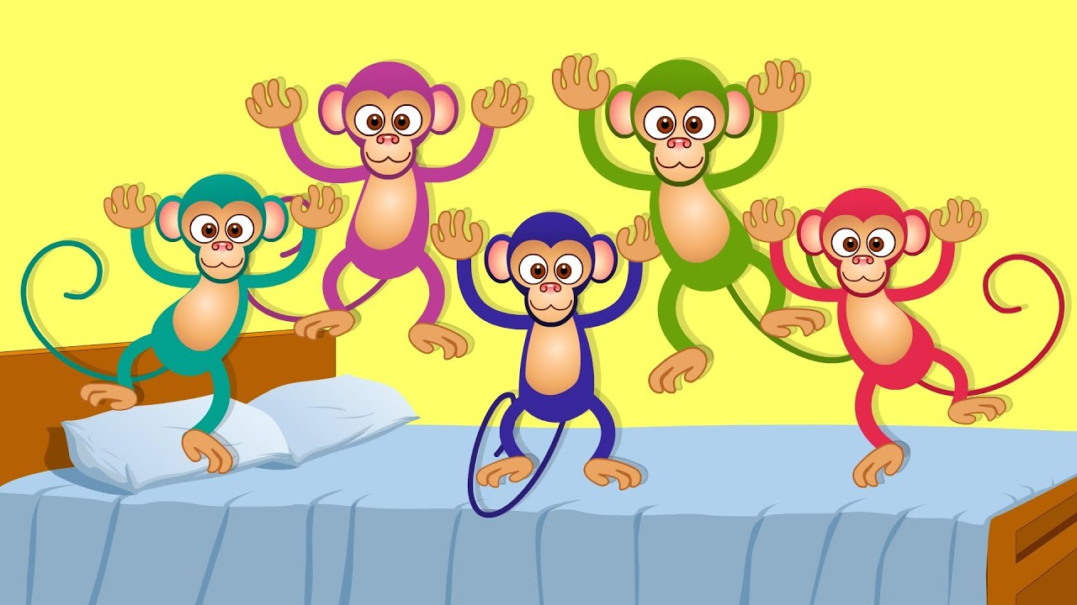
five
four

Slide 16
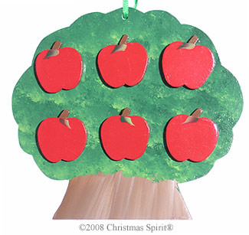
seven
six

Slide 17
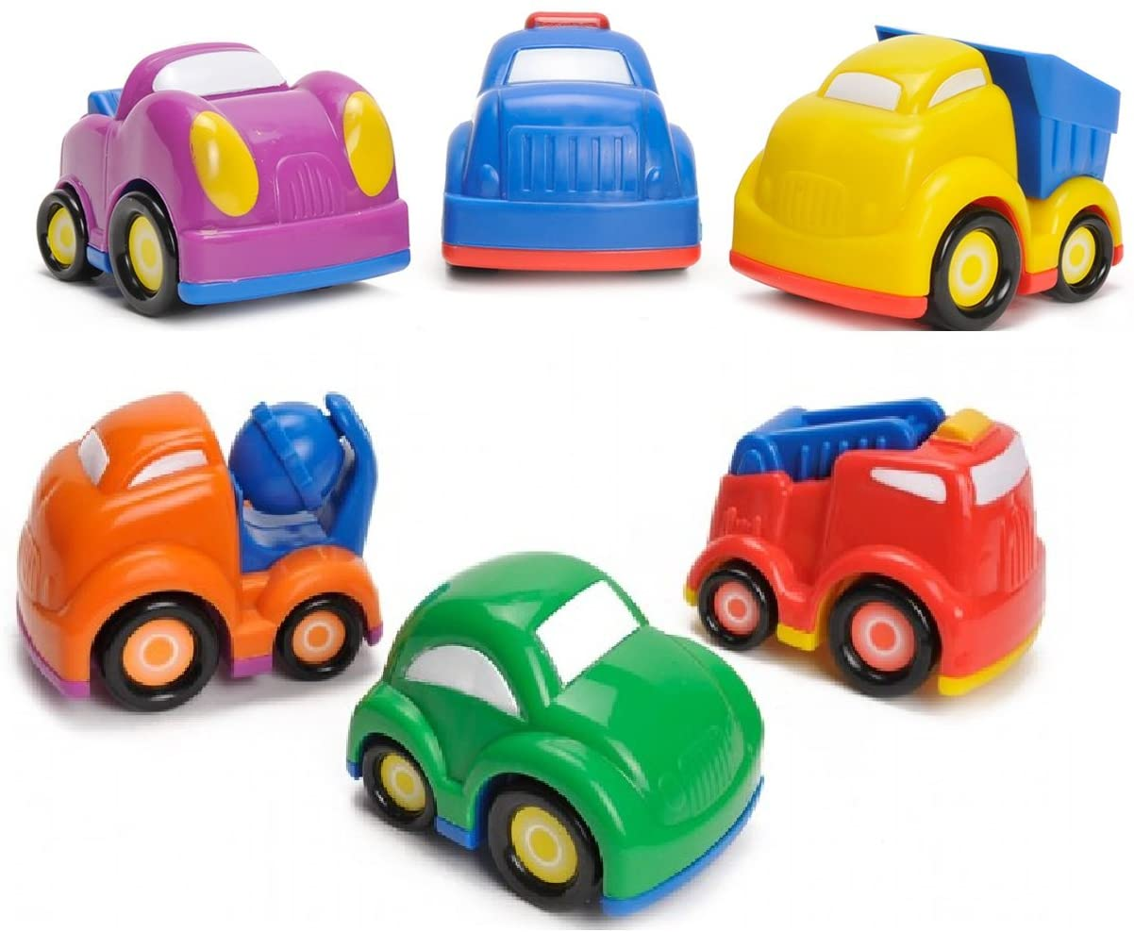
eight
six

Slide 18
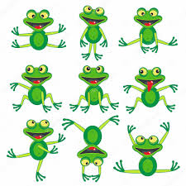
nine
seven

Slide 19
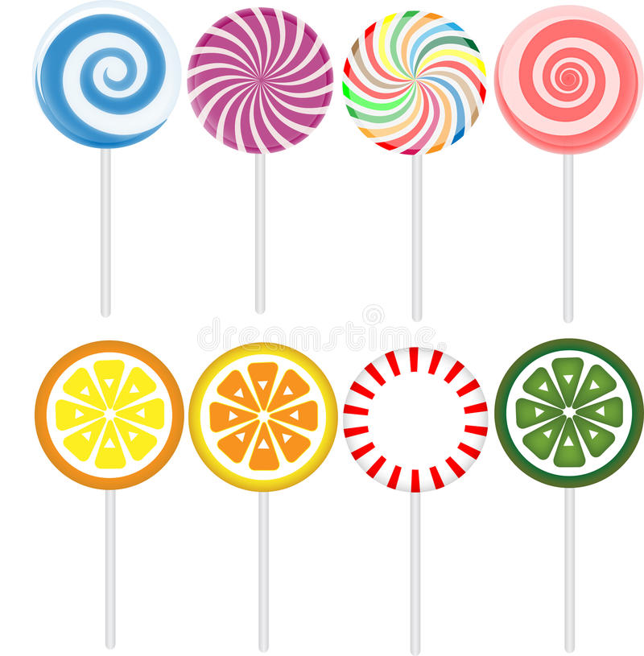
nine
eight

Slide 20
ten
seven

