Slide 1
Daily message
Today we are going to learn a new sound.

Slide 2
oo oo
. .

Slide 3
oo
.

Slide 4

Short /oo/

Slide 5
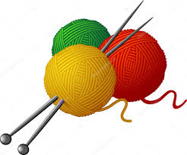
wool
. . .

Slide 6
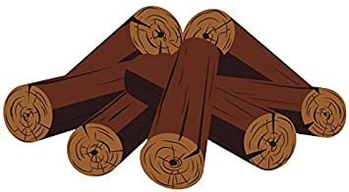
wood
. . .

Slide 7
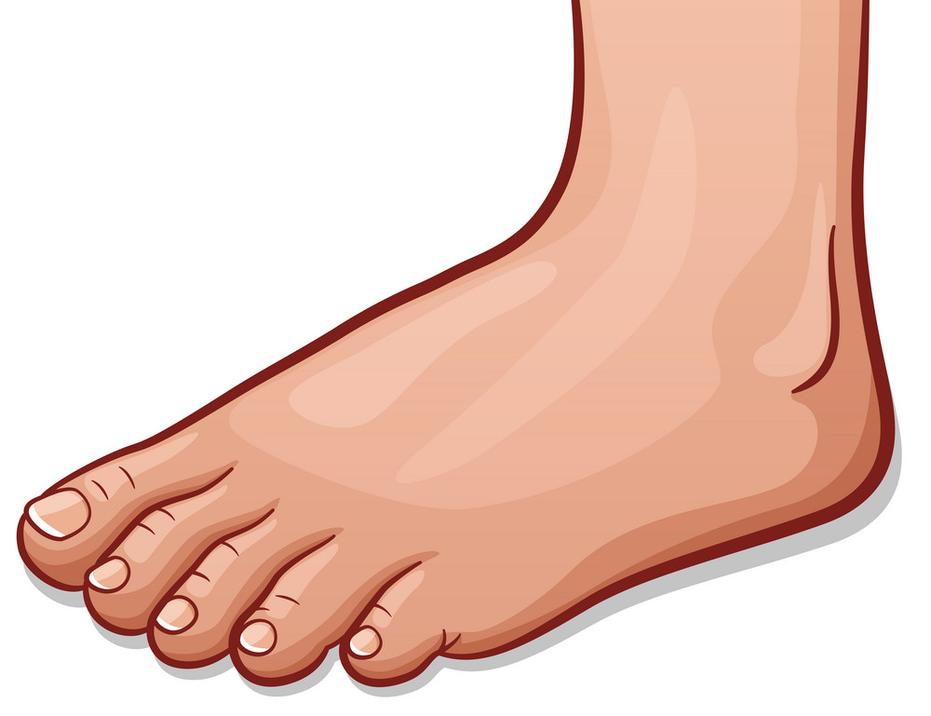
foot
. . .

Slide 8

book
. . .

Slide 9

hook
. . .

Slide 10
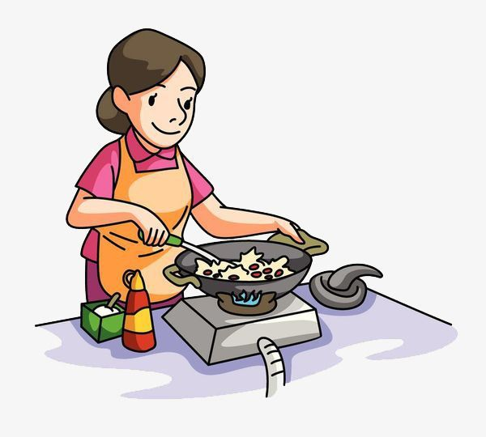
cook
. . .

Slide 11
oo
.

Slide 12

Long oo

Slide 13

moon
. . .

Slide 14

zoo
. .

Slide 15

boot
. . .

Slide 16
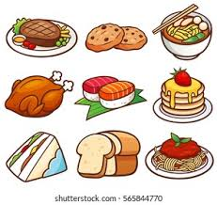
food
. . .

Slide 17

pool . . .

Slide 18

roots
. . .

Slide 19
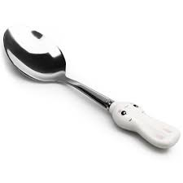
spoon
. . . .

Slide 20


room
. . .

Slide 21

scoop
. . . .

Slide 22
look
. . .

Slide 23
zoom
. . .

Slide 24
bloom
. . . .

Slide 25
book
. . .

Slide 26
good
. . .

Slide 27
noon
. . .

Slide 28
stood
. . . .

Slide 29
soon
. . .

Slide 30
took
. . .

Slide 31
tool
. . .

Slide 32
hook
. . .

Slide 33
cool
. . .

Slide 34
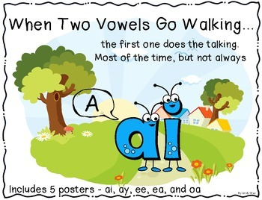

Slide 35
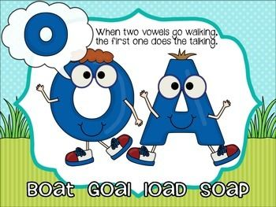

Slide 36



i
i
i
i
i
i
i
i
i

Slide 37
ee or
. .

Slide 38
aid
. .

Slide 39
aim
. .

Slide 40
nail
. . .

Slide 41
rain
. . .

Slide 42


Slide 43
soap
. . .

Slide 44
loaf
. . .

Slide 45
toad
. . .

Slide 46
goal
. . .

Slide 47
tie
. .

Slide 48
pie
. .

Slide 49
dried
. . . .

Slide 50
lied
. . .

Slide 51
speed
. . . .

Slide 52
greed
. . . .

Slide 53
sport
. . . .

Slide 54
storm
.. . .

Slide 55
15-4-2021

