Slide 1
The Governess Play- Drama
https://www.youtube.com/watch?v=VbwddeFjNzE

Slide 2
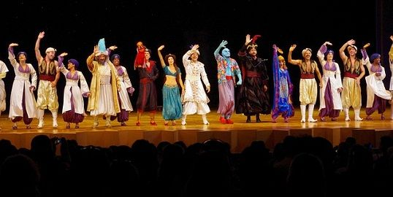
This play is a drama which presents events called the plot, and conveys the time and place of those events, called setting.

Slide 3
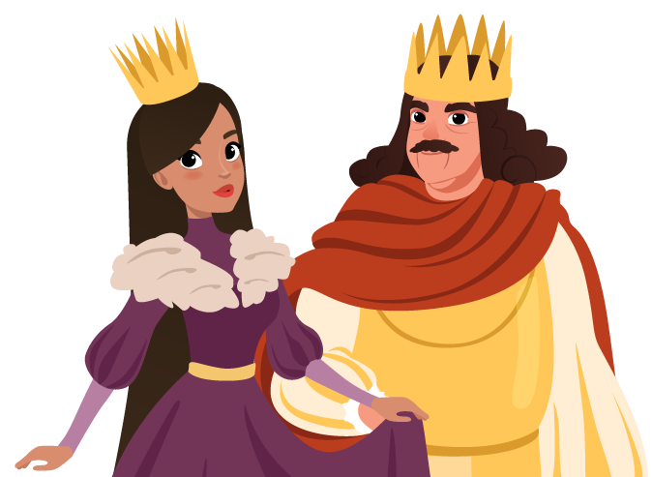
Cast of characters : a list of characters in the drama, that cast appears at the beginning of the drama

Slide 4
Dialogue : the words that the characters say.

Slide 5
Stage Directions: Instructions for how the drama is to be performed, these instructions are often set in parentheses.

Slide 6
Mood of a play: is the feeling that the playwright creates, such as happy.

Slide 7
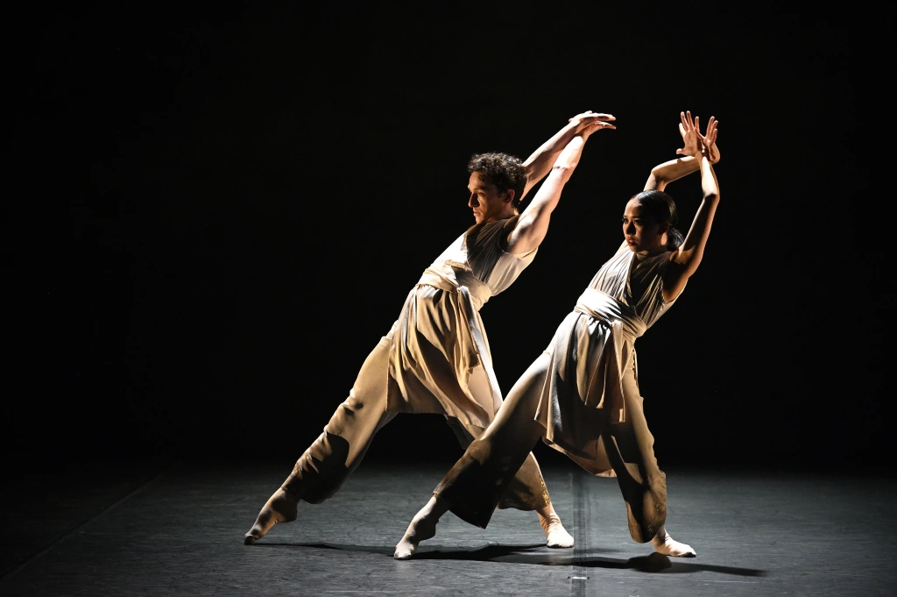
Tone: is the playwright’s attitude towards the play, which might be playful or ironic. In this play Neil Simon uses irony.

Slide 8
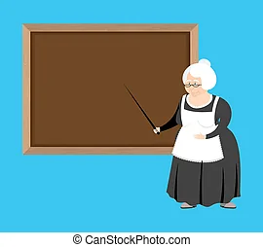
What is the meaning of governesses? governess. noun. gov·​ern·​ess ˈgəv-ər-nəs. : a woman who teaches and trains a child in a private home.

Slide 9
Q.4 Why is Mistress most likely asking Julia if she insists? What does this reveal about Mistress? She was trying to get Julia to insist, to stand up herself. It shows that Mistress is trying to show that she cares about Julia.

Slide 10
What does the dialogue suggest about Mistress? It suggests that Mistress is not who she appears to be.

Slide 11
What is the character analysis of governess? The Governess: She is intelligent as well as sensitive. She is extremely protective of her charges and hopes to win her employer's approval.

