Slide 1
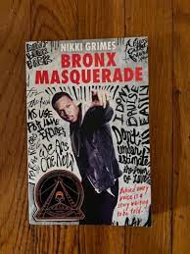
From Bronx Masquerade page 341

Slide 2
Analyze Character page 341

Slide 3
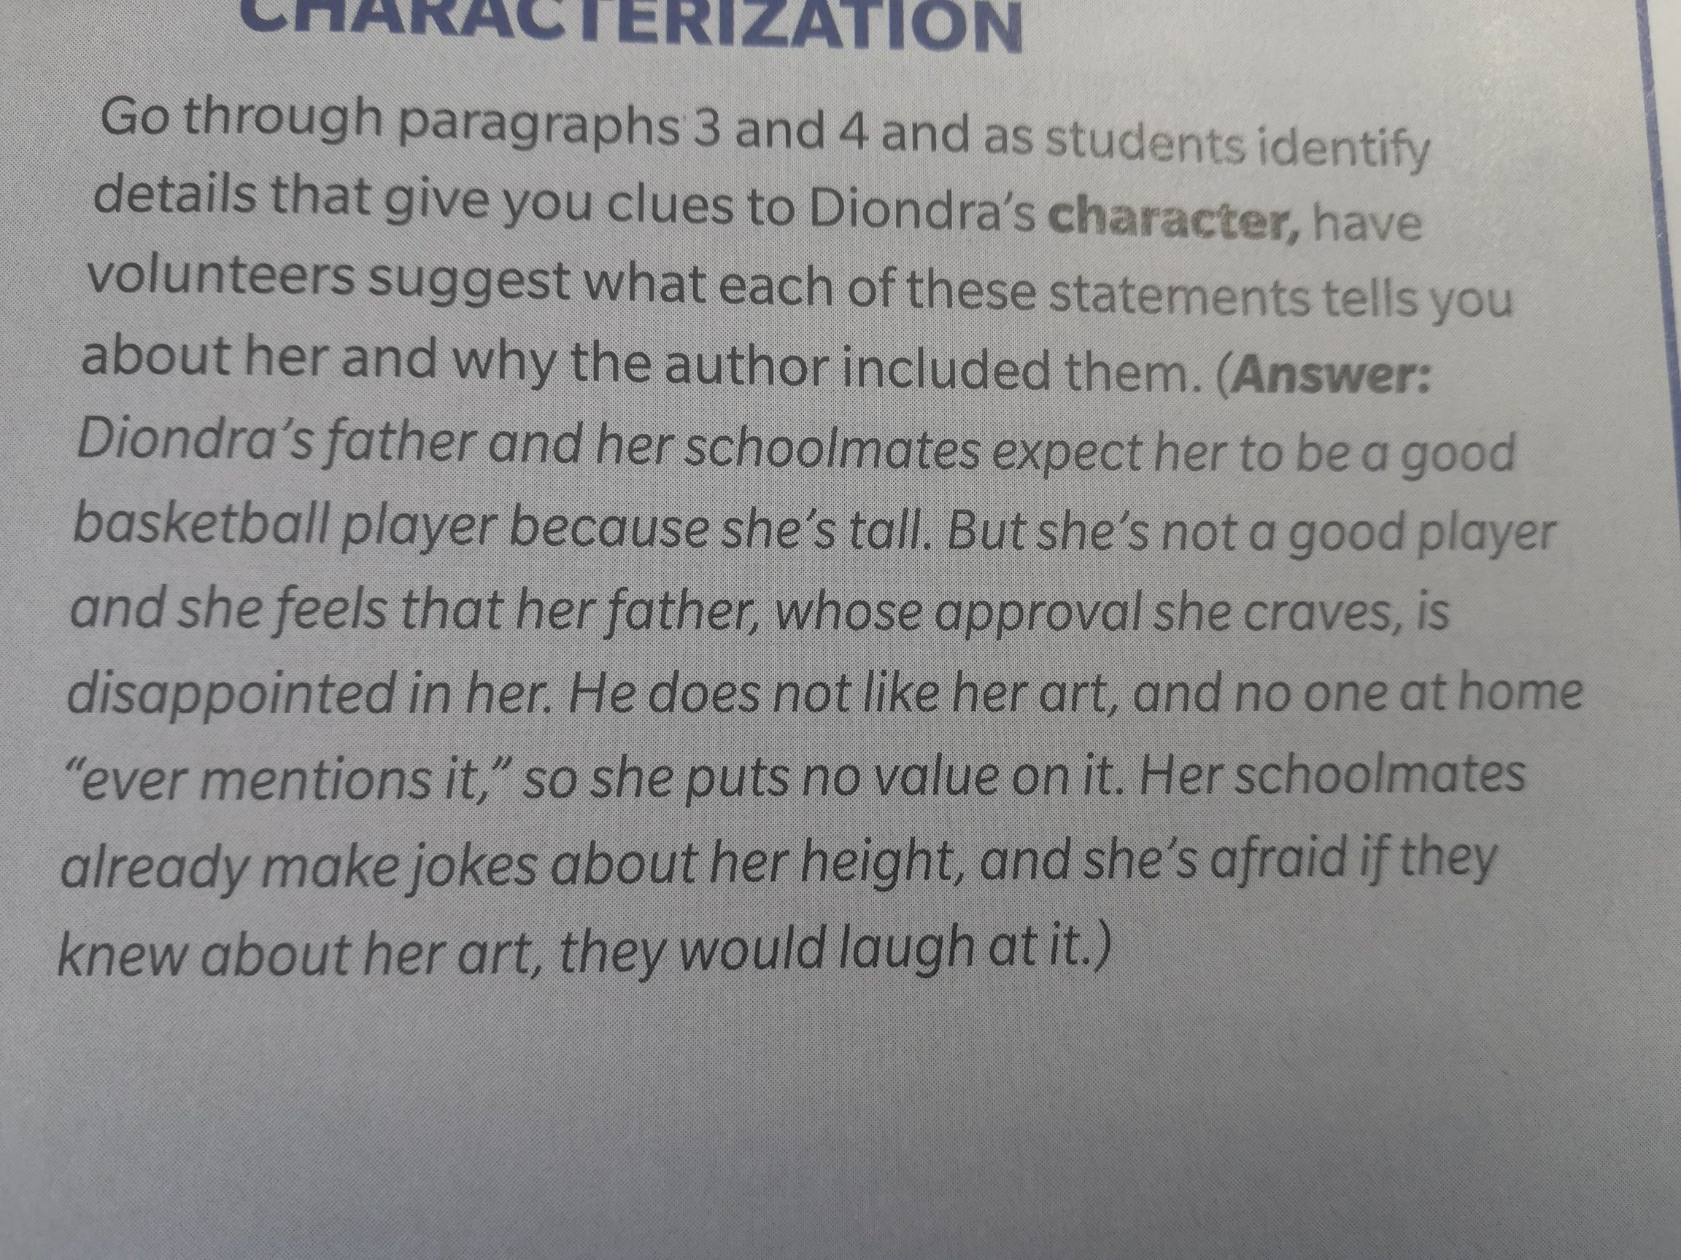
Analyze Character page 342

Slide 4
Language Conventions page 343

Slide 5
Analyze Structure page 344

Slide 6
Analyze Structure page 345

Slide 7
Analyze Characterization page 346

Slide 8
Aha Moment page 346

Slide 9
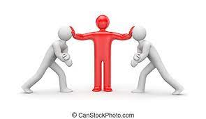
What are the main conflicts in Bronx Masquerade? The main conflicts in Bronx Masquerade are the racial tension students face, and resulting cultural differences between the students.

Slide 10
What is the main lesson within Grimes's Bronx Masquerade? The main lesson found in Bronx Masquerade is that of developing empathy for others through sharing stories and listening in return. The students in the class come from various backgrounds and, in some instances, initially see each other as enemies. As the students share their personal experiences and struggles with their peers, they realize they are not that much different from one another. Thus, they are able to develop empathy for their fellow peers.

Slide 11
Is Bronx Masquerade based on a true story? While Bronx Masquerade is not based on a true story, Nikki Grimes mentions knowing individuals similar to the characters in the novel while growing up.

Slide 12
What happens at the end of Bronx Masquerade? Basically, this ending is all about hope for the future.

