Slide 1
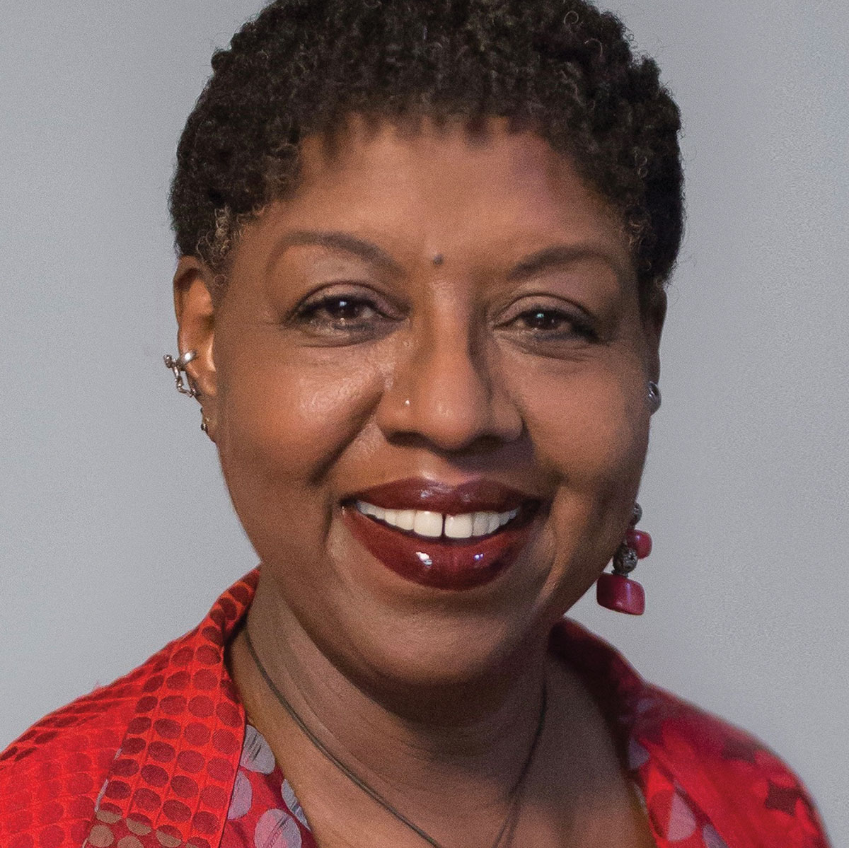
Bronx Masquerade Summary
Nikki Grimes is African-American author, poet, and journalist primarily known for her works for children and young adults.

Slide 2
Bronx Masquerade is one of Grimes’s most acclaimed works, earning her the Coretta Scott King Award for Authors in 2003.

Slide 3
Bronx Masquerade (2002), a young adult novel by African-American author Nikki Grimes, focuses on the kids in an inner-city English class which runs by Mr. Ward.

Slide 4
When a student Wesley Boone writes a poem to read aloud in class, some of his classmates follow suit, and the classroom becomes an exercise in self-revelation as the power of poetry allows these struggling teenagers to reveal their personal problems.

Slide 5
“Open Mike Friday” becomes a tradition in the class that changes the students and their class forever.

Slide 6
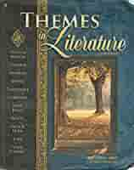
Exploring themes of coming of age, holding on to dreams in the face of adversity, the power of family to help or hurt, and the way literature and poetry serve as a window to the soul.

Slide 7
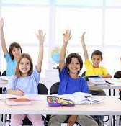
Set at a high school in the Bronx, Bronx Masquerade opens in Mr. Ward’s English class. Despite the school having a lot of funding problems, Mr. Ward works to motivate his students

Slide 8
He assigns them an essay to write, and while most of them follow the assignment, one student—Wesley Boone, a passionate, aspiring rapper and songwriter—takes a different tack.

Slide 9
Mr. Ward asks Wesley to read his poem aloud to the class. The students respond, and it becomes a weekly tradition in the class—Open Mike Fridays.

Slide 10
Every Friday, the eighteen students in Mr. Ward’s class write poems and perform them in front of the other students.

Slide 11
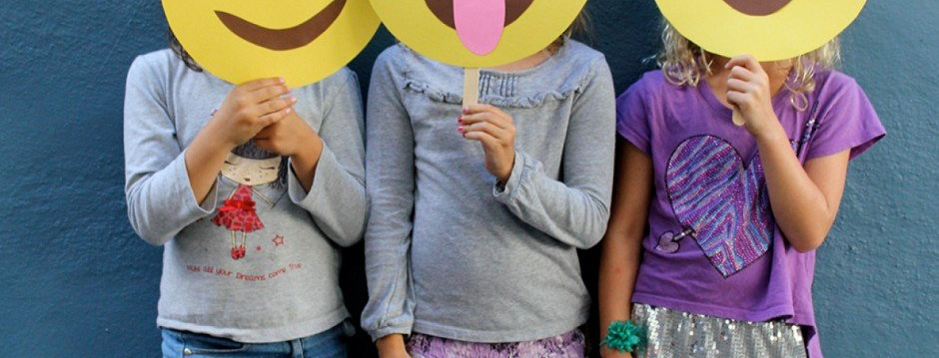
Open Mike Friday allows Tyron’s fellow students to express themselves in front of the class as well, and one by one, the reader learns more about their inner lives.

Slide 12
As every kid in the class reads a personal poem, they realize that they are all struggling with their own problems and trying to hold on to their dreams. Everyone struggles with insecurity, belonging, and worries about the future. The class feels closer than ever.

Slide 13
Word starts getting out about Open Mike Fridays, and soon Mr. Ward’s class gets the attention of a local newspaper. After being written up in an article, the students are given the opportunity to read their poems at an assembly in front of the whole school.

Slide 14
Mr. Ward, stunned by the success of his little experiment that was inspired by Tyrone, decides that next school year he is going to hold Open Mike Fridays in every one of his classes.

Slide 15
He also starts a poetry slam competition for the whole school. The first student to sign up, of course, is Tyrone.

Slide 16
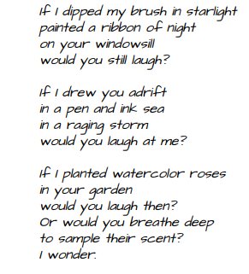

Slide 17
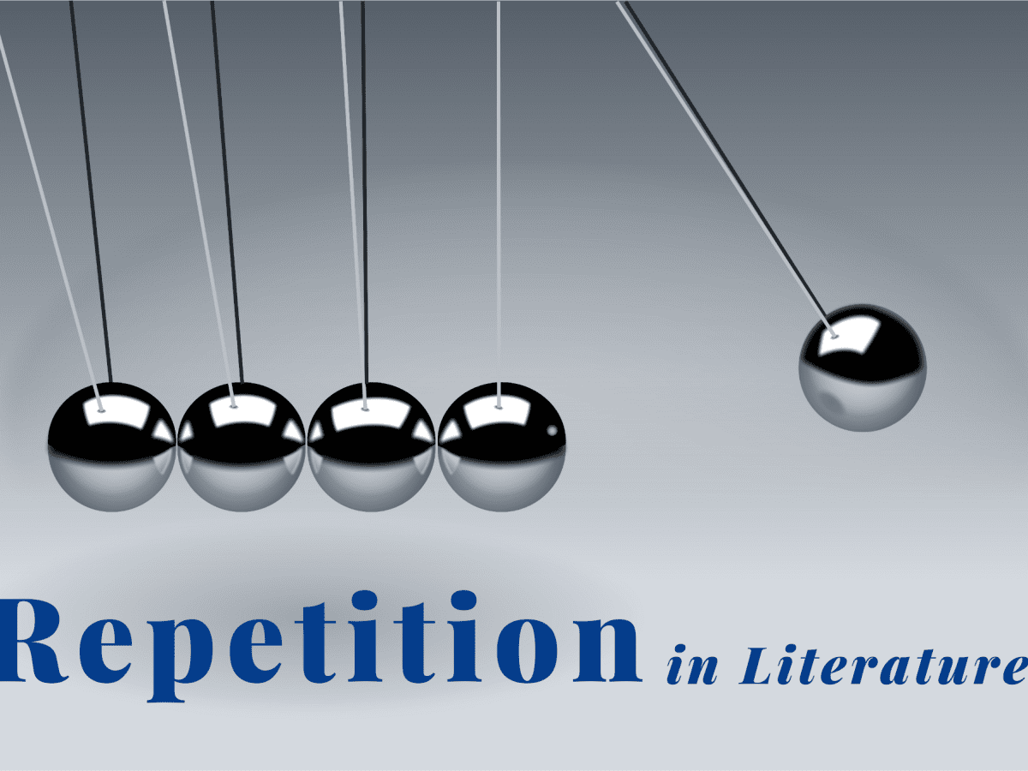
After reading the( If) poem, how does the repetition emphasize the feelings of Diondra? It emphasizes Diondra’s hesitancy about expressing her true self, and wonders what other people think.

Slide 18
What do the descriptions of the library and the books of poetry reveal about Devon’s character? It reveals that he enjoys reading poetry on his own. His experience in the library leaves him thinking that it may be time to show his true self.

