Slide 1
Oxford Discover Grammar Book Tag Questions Unit 10 Answer key

Slide 2
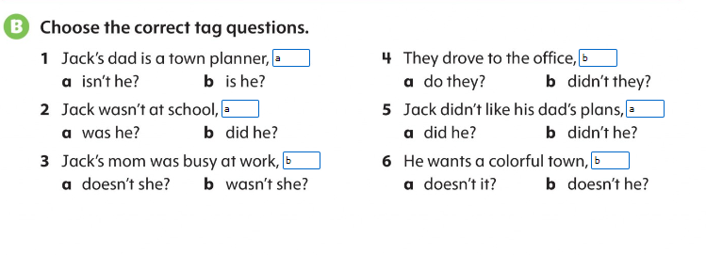
Page 54

Slide 3
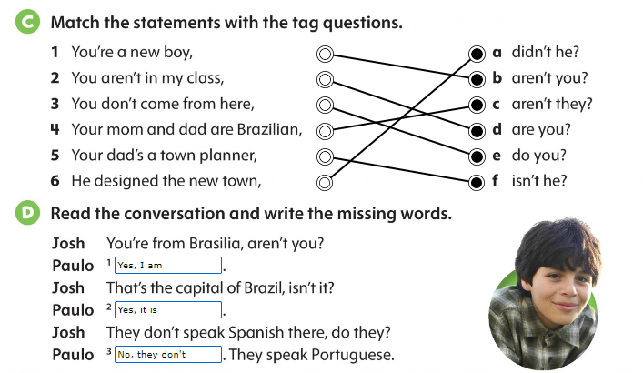
Page 55

Slide 4
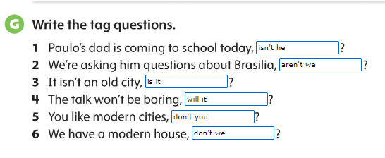
Page 55

Slide 5
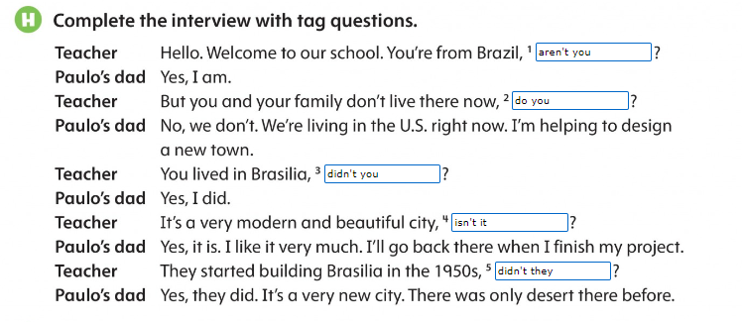
Page 56

Slide 6
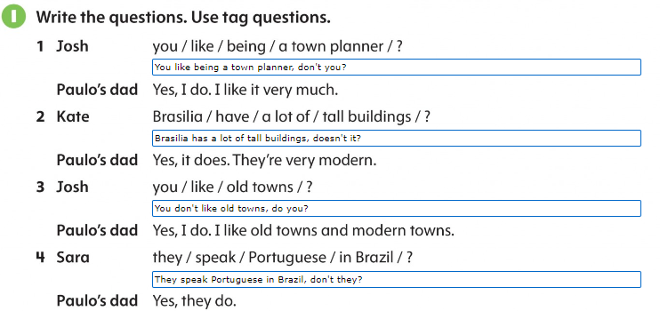
Page 56

