Slide 1
Student Book and Workbook Answer Keys Unit 8

Slide 2
Student Book Page 76

Slide 3
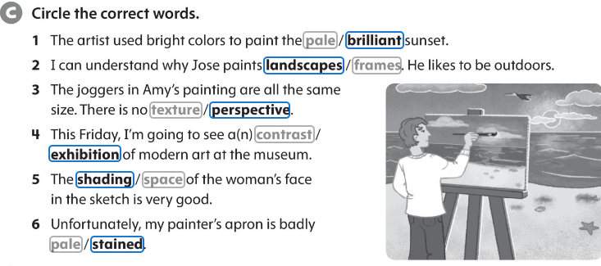
Workbook p.68

Slide 4
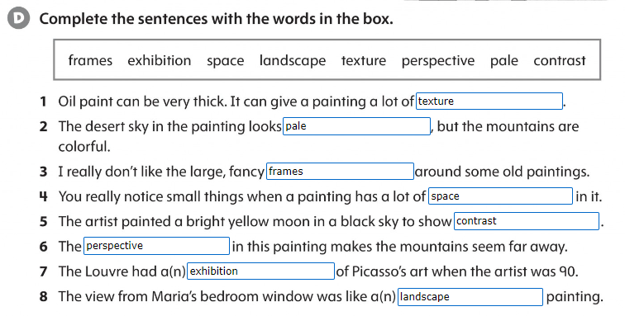
Workbook p.68

Slide 5
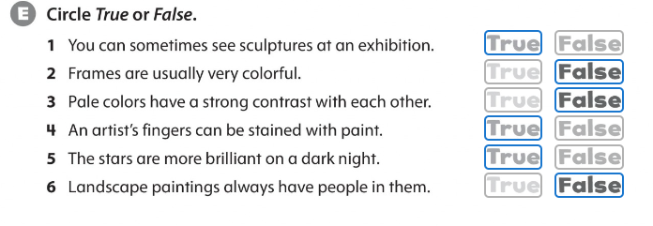
Workbook p.68

Slide 6
Synonyms Student Book p.83

Slide 7
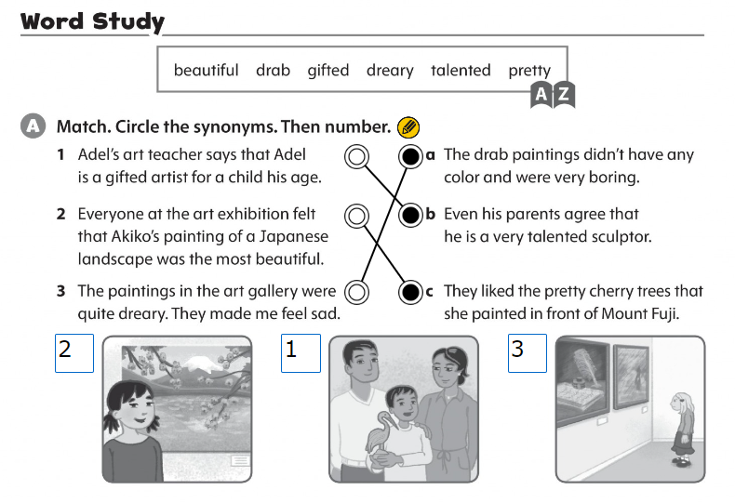
Workbook p.73

Slide 8
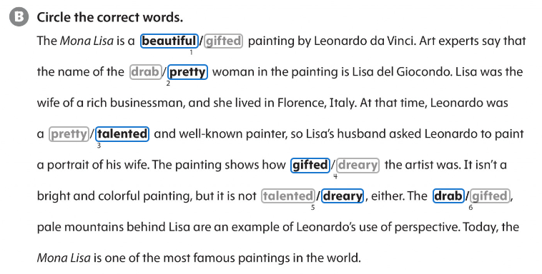
Workbook p.73

