Slide 1
Oxford Discover 5 Grammar Book –Answer key Units 11+12

Slide 2
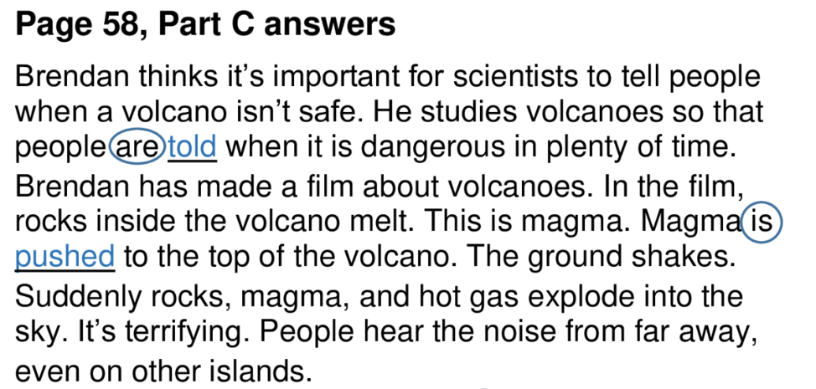
Page 58

Slide 3
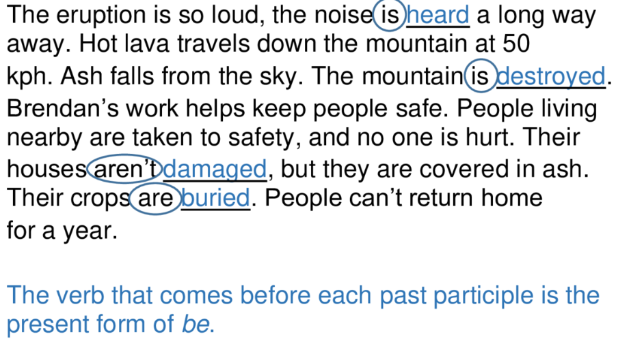
Page 58

Slide 4
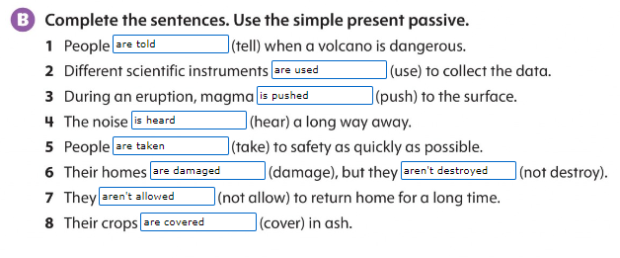
Page 59

Slide 5
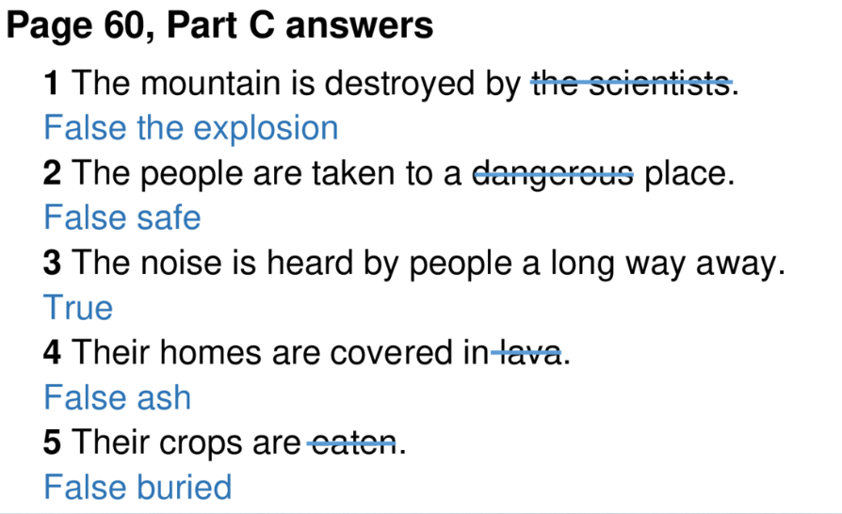
Page 60

Slide 6
Page 60

Slide 7
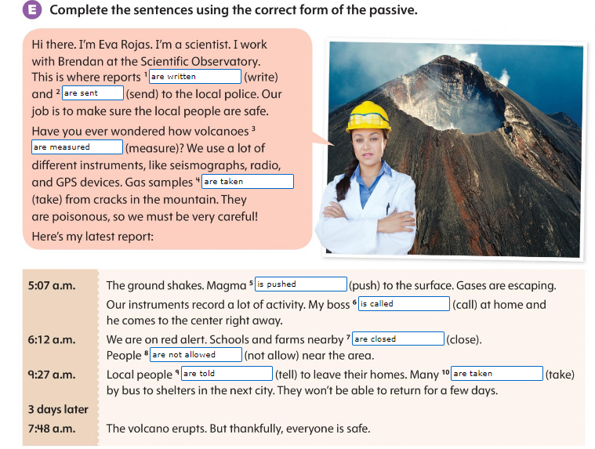
Page 60

Slide 8
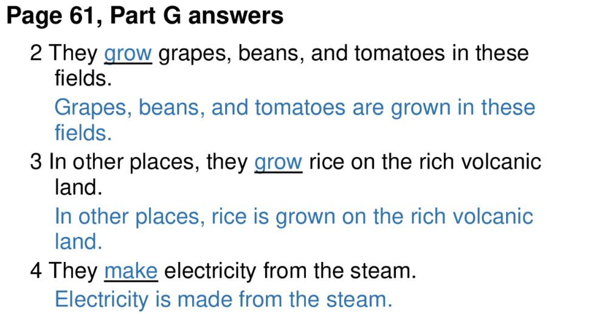
Page 61

Slide 9
Page 61

Slide 10
Page 62

Slide 11
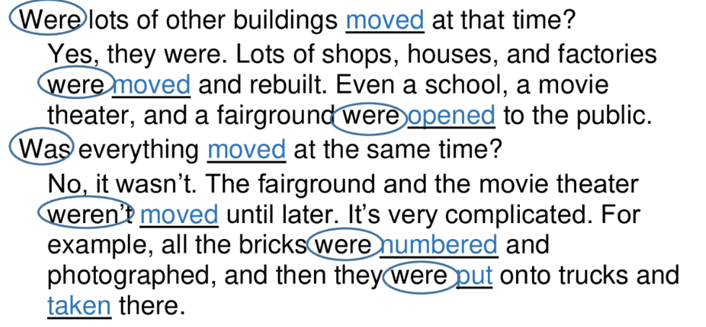

Slide 13
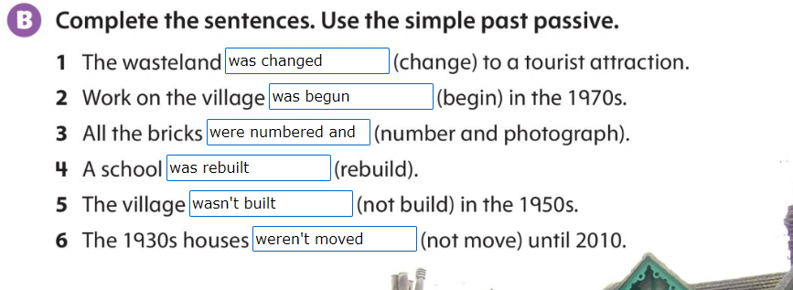
Page 63

Slide 14
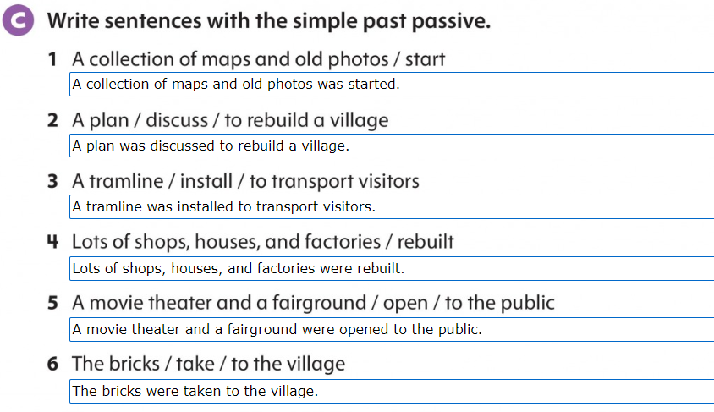
Page 64

Slide 15
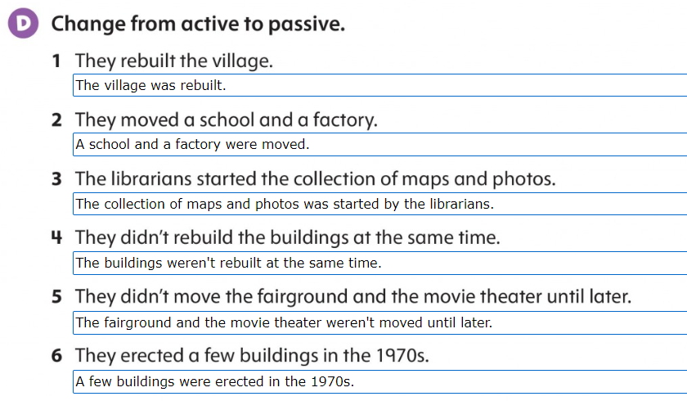
Page 64

Slide 16
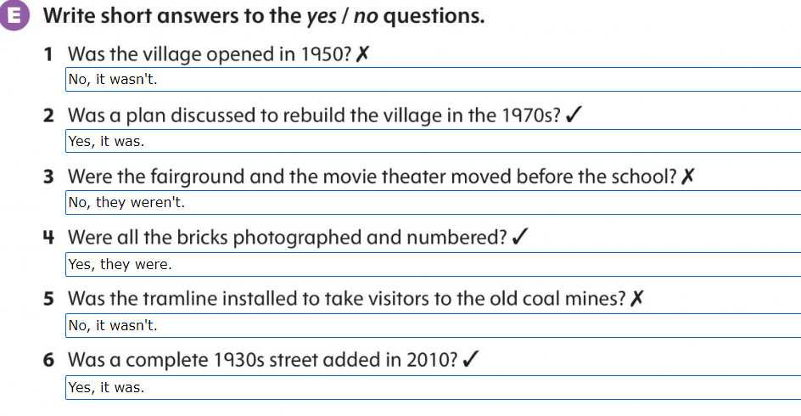
Page 64

Slide 17
Page 65

