Slide 1
Getting the verbs right
Student Book Page. 116
Workbook Page 54

Slide 2
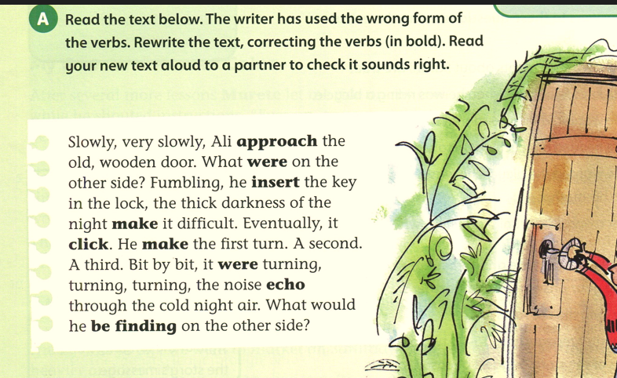
approached
was
inserted
made
made
clicked
was
echoed
find

Slide 3
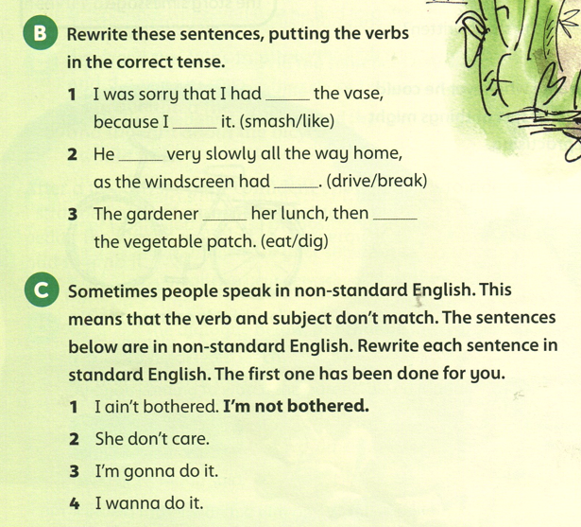
smashed
liked
drove
broken
ate
dug
She doesn’t care.
I am going to do it.
I want to do it.

Slide 4
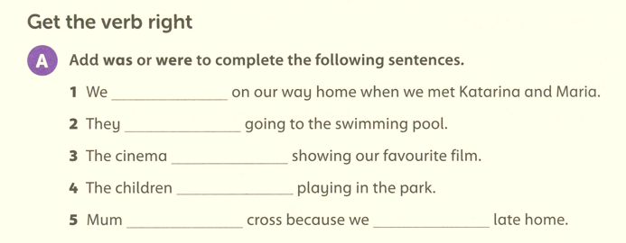
Workbook Page 54
were
were
was
were
was
were

Slide 5
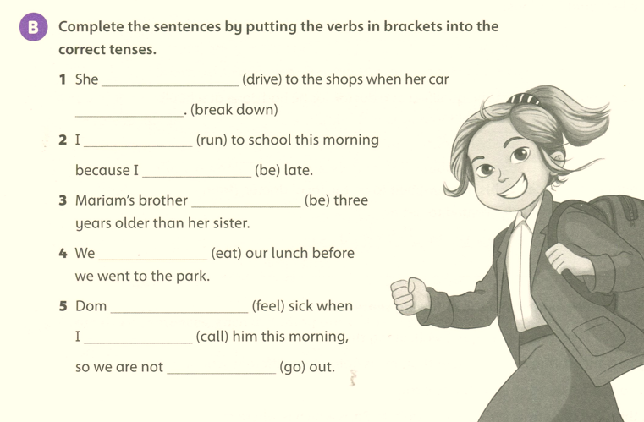
was driving
broke down
ran
was
is
ate
was feeling
called
going

Slide 6
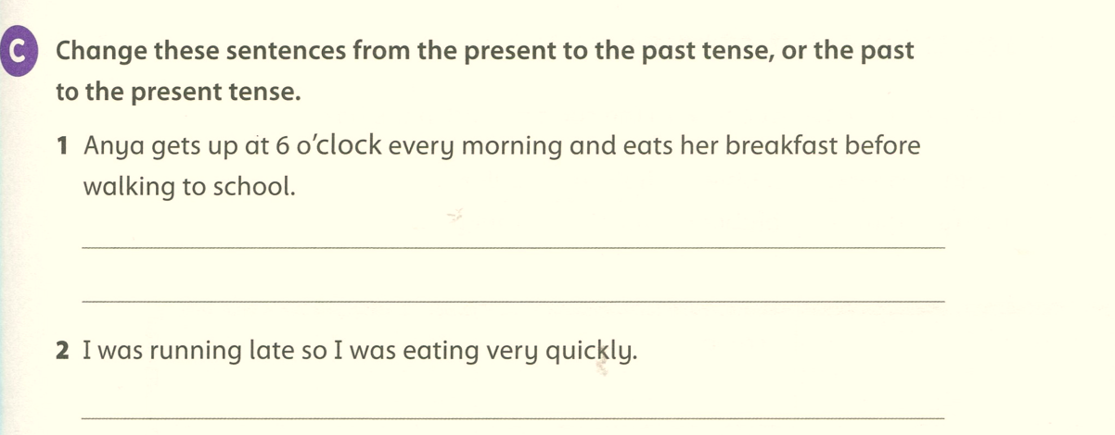
Anya got up at 6 o’clock every morning and ate her breakfast before walking to school.
I am running late so I am eating very quickly.

Slide 7
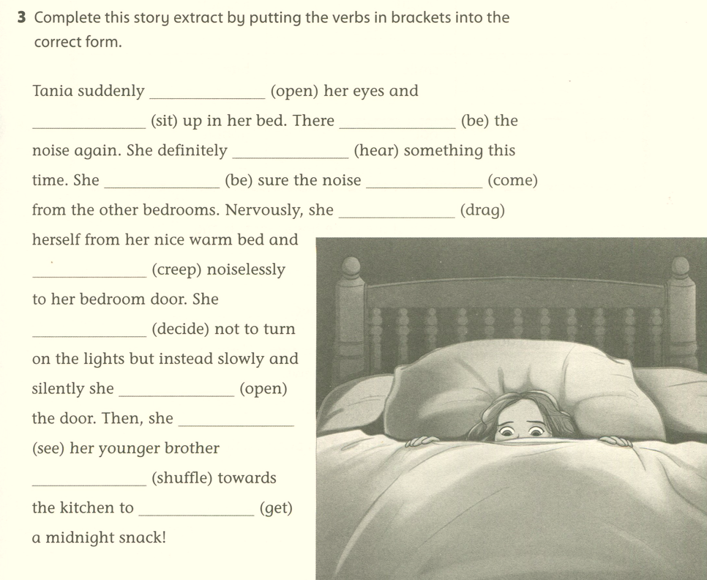
opened
sat
was
heard
was
was coming
dragged
crept
decided
opened
saw
shuffling
get

