Slide 1
The Past Tense
Grammar Booklet

Slide 2
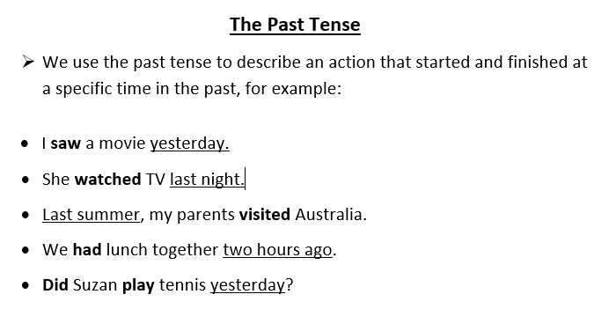

Slide 3
Keep these rules in mind when changing the regular basic form of a verb to the past tense.
Sometimes adding ed to a verb will change it to the past tense.
talk → talked blink→ blinked look→looked
2. Verbs ending in –e take only -d.
love → loved smile→ smiled bake→baked
3. Verb ending in a consonant + y, drop the y and take -ied
fry→ fried cry→ cried carry→ carried
4. Verbs ending in a vowel +y, take -ed
stay → stayed play → played pray→prayed
5. Verb ending in one stressed vowel between two consonants double the last consonants and take - ed.
( never double w, y, x or z)
stop→ stopped plan→ planned sob→ sobbed

Slide 4
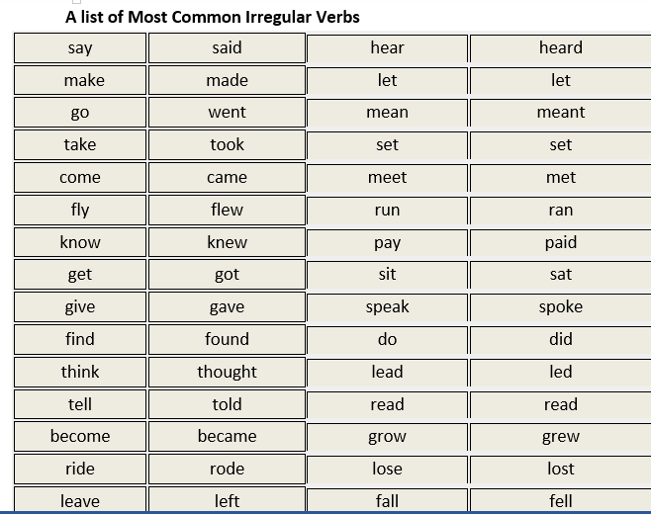

Slide 5
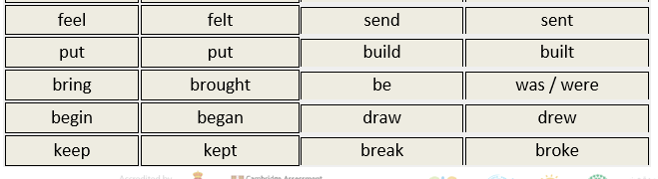
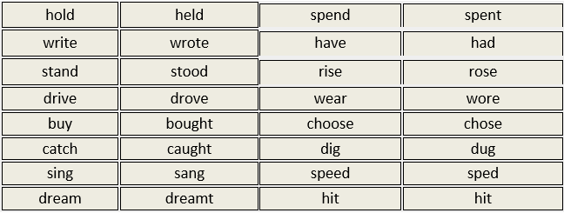

Slide 6
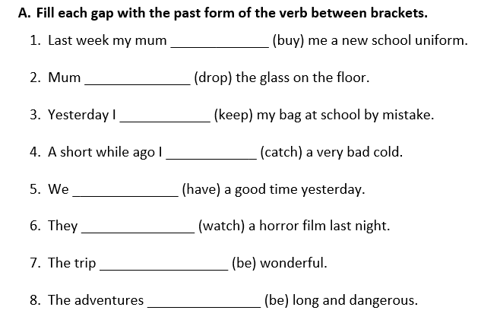
bought
dropped
kept
caught
had
watched
was
were

Slide 7
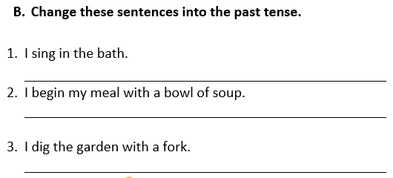
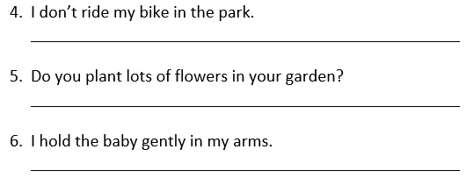
I sang in the bath.
I began my meal with a bowl of soup.
I dug the garden with a fork.
I didn’t ride my bike in the park.
Did you plant lots of flowers in your garden?
I held the baby gently in my arms.

Slide 8
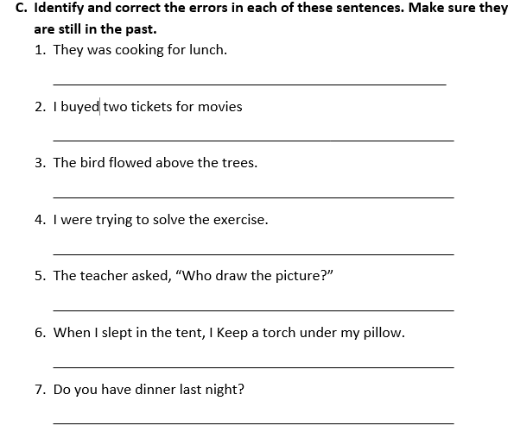
were
bought
flew
was
drew
kept
Did

Slide 9
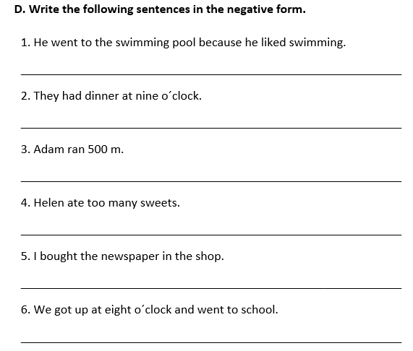
He didn´t go to the swimming pool because he didn´t like swimming.
They didn´t have dinner at nine o´clock.
Adam didn´t run 500 m
Helen didn´t eat too many sweets.
I didn´t buy the newspaper in the shop.
We didn´t get up at eight o´clock and didn’t go to school.

Slide 10
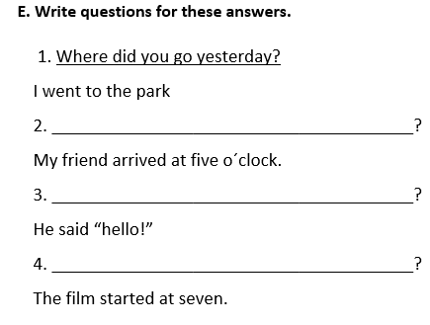
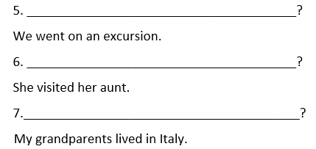
What time / When did your friend arrive?
What did he say?
What time / when did they film start?
Where did you go?
Who did she visit?
Where did your grandparents live?

