Slide 1
Homophones
Student’s book page 120 / Workbook page 58

Slide 2
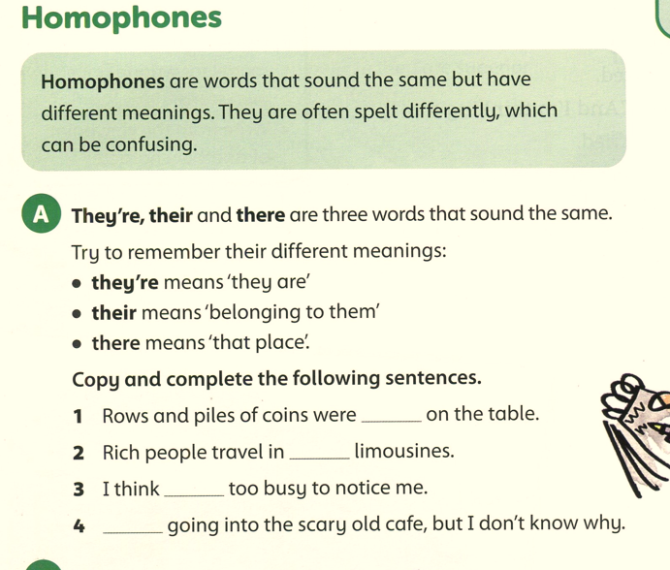
Student’s book page 120

Slide 3
Student’s book page 120
there
their
they’re
They’re

Slide 4
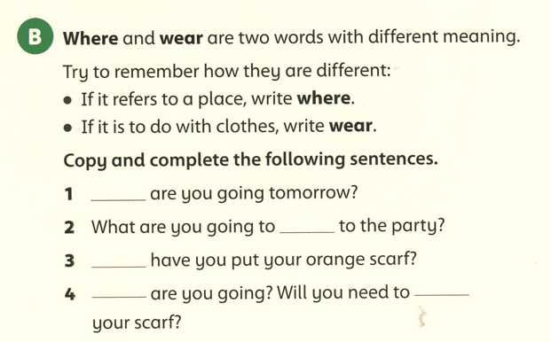
Student’s book page 120
Where
wear
Where
Where
wear

Slide 5
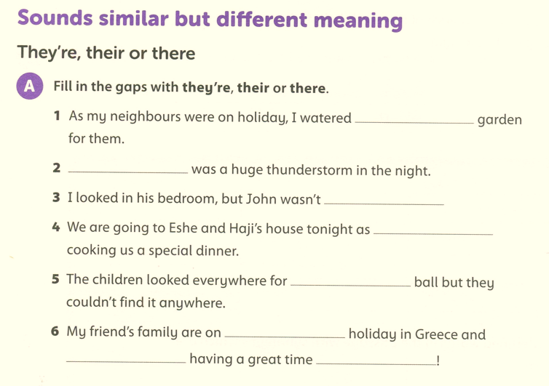
Workbook page 58
their
There
there
they’re
their
their
they’re
there
Notes:
5

Slide 6
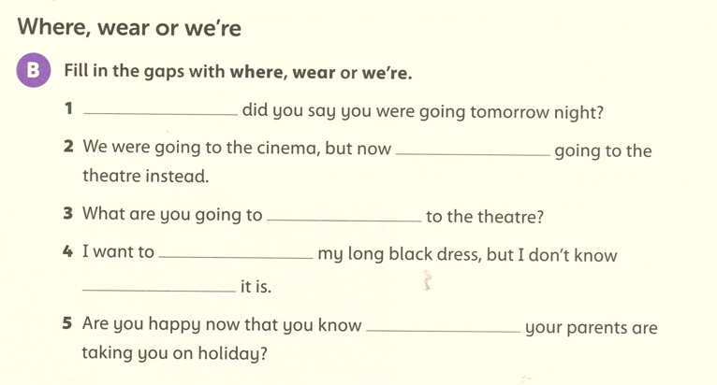
Workbook page 58
Where
we’re
wear
wear
where
where

