Slide 1
Astrophysics

Slide 3
Kuiper Belt

Slide 4
Oort Cloud

Slide 6
Proxima Centauri and other neighbours

Slide 8
Andromeda

Slide 9
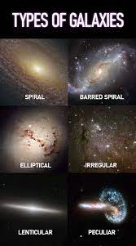
Types of galaxies

Slide 16
Asteroid

Slide 17
Meteoroid

Slide 18
Meteoroid

Slide 19
Comets

