Slide 1
Area, perimeter and volume
Chapter 5

Slide 2
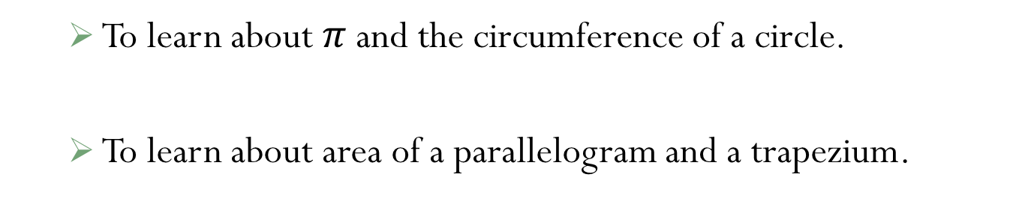
Objectives:
  To learn about $π$ and the circumference of a circle.
  To learn about area of a parallelogram and a trapezium.

Slide 3
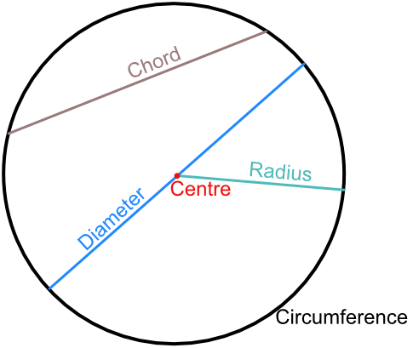
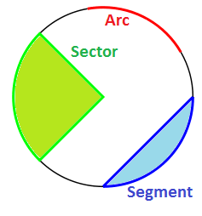
Circle parts
Circumference: is the distance around a circle. It’s basically the term used to describe the perimeter of the circle.
Diameter: the length of a line passing through the center from one point on the circle to another.
Radius: the length of a line drawn from the center to any point on the circle.
Chord: is a straight line from one point on the circumference to another.
Segments: a chord splits a circle into two segments.
Arc: is part of the circumference.
Sector: is formed by joining a radius to an arc to a radius.

Slide 4
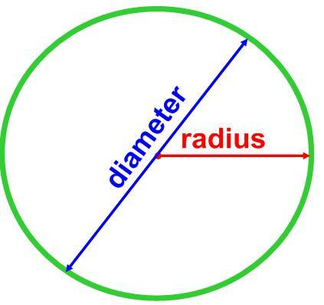
Important things to know about a circle
The diameter and radius are very important to work out the circumference and area of any circle.
You also notice that both rules (area and circumference) will use the Greek letter π (known as pi, pronounced as pie).
π is about 3.14 rounded to 2 d.p.
diameter = d
radius = r
Diameter = 2 × radius = 2r
to learn more about π, please watch the video below:
https://www.youtube.com/watch?v=cC0fZ_lkFpQ&t=6s

Slide 5
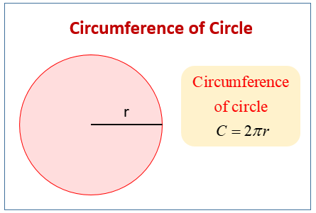
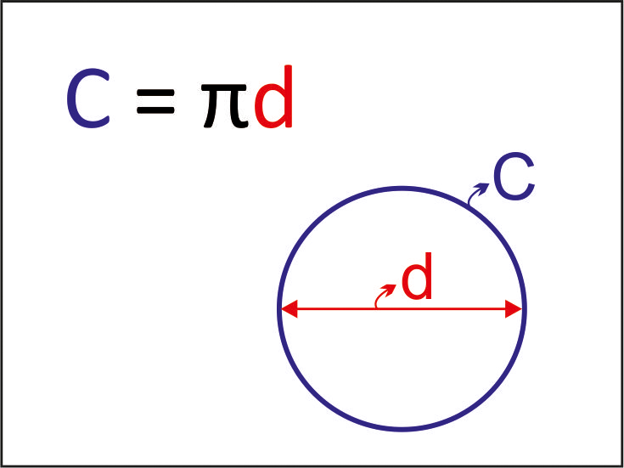
Circumference of circles
The rule to find the circumference of a circle is as follows:
Remember that the diameter is 2 × radius OR (2r).
Therefore, if a question gives you the diameter instead of the radius, you may use the rule below.
To understand more, please watch the video below:
https://www.youtube.com/watch?v=O-cawByg2aA&t=300s

Slide 6
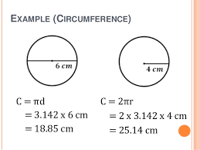
Examples: Find the circumference of the circles below:
Circumference = πd
= 3.14 × 6
= 18.84 cm
Circumference = 2πr
= 2 × 3.14 × 4
= 25.12 cm

Slide 7

P. 67 Ex.5A:
Q1
Q2 (b, d)
Q3 (b, d)
Q4
Q5
Q8 (a, b)
Q15 (a, c, d, e)

Slide 8
Area of Parallelograms
Properties of a parallelogram:
  It has two pairs of opposite parallel lines.
  Every two opposite sides are equal to each other (congruent).
  Every two opposite angles are equal to each other. Two of which are acute, and two are obtuse.
  Interior angles add up to 360º.

Slide 9
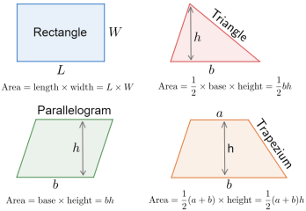
Area of Parallelograms
Please watch the video below:
https://www.youtube.com/watch?v=PKzE3OWxDfQ
So, you will notice from the video that finding the area of a parallelogram is the same as a rectangle. But instead of using the length and the width, you will use the base and the height. Therefore, you can find the area of a parallelogram using the rule:
  Area = Base × height
Note: ‘h’ is the vertical height

Slide 10
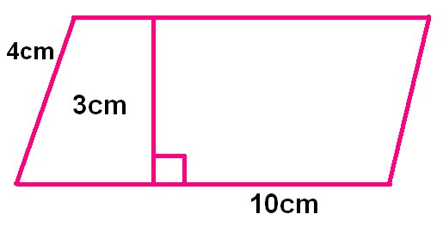
Sometime, the question might give you the area and ask you to find a missing side. In such cases, use inverse operation to find the missing side (just like we did in rectangles). Please refer to slide 4.
Example: the area of the parallelogram is 43 cm². what is the height of the parallelogram?
Area = base x height
43 = 10 x h
h = 43 ÷ 10
so the height is 4.3 cm.
P. 69 Ex.5B:
Q1 (b), Q2 (a), Q4 and Q5 (b)

Slide 11
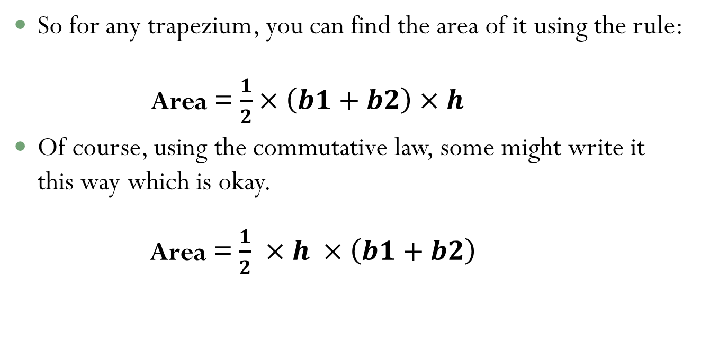
Area of Trapeziums
First please start by watching the video below:
https://www.youtube.com/watch?v=ludxEuznIRs
So for any trapezium, you can find the area of it using the rule:
  Area = $\frac{1}{2}×\left(b1+b2\right)×h$
Of course, using the commutative law, some might write it this way which is okay.
Area = $\frac{1}{2}$ $×h ×\left(b1+b2\right)$
b1
b2

Slide 12
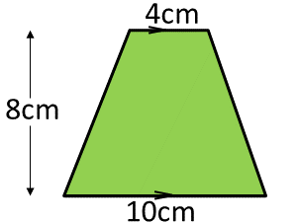

Example: Find the area of the trapezium below.
Answer:
Area = $\frac{1}{2}$ × 8 × (4 + 10)
= 4 × 14
= 56 cm²
Sometime, the question might give you the area and ask you to find a missing side.

Slide 13
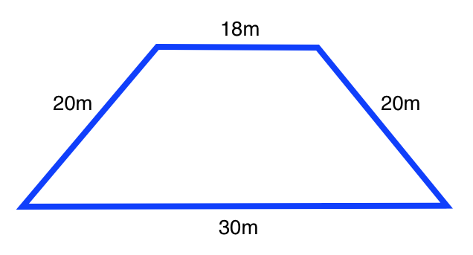
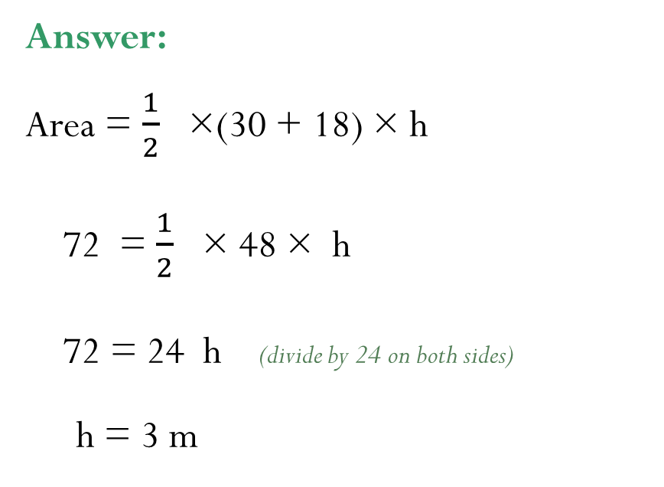
For Example: Find the length of the height, if the area is 72m².
Answer:
Area = $\frac{1}{2}$ ×(30 + 18) × h
72 = $\frac{1}{2}$ × 48 × h
72 = 24 h (divide by 24 on both sides)
h = 3 m
Use what you learned in algebra ☺
P. 70 Ex.5C:
Q3 , Q4
To review again: please watch the link below:
https://www.youtube.com/watch?v=Y1_SbgUbgPY

Slide 14
Compound shapes
P. 72 Ex.5D:
Q1 (a, d)
Q3 (b, d)
Q4
Q5
Q8

