Slide 1
When we use “WILL” – all about “WILL” ☺

Slide 2
When we use WILL:
To give information about future.
Prediction in general .
Don’t worry! It will be OK.
The weather will change soon.
You will never finish that book
Who do you think will win on Saturday?
I Will .

Slide 3
We use WILL with adverbs to indicate the level of certainty:
definitely
possibly
certainly
probably
The weather will definitely change soon.
Man will probably land on Mars before
the end of the century.
I will certainly be home soon.
This bakary will possibly close this weekend.

Slide 4
- To express a presonal opinion, we use WILL with:
I think
I don’t think
I guess
I expect
I’m sure
I’m afraid
I wonder
I hope
I will go to bed.
the test will be difficult.
you will do the right thing.
Serbia will win.
we will have a great time together!
I will not pass the exam.
who will win the football
tournament this year?
you will come.

Slide 5
On –a spot- decision :-
It is too late ,we will take a taxi .
Will is used for warning ,threat ,promise, hope ,request ,offer.
Don’t sit near the edge, you will fall down .
Your dad will punish you if your marks are low
I promise I will tell the truth .
I hope the weather will be fine tomorrow .
Will you help me with this heavy bag?
I will help you to pass your exam.

Slide 6
In sentences with WILL, we often find:
definite time expressions:
Indefinite time expressions:
Tomorrow
This year
In the next month
In five days
In two years’ time
In 2050
In the future
In the near future
Soon
Later
Sooner or later
These expressions are usually placed at the end of the sentence.
I am busy now. I’ll see you later.
The climate will get warmer and warmer in the future.

Slide 7
We use WILL:
- To make promises and express propositions for the future.
We’ll see what we can do.
I will come to see you in Greece, I promise!
I will try and work harder next semester.

Slide 8
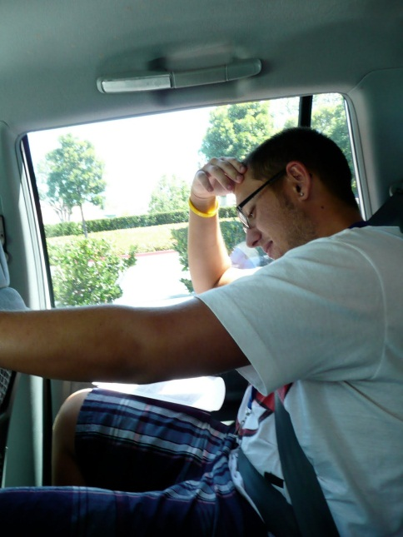
I’m sorry.
I promise I won’t drive your car again.

Slide 9
We use WILL:
- To express an immediate decision, made at the time of speaking.
- OFFER to do something!
Let me help you. I will carry those bags for you.
I will call taxi for you, madam!
I will pay!
Have you lost your key? I will go and look for it!

Slide 10
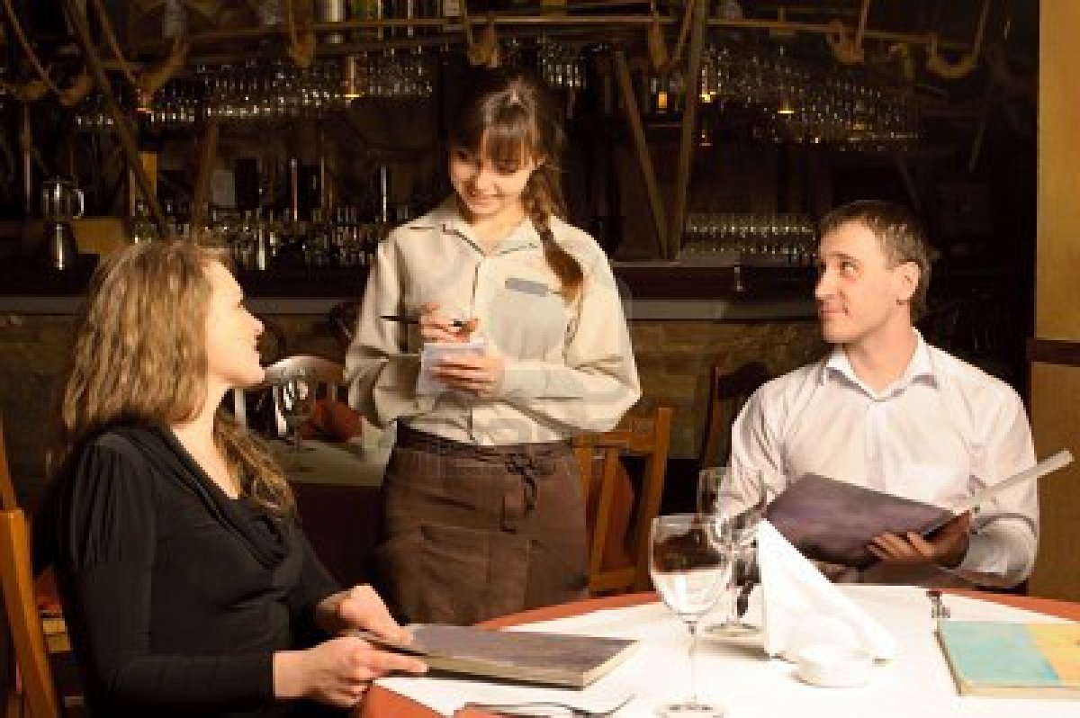
We use WILL:
- To say what you would like, for example in a restaurant.
Yes. I will have
steak with potato chips.
Are you ready to order?

Slide 11

We use WILL:
To refuse to do something (in this case we use NEGATIVE
form of WILL = WON’T (WILL NOT)
I won’t tell.
What is the answer to exercise 4?
(will not)

Slide 12
But now, let’s see when we use BE + GOING TO + VERB

Slide 13
We use BE + GOING TO + VERB
To talk about things that we decided to do, but that we haven’t yet planned in detail. (Intension )
Mike is going to orgnise a welcome party!
I am going to give them a wedding present.
(but I haven’t decided what to get yet)
NOTE: The future with going to only expresses willingness
and intention of doing something.

Slide 14
We use BE + GOING TO + VERB
To talk about long-term project)ts (Plans and
Intenstion).
A: What are you going to be when you grow up?
B: I am going to be a reporter.

Slide 15
We use BE + GOING TO + VERB
(Predication with evidence )
To foretell an event that will happen in the immediate
future esspecially on the basis of what we see in the present
Prediction with evidence.
Hey, look! She is going to fall down!
The clouds are grey. It is going to rain.

