Slide 1
Unit 3: Shapes and mathematical drawings

Slide 2
Polygons.
In geometry, a polygon can be defined as a flat or plane, two-dimensional closed shape bounded with straight sides.
It does not have curved sides.
The sides of a polygon are also called its edges. The points where two sides meet are the vertices (or corners) of a polygon.

Slide 3
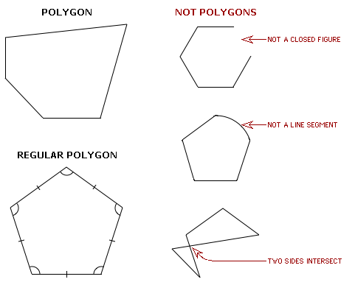

Slide 4
Simple polygons can then be split into even more categories! These categories include information about how many sides make up the polygon.

Slide 5
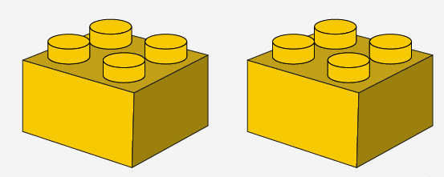
Congruency.
The term “congruent” means exactly equal shape and size. This shape and size should remain equal, even when we flip, turn, or rotate the shapes.
Examples of congruent figures.
Two butterflies that have equal shape and size Two Lego bricks which represent equal shape and size

Slide 6
Congruent triangles
A triangle has 3 sides and 3 angles, so for triangles to be congruent all 3 sides and angles should be congruent.
We observe that:
Side AC = EG, AB = EF and BC = FG,
and ∠ A = ∠ E, ∠ B = ∠ F and ∠ C = ∠ G
Therefore, ABC ≅ EFG.
This symbol (≅) means congruent.

Slide 7
Difference between Congruent Figures and Similar Figures
The significant difference between congruent figures and similar figures is that:

Slide 8
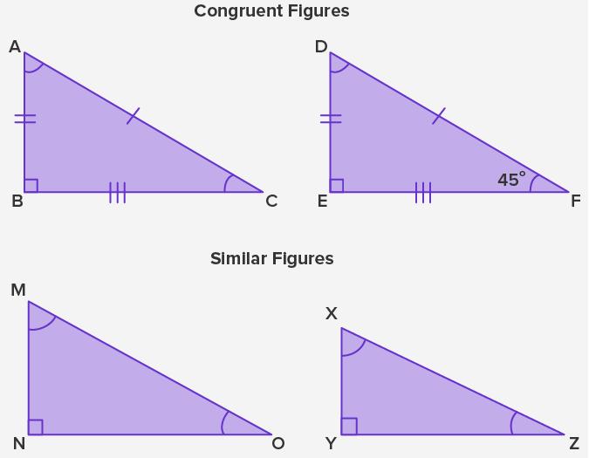

Slide 9
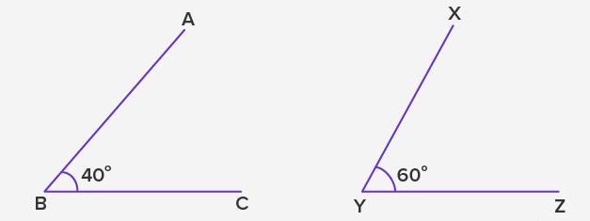
Examples.
Example 1: Are the two angles ∠ ABC and ∠ XYZ congruent to each other?
Solution:
The measure of ∠ ABC = 40° and ∠ XYZ = 60°.
As per the rule, two angles are congruent if the measures of both angles are equal to each other.
The measure of ∠ ABC is not equal to the measure of ∠ XYZ.
Therefore, ∠ ABC is not congruent with ∠ XYZ.

Slide 10
Example 2: Two triangles MNO and XYZ are congruent. Mention the corresponding sides and angles that will be equal.
Given, ∆MNO ≅ ∆XYZ
As per CPCT, all the three corresponding sides and angles of congruent triangles ∆MNO and ∆XYZ will be equal to each other.
Therefore,
MN = XY
NO = YZ
MO = XZ
Also,
∠ M = ∠ X, ∠ N = ∠ Y and ∠ O = ∠ Z

Slide 11
Conclusion.
We understand that identical shapes and sizes are called congruent in geometry.
In congruent figures, the shape and size should remain equal when we flip, turn, or even rotate the shapes.
And in congruent shape, two figures can be placed over each other.

Slide 12
To review watch the videos below:
https://www.youtube.com/watch?v=86iU3fypTd4
https://www.youtube.com/watch?v=bo0aqufTJV4
Polygons.
https://www.youtube.com/watch?v=DUGkQMLowXA
P.44, Ex 3B
Q1, 2, 3, 4, 9, 10

Slide 13
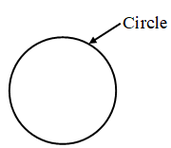
Parts of a circle
Circle is a closed figure that has a curvilinear boundary.
When we think of circles, the very first thing that comes to our mind is their round shape, for example, bangles, coins, rings, plates, pizzas, CDs, etc. The wheels of a car, buses, cycles, trucks, trains, and airplane are also round in shape.

Slide 14
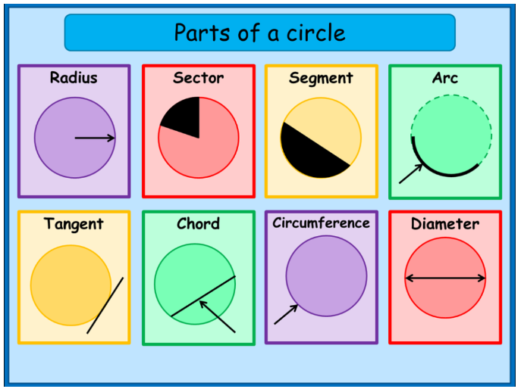

Slide 15
To review watch the video below:
https://www.youtube.com/watch?v=NTRhOU8JHtw
P.46, Ex 3C
Q1, 2, 3

Slide 16
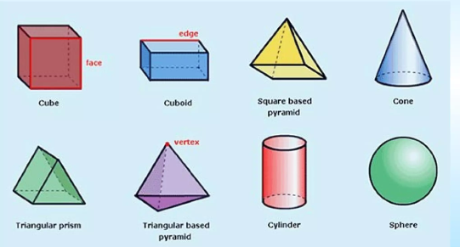
Solid shapes.
A solid shape is three-dimensional (3D).
In 3D shapes, each side is called a face.
Two faces meet an edge.
Edges meet to form a vertex.

Slide 17
The difference between prisms and pyramids.
Prisms | Pyramids
The prism on one side has two identical and parallel bases. | the pyramid only consists of a single base.
The faces or sides of the prism are always rectangular or a parallelogram | pyramids are triangular in shape.
The sides of a prism are perpendicular to its base. | Pyramids’ sides are inclined at a certain angle.

Slide 18
To review watch the video below:
https://www.youtube.com/watch?v=lEijwy3lrZ8
P.48, Ex 3D
Q1, 2, 3, 4 , 8 , 9 , 10, 11

Slide 19
Mathematical drawings
Draw perpendicular lines and parallel lines.
We will need a protractor, a set square, a ruler a sharp pencil.
Go to pages 54 and 55 from your book.
To review watch the video below:
https://www.youtube.com/watch?v=F1qG0l_FEmk
P.55, Ex 3G
Q1, 2

