Slide 1
Daily message
Today, we are going to learn a new sound.

Slide 2
V v
. .

Slide 3
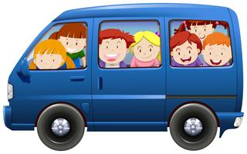
van
. . .

Slide 4

vest
. . . .

Slide 5

vet
. . .

Slide 6
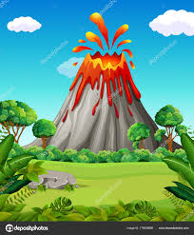
volcano . . . . . . .

Slide 7

vase
. . .

Slide 8
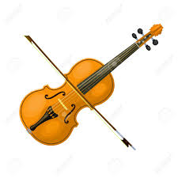
Violin

Slide 9

violets

Slide 10
Seven 7
. . . . .
Eleven 11
. . . . . .

Slide 11
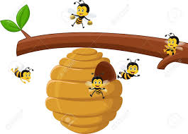
hive
. . . .

Slide 12
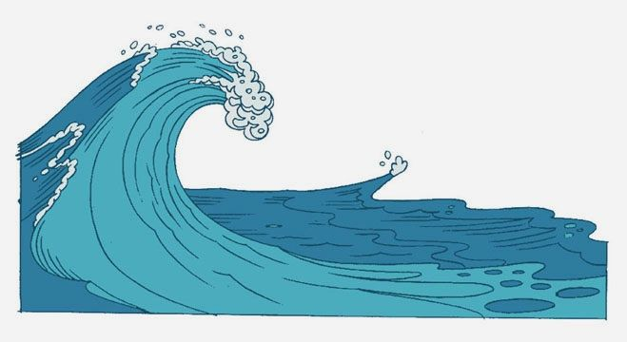
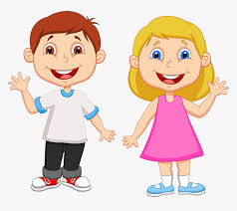
wave
. . .

Slide 13
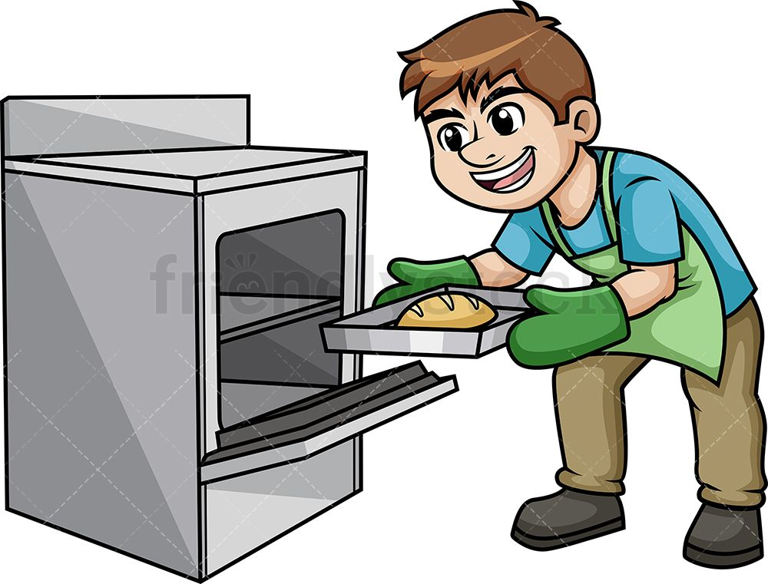
oven
. . . .

Slide 14
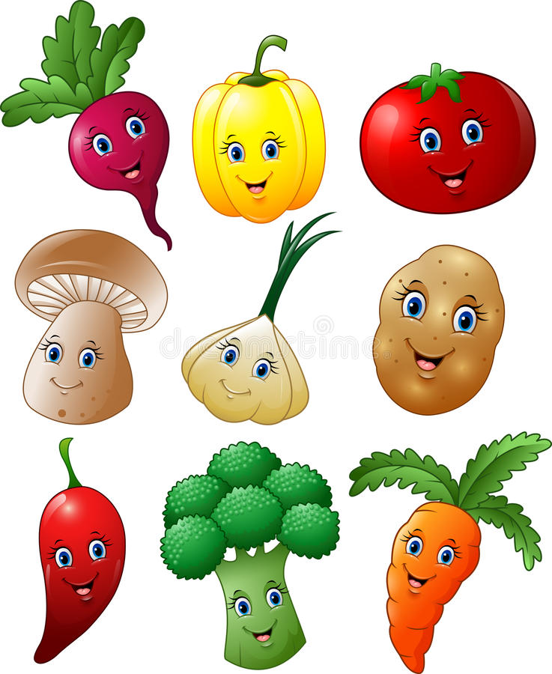
vegetables

Slide 15
vat
. . .

Slide 16
van
. . .

Slide 17
vent
. . . .

Slide 18
vet
. . .

Slide 19
vain
. . .

Slide 20
have
. . .

Slide 21
invent
……

Slide 22
vest
. . . .

Slide 23
velvet
. . . . . .

Slide 24
lava
. . . .

Slide 25
seven
. . . . .

