Slide 1
Daily message
Today, we are going to learn a new sound.

Slide 2
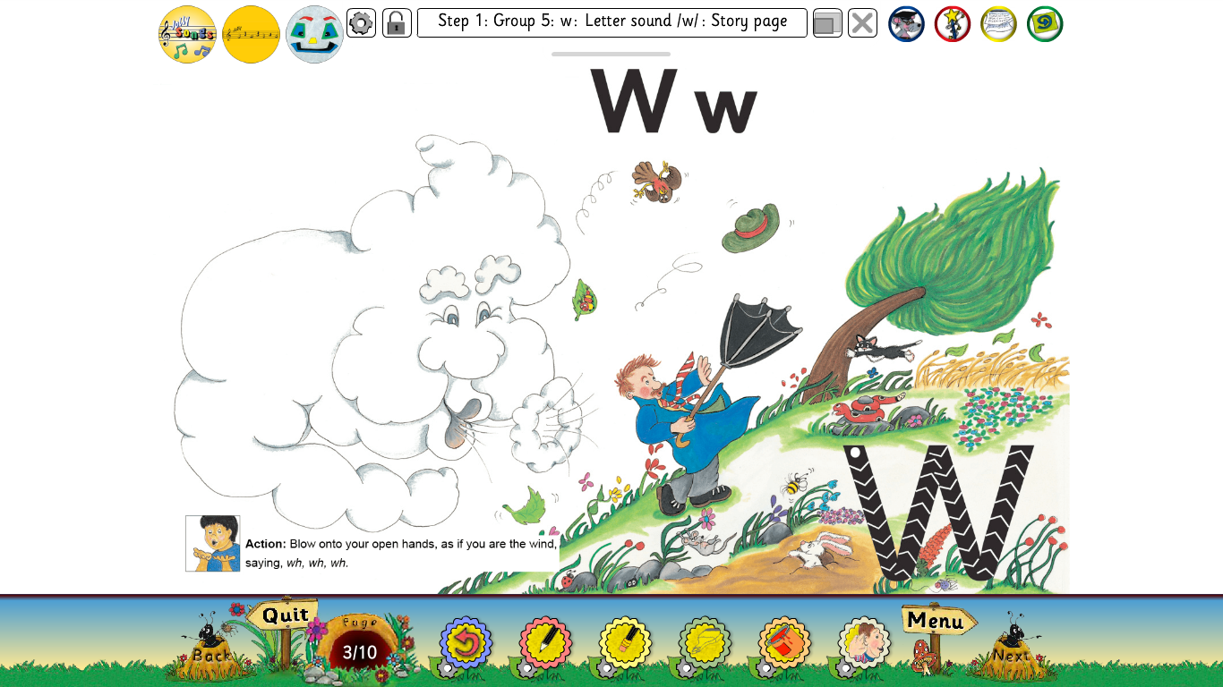

Slide 3
wig
. . .

Slide 4
web
. . .

Slide 5
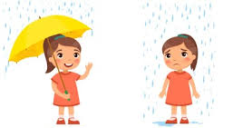
wet
. . .

Slide 6
window
. . . . .

Slide 7
wind
. . . .

Slide 8
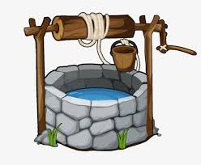
well
. . .

Slide 9
twig
. . . .

Slide 10
wag
. . .

Slide 11
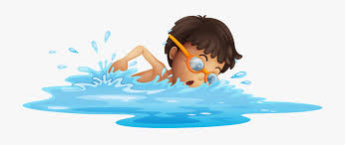
swim
. . . .

Slide 12
sweet
. . . .

Slide 13
wall
. . .

Slide 14
wet wag
. . . . . .

Slide 15
web wig
. . . . ..

Slide 16
went
. . . .

Slide 17
twig
. . . .

Slide 18
well
. . .

Slide 19
will
. . .

Slide 20
swam
. . . .

Slide 21
swim
. . . .

Slide 22
wait
. . .

Slide 23
waist
. . . .

Slide 24
twist
. . . . .

Slide 25
weekend
. . . . . .

Slide 26
Where want were
why was when
we what

