Slide 1
Ex. B page 117

Slide 3
get the sack

Slide 5
launch a new product

Slide 7
take on staff

Slide 9
lay off workers

Slide 10
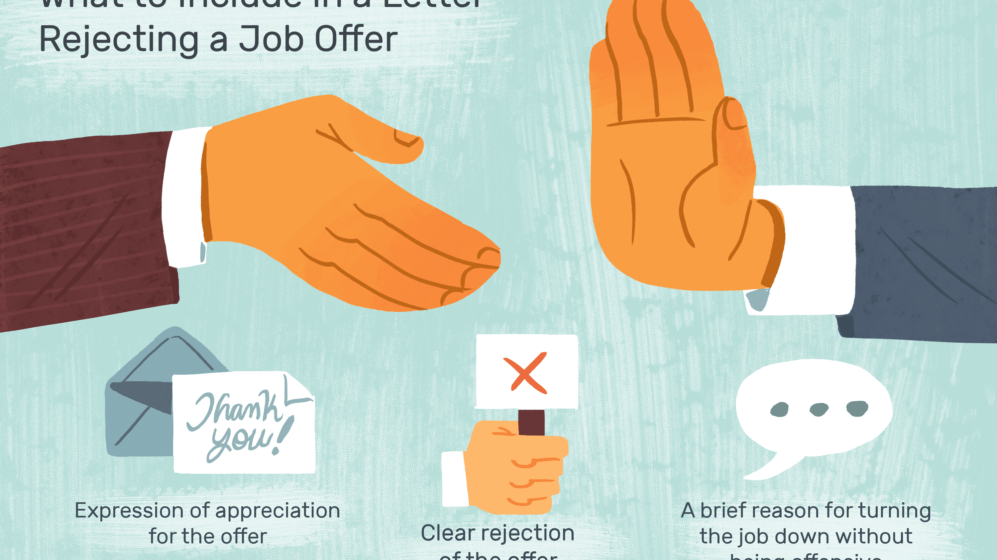

Slide 11
reject an offer

Slide 13
work shift

