Slide 1
Daily message
Today, we are going to learn a new sound.

Slide 3
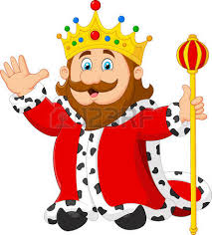
king
. . .

Slide 4
wing
. . .

Slide 5
ring
.. .

Slide 6
bang
. . .

Slide 7
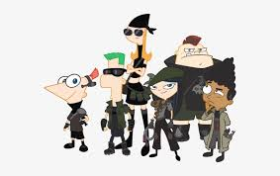
gang
. . .

Slide 8
long
. . .

Slide 9
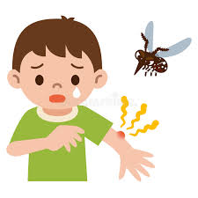
sting
.. . .

Slide 10
string
. . . . .

Slide 11
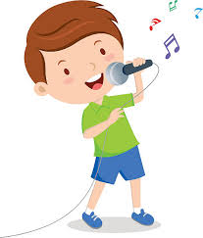
sing
. . .
song
. . .

Slide 12
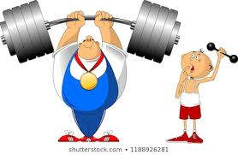
strong... . .

Slide 13
sing sang
. . . . . .

Slide 14
long song
.. . . . .

Slide 15
rang ring
. . . . . .

Slide 16
wing king
. . . . . .

Slide 17
long lung . . . . . .

Slide 18
bang gang
. . . . . .

Slide 19
hang
. . .

Slide 20
sling
.. . .

Slide 21
sting
. . . .

Slide 22
string
.. . . .

Slide 23
strong
... . .

Slide 24
bring
. . . .

Slide 25
swing
. . . .

Slide 26
swung
. . . .

Slide 27
swimming
. . . . . .

