Slide 1
Daily message
Today, we are going to learn a new sound.

Slide 2
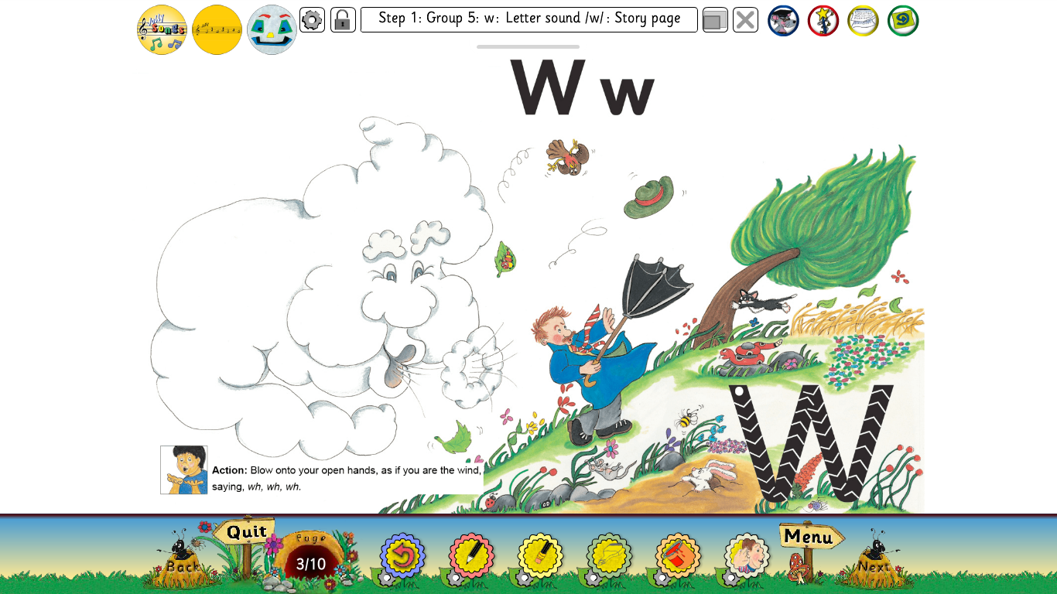

Slide 3
wig
. . .

Slide 4
web
. . .

Slide 5
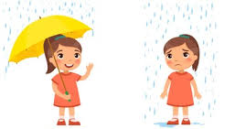
wet
. . .

Slide 6
window
. . . . .

Slide 7
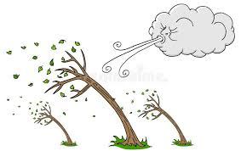
wind
. . . .

Slide 8
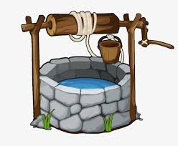
well
. . .

Slide 9
twig
. . . .

Slide 10
wag
. . .

Slide 11
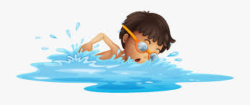
swim
. . . .

Slide 12
sweet
. . . .

Slide 13
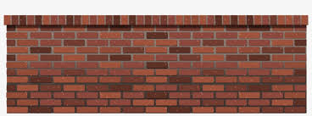
wall
. . .

Slide 14
Jam jug
. . . . . .

Slide 15
wet wag
. . . . . .

Slide 16
web wig
. . . . ..

Slide 17
went
. . . .

Slide 18
twig
. . . .

Slide 19
well
. . .

Slide 20
will
. . .

Slide 21
swam
. . . .

Slide 22
swim
. . . .

Slide 23
wait
. . .

Slide 24
waist
. . . .

Slide 25
twist
. . . . .

Slide 26
weekend
. . . . . .

Slide 27
Where want were
why was when
we what

