Slide 1
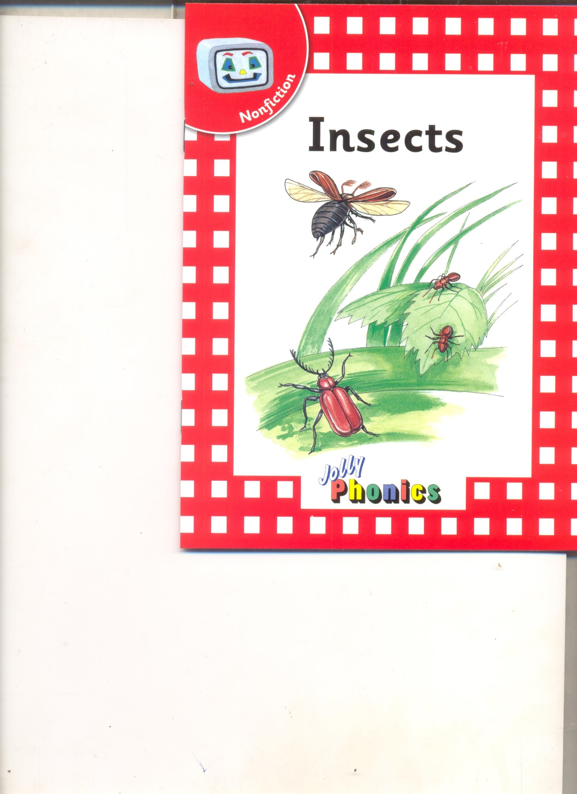

Slide 2
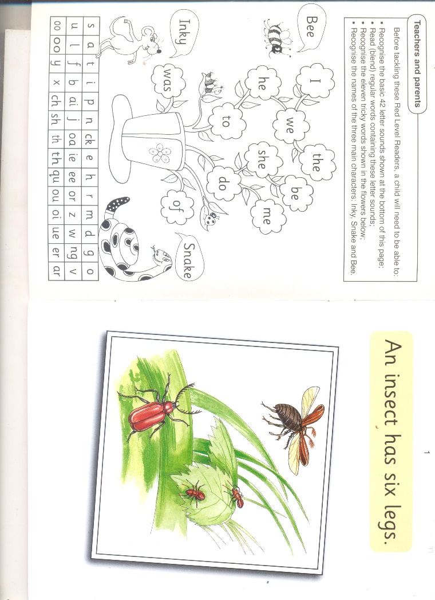

Slide 3
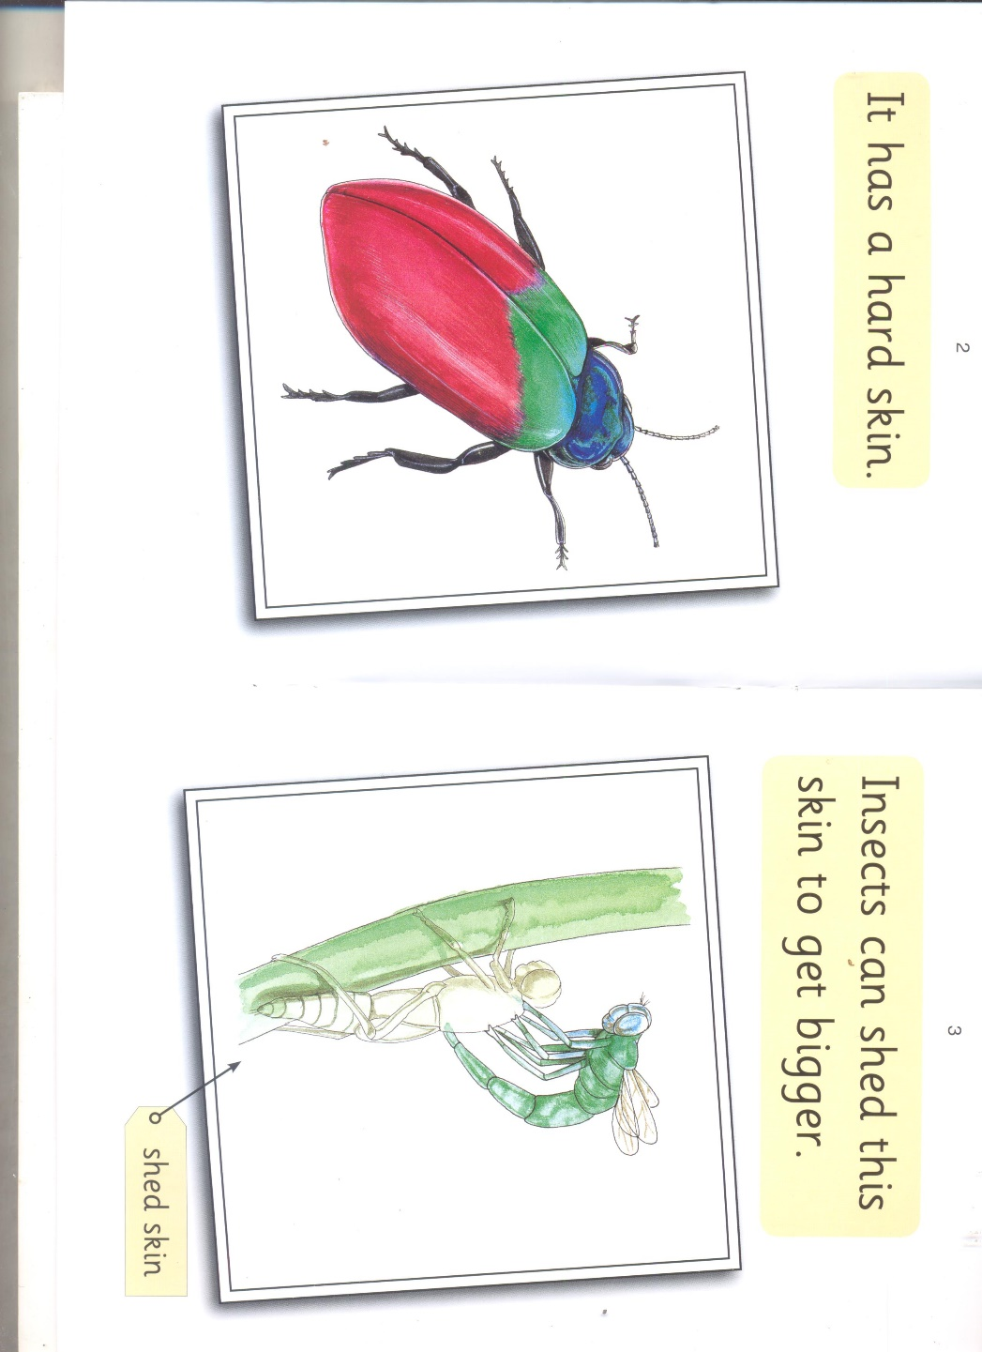

Slide 4
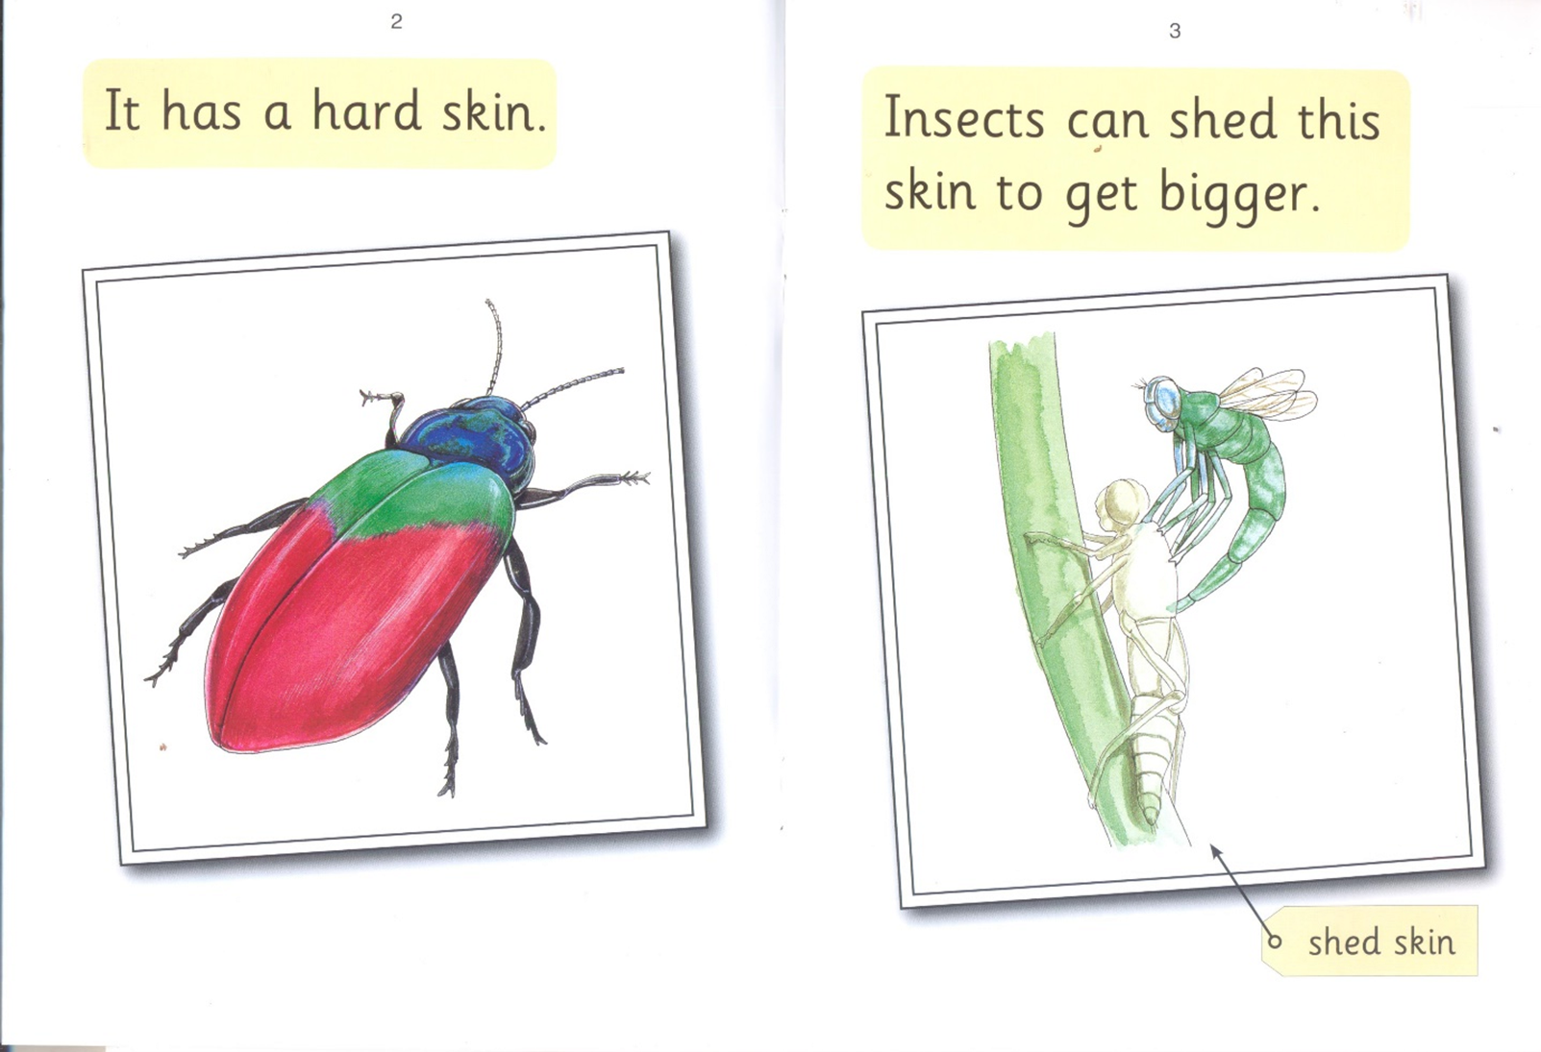

Slide 5
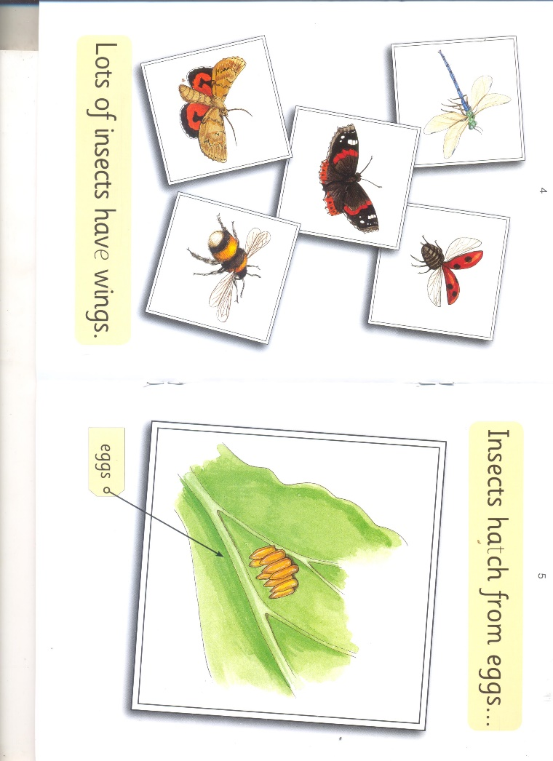

Slide 6
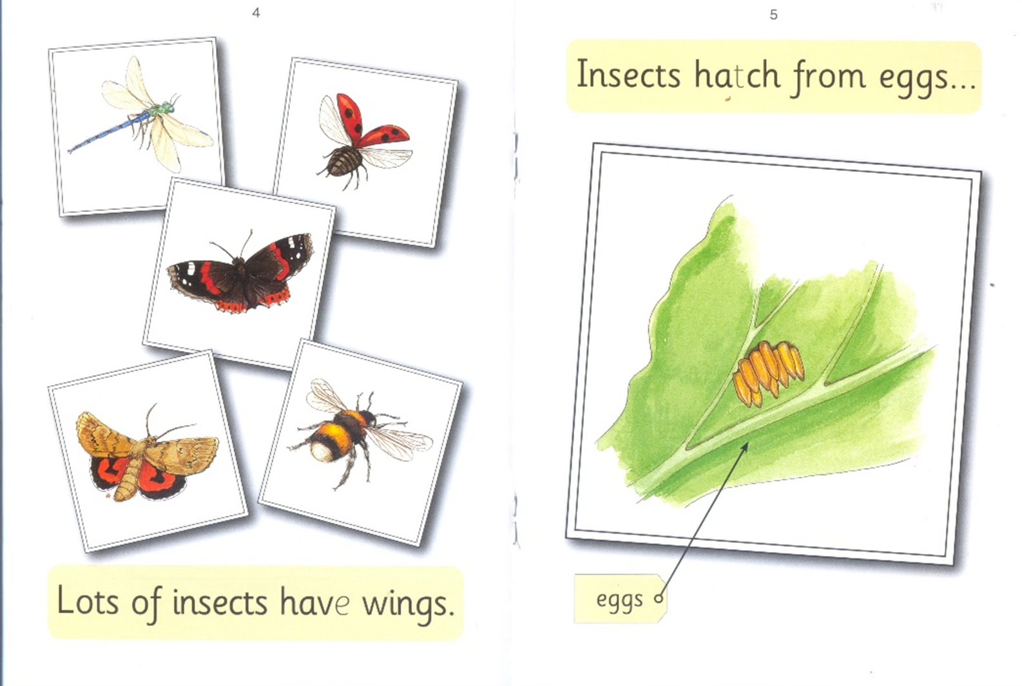

Slide 7
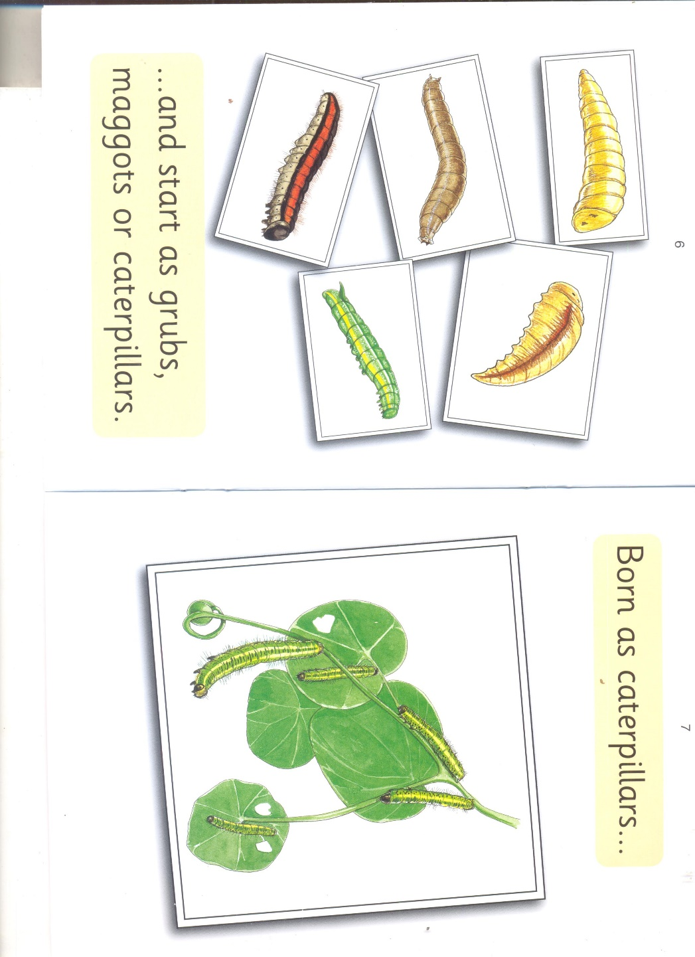

Slide 8
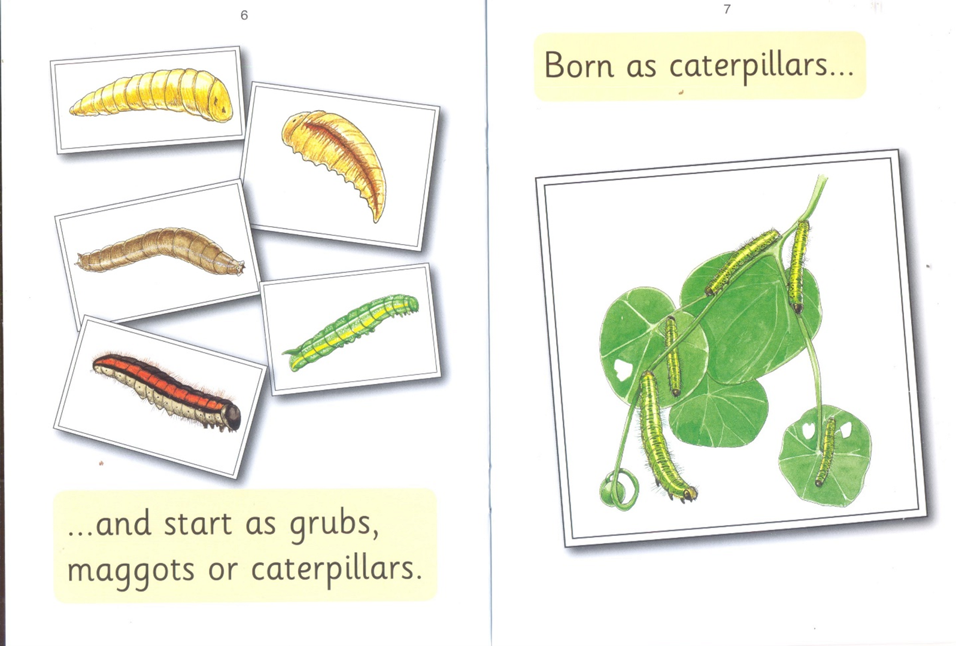

Slide 9
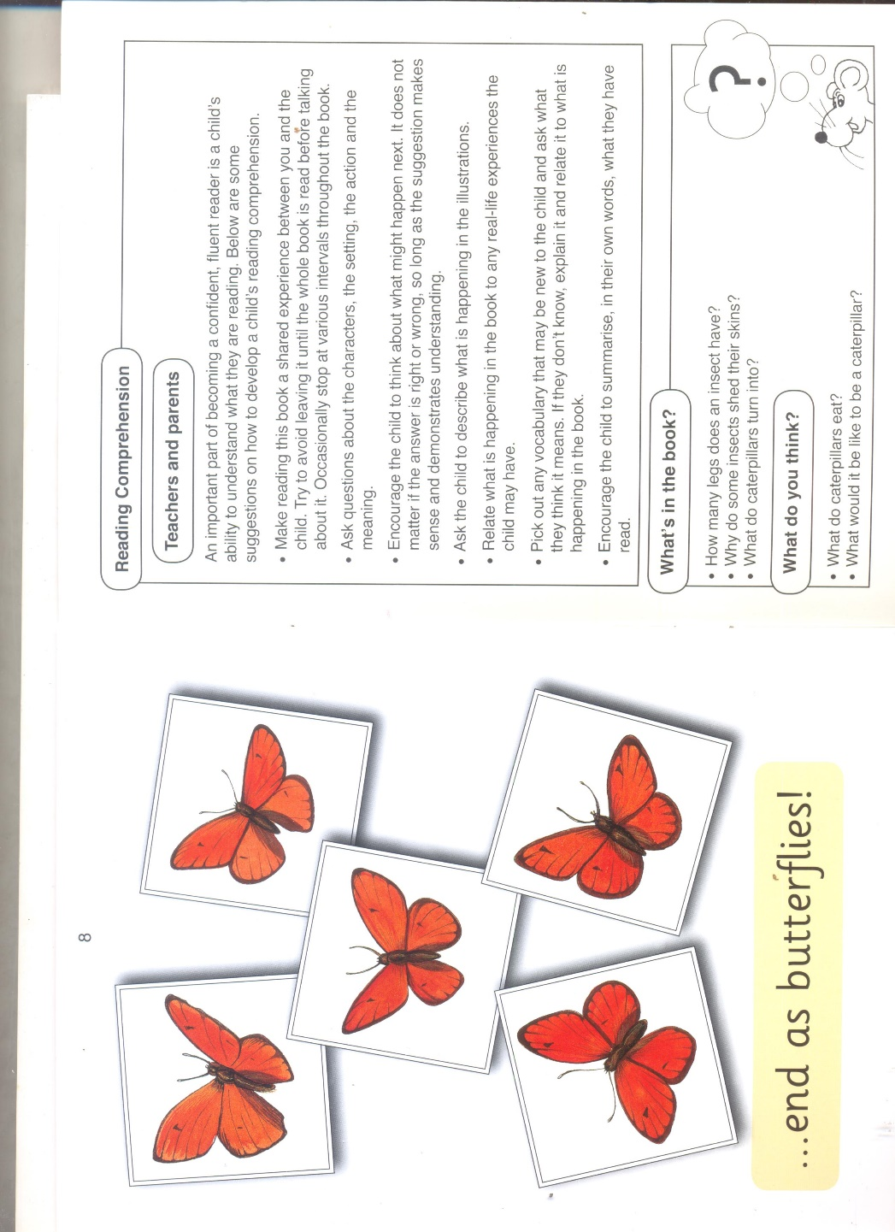

Slide 10
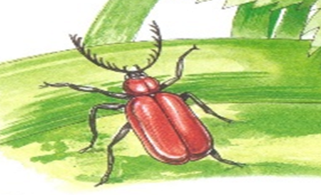


An insect legs

Slide 11
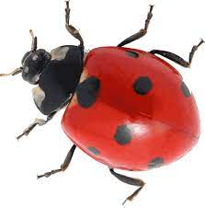




Slide 12


6
six seven

Slide 13
An
insect
has
six
legs.

Slide 14
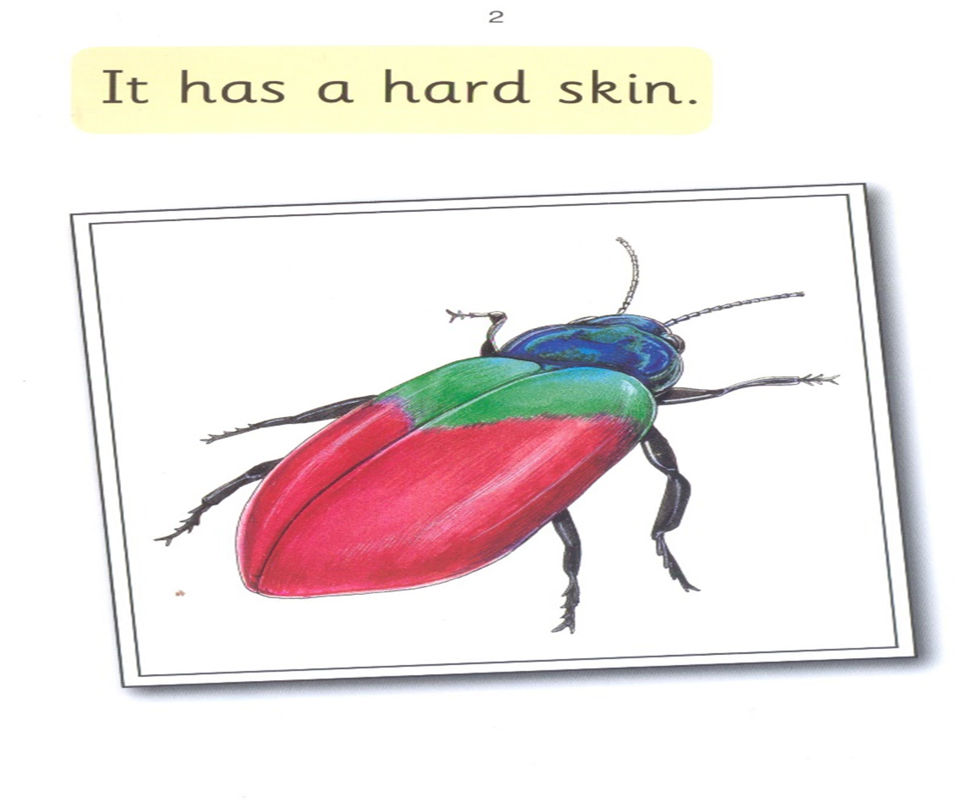

Slide 15

It has

Slide 16

has hard

Slide 17
hard skin

Slide 18
It
has
a
hard
skin.

Slide 19
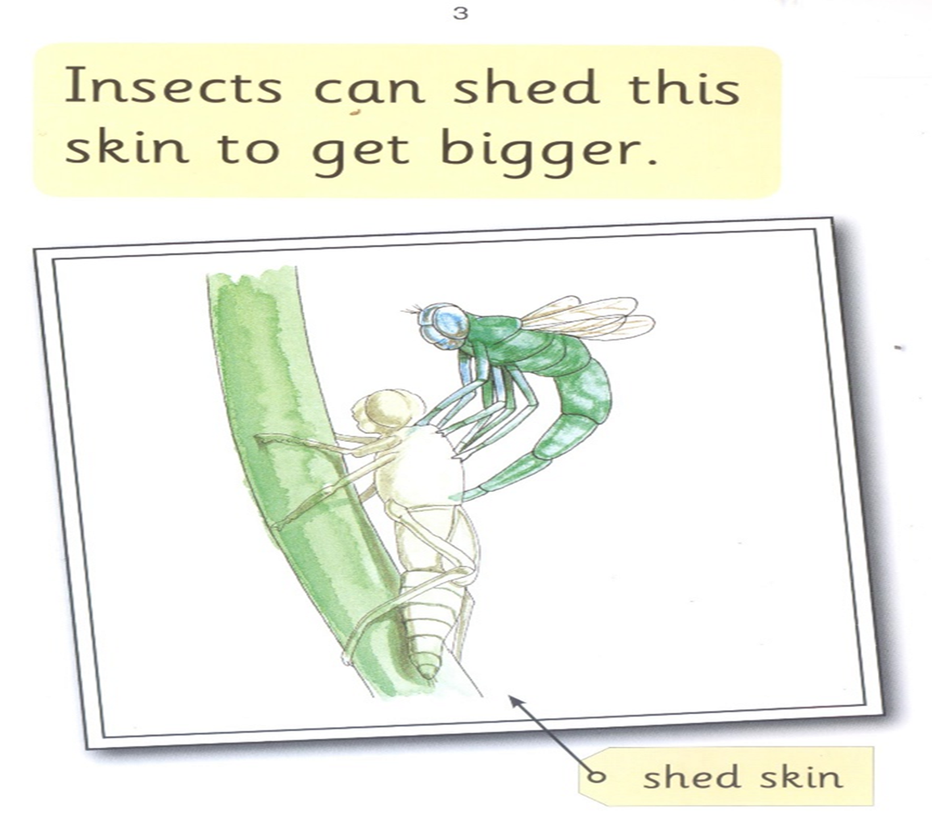

Slide 20

Insect can

Slide 21
shed this

Slide 22

skin to get

Slide 23
shed bigger

Slide 24
Insect
can
shed
this
skin
to
get
bigger.

Slide 25
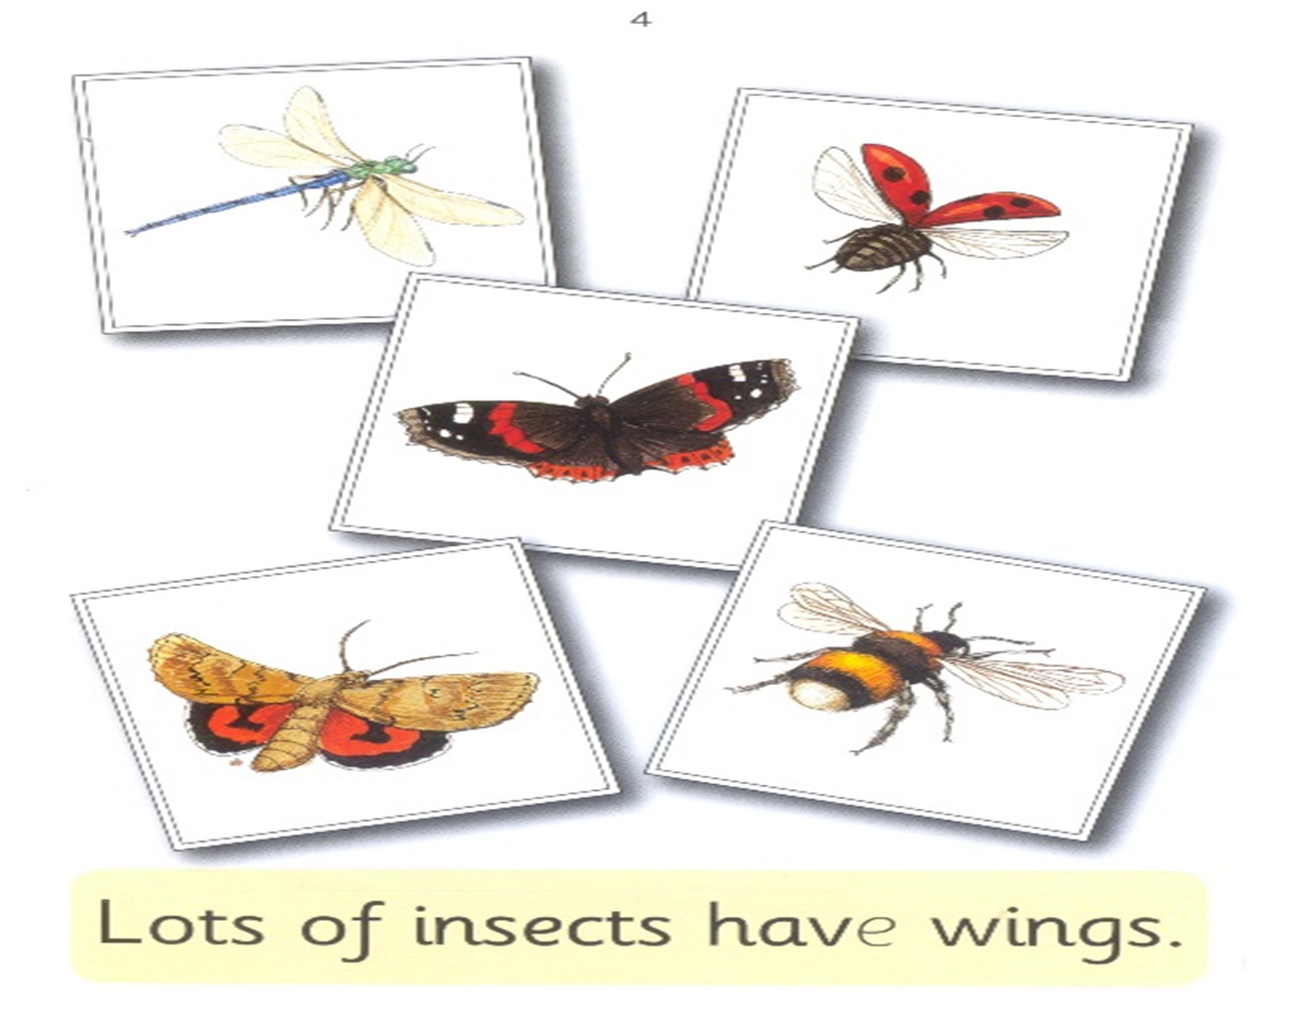

Slide 26

lots of insects

Slide 27

have wings

Slide 28
lots
of
insects
have
wings.

Slide 29
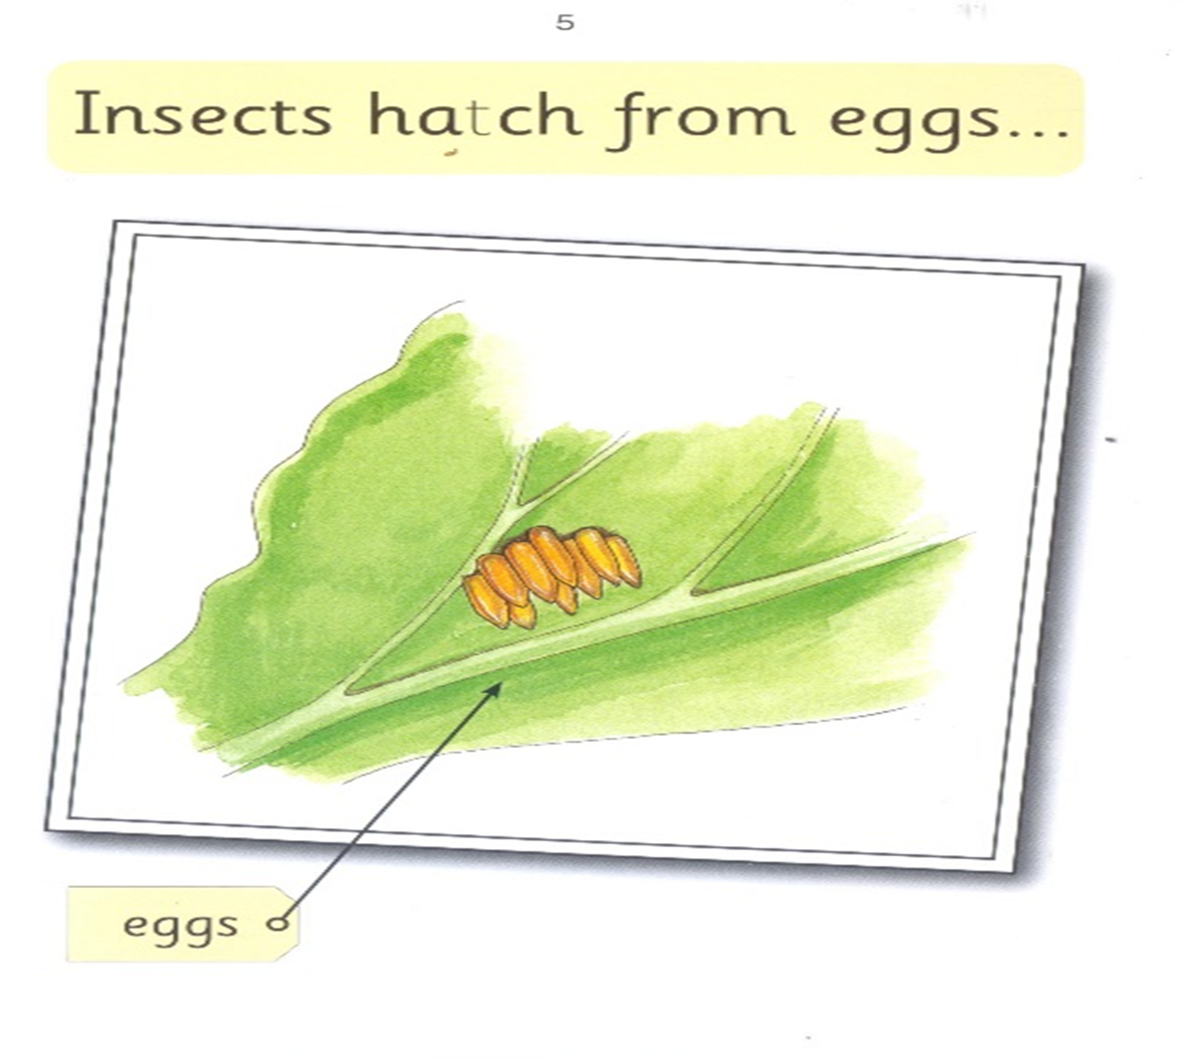

Slide 30

Insects hatch

Slide 31
from eggs

Slide 32
Insects
hatch
from
eggs.

Slide 33
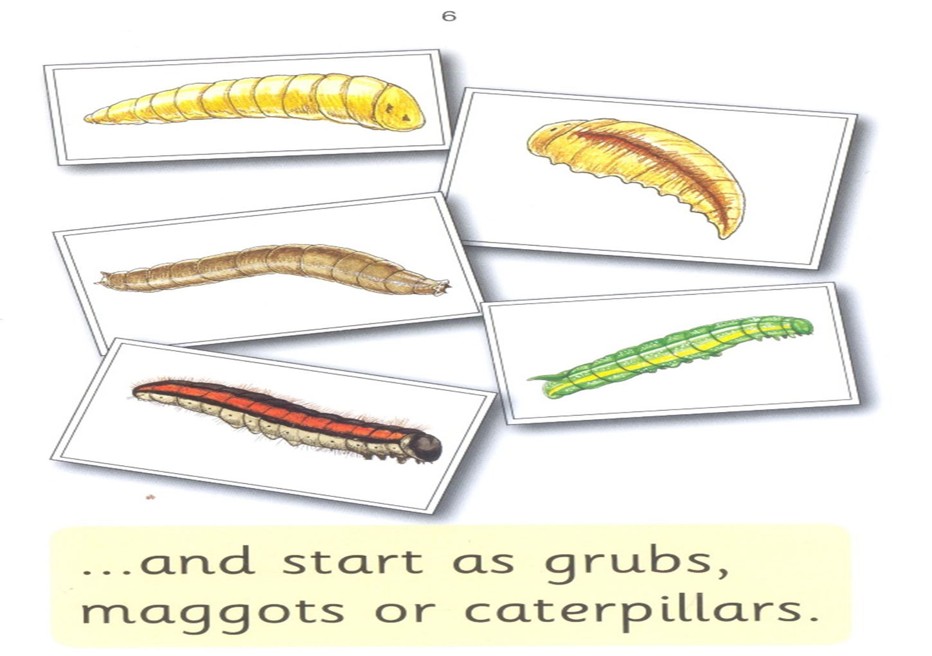

Slide 34
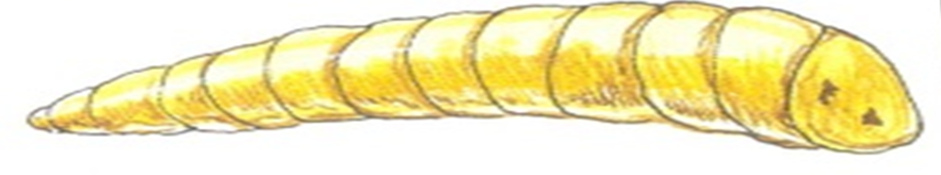

grubs maggots

Slide 35

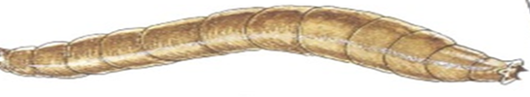



Slide 36
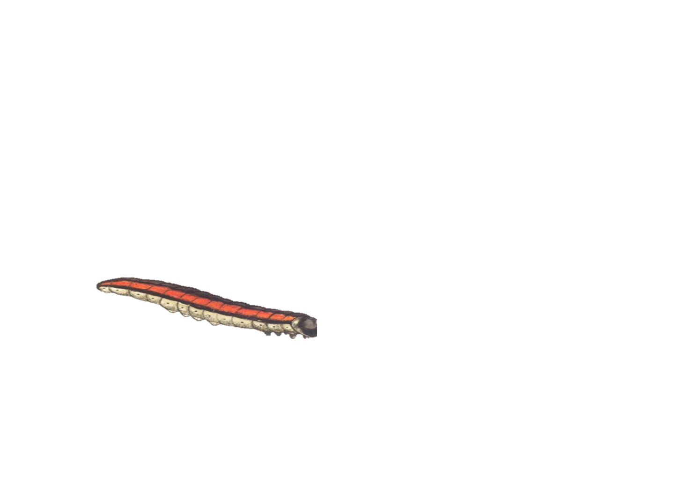
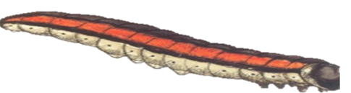


caterpillars maggots

Slide 37
and start as grubs, maggots or caterpillar.

Slide 38
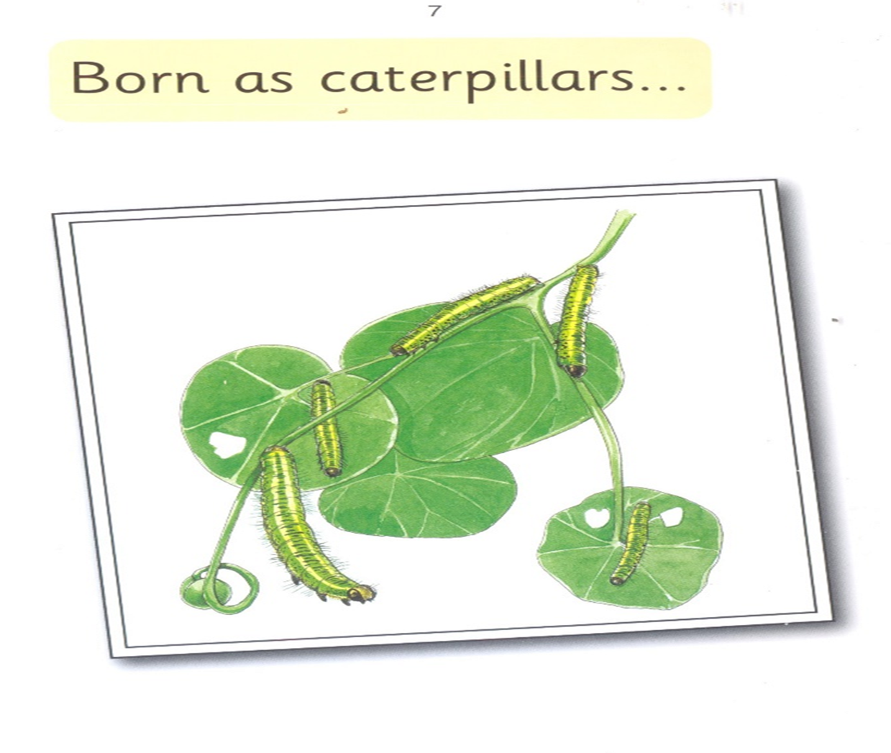

Slide 39
Born
as
caterpillars…

Slide 40
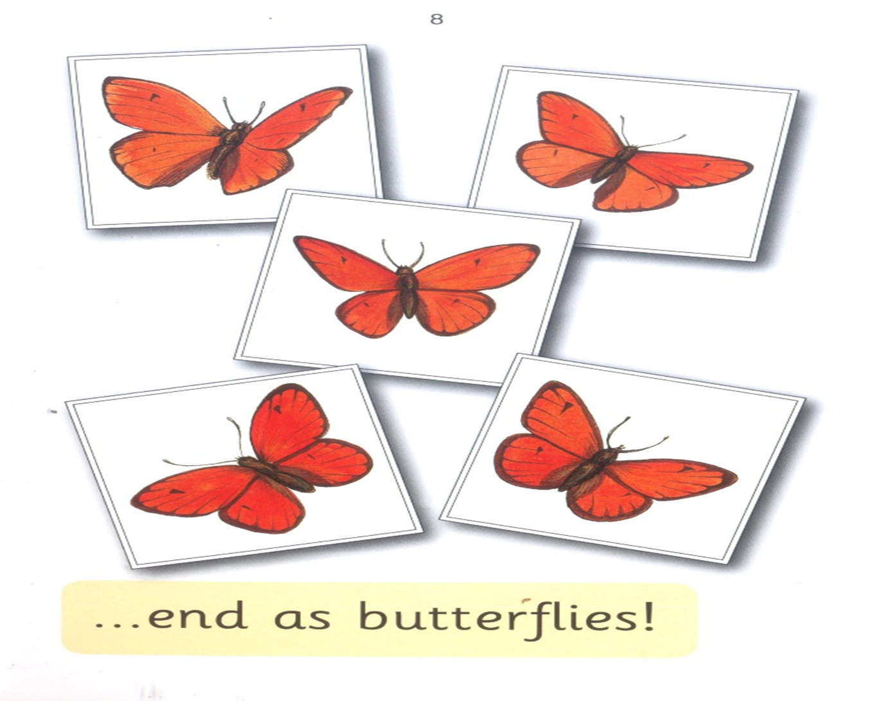

Slide 41
end
as
butterflies…

