Slide 1
Comparative and superlative
Grammar Booklet
page 55

Slide 2
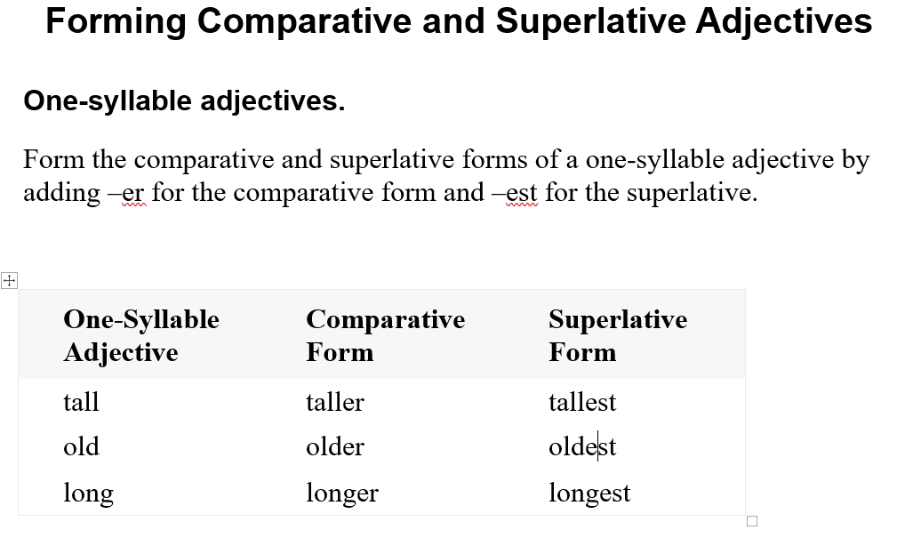

Slide 3
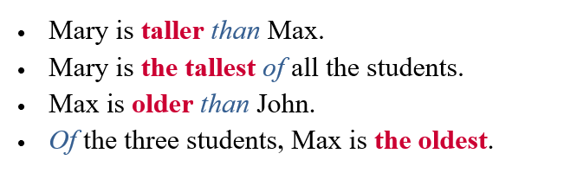

Slide 4
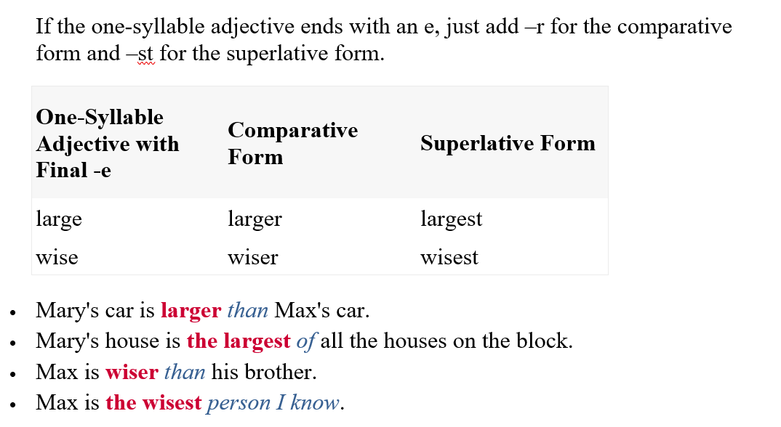

Slide 5
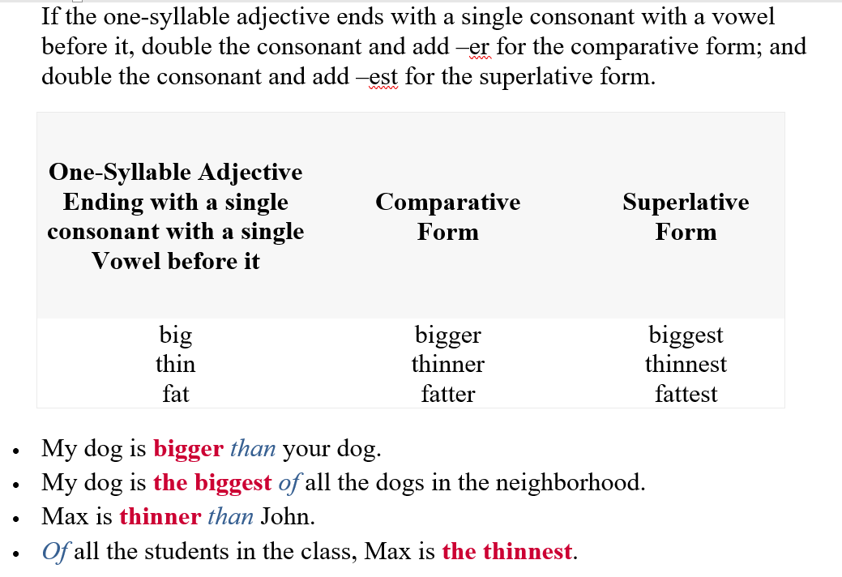

Slide 6
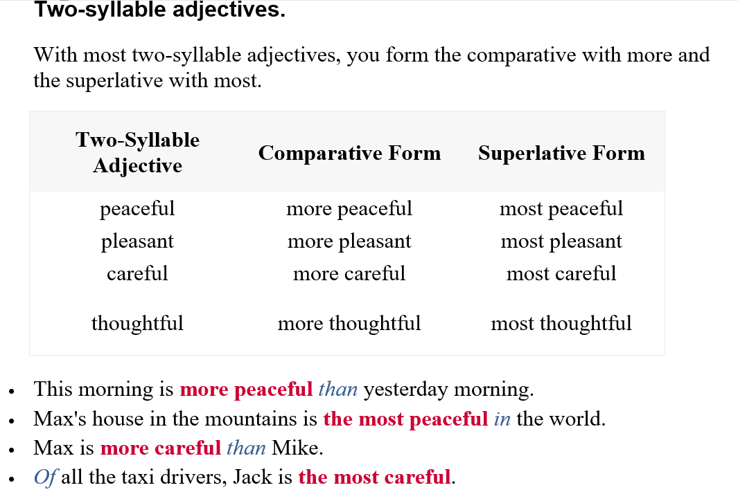

Slide 7
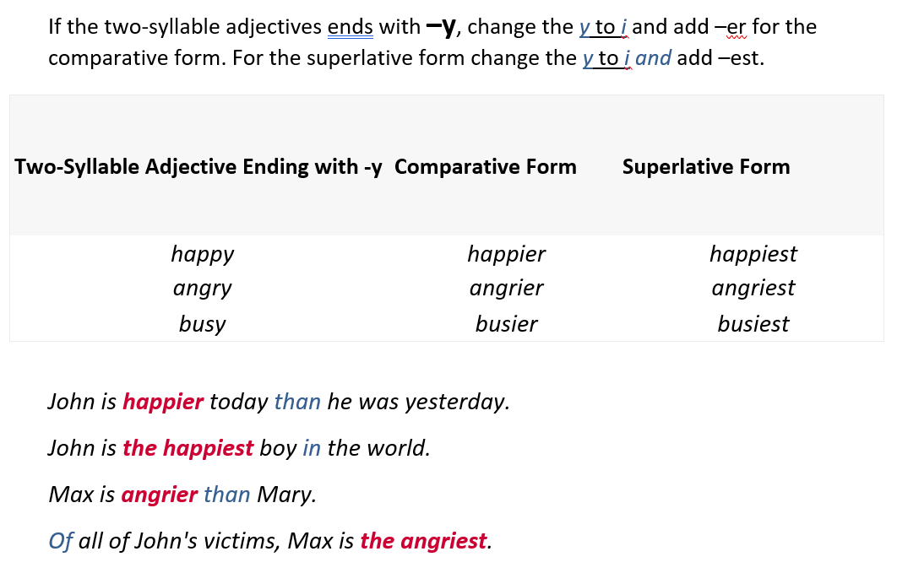

Slide 8
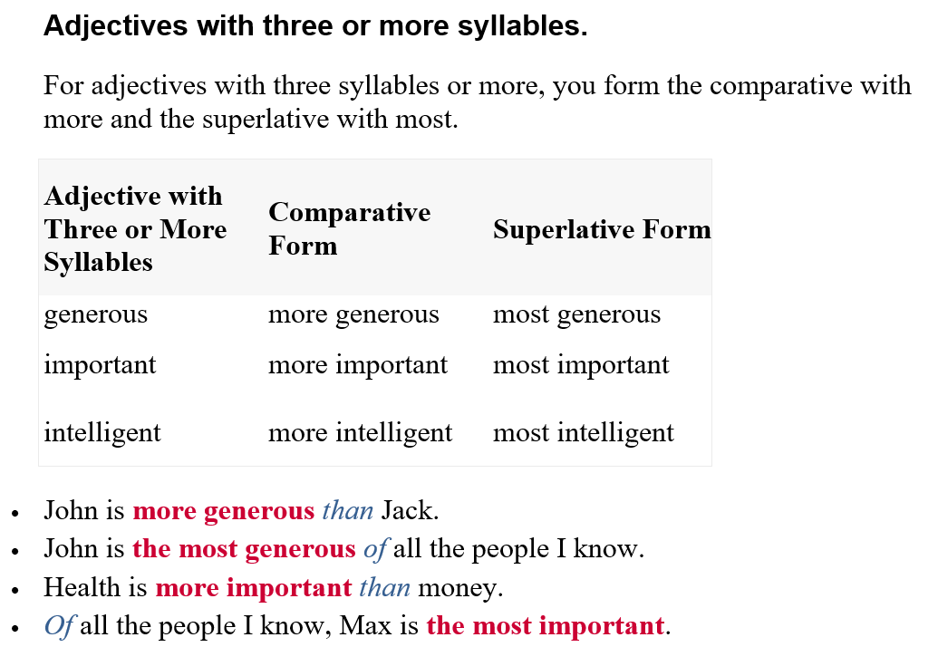

Slide 9
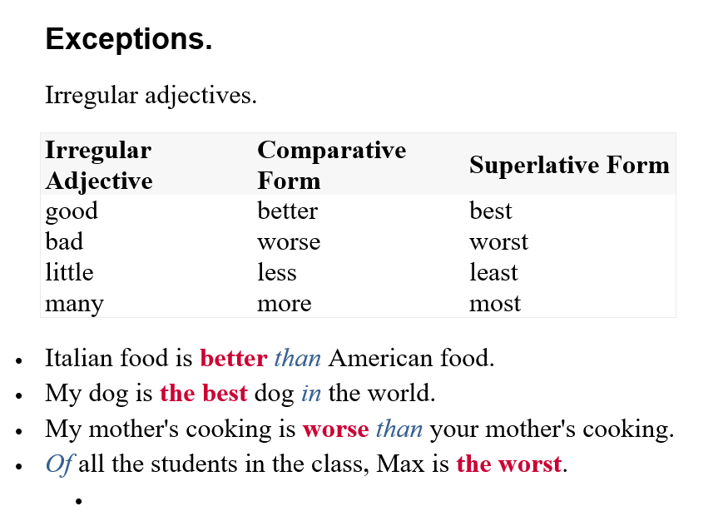

Slide 10
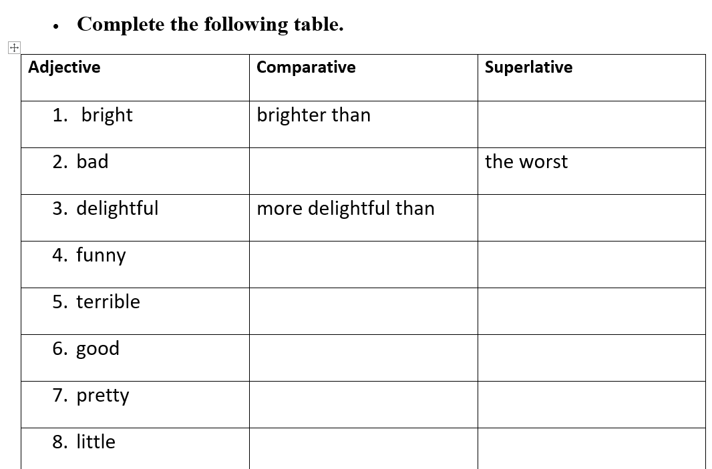
the brightest
worse
the most delightful
funnier
the funniest
more terrible
the most terrible
better
the best
prettier
the prettiest

Slide 11
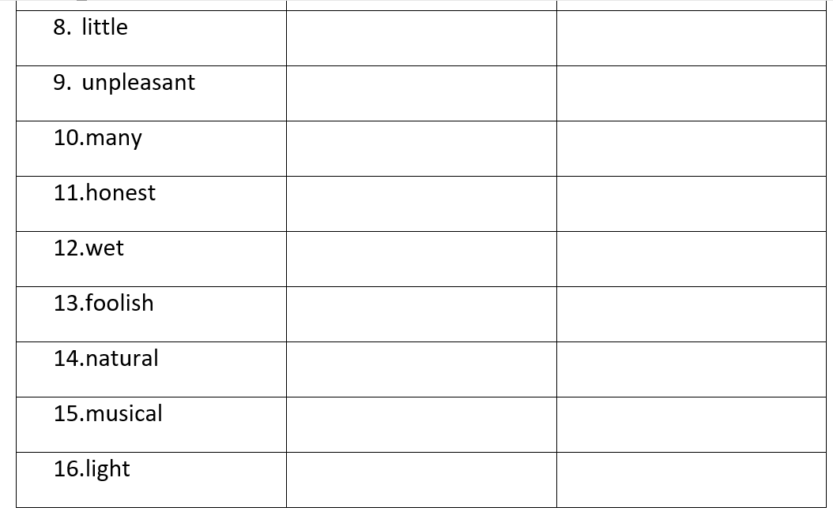
less
the least
more unpleasant
the most unpleasant
more
the most
more honest
the most honest
wetter
the wettest
more foolish
the most foolish
more natural
the most natural
more musical
the most musical
lighter
the lightest

Slide 12
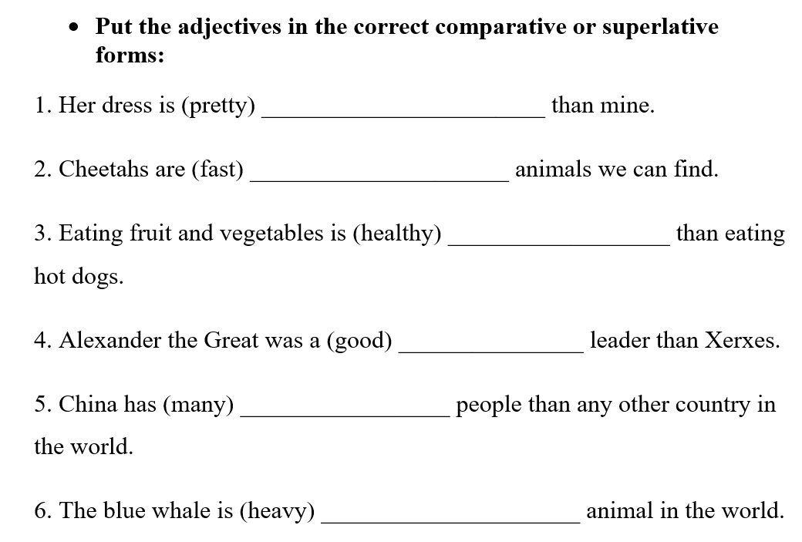
prettier
the fastest
healthier
better
more
the heaviest

Slide 13
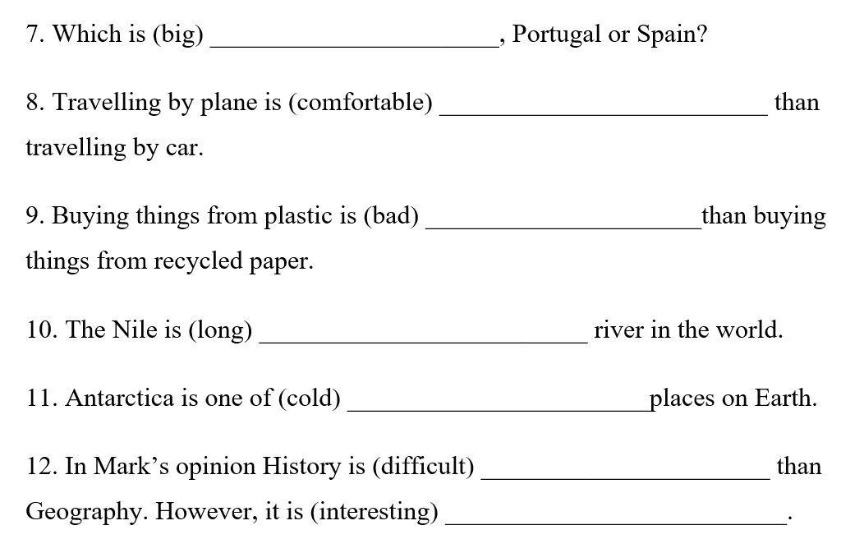
bigger
more comfortable
worse
the longest
the coldest
more difficult
more interesting

Slide 14
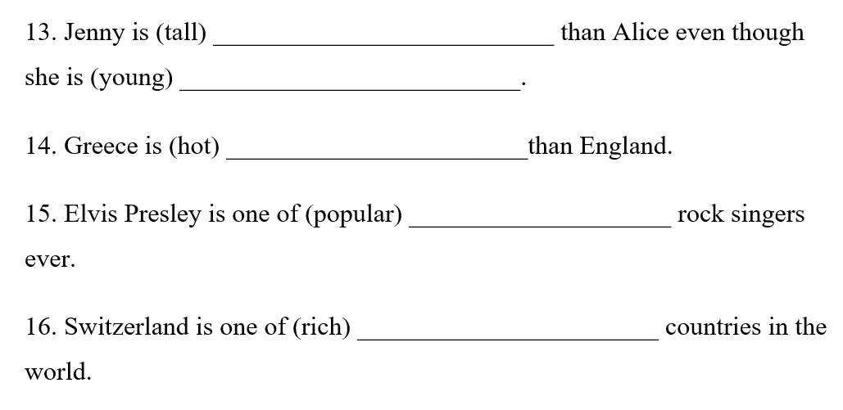
taller
younger
hotter
the most popular
the richest

