Slide 1
Geometry Chapter 8

Slide 2
Objectives:
To learn about the exterior angle of a triangle.
To learn about angles in parallel lines and intersecting lines.

Slide 3
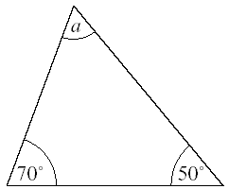
Angles in a triangle
Angles in a triangle add up to 180º.
Example: find the missing angle.
Answer:
Sum of the known angles is
70º + 50º = 120º
Angle ‘a’ = 180º − 120º = 60º because angles in a
triangle add up to 180º.
To review watch the video below: https://www.youtube.com/watch?v=mLeNaZcy-hE

Slide 4
Exterior angles
Exterior Angle of a Triangle - YouTube

Slide 5
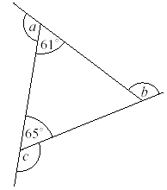
Example: find the missing angles.
Answer:
Angle ‘a’= 180º − 61º = 119º supplementary
angles on a straight line
Angle ‘b’ = 61º + 65º = 126º
Angle ‘c’ = 180º − 65º = 115º
supplementary angles on a straight line
P. 128 Ex.8A:
Q1
Q3
Q5 (a)
Q6

Slide 6
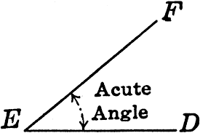
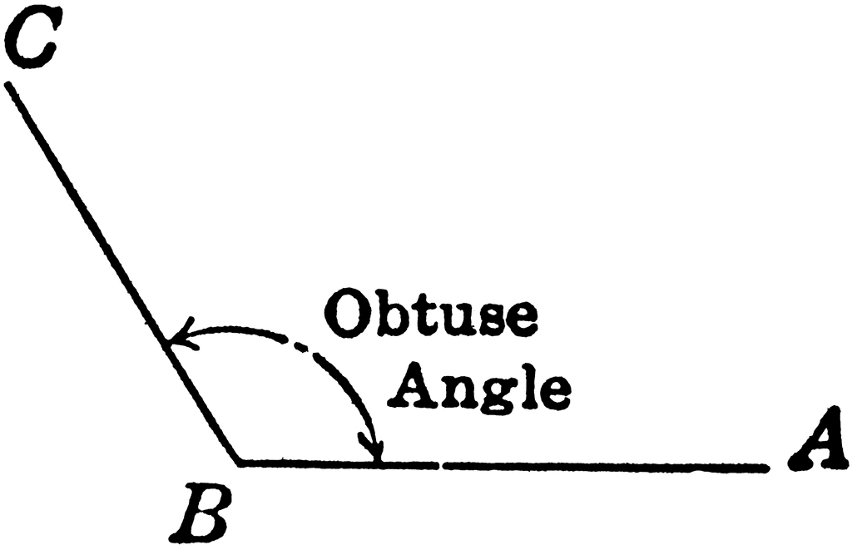
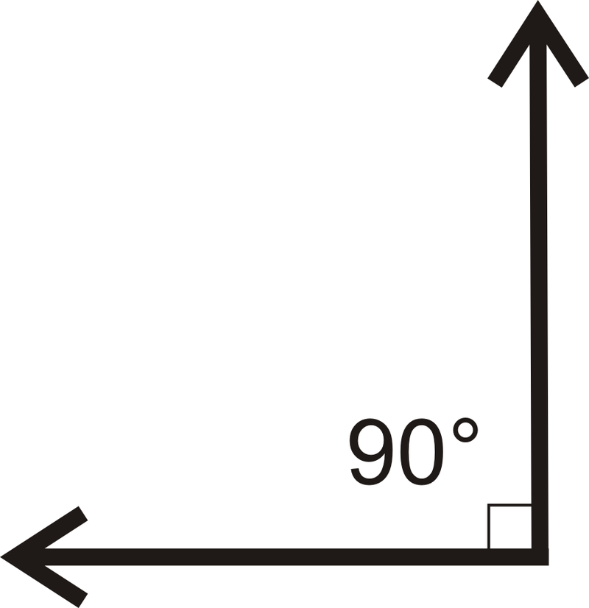
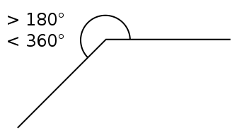
Things to remember:
Angles less than 90º are called acute angles.
Angles more than 90º and less than 180º are called obtuse angles.
A 90º angle is called a right angle. Angles that add up to 90º are called complementary angles.
An angle greater than 180º and less than 360º is called a reflex angle.

Slide 7
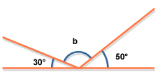
Angles on a straight line add up to 180º. They are called supplementary angles.
Example: calculate the missing angle.
Answer:
Sum of the two angles is 30º + 50º = 80º
Angle ‘b’ = 180º − 80º = 100º because they are
supplementary angles on a straight line.

Slide 8
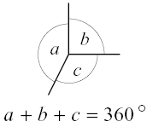
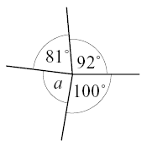
Angles around a point add up to 360º.
Example: calculate the missing angle.
Answer:
Sum of the known angles is
81º + 92º + 100º = 273º
Angle ‘a’ = 360º − 273º = 87º because angles around a
point add up to 360º.

Slide 9
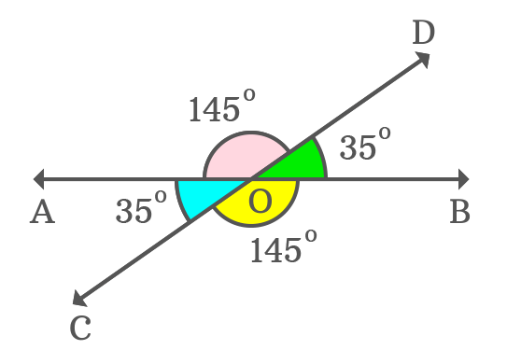
When two lines intersect, every two opposite angles are equal. These are called vertically opposite angles.
To review watch the two videos below: https://www.youtube.com/watch?v=DGKwdHMiqCg&t=269s
https://www.youtube.com/watch?v=_n3KZR1DSEo

Slide 10
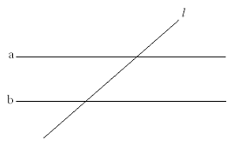
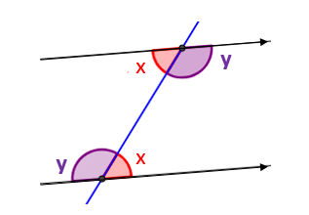
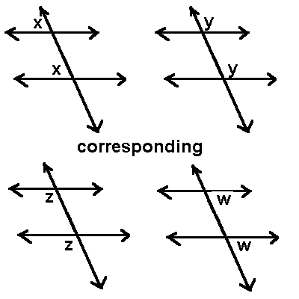
Parallel Lines
When a line crosses two parallel lines such as this diagram you get other properties.
1st property: alternate angles, resembles the letter “Z”. There will be two obtuse equal angles and two acute equal angles.
2nd property: corresponding angles, resembles the letter “F”. There will be two obtuse equal angles and two acute equal angles.

Slide 11
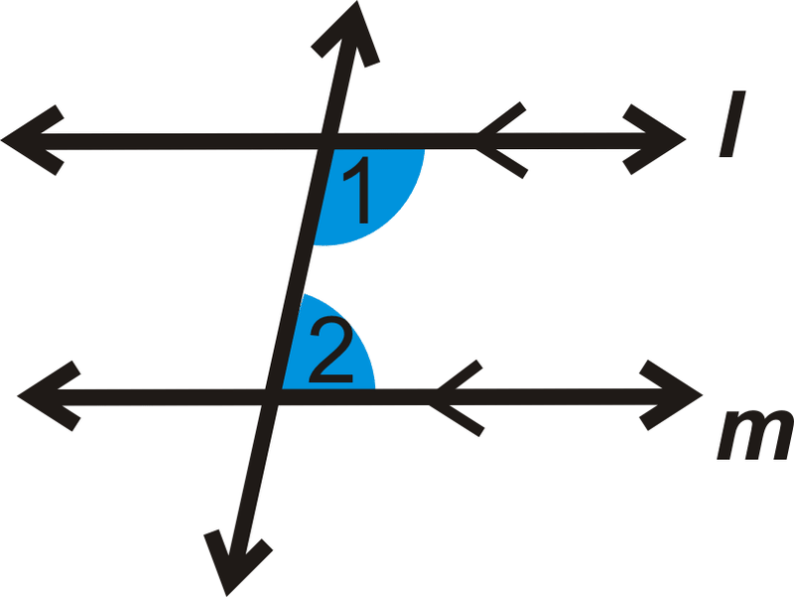
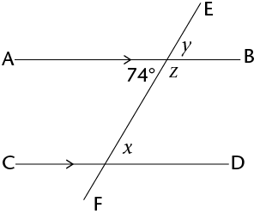
3rd property: same side interior supplementary angles (allied angles), resembles the letter “C”. These angles add up to 180º. So 1 + 2 = 180º
Example: calculate the missing angles.
Answer:
X= 74º Alternate with the given angle
Y = 74º vertically opposite with the given angle
OR Y = 74º corresponding with angle ‘X’
Z= 180º − 74º = 106º supplementary with the given angle on a straight line
OR Z= 180º − 74º = 106º allied angle with ‘X’.
To review watch the videos below:
Corresponding angles: https://www.youtube.com/watch?v=fhvR6lzy_jg
Alternate angles: https://www.youtube.com/watch?v=-BPdBfwFgUM

Slide 12
Angles in quadrilaterals
Angles in quadrilaterals add up to 360º.
Example: find the missing angles.
Answer:
Angle ‘x’=120º because opposite angles
in a Parallelogram are equal.
Answer:
Sum of angles =120º + 60º + 70º = 250º
Angle ‘x’ = 360º − 250º = 110º
To review watch the video below:
https://www.youtube.com/watch?v=yiREqzDsMP8&t=7s

Slide 13
P. 131 Ex.8B
Q1
Q2
Q3 (a, c)
Q. 5
Q6 (b, c)
Q7
Q10 (a)

Slide 14
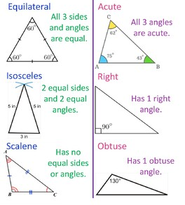
Types of Triangles
Things you should always remember ☺

Slide 15
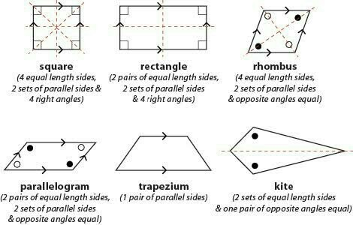
Quadrilaterals
Things you should always remember ☺

