Slide 1
Adjectives & Adverbs
1

Slide 2
Adjectives are used to describe nouns. They say what something is like.
- Adjectives come before nouns or after “be” and linking verbs.
- They have the same form in the singular and plural.

Slide 3
1. ADJECTIVES: Uses
(a) She is a skinny woman.

Slide 4
1. ADJECTIVES: Uses
(b) It is a giant fish.

Slide 5
1. ADJECTIVES: Uses
(c) It is a mysterious tree.

Slide 6
Before a noun: →ADJECTIVE + NOUN
(a) She is a skinny woman
adjective + noun
(b) It is a giant fish.
adjective + noun
(c) It is a mysterious tree.
adjective + noun

Slide 7
1. ADJECTIVES: Uses
(d) This man is fat.

Slide 8
1. ADJECTIVES: Uses
(e) The child seems naughty.

Slide 9
1. ADJECTIVES: Uses
(f) The monkey looks clever.

Slide 10
1. ADJECTIVES: Uses
(g) This clip appears funny.

Slide 11
After “Be” and “link verbs”: →BE/ LINK VERBS + ADJECTIVE
1. ADJECTIVES: Uses
(d) This man is fat.
be + adjective
(e) The child seems naughty
link verb + adjective
(f) The monkey looks clever.
link verb + adjective

Slide 12
Adverbs are used to describe or give information about verbs, adjectives or other adverbs
2. ADVERBS
- They explain:
how (adverbs of manner)
where (adverbs of place)
when (adverbs of time)
how often (adverbs of frequency)
something happens

Slide 13
2. ADVERBS: Uses
(a) Her hair grows quickly.
verb + adverb

Slide 14
2. ADVERBS: Uses
(b) He is shouting angrily
verb + adverb

Slide 15
An adverb usually goes right after the verb it describes:→ VERB + ADVERB
2. ADVERBS: Uses
(a) Her hair grows quickly.
(b) He is shouting angrily
verb + adverb

Slide 16
2. ADVERBS: Uses
(c) Look. It’s an extremely big snake
adverb + adjective

Slide 17
2. ADVERBS: Uses
(d) Oh. It’s a very fat dog
adverb + adjective

Slide 18
2. ADVERBS: Uses
(e) The baby is drinking quite comfortably
adverb + adverb

Slide 19
An adverb usually goes right after the adjective or adverb it describes:→ ADVERB + ADVERB → ADVERB + ADJECTIVE
2. ADVERBS: Uses
(c) Look. It’s an extremely big snake
(d) Oh. It’s a very fat dog
adverb +adjective
(e) The baby is drinking quite comfortably
adverb + adverb

Slide 20
3. ADVERBS OF MANNERS
How did he drive the car?
He drove it carelessly

Slide 21
3. ADVERBS OF MANNERS
(b) The donkey is pulling the cart heavily
(b) The donkey is pulling heavily the cart
?

Slide 22
Use adverbs of manner to describe or give more information about action verbs. These adverbs often answer “How” questions. NOTE: Don’t put Adverb of manner between the verb and the object
2. ADVERBS OF MANNERS
(a) How did he drive the car?
He drove it carelessly
(b) The donkey is pulling the cart heavily
verb object adverb
(b) The donkey is pulling heavily the cart

Slide 23
3. ADVERBS OF MANNERS: FORM
(a) She is a busy mom.
adjective
(b) The mom works busily.
adverb

Slide 24
3. ADVERBS OF MANNERS: FORM
(c) It is a curious dog.
adjective
(d) The dog looks curiously.
adverb

Slide 25
3. ADVERBS OF MANNERS: FORM
(e) He is a miserable boy.
adjective
(f) The boy lives miserably.
adverb

Slide 26
Adverbs of manner are often formed by adding -ly to adjectives: ADJECTIVE + LY → ADVERB
2. ADVERBS OF MANNERS

Slide 27
3. ADVERBS OF MANNERS: FORM
(g) It is a lonely dog.
adjective
?
adverb

Slide 28
3. ADVERBS OF MANNERS: FORM
(g) It is a silly hat.
adjective
?
adverb

Slide 29
Some adjectives also end in -ly —for example, friendly, lonely, lovely, and silly
3. ADVERBS OF MANNERS: FORM

Slide 30
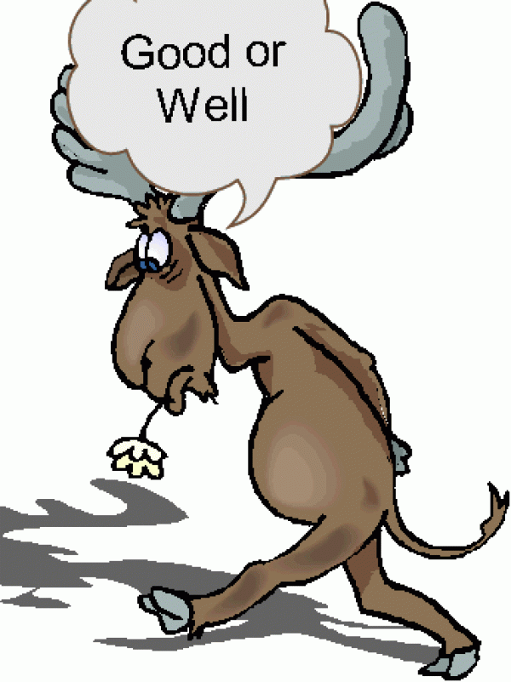
3. ADVERBS OF MANNERS:
IRREGULAR FORMS
(a) Jane is a good student.
(b) Jane studies well.

Slide 31
3. ADVERBS OF MANNERS:
IRREGULAR FORMS
(c) Are you a hard worker?.
(d) Do you work hard?

Slide 32
3. ADVERBS OF MANNERS:
IRREGULAR FORMS
(e) He was late for work
(f) He went to work late

Slide 33
3. ADVERBS OF MANNERS:
IRREGULAR FORMS
(g) A leopard runs fast.
(h) It’s a fast animal.

Slide 34
Some common adverbs of manner are not formed by adding -ly to adjectives: a. The adverb form of good is well. b. A few adjectives and adverbs have the same form—for example, early, fast, hard, late, and wrong.
3. ADVERBS OF MANNERS:
IRREGULAR FORMS

Slide 35
3. ADVERBS OF MANNERS:
IRREGULAR FORMS
HARD is an adjective and adverb
HARDLY is an adverb meaning ‘very little’
eg. He hardly had time to say ‘hello’.
(= He had very little time to say ‘hello’)

Slide 36
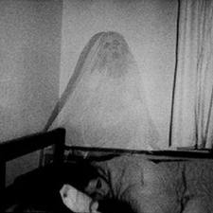
3. ADVERBS OF MANNERS:
IRREGULAR FORMS
LATE is an adjective and adverb
LATELY is not an adverb of LATE meaning ‘RECENTLY’
eg. I’ve seen a ghost lately (recently).

Slide 37
4. ADVERBS OF FREQUENCY:
(a) It always drinks coke .

Slide 38
4. ADVERBS OF FREQUENCY:
(b) Snakes are usually dangerous.

Slide 39
4. ADVERBS OF FREQUENCY:
(c) I sometimes miss my old home.

Slide 40
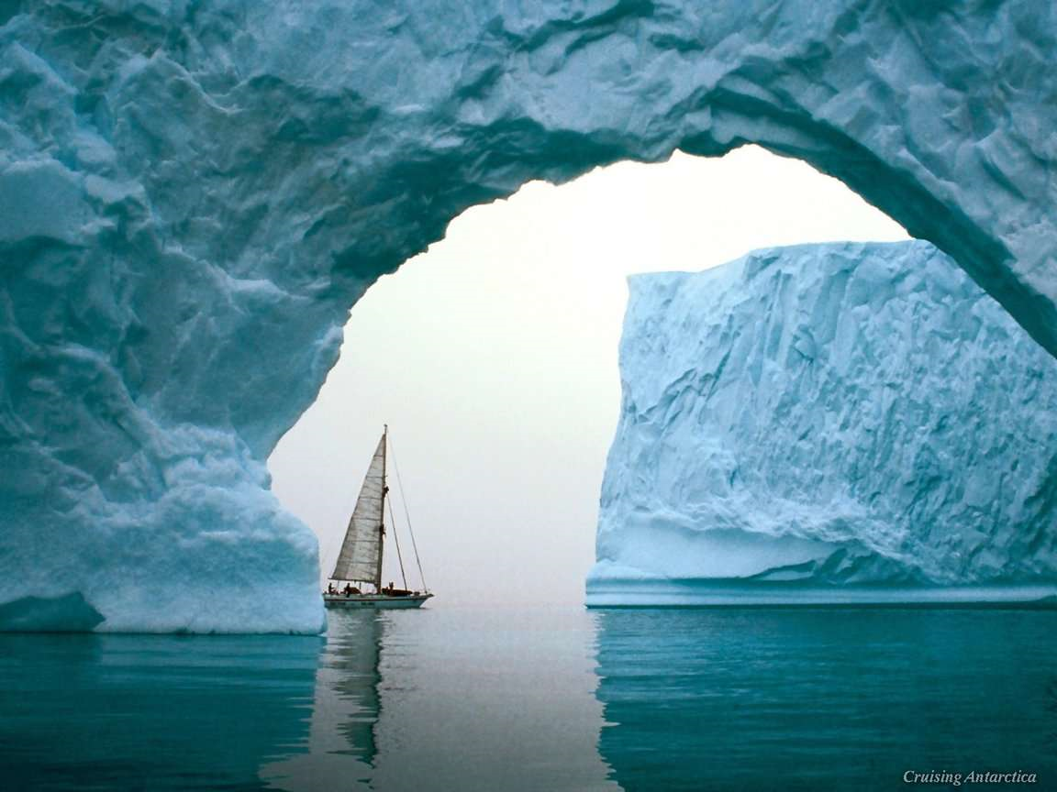
4. ADVERBS OF FREQUENCY:
Use adverbs of frequency to say how often
something happens.
Adverbs of frequency usually go before the main verb. They usually go after a form of be

Slide 41
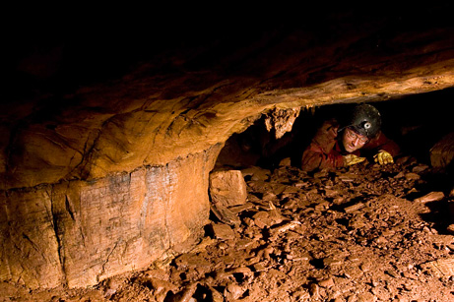
5. ADVERBS OF PLACE:
(b) Try to stay near the cave.

Slide 42
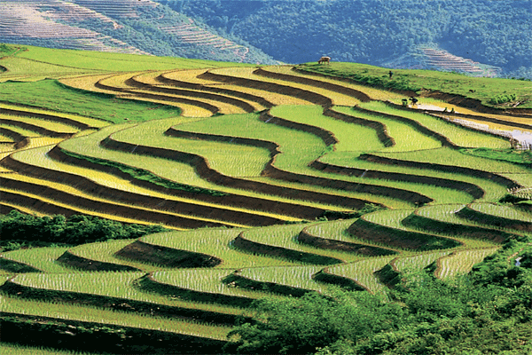
5. ADVERBS OF PLACE:
(b) It’s the first time I’ve been there.

Slide 43
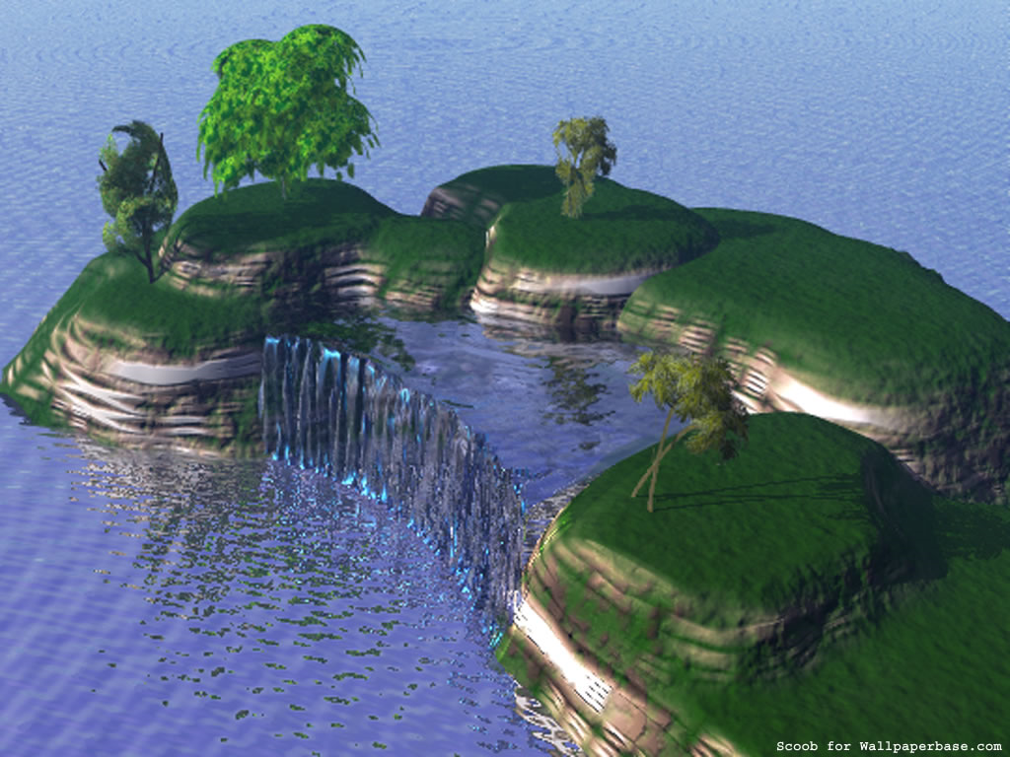
4. ADVERBS OF TIME: when
Adverbs of place often come after the verb

Slide 44
5. ADVERBS OF INTENSITY: (degree)
(a) These cats are very lovely.

Slide 45
5. ADVERBS OF INTENSITY:
(b) He is extremely angry.

Slide 46
5. ADVERBS OF INTENSITY:
Intensity adverbs affect the strength of adjectives or adverbs
common intensity adverbs: fairly, quite, rather, very, extremely, absolutely, …

Slide 47
End of Adjectives and Adverbs

