Slide 1
over
in
in front of
Where is the turtle?
Where are the toys?
between
next to
on
START
behind
under

Slide 2
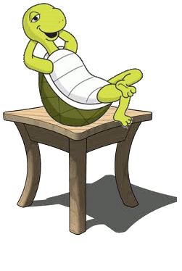
Where is the turtle?
It is on the chair.

Slide 3
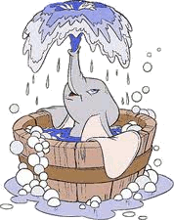
Where is the elephant?
It isin the bath.

Slide 4
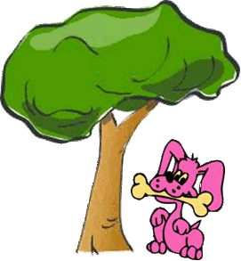
Where’s the dog?
It’s under the tree.

Slide 5
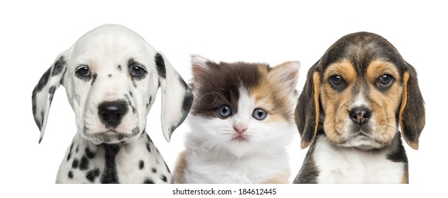
Where’s the cat?
It is between the dogs.

Slide 6
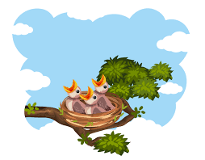
Where are the chicks?
They are in the nest.

Slide 7
Where are the honeybees?
They are next to the hive.

Slide 8
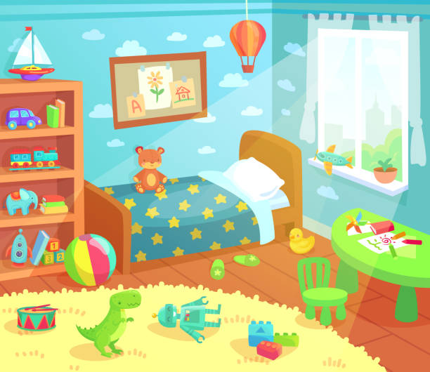
Where are the toys?
They’re on the mat.

