Slide 1
Reported Verbs

Slide 2
Verb + full infinitive

Slide 3
“I think I will buy a newspaper” He decided………………….

Slide 4
“I think I will buy a newspaper” He decided to buy a newspaper

Slide 5
“I won’t buy you a newspaper” He refused……………….

Slide 6
“I won’t buy you a newspaper” He refused to buy me a newspaper.

Slide 7
“Shall I buy you newspaper” He offered…………………………

Slide 8
“Shall I buy you newspaper” He offered to buy me a newspaper.

Slide 9
“ I will buy you newspaper” He promised………………………………..

Slide 10
“ I will buy you newspaper” He promised to buy me a newspaper

Slide 11
Verb + object + full infinitive

Slide 12
“ if I were you, I’d buy a newspaper “ He advised……………………………………..

Slide 13
“ if I were you, I’d buy a newspaper “ He advised me to buy a newspaper.

Slide 14
“ Don’t forget to buy a newspaper” He reminded…………………………………

Slide 15
“ Don’t forget to buy a newspaper” He reminded me to buy a newspaper.

Slide 16
Verb + gerund

Slide 17
“ I didn’t take a newspaper” He denied……………………………

Slide 18
“ I didn’t take a newspaper” He denied taking a newspaper.

Slide 19
Let’s buy a newspaper” He suggested…………………………….

Slide 20
Let’s buy a newspaper” He suggested buying a newspaper.

Slide 21
Verb+ preposition + gerund

Slide 22
“ I'm sorry I took yours newspaper “ He apologized………………………

Slide 23
“ I'm sorry I took yours newspaper “ He apologized for taking my newspaper

Slide 24
“ Don’t be silly. I will buy a newspaper for you”. He insisted …………………………….

Slide 25
“ Don’t be silly. I will buy a newspaper for you”. He insisted on buying me a newspaper.

Slide 26
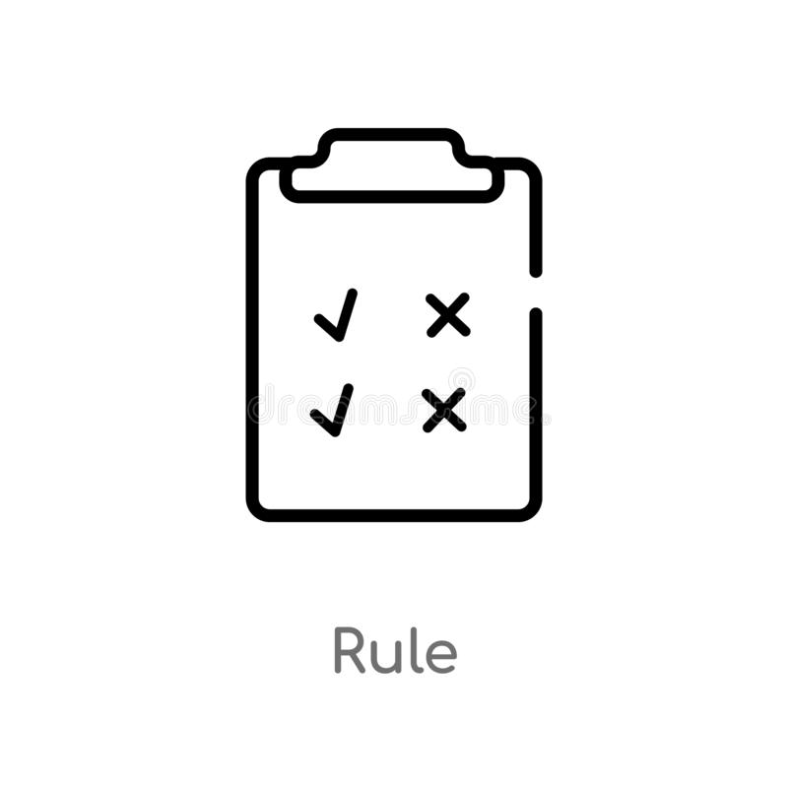
Verb + object+ preposition +gerund

Slide 27
“I’m sure you took my newspaper” he accused……………………………

Slide 28
“I’m sure you took my newspaper” he accused me of taking his newspaper

