Slide 1
Reported Questions

Slide 2
What do you want to know? He asked me.
He asked me ……………………………………………………

Slide 3
What do you want to know? He asked me. He asked me what I wanted to know.

Slide 4
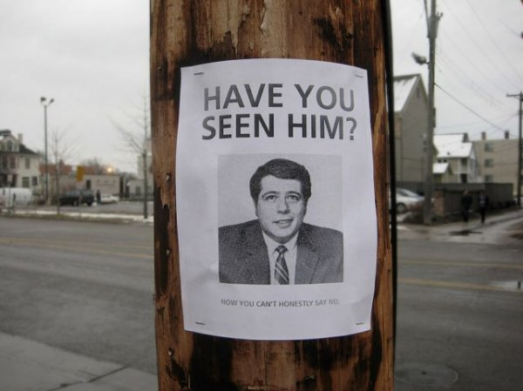
Have you seen this man before? he asked me.
He asked me ………………………………………………

Slide 5
Have you seen this man before? he asked me. He asked me if I had seen the man before.

Slide 6
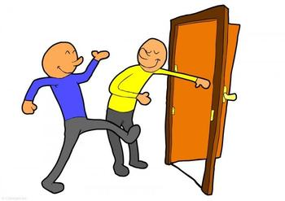
“Can you hold the door for me , please?” the man asked me.
The man asked me ……………………………………..

Slide 7
“Can you hold the door for me , please?” the man asked me. The man asked me if I could hold the door for him.

Slide 8
“Where are you going?” Sam asked her.
Sam asked her …………………………………………

Slide 9
“Where are you going?” Sam asked her. Sam asked her where she was going.

Slide 10
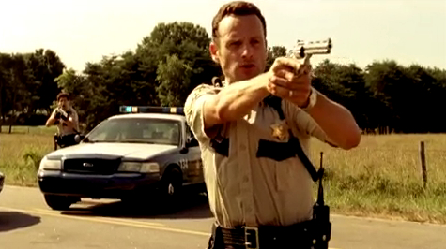
To report commands
“Put the gun down.” he said to him.
He ordered him ……………………………………….

Slide 11
“Put the gun down.” he said to him. He ordered him to put the gun down.

Slide 12
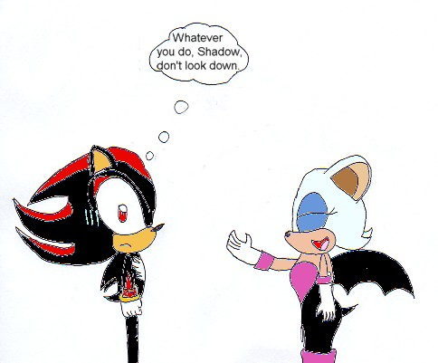
Report Instructions
“Don't look down”. He said to us.
He told us ………………………………………….

Slide 13
“Don't look down”. He said to us. He told us not to look down.

Slide 14
Report requests
“Please, please don’t call the police”. He said to Colin.
He begged Colin ………………………………………………

Slide 15
“Please, please don’t call the police”. He said to Colin. He begged Colin not to call the police.

Slide 16
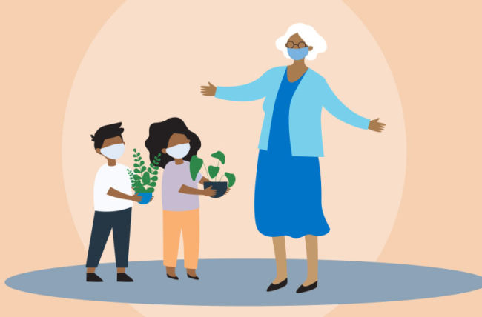
“Let’s visit Jane.” He suggested……………………….

Slide 17
“Let’s visit Jane.” He suggested visiting Jane.

