Slide 1
Gerund and Infinitive

Slide 2
Gerund and Infinitive
INFINITIVE | GERUND
To play To dance To watch | Playing Dancing Watching

Slide 3
Gerund and Infinitive
We use the Gerund form of the verb when it is the subject of the sentence.

Slide 4
Gerund and Infinitive
Swimming is my favorite sport.

Slide 5
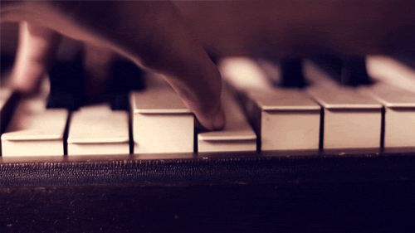
Gerund and Infinitive
PLAYing The piano Is my favorite WAY TO RELAX.

Slide 6
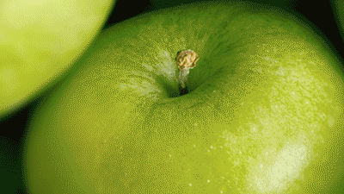
Gerund and Infinitive
EATing FRUITS is good for your health.

Slide 7
Gerund and Infinitive
According to the first verb, you can use the second ONE in the infinitive or in the gerund form.
E.g.:
I like watching MOVIES.
She wants to play games.

Slide 8
Gerund and Infinitive
Some verbs that can be followed ONLY by Gerund are:
like
hate
Enjoy
mind
Look forward to
Be good/bad at
Be interested in

Slide 9
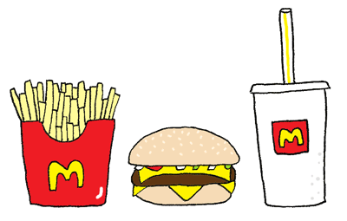
Gerund and Infinitive
he ENJOYS LISTENING TO MUSIC.
SHE hates TRAVELING by plane.
WE hate eating JUNK FOOD.

Slide 10
Gerund and Infinitive
Some verbs that can be followed ONLY by INFINITIVE are:
Need
Want
Plan
Help
Decide
manage

Slide 11
Gerund and Infinitive
I planned TO SURF.
SHE DECIDED to move to PARIS.

Slide 12
So…
VERB + INFINITIVE Verb + to______ | VERB + GERUND Verb + ______ing
Need Want Plan Help Decide Manage | Like Hate Enjoy Mind Look forward to Be good/bad at Be interested in

