Slide 1
Comparative and superlative
Grammar Booklet
page 55

Slide 2
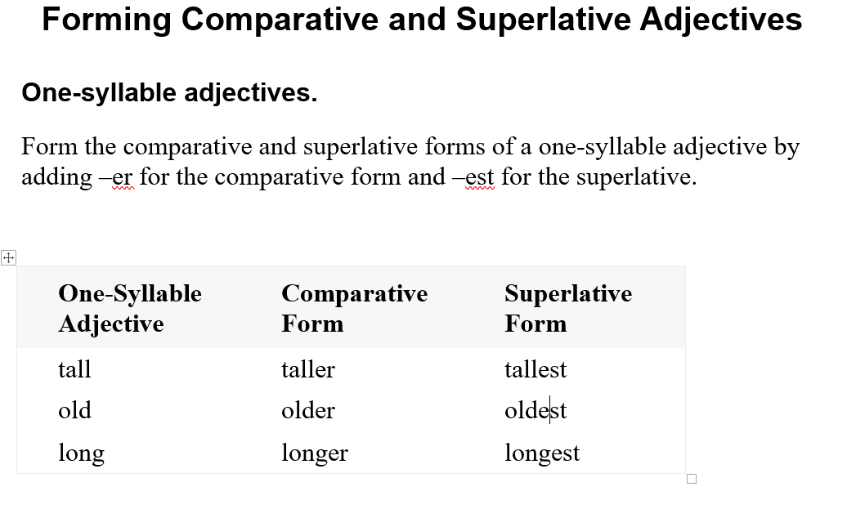

Slide 3
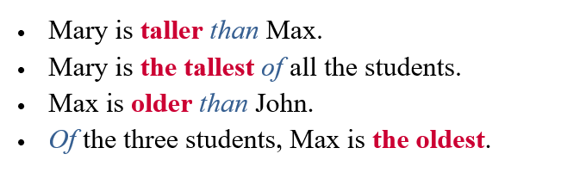

Slide 4
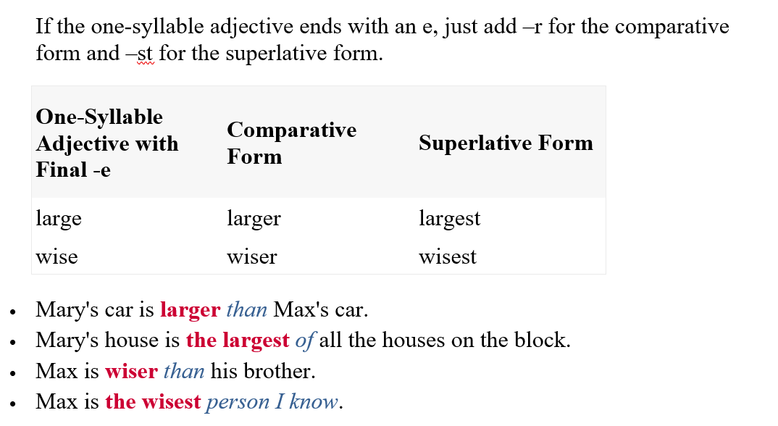

Slide 5
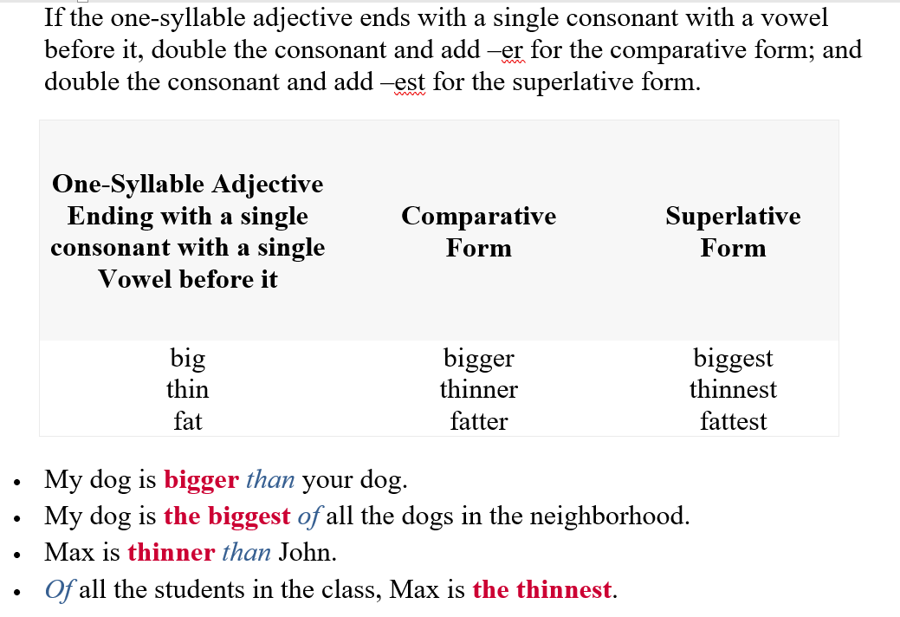

Slide 6
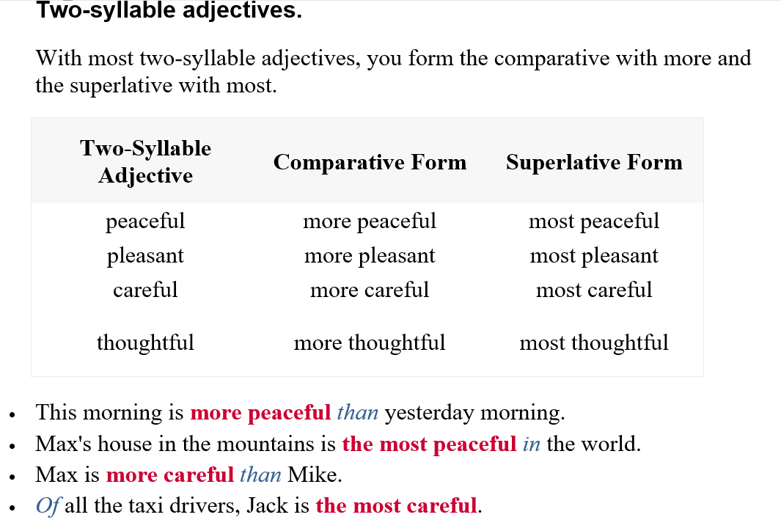

Slide 7
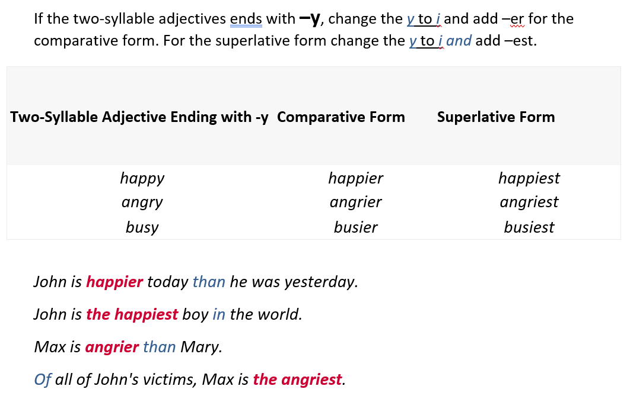

Slide 8
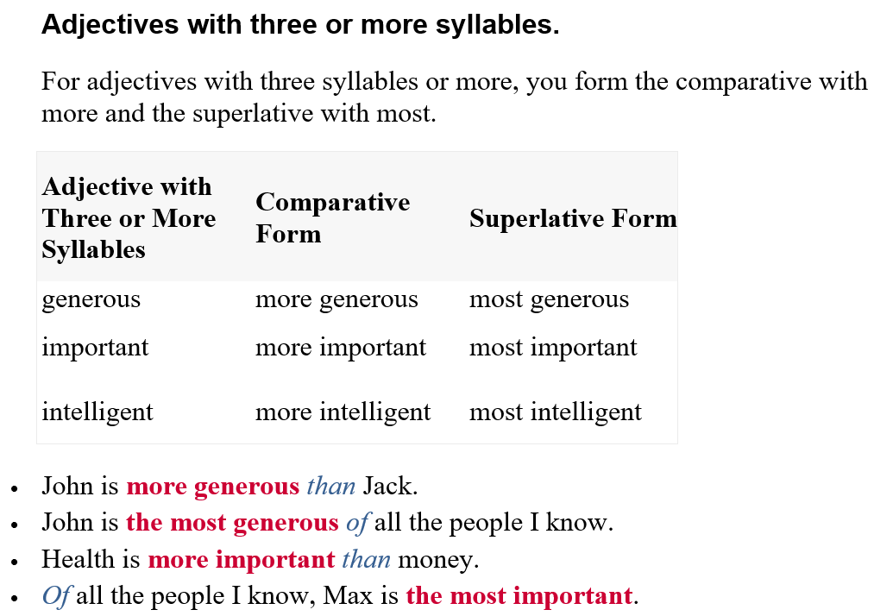

Slide 9
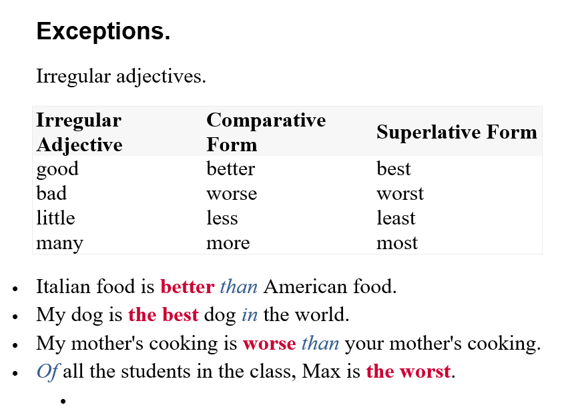

Slide 10
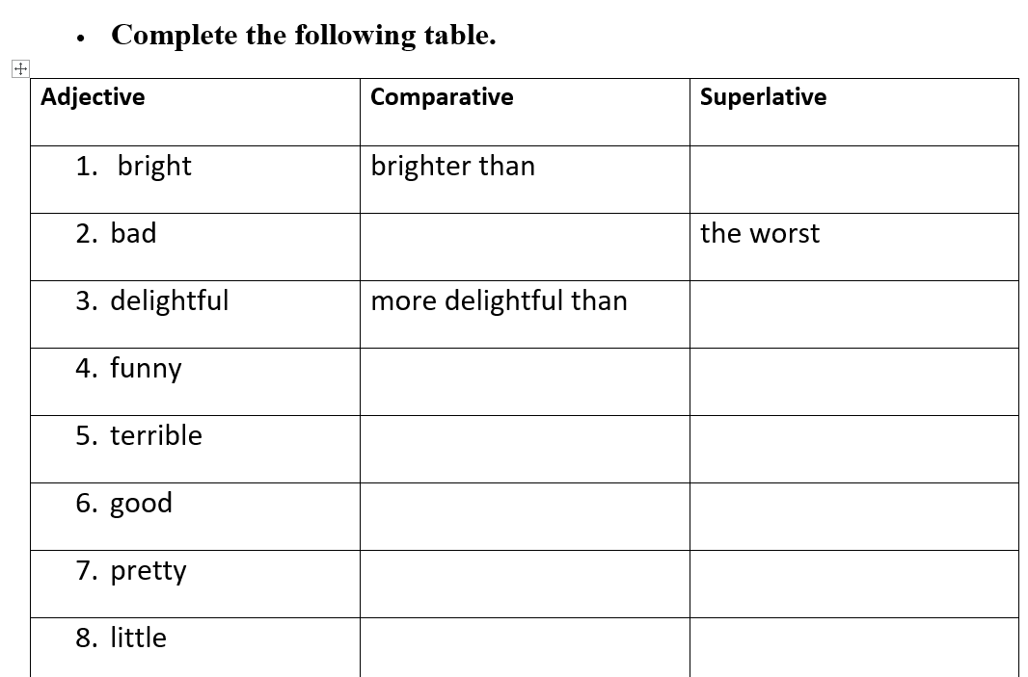
the brightest
worse than
the most delightful
funnier than
the funniest
more terrible than
the most terrible
better than
the best
prettier than
the prettiest

Slide 11
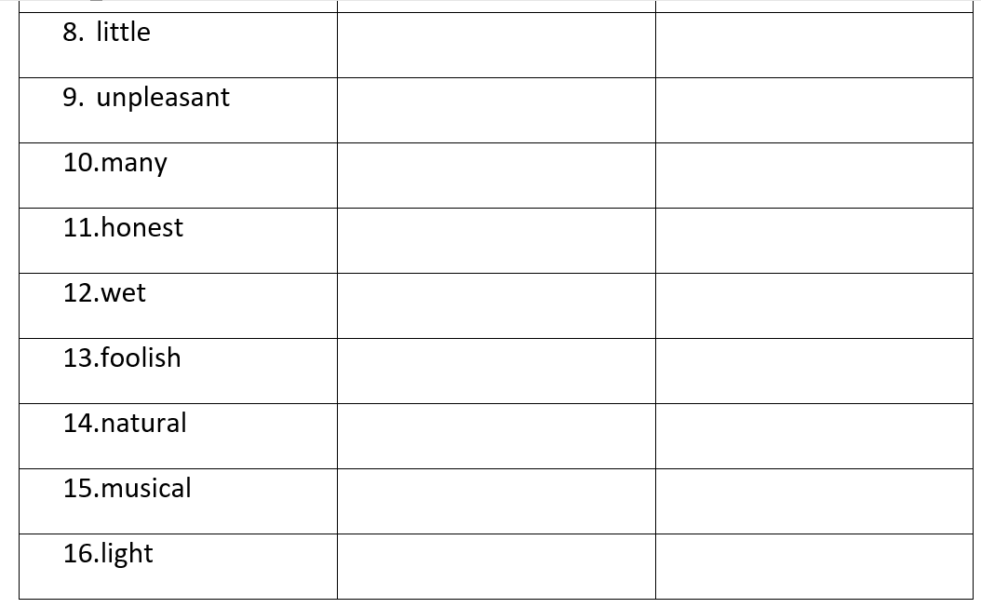
Less than
the least
more unpleasant than
the most unpleasant
more than
the most
more honest than
the most honest
wetter than
the wettest
more foolish than
the most foolish
more natural than
the most natural
more musical than
the most musical
lighter than
the lightest

Slide 12
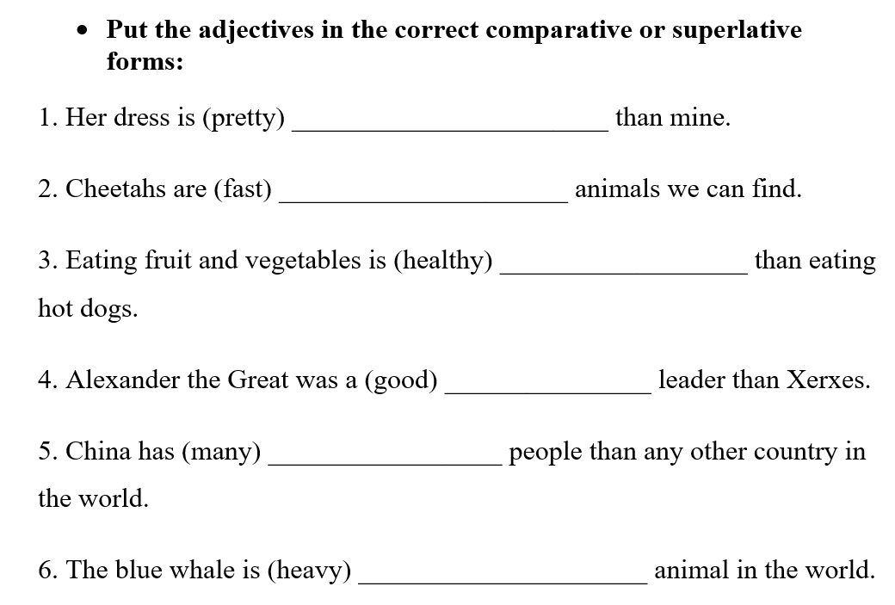
prettier
the fastest
healthier
better
more
the heaviest

Slide 13
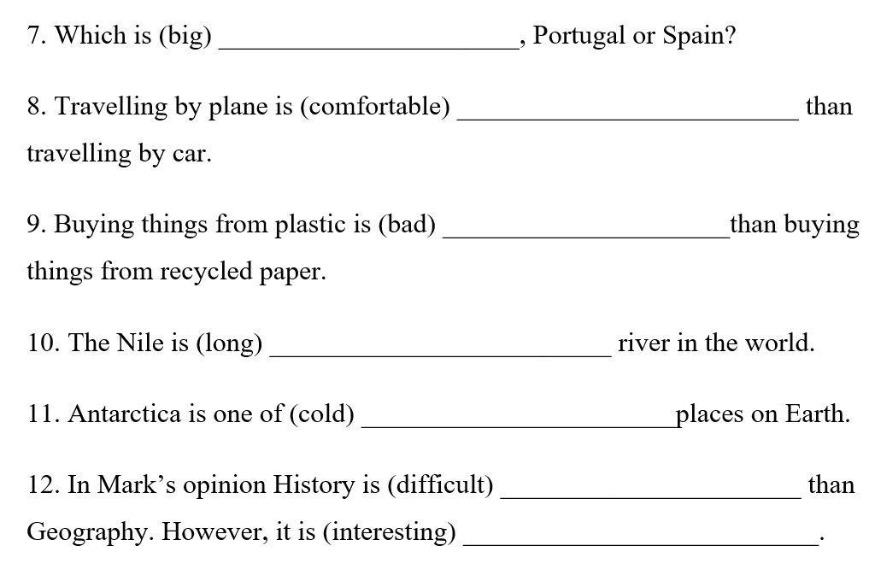
bigger
more comfortable
worse
the longest
the coldest
more difficult
more interesting

Slide 14
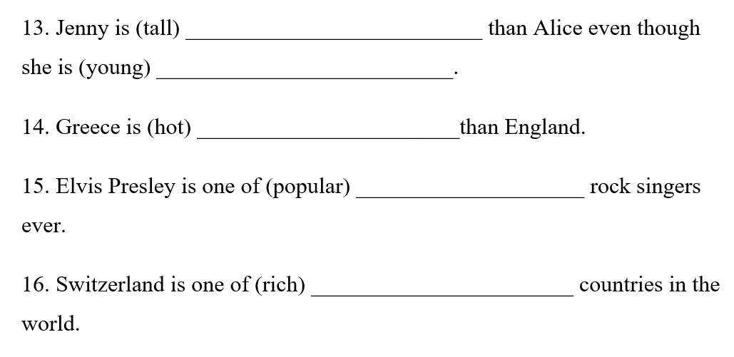
taller
younger
hotter
the most popular
the richest

