Slide 1


Reports
Reports are usually written for a person in authority e.g.

Slide 2
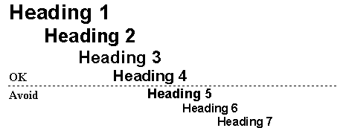
Information is presented in separate sections. Each section has an appropriate heading to help the reader easily identify what the report contains.

Slide 3
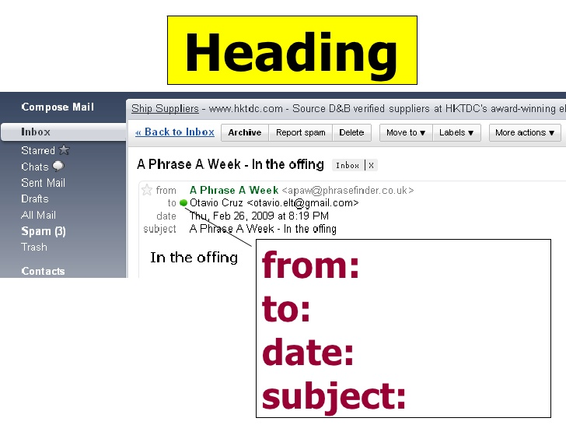
Top left hand corner

Slide 4

First paragraph
Short section entitled purpose or introduction
It’s important that we mention the reason of writing and prepare the reader for the information that we will include in the main body.

Slide 5
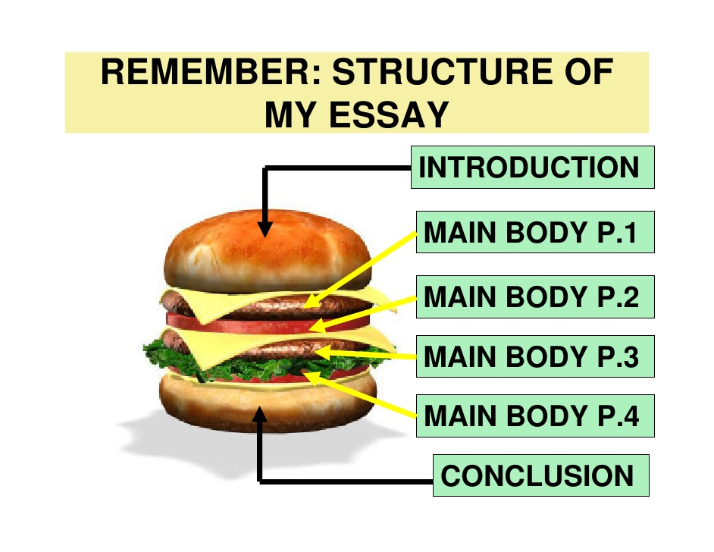
Main body is divided into sections , each of which starts with a heading .
We need linking words and short sentences to make the information easy to understand.

Slide 6
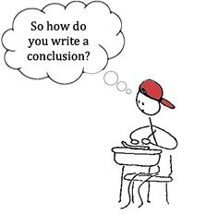



Reports end with final section, often entitled conclusion, in which we can:
Summarise the points in the main body.
Make a recommendation for future action.
Offer a personal opinion.

Slide 7
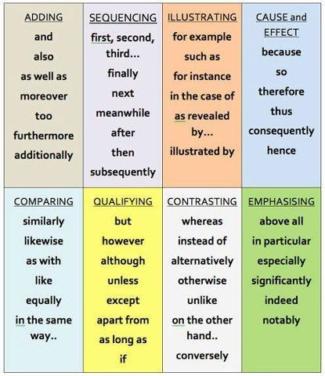
Link your ideas with appropriate linking words and you need short sentences to make the information easy to understand.

Slide 8

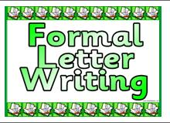
Present tenses and formal writing are normally used in reports.

Slide 9
Good Model
Upstream book page 56

Slide 10
